Slide 1
Teacher’s cheat sheet
Debating Video Games

Slide 2
Debating video games
Activity 1 : Debate in pairs (no rules)
Useful words and phrases : Your opinion + Agreeing & disagreeing
Use the words and phrases to react to the cartoon
Statement : Video games are good for teens. → Debate in pairs
Debriefing
Activity 2 : Debate in pairs → Debate in teams of 2 vs 2 + chairperson (rules)
More useful words and phrases
Use the words and phrases and to react to the picture
Some debating rules
Statement → Follow the rules to debate in pairs
Debriefing
Prepare to debate in teams of 4
Debate in teams of 2 vs 2 under the supervision of a chairperson
Debriefing
Activity 3 : Final debate: teams of 3 vs 3 + chairperson (rules)
Debating format : 2 groups of 3 + chairperson
Final debates

Slide 3
Debating video games
Activity 1 : Debate in pairs (no rules)
Useful words and phrases : Your opinion + Agreeing & disagreeing
Use the words and phrases to react to the cartoon
Statement → Debate in pairs
Debriefing

Slide 4
Debating video games
Activity 1 : Debate in pairs (no rules)
Useful words and phrases : Your opinion + Agreeing & disagreeing
Use the words and phrases to react to the cartoon
Statement → Debate in pairs
Debriefing

Slide 5
Your opinion:
Useful
words &
phrases
In my opinion,
To me,…
As far as I know,…
As far as I am concerned,…
I think it’s worth noting that…
As for me,
For my part,
As far as I know…
As far as I am concerned…
And I think it’s worth noting that…
⏳
🤔
⏳
⏳
🤔
⏳
You see... / You know…
Well, how shall I put it...
Actually, I think that…
On second thoughts…
On the one hand..., On the other hand…
For one thing..., For another…
This brings us to the question of whether... or…
It would be convenient to divide the question into…
Anyway…
However that may be…
Assuming this to be true…
As a matter of fact…
However/Nevertheless
... Whereas…

Slide 6
Agreeing & disagreeing
I agree. / I agree with you.
I take a similar view.
I couldn’t agree more.
I concur with you on this point.
You are absolutely right!
That’s right! / How true!
I’m with you there!
I disagree. / I disagree with you.
I don’t agree. / I don’t agree with you.
We don’t see eye to eye.
Unlike you, I think…
Contrary to what you’re suggesting…
I couldn’t disagree more.
I wish I could agree with you, but…
You must be joking!
No you’re wrong! / You’re mistaken!
😐 ❓
I only agree up to a point…
Yes, in a way, but...
I’m afraid it isn’t perfectly right.
Well, it depends.
I think the best would be to say…
Shouldn’t we consider…?
I honestly don’t know, because…
I couldn’t say, because…
It’s hard to say, because…
I don’t have a clue, to be honest.

Slide 7
Debating video games
Activity 1 : Debate in pairs (no rules)
Useful words and phrases : Your opinion + Agreeing & disagreeing
Use the words and phrases to react to the cartoon
Statement → Debate in pairs
Debriefing

Slide 8
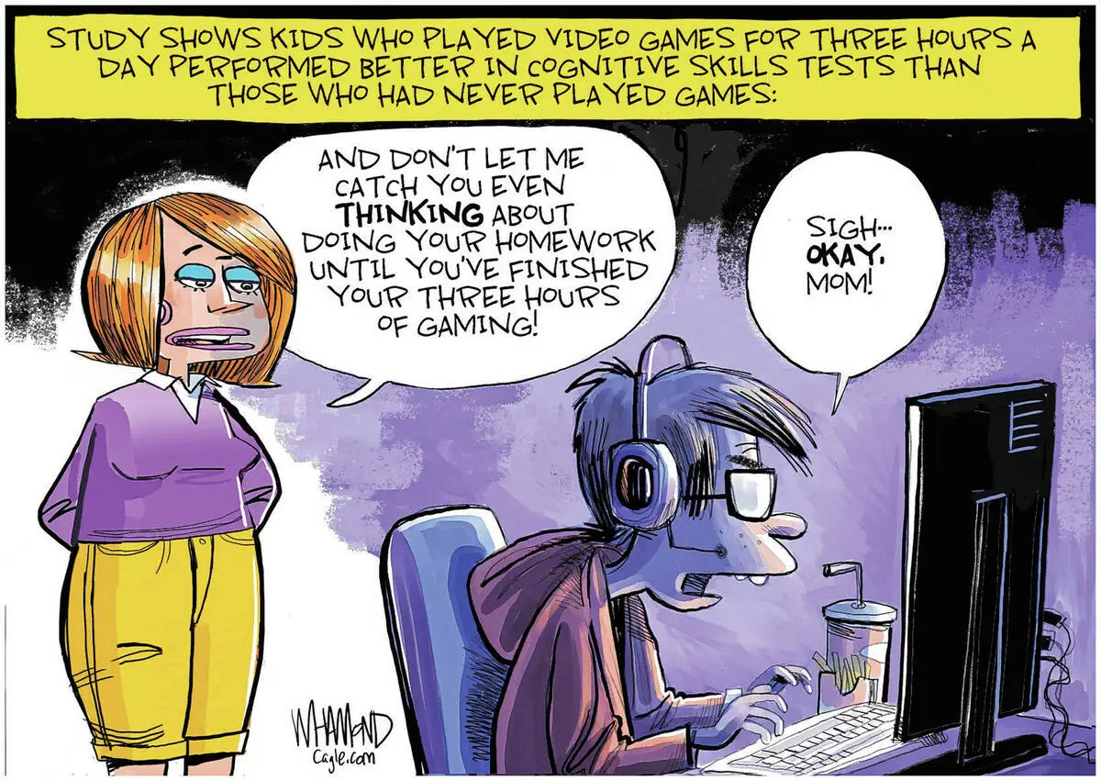
#1

Slide 9
A little context?

Slide 10
Debating video games
Activity 1 : Debate in pairs (no rules)
Useful words and phrases : Your opinion + Agreeing & disagreeing
Use the words and phrases to react to the cartoon
Statement → Debate in pairs
Debriefing

Slide 11
Statement #1: Video games are good for teens.
AFFIRMATIVE
NEGATIVE
→ Debate in pairs using as many “useful words & phrases” as you can

Slide 12
Debating video games
Activity 1 : Debate in pairs (no rules)
Useful words and phrases : Your opinion + Agreeing & disagreeing
Use the words and phrases to react to the cartoon
Statement → Debate in pairs
Debriefing

Slide 13
Debriefing
😊 👍
😕

Slide 14
Debating video games
Activity 2 : Debate in pairs → Debate in teams of 2 vs 2 + chairperson (rules)
More useful words and phrases
Use the words and phrases and to react to the picture
Some debating rules
Statement → Follow the rules to debate in pairs
Debriefing
Prepare to debate in teams of 4
Debate in teams of 2 vs 2 under the supervision of a chairperson
Debriefing

Slide 15
Debating video games
Activity 2 : Debate in pairs → Debate in teams of 2 vs 2 + chairperson (rules)
More useful words and phrases
Use the words and phrases and to react to the picture
Some debating rules
Statement → Follow the rules to debate in pairs
Debriefing
Prepare to debate in teams of 4
Debate in teams of 2 vs 2 under the supervision of a chairperson
Debriefing

Slide 16
First of all, I would like to say that…
To begin with, I’d like to point out that…
By way of introduction, I will say that…
The first thing that must be said is that...
Organising your speech
Secondly..., Thirdly…
What’s more, /Moreover,
Furthermore,
Besides,
In addition, / I’d like to add that…
Not to mention that…
In conclusion, / To conclude,
To come to a conclusion…
To sum up/To summarize...
Finally,/Eventually,/In the end,
To put it in a nutshell…
In short/In brief…
To use a famous quotation, I’ll say that…
All things considered…
Weighing up the situation, I would say…
To weigh the pros and cons…
All in all…
The long and the short of it…
To reach a consensus...

Slide 17
Debating video games
Activity 2 : Debate in pairs → Debate in teams of 2 vs 2 + chairperson (rules)
More useful words and phrases
Use the words and phrases and to react to the picture
Some debating rules
Statement → Follow the rules to debate in pairs
Debriefing
Prepare to debate in teams of 4
Debate in teams of 2 vs 2 under the supervision of a chairperson
Debriefing

Slide 18
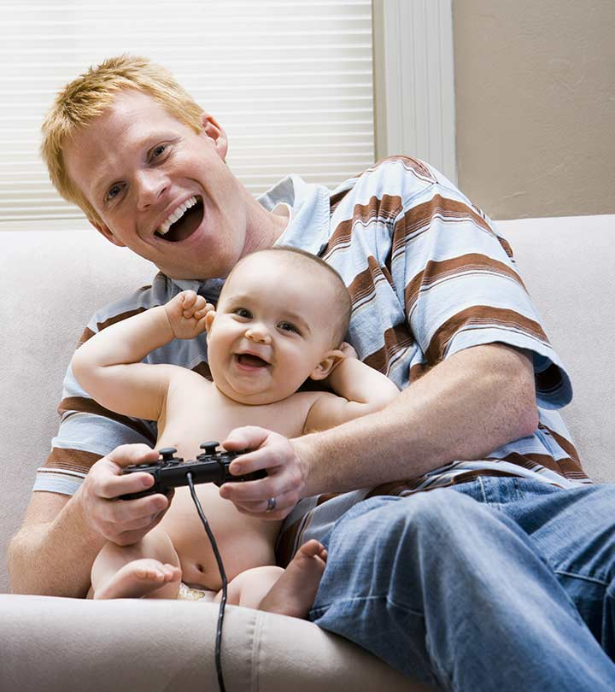
#2

Slide 19
Debating video games
Activity 2 : Debate in pairs → Debate in teams of 2 vs 2 + chairperson (rules)
More useful words and phrases
Use the words and phrases and to react to the picture
Some debating rules
Statement → Follow the rules to debate in pairs
Debriefing
Prepare to debate in teams of 4
Debate in teams of 2 vs 2 under the supervision of a chairperson
Debriefing

Slide 20
Debate* format (*abbreviated Lincoln-Douglas debate): in pairs
Part 1 : Arguments
AFFIRMATIVE ARGUMENT
1 minute
NEGATIVE ARGUMENT
1 minute
1
2
⏳ 1-minute break ⏳
Part 2 : Rebuttal
REBUTTAL
1 minute
3
4
REBUTTAL
1 minute
⏳ 1-minute break ⏳
Part 3 : Conclusion
CONCLUSION
1 minute
5
6
CONCLUSION
1 minute

Slide 21
⏳ 1-minute break ⏳
→ Preparing for rebuttal
Rebuttal of
Negative argument
Rebuttal of
Affirmative argument

Slide 22
Debating video games
Activity 2 : Debate in pairs → Debate in teams of 2 vs 2 + chairperson (rules)
More useful words and phrases
Use the words and phrases and to react to the picture
Some debating rules
Statement → Follow the rules to debate in pairs
Debriefing
Prepare to debate in teams of 4
Debate in teams of 2 vs 2 under the supervision of a chairperson
Debriefing

Slide 23
Statement #2 : Video games are good for babies.
Debate in pairs following the rules

Slide 24
Debating video games
Activity 2 : Debate in pairs → Debate in teams of 2 vs 2 + chairperson (rules)
More useful words and phrases
Use the words and phrases and to react to the picture
Some debating rules
Statement → Follow the rules to debate in pairs
Debriefing
Prepare to debate in teams of 4
Debate in teams of 2 vs 2 under the supervision of a chairperson
Debriefing

Slide 25
Debriefing
😊 👍
😕

Slide 26
Debating video games
Activity 2 : Debate in pairs → Debate in teams of 2 vs 2 + chairperson (rules)
More useful words and phrases
Use the words and phrases and to react to the picture
Some debating rules
Statement → Follow the rules to debate in pairs
Debriefing
Prepare to debate in teams of 4
Debate in teams of 2 vs 2 under the supervision of a chairperson
Debriefing

Slide 27
vs
vs

Slide 28
Debate format : groups of 2 + chairperson
Part 1 : Arguments
1
AFFIRMATIVE ARGUMENTS
2 minutes
NEGATIVE ARGUMENTS
2 minutes
2
⏳ 3-minute break ⏳
Part 2 : Rebuttal
REBUTTAL #1
1 minute
3
4
REBUTTAL #1
1 minute
REBUTTAL #2
1 minute
5
6
REBUTTAL #2
1 minute
⏳ 2-minute break ⏳
7
Part 3 : General conclusion
1-2 minutes

Slide 29
⏳ 3-minute break ⏳
→ Preparing for rebuttal
Rebuttal of
Negative argument
#1
Rebuttal of
Affirmative argument
#1
1
1
Rebuttal of
Negative argument
#2
Rebuttal of
Affirmative argument
#2
2
2

Slide 30
Part 2 : Rebuttal (example)
The first speaker* from the negative team has tried to tell you …
This is wrong* because…
The first speaker* from the affirmative team has tried to tell you …
This is wrong* because…
1
The second speaker* from the negative team has tried to tell you …
This is wrong* because…
1
The second speaker* from the affirmative team has tried to tell you …
This is wrong* because…
2
2
✋ 👆
👈
✋ 👆
👉

Slide 31
⏳ 2-minute break ⏳
→ Preparing to conclude

Slide 32
Debating video games
Activity 2 : Debate in pairs → Debate in teams of 2 vs 2 + chairperson (rules)
More useful words and phrases
Use the words and phrases and to react to the picture
Some debating rules
Statement → Follow the rules to debate in pairs
Debriefing
Prepare to debate in teams of 4
Debate in teams of 2 vs 2 under the supervision of a chairperson
Debriefing

Slide 33
Statement #2 : Video games are good for babies.
Debate in pairs following the rules

Slide 34
Debating video games
Activity 2 : Debate in pairs → Debate in teams of 2 vs 2 + chairperson (rules)
More useful words and phrases
Use the words and phrases and to react to the picture
Some debating rules
Statement → Follow the rules to debate in pairs
Debriefing
Prepare to debate in teams of 4
Debate in teams of 2 vs 2 under the supervision of a chairperson
Debriefing

Slide 35
Debriefing
😊 👍
😕

Slide 36
Debating video games
Activity 3 : Final debate: teams of 3 vs 3 + chairperson (rules)
Debating format : 2 groups of 3 + chairperson
Final debates

Slide 37
Debate format : groups of 3 + chairperson
Part 1 : Arguments
1
AFFIRMATIVE ARGUMENTS
3 minutes
NEGATIVE ARGUMENTS
3 minutes
2
⏳ 5-minute break ⏳
Part 2 : Rebuttal
REBUTTAL #1
1 minute
3
4
REBUTTAL #1
1 minute
REBUTTAL #2
1 minute
5
6
REBUTTAL #2
1 minute
REBUTTAL #3
1 minute
7
8
REBUTTAL #3
1 minute
⏳ 5-minute break ⏳
9
Part 3 : General conclusion
2-3 minutes

Slide 38
Part 1: Affirmative arguments
Greetings
We, the affirmative team, define the topic as …
We, the affirmative team, believe that the statement is true.
I will now let you hear what our 2nd and 3rd speakers have to say.
⏳ 1 minute
1
1
⏳ 1 minute
Greetings, transition
Argument #1
Argument #2
2
2
⏳ 1 minute
Greetings, transition
Argument #3
Conclusion
3
✋ 👆
👈
3

Slide 39
Part 2: Negative arguments
Greetings
We, the negative team,
agree with the definition of the subject given by the affirmative team
disagree with the definition given by the affirmative team. We define the subject as…
We, the negative team, believe that the statement is false.
I will now let you hear what our 2nd and 3rd speakers have to say.
⏳ 1 minute
1
1
⏳ 1 minute
Greetings, transition
Argument #1
Argument #2
2
2
Greetings, transition
Argument #3
Conclusion
⏳ 1 minute
3
✋ 👆
👉
3

Slide 40
⏳ 5-minute break ⏳
→ Preparing for rebuttal
Rebuttal of
Negative argument
#1
Rebuttal of
Affirmative argument
#1
1
1
Rebuttal of
Negative argument
#2
Rebuttal of
Affirmative argument
#2
…
2
2
Rebuttal of
Negative argument
#3
Rebuttal of
Affirmative argument
#3
3
3

Slide 41
⏳ 5-minute break ⏳
→ Preparing for rebuttal
Do we keep the same order
(#1, #2, #3)
to rebut their arguments?
Or do we REORGANIZE the arguments?
⏳

Slide 42
Part 2: Rebuttal (example)
The first speaker* from the negative team has tried to tell you …
This is wrong* because…
The first speaker* from the affirmative team has tried to tell you …
This is wrong* because…
1
The second speaker* from the negative team has tried to tell you …
This is wrong* because…
1
The second speaker* from the affirmative team has tried to tell you …
This is wrong* because…
The third speaker* from the negative team has tried to tell you …
This is wrong* because…
2
The third speaker* from the affirmative team has tried to tell you …
This is wrong* because…
2
3
✋ 👆
👈
✋ 👆
👉
3

Slide 43
⏳ 5-minute break ⏳
→ Preparing to conclude

Slide 44
Part 3: General conclusion
Ladies and Gentlemen, thank you very much for this very interesting and lively debate about whether…
The affirmative team defined the subject as …
as did the negative team.
However, the negative team defined the subject as…
The affirmative team’s arguments were as follows … (summary of the affirmative arguments)
To which, the negative team responded … (summary of the rebuttal of the affirmative arguments)
The negative team’s arguments were the following… (summary of the rebuttal of the negative team)
To which, the affirmative team replied… (summary of the rebuttal of the negative arguments)
Conclusion

Slide 45
Statement #2 : Video games are good for babies.
2. Debate in teams of 4 + Chairperson

Slide 46
Debating video games
Activity 3 : Final debate: teams of 3 vs 3 + chairperson (rules)
Debating format : 2 groups of 3 + chairperson
Final debates

Slide 47
Preparing for your debate as a group
Define the subject of the debate (do some research if necessary)
Find 5 strong arguments + supporting evidence for each (do some research if necessary)
Rebut your 5 arguments + supportive evidence
Select your 3 key arguments + supporting evidence
Prepare your conclusion
Prepare your introduction
→ Get ready to work on your own intervention
Strong arguments versus weak arguments
A strong argument has the following qualities:
it logically supports the opinion
it is specific and states the idea clearly
it is convincing to a majority of people
Example: Which argument is strong and which is weak? Explain.
Smoking should be banned in public because:
it is bad
it gives people bad breath and makes their teeth yellow
secondhand smoke is harmful for nonsmokers

Slide 48
Your debating questions
Video games are sports
Video games are bad for society
Video games are for everyone
Video games are a public health concern

Slide 49
Student printouts

Slide 50
Statement #1: Video games are good for teens.
AFFIRMATIVE
NEGATIVE
→ Debate in pairs using as many “useful words & phrases” as you can

Slide 51
Statement #2 : Video games are good for babies.
Debate in pairs following the rules

Slide 52
First affirmative speaker
2nd affirmative speaker
Greetings
We, the affirmative team, define the topic as …
We, the affirmative team, believe that the statement is true.
I will now let you hear what our 2nd and 3rd speakers have to say.
Greetings
Transition
1st argument
2nd argument
I will now let you hear what our 3rd speaker has to say.
1
2
Notes.
No full sentences.
Notes.
No full sentences.

Slide 53
3rd affirmative speaker
First negative speaker
Greetings
Transition
Argument #3
Conclusion
Greetings
We, the negative team,
agree with the definition of the subject given by the affirmative team
disagree with the definition given by the affirmative team. We define the subject as…
We, the negative team, believe that the statement is false.
I will now let you hear what our 2nd and 3rd speakers have to say.
3
1
Notes.
No full sentences.
Notes.
No full sentences.

Slide 54
2nd negative
speaker
3rd negative
speaker
Greetings
Transition
1st argument
2nd argument
I will now let you hear what our 3rd speaker has to say.
Greetings
Transition
Argument #3
Conclusion
2
3
Notes.
No full sentences.
Notes.
No full sentences.

Slide 55
Chairperson 1/2
Greetings
Introduction to the debate
Part 1 : Arguments
Acknowledgements
Announcement of the break
Notes.
No full sentences.
⏳ 5-minute break ⏳
Announcement of the rebuttal
Part 2 : Rebuttal
Part 3: General conclusion (see 2/2)
Thank yous
Reminder of the definition(s) of the subject
Summary of the affirmative arguments
Summary of the rebuttal
Summary of the negative arguments
Summary of the rebuttal
Conclusion

Slide 56
Chairperson 2/2 - Part 3: General conclusion
Ladies and Gentlemen, thank you very much for this very interesting and lively debate about whether…
The affirmative team defined the subject as …
as did the negative team.
However, the negative team defined the subject as…
The affirmative team’s arguments were as follows … (summary of the affirmative arguments)
To which, the negative team responded … (summary of the rebuttal of the affirmative arguments)
The negative team’s arguments were the following… (summary of the rebuttal of the negative team)
To which, the affirmative team replied… (summary of the rebuttal of the negative arguments)
Conclusion

Slide 57
Preparing for your debate as a group
Define the subject of the debate (do some research if necessary)
Find 5 strong arguments + supporting evidence for each (do some research if necessary)
Rebut your 5 arguments + supportive evidence
Select your 3 key arguments + supporting evidence
Prepare your conclusion
Prepare your introduction
→ Get ready to work on your own intervention
Strong arguments versus weak arguments
A strong argument has the following qualities:
it logically supports the opinion
it is specific and states the idea clearly
it is convincing to a majority of people
Example: Which argument is strong and which is weak? Explain.
Smoking should be banned in public because:
it is bad
it gives people bad breath and makes their teeth yellow
secondhand smoke is harmful for nonsmokers

Slide 58
Group worksheet: before the debate
Definition of the topic :
 | Argument | Supporting evidence | Rebuttal
1.
2.
3.
4.
5.
Conclusion :

Slide 59
Argument
Argument
Evidence
Notes from the debate
Evidence
Notes from the debate
Rebuttal
Rebuttal

