Slide 1
Historians and World War II Memories in the British Empire and the United States
History – Topic 1

Slide 2
« History is written by the victors »
Quote attributed to Winston Churchill
And George Orwell
Herman Goering, ...

Slide 3
Definitions
History
« Knowledge acquired by investigation » (etymology)
Study of the past
Academic discipline
Uses a narrative to examine and analyse objectively past events
Past events may leave traces : ruins, archeological artefacts, documents collected in archives, ...

Slide 4
Scientific history
5 aspects
Method (technique to find and criticize data ; presentation of data)
Candour (credit to other reseachs and historians)
Accuracy (correctedness of fact)
Thoroughness (use of all important sources)
Verifiability (indications of sources)

Slide 5
But :
Historians write in the context of their own time
Consider dominant ideas of how to interpret the past, sometimes to go against them
Write to provide lessons for their society
May select sources and facts corresponding to their hypothesis

Slide 6
Memory
Elusive
Not necessarily linear
Individual memory (witness, casualty), direct experience
Collective memory
Cf Carol Gluck : « memory refers to all popular views about an event, […] memories are propagated through social media such as government monuments and museums, but even more so through mass media like TV, movies and video games »

Slide 7
It means that :
Collective memory is organized (state, community, party, etc.)
Collective memory can be a tool, a group may defend a version of past events in order to gain something (= instrumentalization)
The State has a major influence in shaping memory (through textbooks, memorials, celebration days, ...), and some groups ask for state intervention to get compensations
The work of historians is under scrutiny by many entities (State, communities, …) who want their version of events to be recognized as THE truth.

Slide 8
According to Pr Gluck, most memories fail to capture the moral ambiguity of historical events, simplifying the past
into a binary of good and evil

Slide 9
Key questions :
Never occupied and victorious, the US and the UK have an easier time with WWII memories than most European countries.
The two countries created myths.
What are those myths ?
How are they perpetuated and challenged
since 1945 ?

Slide 10
I. British Memories of World War II
A) The « Dunkirk Spirit »

Slide 11
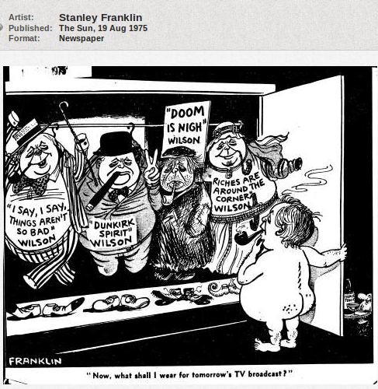

Slide 12
