Slide 1
C) The People’s War: Britain’s Home Front
1) The Blitz and Churchill: a united nation and a great leader

Slide 2
The Blitz – main facts:
The Blitz, from German: lightning
Bombing of British cities (september 1940 – May 1941)
By Nov 1940, over a quarter of London’s population had left the city
Blackout: lights not allowed after dark for 6 years
+ 1 million London houses destroyed or damaged
+ 40 000 civilians killed
Image: national solidarity

Slide 3
Churchill’s legend – the War Speeches
surprising arrival in power
embodiment of war spirit against Hitler very early: when Appeasement failed, his continuing denunciations of Nazism appeared as a visionary.
PM from 1940 to 1945: embodiment of the UK at war
Astonishing defeat in 1945: desire to return to normalcy
Image not stained by later political activity
Memory made easy by his talent for public communication: cigar, military uniforms, bowler hat, writing talent, victory sign
Churchill, 1945

Slide 4
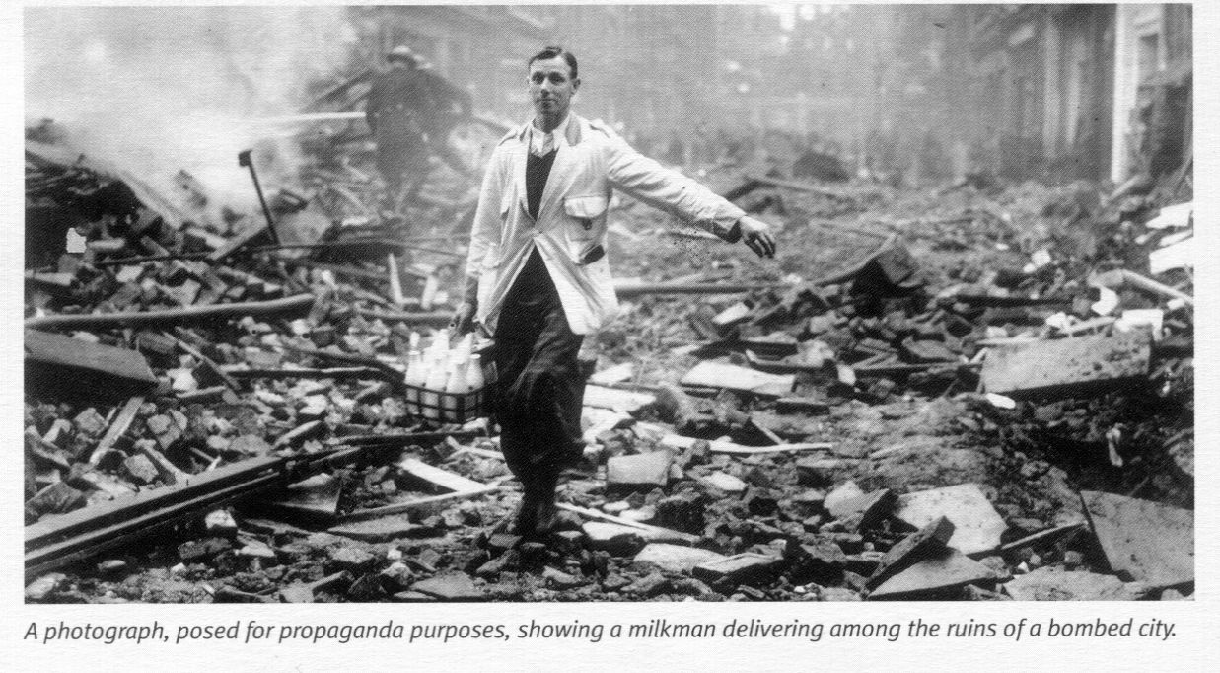
2) Myths or realities?

Slide 7
3) An official memory built through monuments?

Slide 8
National Firefighters Memorial, London

Slide 9
Monument to the Women of World War II, London

Slide 10
Animals in War Memorial, London (Hyde Park)

Slide 11
4) The People’s War Myth in popular culture
a) Un film: Hope and Glory, John Boorman, 1987

Slide 12
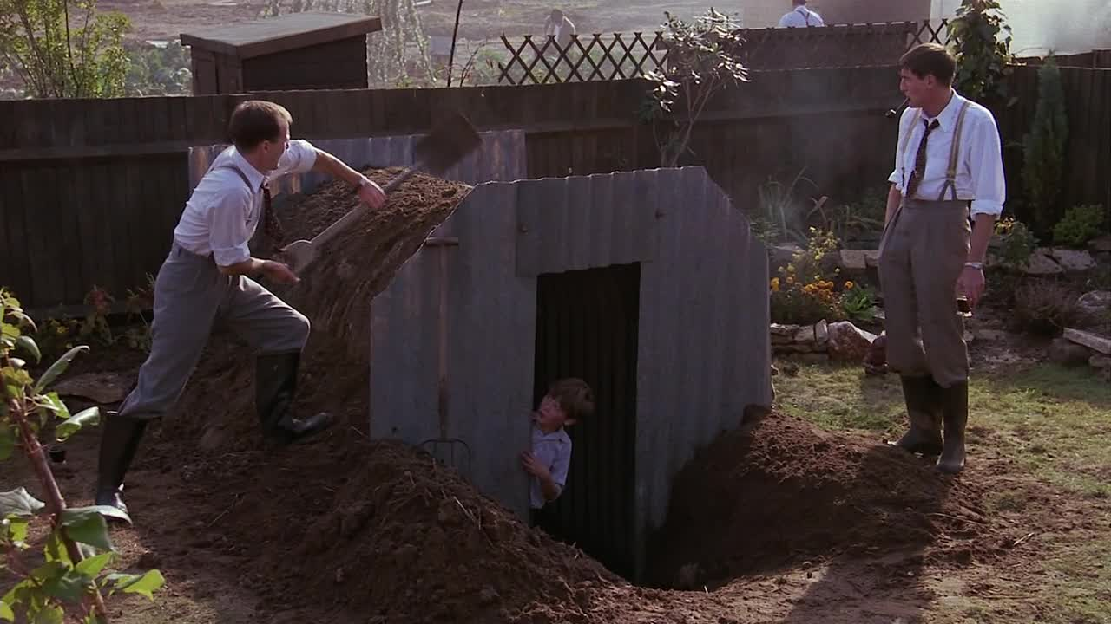
The hero’s father is building an Anderson shelter in the garden

Slide 13
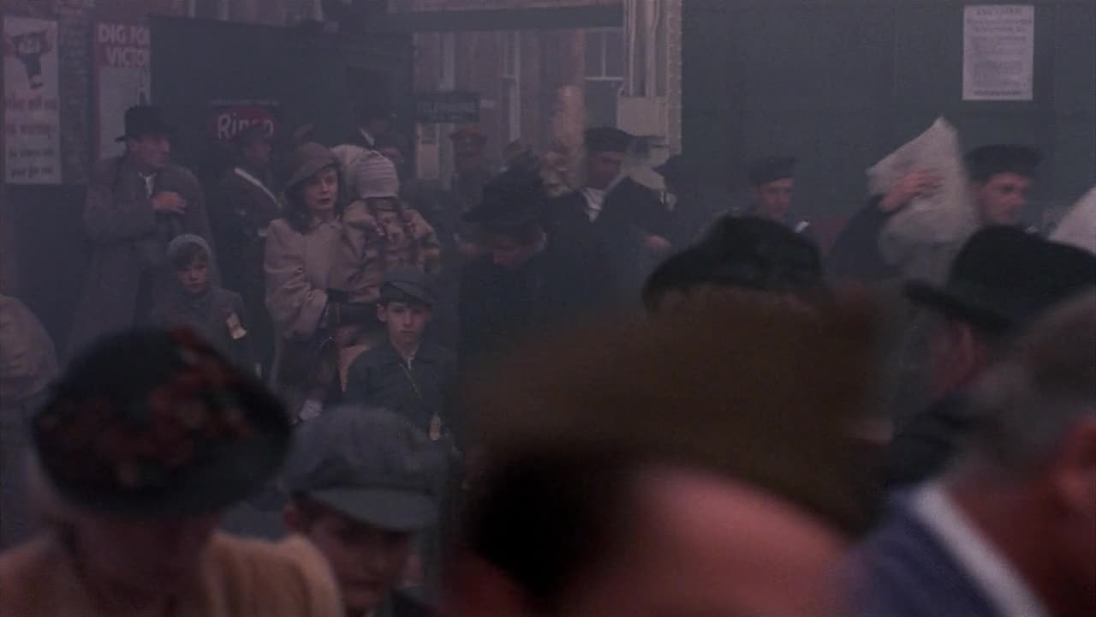
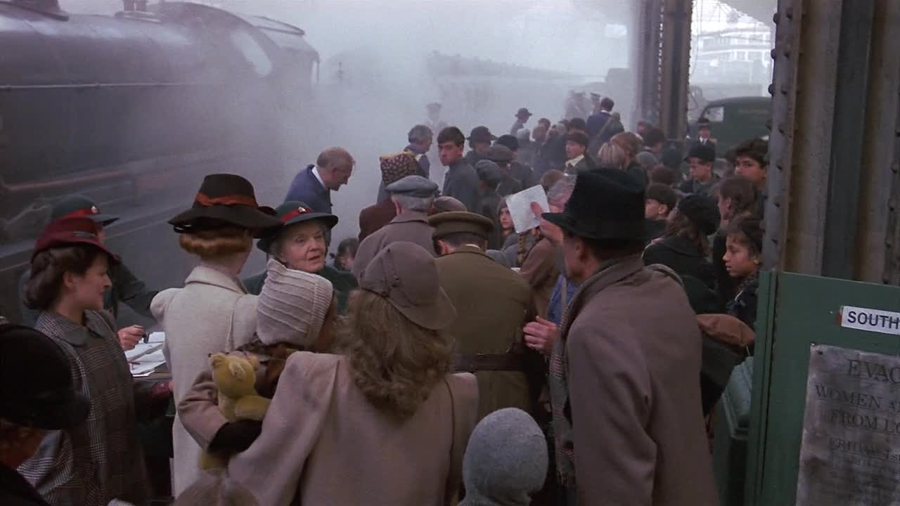
Evacuated children leaving London

Slide 14
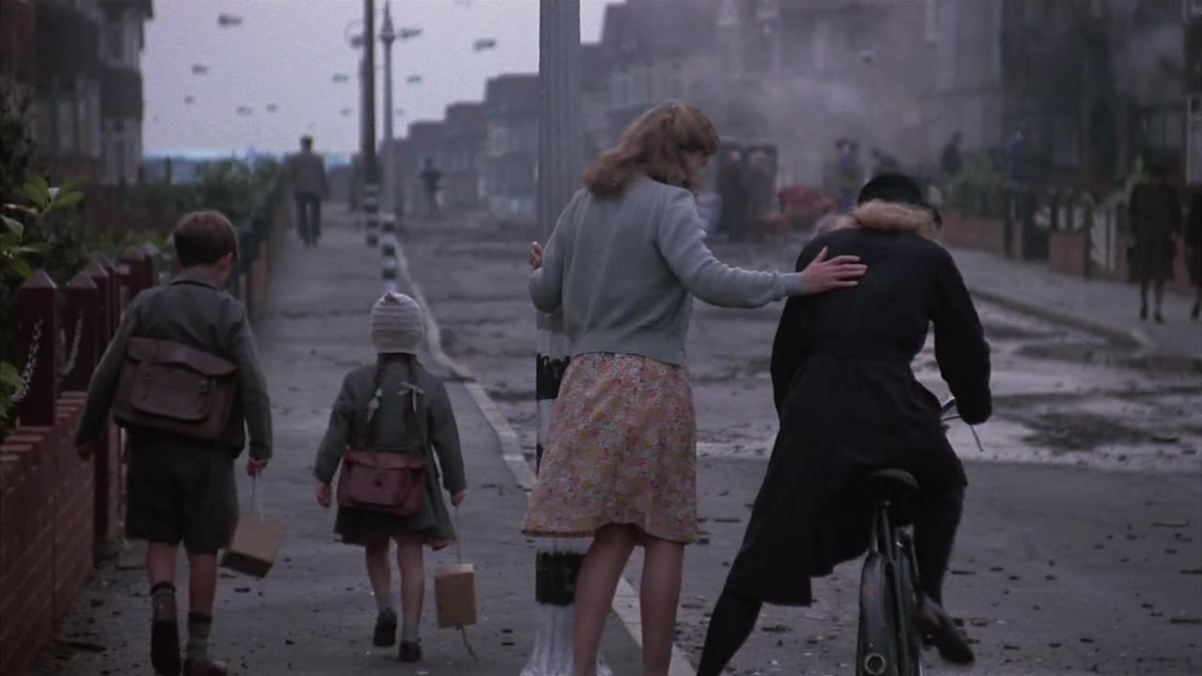
School children during an air raid

Slide 15
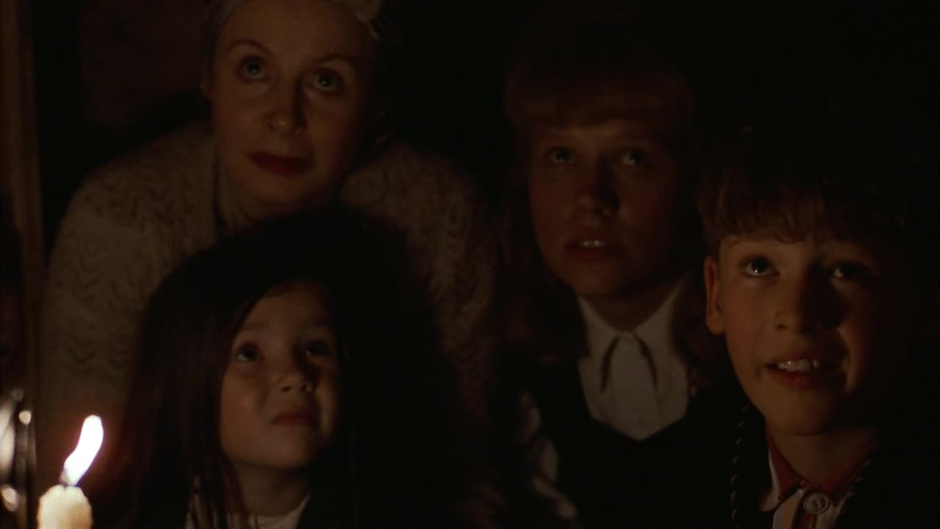
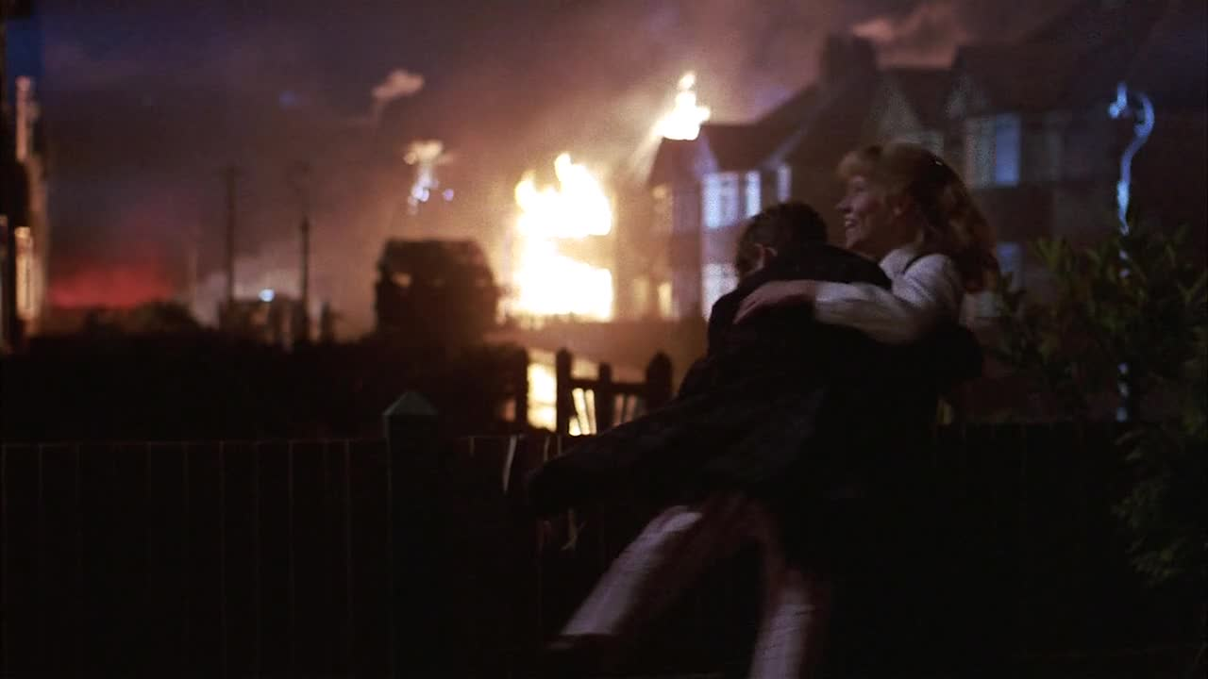
An air raid, from fear …
… to elation and dancing

Slide 16
The necessity to grow vegetables in a community garden due to rationing and shortages

Slide 17
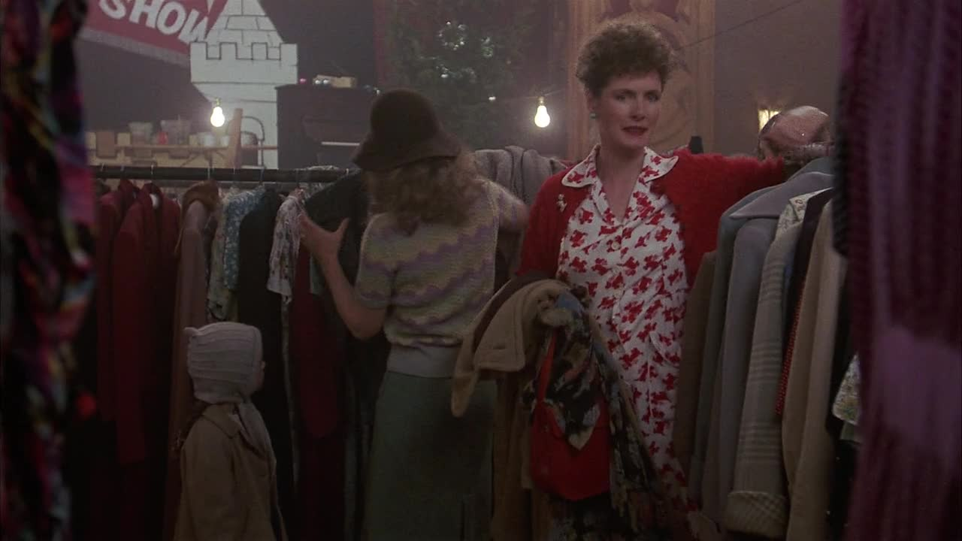
Clothes are rationed too

Slide 18
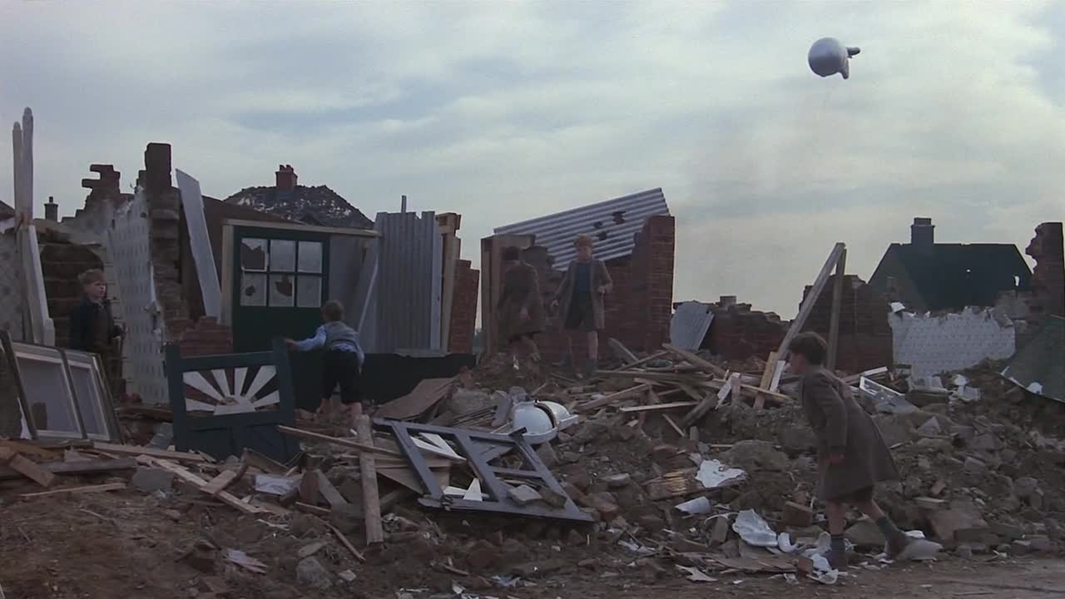
The rubble as a playground

Slide 19
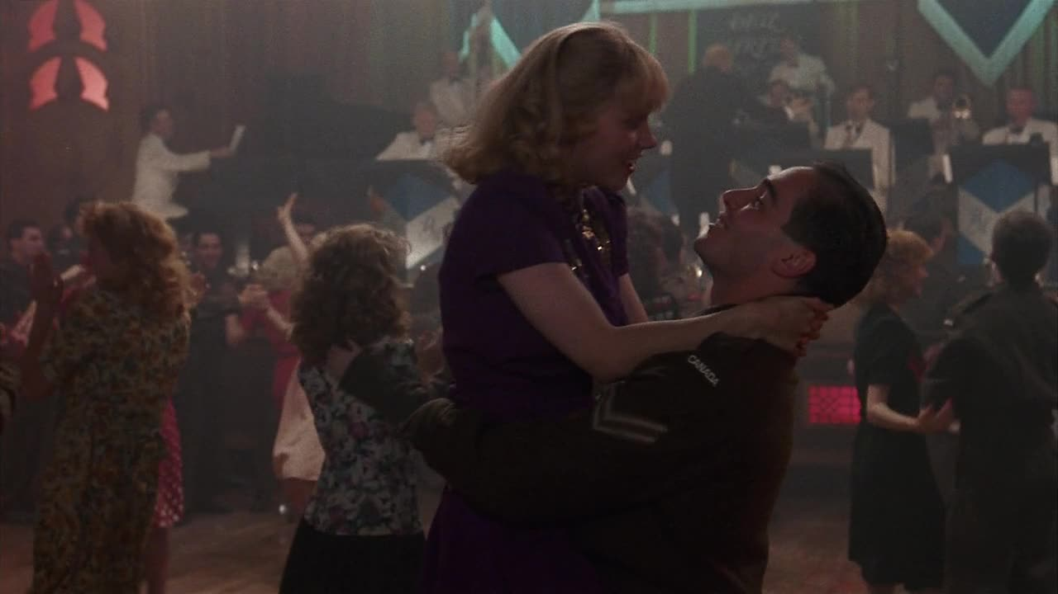
The swing era (Duke Elligton and orchestral jazz)… and falling for an allied soldier

Slide 20
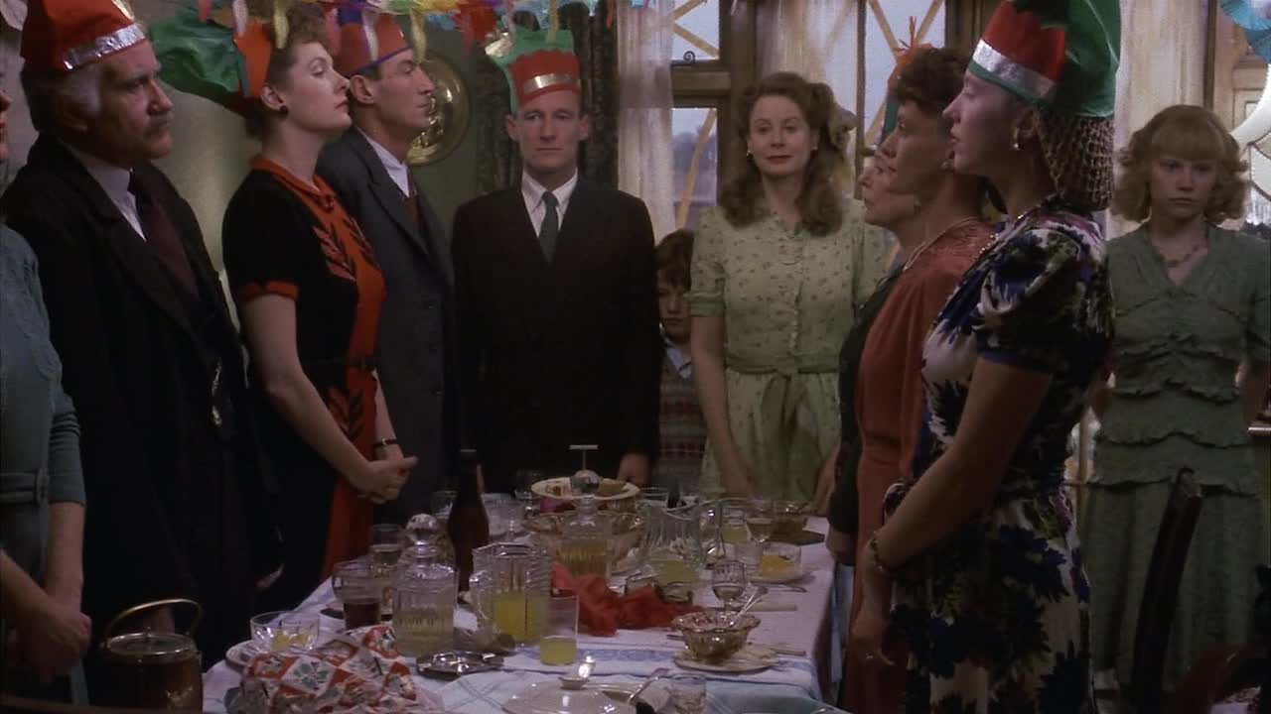
Ordinary patriotism: the whole family stands for the national anthem

Slide 21
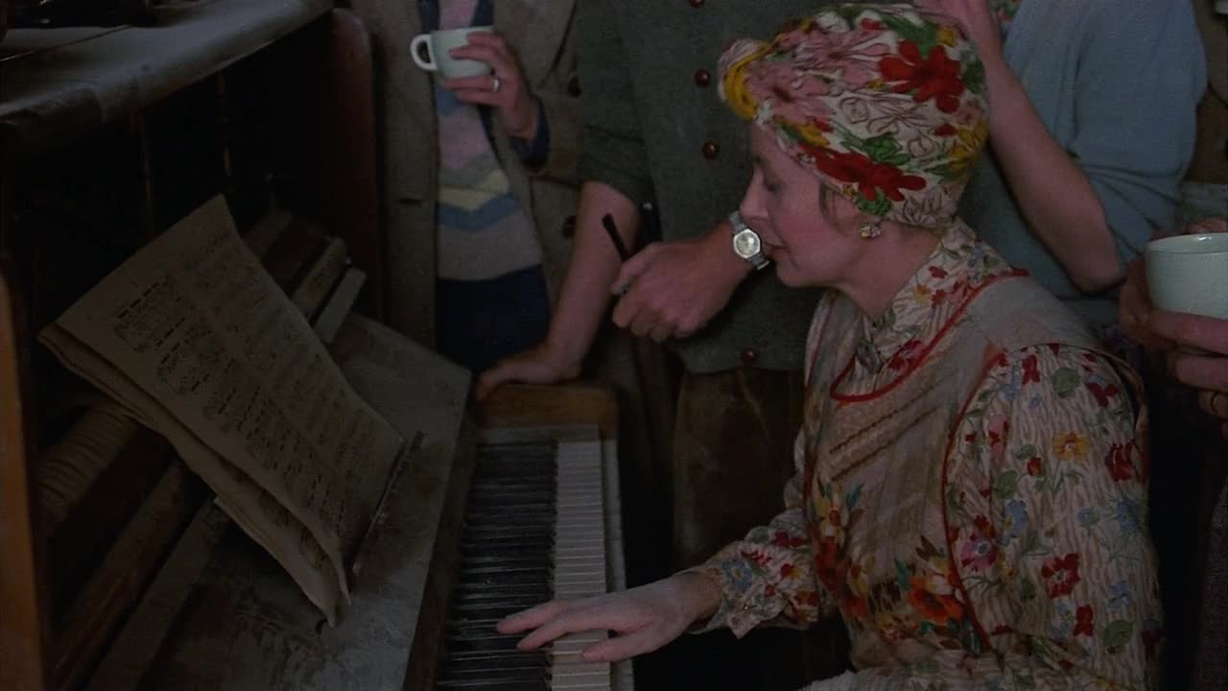
Resilience: playing Chopin in a bombed house

Slide 22
b) A series: The 1940s House
Historical reality tv
Channel 4
Broadcast in the UK: 2001 ( 5 episodes); in the US: 2002

Slide 23
c) A mass-market product: the « Keep Calm and Carry On » product line

Slide 24
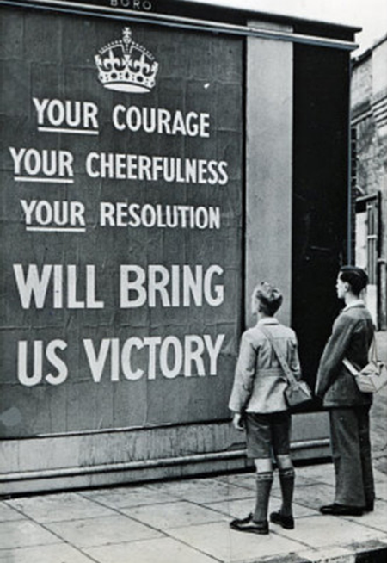
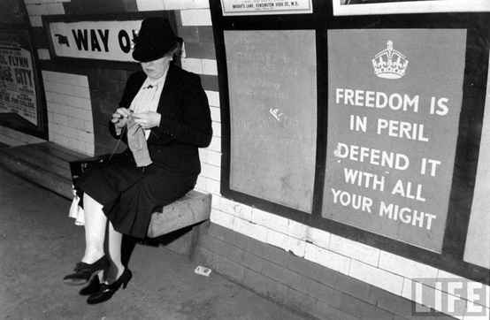

Slide 25
5) The People’s War Myth in Politics

