Slide 1
B) The Battle of Britain
1) The Few, the origin of the myth

Slide 2
2) The myth is perpetuated
Battle of Britain, Guy Hamilton, 1969
Battle of Britain Memorial, Capel-le-Ferne, 1993
Battle of Britain Monument, London, 2005

Slide 3
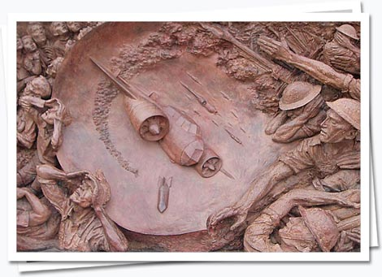
German Bomber

Slide 4
Air-raid look-outs (Observer Corps)

Slide 5
Aircraft factory workers

Slide 6
Air Raid Patrol wardens during the Blitz

Slide 7
Family in an Anderson shelter

Slide 8
Aircraft ground crew

Slide 9
RAF Bomber Command Memorial, 2012
Daily Mail, June 27, 2012: Defence Secretary branded a 'hypocrite' for saying he will go to Bomber Command Memorial unveiling despite refusing to pay for ceremony
Veterans have stumped up their own money and put their homes at risk
New monument took five years to save for and cost £6.5m to build
http://www.dailymail.co.uk/news/article-2165396/Philip-Hammond-branded-hypocrite-saying-memorial-unveiling-despite-refusing-pay-ceremony.html

Slide 10
The Globe and Mail: “A memorial for Bomber Command – too late for many “, Elizabeth Renzetti
http://www.theglobeandmail.com/news/national/a-memorial-for-bomber-command-too-late-for-many/article4382292/
For decades, they lived without a memorial to their efforts, and you can still hear grinding of teeth over the fact that Winston Churchill failed to mention Bomber Command in his victory speech. Simply, the Allies were too embarrassed by the trail of flattened and charred German cities, and the number of dead civilians, to acknowledge the contribution of the men who’d flown and navigated the planes – and dropped their bombs when they were told to. As British veteran Harry Irons, rear gunner, told the BBC this week, “It was a kick in the teeth, the way we was completely forgotten.”

Slide 11
3) The myth criticized by historians: the Battle of Britain debate

