Slide 1
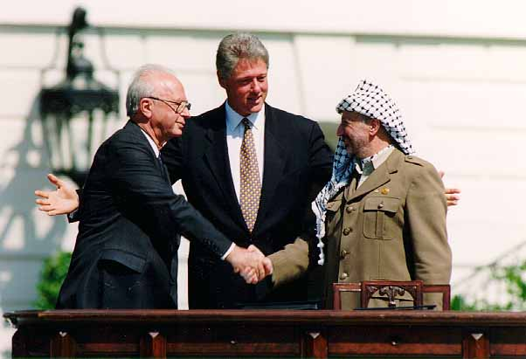
B) 2001 : the end of the "American century" ?
The situation before the attacks:
Key role in negotiation to restore the peace
Ex: Oslo Agreement, 1993; signing ceremony in the White House
Ex: NATO forces in Bosnia (1994), and Kosovo (1999)
American economy still powerful, but suffers from global competition (trade balance in deficit; creditor = China)
BUT, soft power; innovation center; attractive country (migrants)

Slide 2
9/11 and its impact on American foreign policy
Text study
Unilateralist policy is explicit
New slogan « America first »
Ex: War in Iraq, 2003. First preventive war (no aggression, suspicion of WMDs) launched without UN approval and against the judgment of allies such as Germany, France and Canada
« War on Terror » = new crusade; the US is the leader; world considered by US foreign policy as divided in two (Good vs. Evil; « us » vs. « them »)

Slide 3
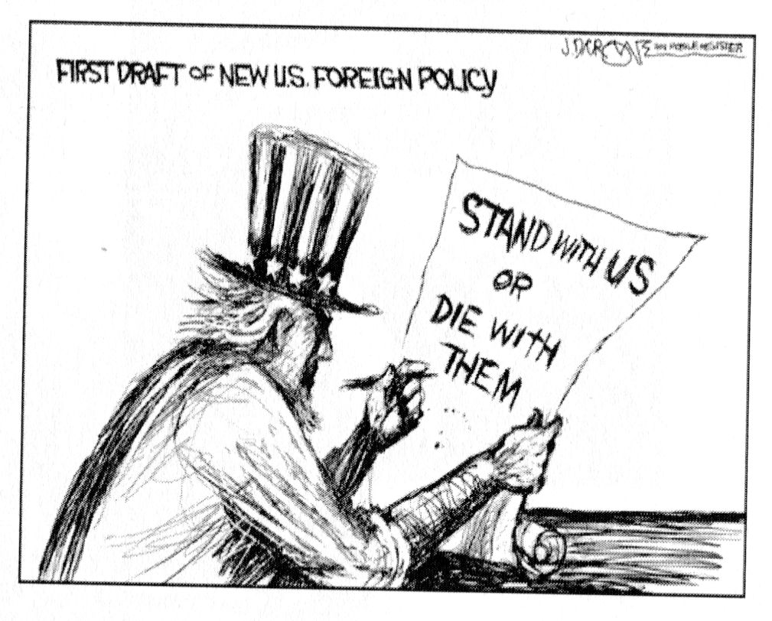
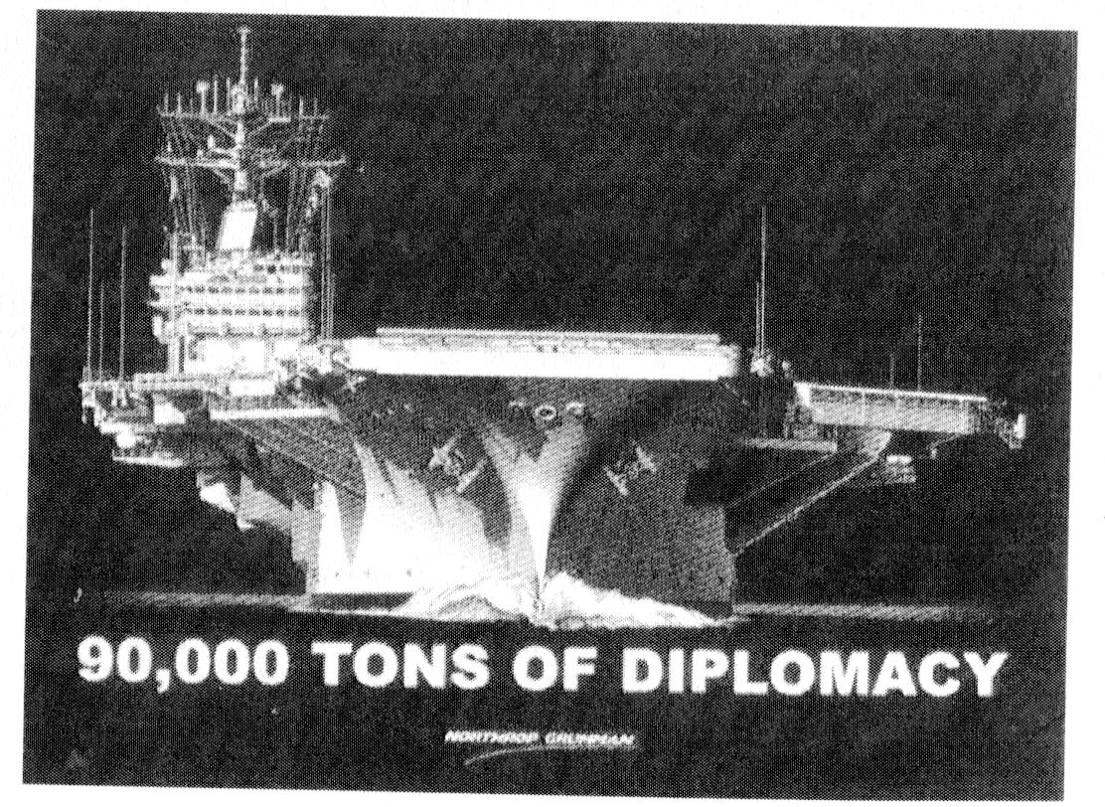
Advertisement for the future aircraft carrier ‘George Bush’ (launched 2006)
Cartoon by Dary Cagle, september 17, 2001

Slide 4
A degraded moral authority
Patriot Act, october 2001 (limits civil liberties and right to privacy; enemy combattant statute)
Guantanamo prison (Cuba) and harsh living conditions for inmates
Photographs depicting inhumane and degrading treatments in the Abou Ghraib prison
Forms of torture allowed to CIA operatives
Relocation of suspects in countries without human rights protection
Anti-Americanism in the world
Ex: Chavez, 2006, branded Bush « the Devil » in a speech in front of the UN

