Slide 1
C) A World leader in a bipolar world organization
1) Alliance systems on four continents

Slide 2
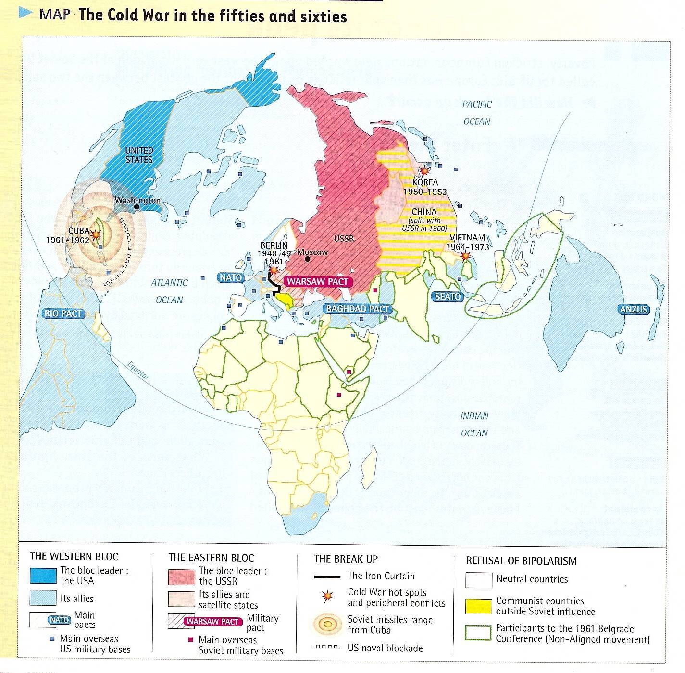

Slide 3
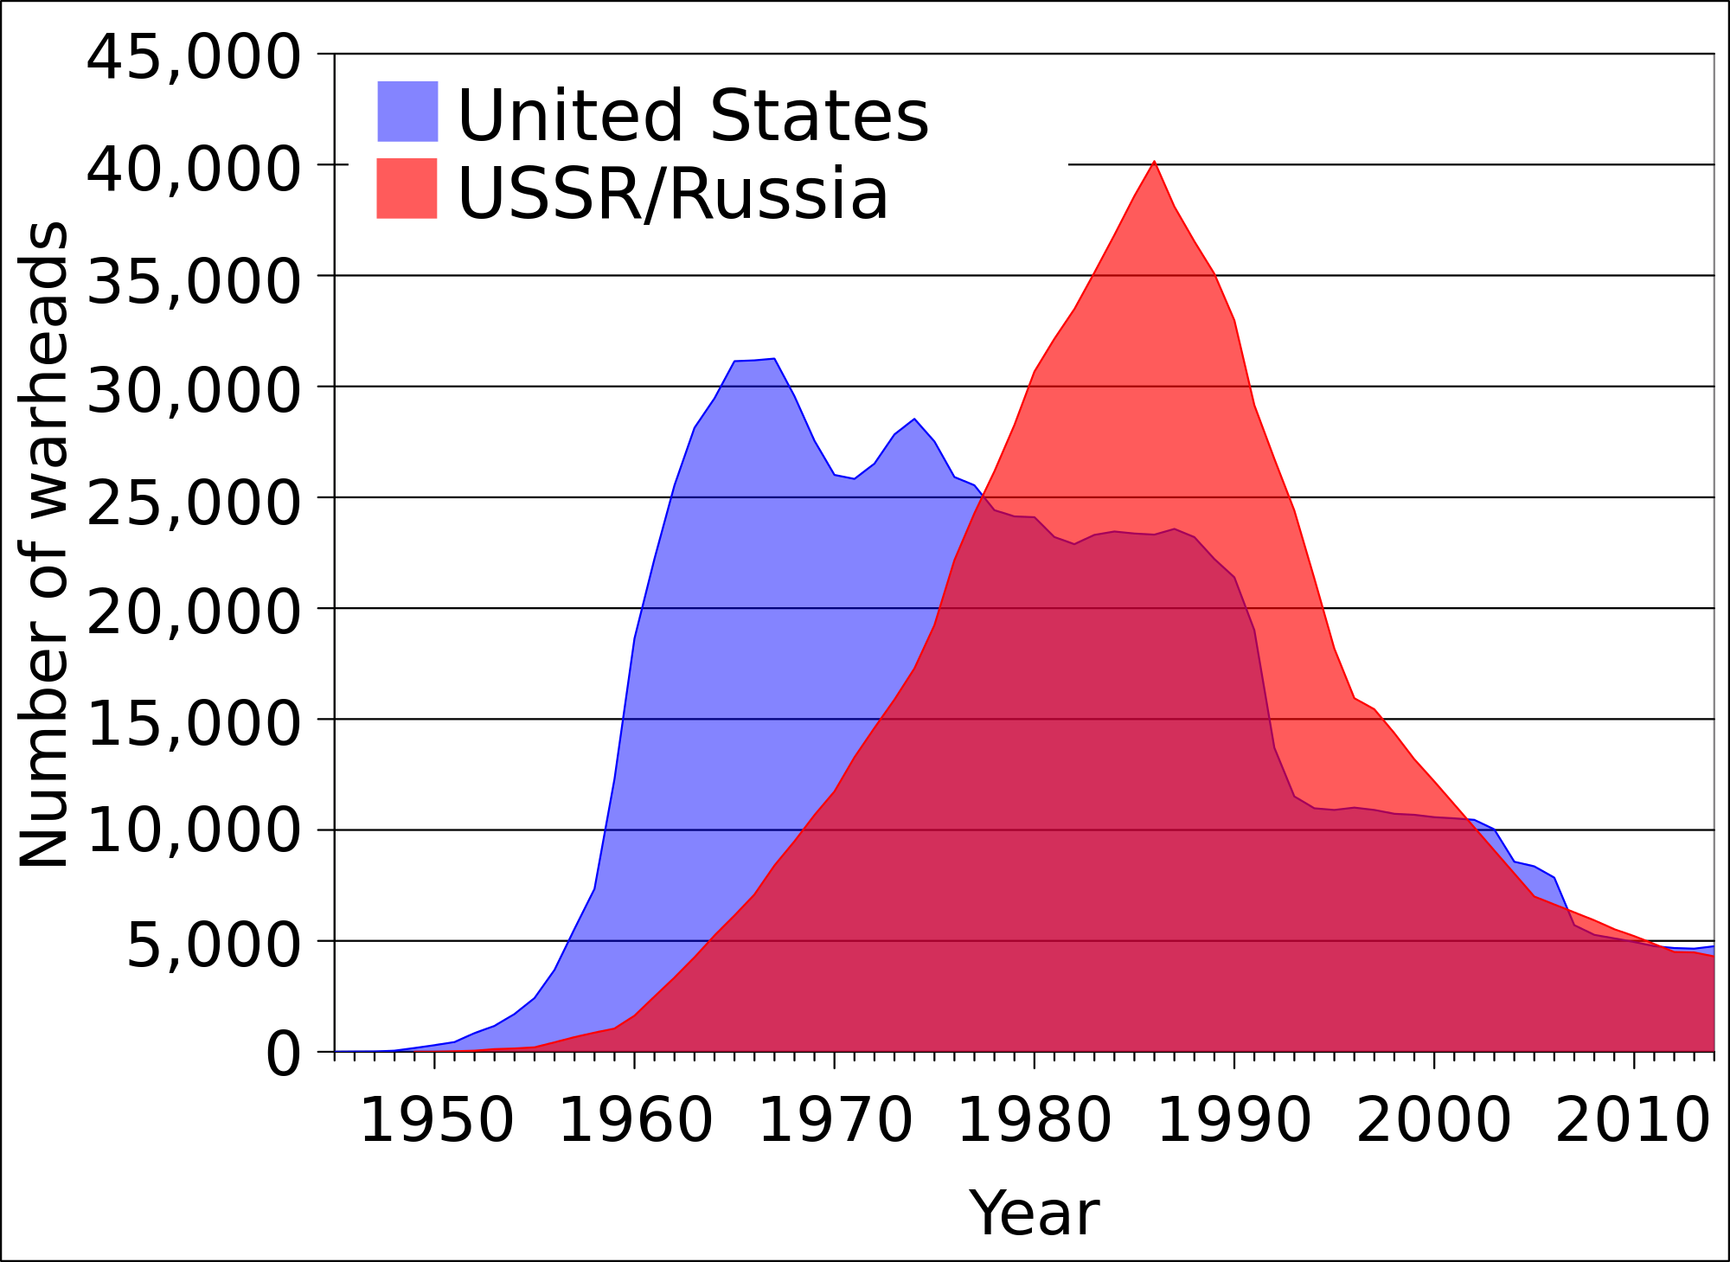
2 ) The arms race
Nuclear warhead stockpiles of the United States
and the Soviet Union/Russia, 1945-2014
Source: Robert S. Norris and Hans M. Kristensen, "Global nuclear stockpiles, 1945-2006," Bulletin of the Atomic Scientists 62, no. 4 (July/August 2006), 64-66.

Slide 4
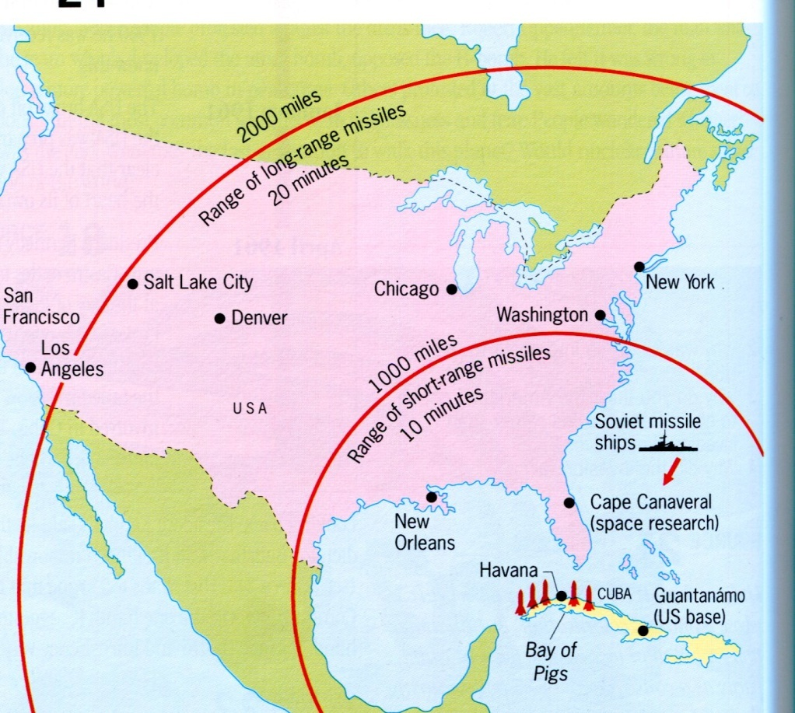
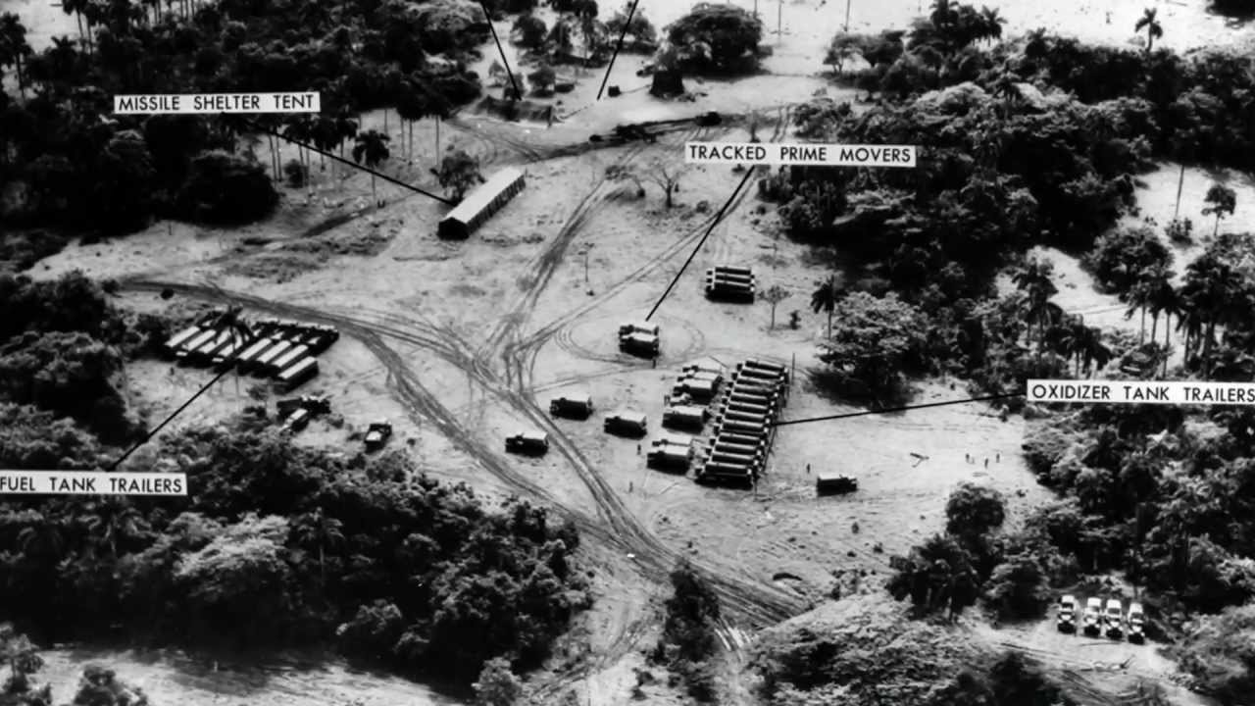
A Case study: the Cuban missile crisis, 1962
Military surveillance photograph presented to the UN Security Council as evidence

Slide 5
3 ) Military interventions

Slide 6
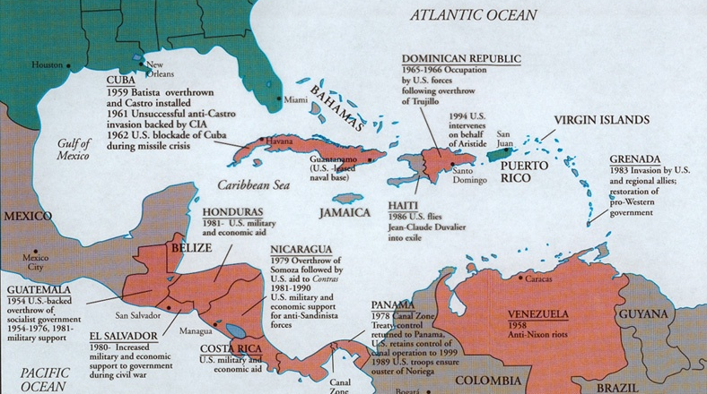

Slide 7
D) The 1970s: a turning point regarding the power and the image of the US
the Cold War necessities lead the US to trample upon its democratic ideals
In Latin America (support to dictatorships in Argentina, Brazil …)
In Vietnam (use of napalm, atrocities committed by soldiers …)
International protest since the 1960s against the war in Vietnam
Ex: 1965; first International Day of Protest; Anti US demonstrations in London, Rome, Brussels, Copenhagen and Stockholm
Mostly, national protests (student movement)

Slide 8
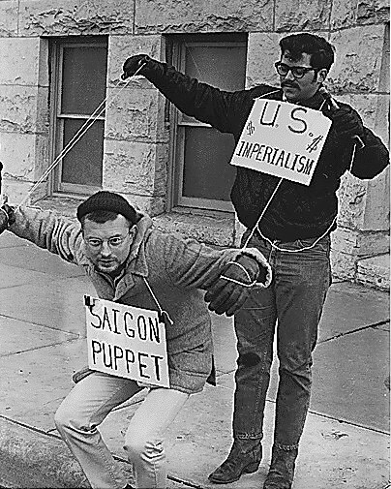
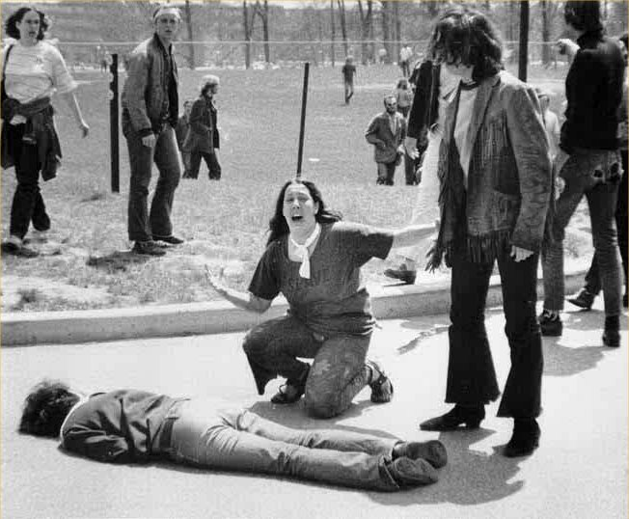
John Filo's Pulitzer Prize-winning photograph of Mary Ann Vecchio, a fourteen-year-old runaway, kneeling over the body of Jeffrey Miller after he was shot dead, by the Ohio National Guard on the Kent State University Campus in 1970.
Vietnam War protesters, 1967, Kansas

Slide 9
the end of the Glorious Thirty
Dollar crisis; and lack of confidence in the country’s economy
Symbol = 1971, the beakdown of the convertibility regime; the end of the gold-exchange standard based on the dollar
New competitors (ex: newly industrialised Asian countries)
New conflicts patterns (independent from the Cold War): a new enemy appears that fights the US as a symbol of westernization

Slide 10
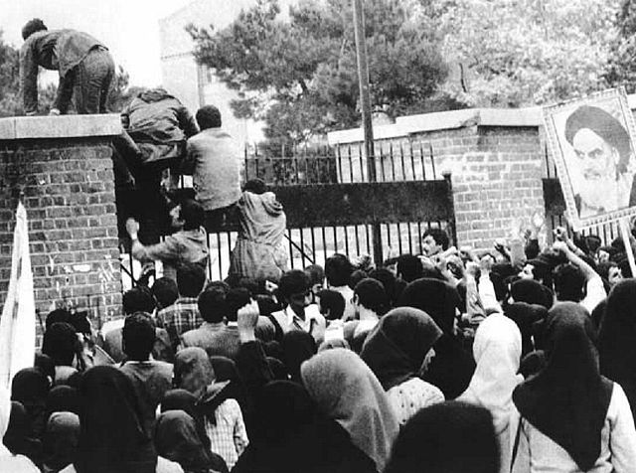
New conflict patterns
1979 = Iran hostage crisis (US Embassy in Tehran)
Rescue attempt (1980) = failure
Embarrassment for the US govt
Failure broadcast worldwide
New enemy = islamist movement

Slide 11
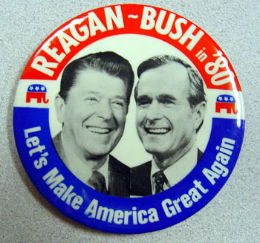
II. 1981-2015: the US, a superpower?
A) 1981-2001: a "super-power" in a "New World Order" ?
A symbol of the 80s = the Reagan presidencies (elected in 1980 and 1984)

Slide 12
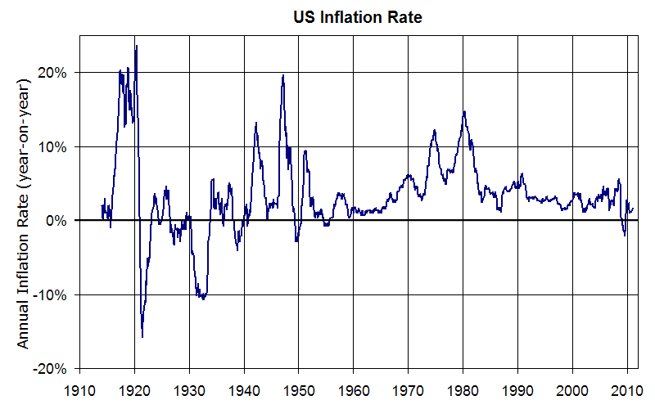
Source: https://upload.wikimedia.org/wikipedia/commons/8/83/US_Inflation.png

Slide 13
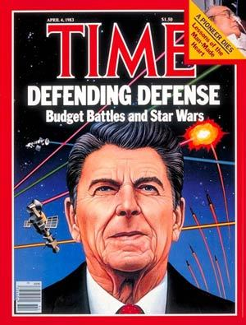
Strategic Initiative Defense (SID)
Ground and space-based laser systems to protect the US from attack by strategic nuclear missiles
Defense shield/ new nuclear umbrella
1983, in a speech, Reagan branded the USSR an « evil empire », like in the Star Wars movies
Time Magazine Cover, April 1983

Slide 14
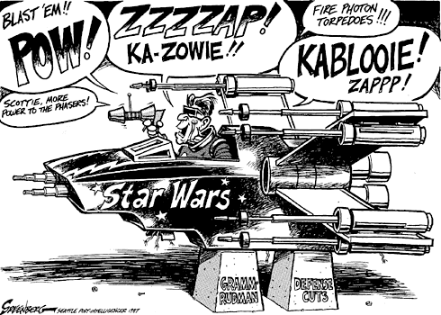
Published in Seattle Post November 20th 1987

Slide 15
the situation in the USSR continues to deteriorate
1991 (december) = the USSR officially ceases to exist
The US is the only superpower left as the Cold War victor
Hopes of a new world order

Slide 16
multilateralism = when multiple countries are working together on a given issue
Negotiation
Consensus
1 country = 1 vote
Opposed to unilateralism = when a single country imposes its policy
Does NOT negotiate; only takes into account its own interests
One-sided decision-making process
After the Cold War, the « international community » hopes for a multilateralist world order

Slide 17
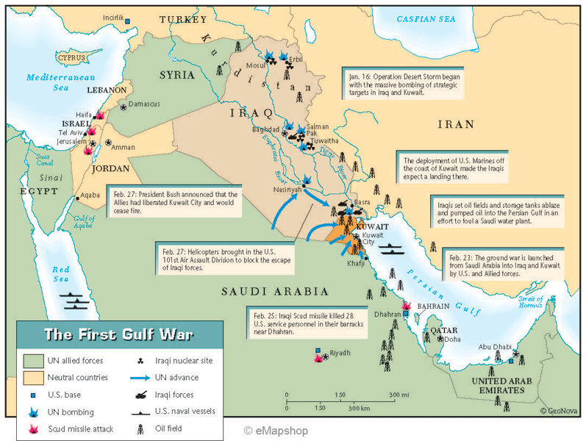

Slide 18
The first Gulf War
August 1990 – February 1991
Iraq (S. Hussein = leader) invades Kuwait
Operation Desert Storm is authorized by the UN (Resolution 678)
1 M soldiers, including 700 000 US troops; about 30 countries in the coalition
148 US soldiers killed; 35 000 Iraqi soldiers killd (+ 75 000 wounded)

Slide 19
Gulf War = first legal war (approval of the UN)
Large coalition
Defense of a small country, under aggression
The « world’s policeman » / Pax Americana
At the same time, a unilateralist policy implemented when the country’s interests are threatened
Ex: refusal to ratify the Kyoto Protocol (1997) and the treaty creating the International Criminal Court (1998)

