Slide 1
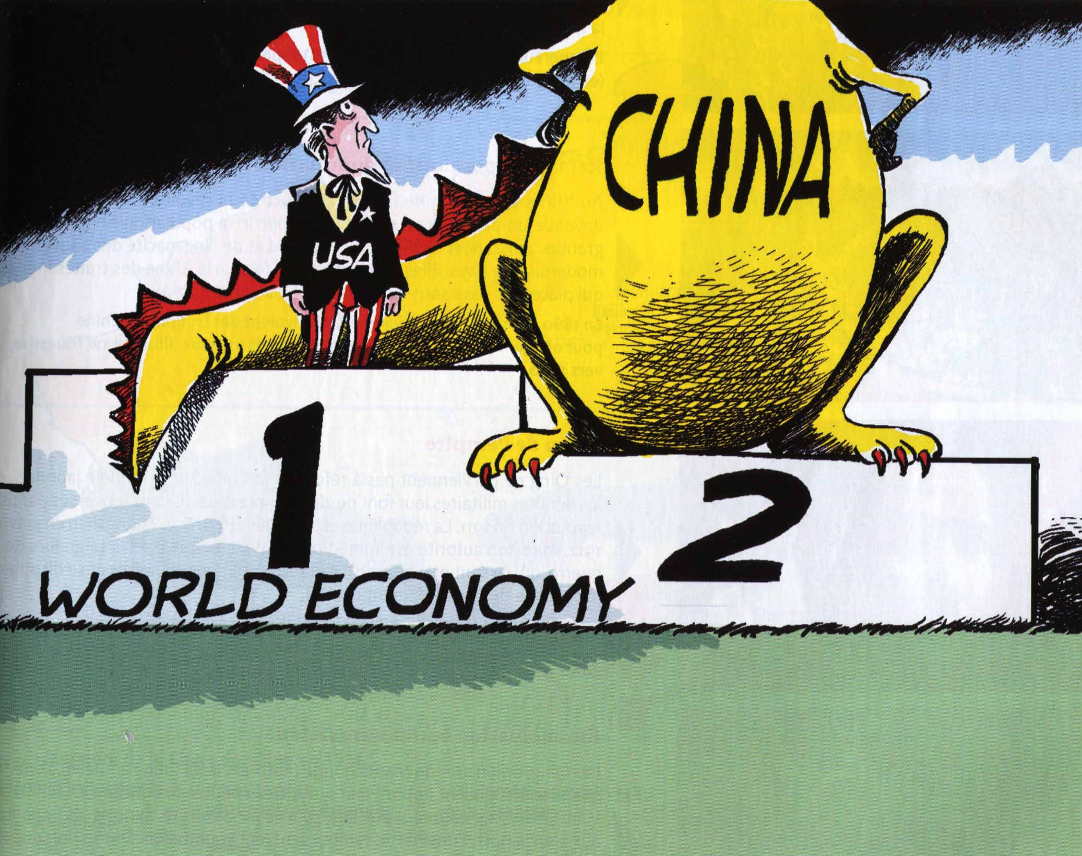
The United States as a global power, 1945-2015
Swedish cartoon
Olle Johansson
2010
Section européenne – History – Topic 2
2015-2016

Slide 2
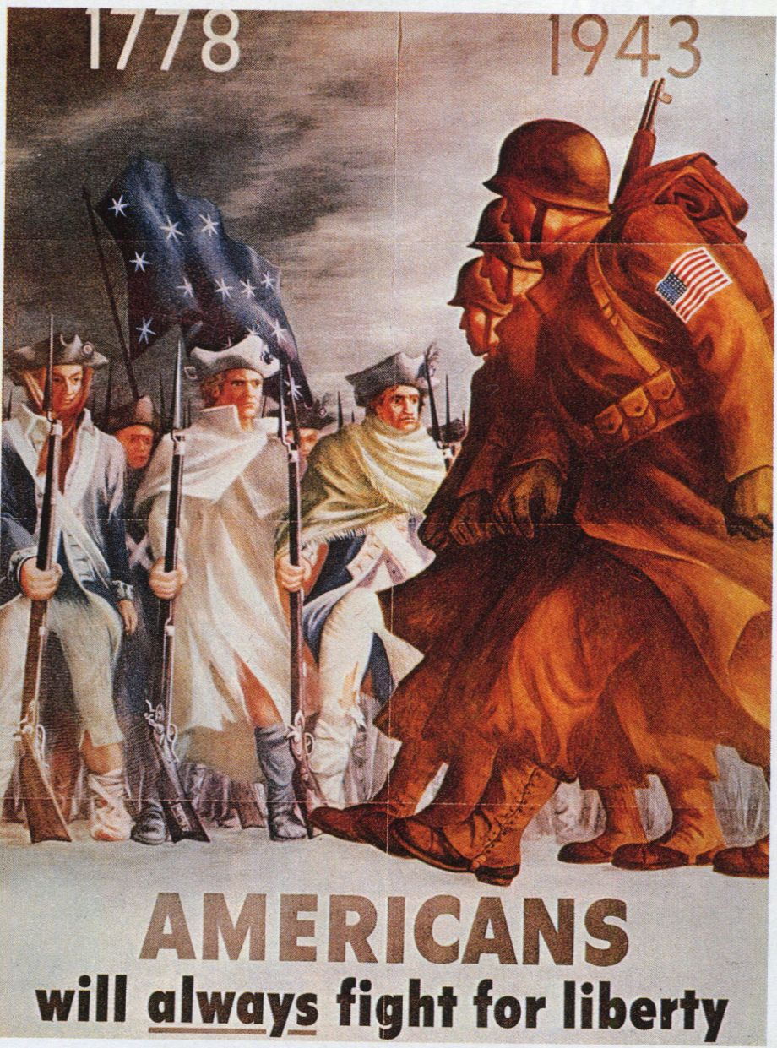
1778, 1943. Americans will always fight for liberty
Bernard Perlin
(Office of War Information), 1943

Slide 3
US foreign policy (alliances, diplomacy, war …)
How American power is perceived abroad (American Dream, soft power, image as the leader of the free world …)
Instruments of power (economic growth, technological and intellectual power …)

Slide 4
Key questions
How does the US transform and model the very notion of power?
How does the US exert its leadership after the Second World War ?

Slide 5
I. 1945-1980: the « leader of the free world » fulfills its responsabilities
A) A victory that reinforces the US as a global power

Slide 6
From a political point of view: a key role in the peace settlement and the new order
The Yalta Conference (february 1945); the Big Three agree on a plan for Europe after Germany’s defeat (dividing Germany, organizing free elections …)
The Postdam Conference (july-august); confirms
The San Francisco Conference (april); creates the UN, the US is a member with veto power

Slide 7
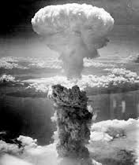
From a military point of view: no rival in 1945
Only goverment equipped with the atomic bomb
Hiroshima, Nagasaki (august 1945) = a demonstration of absolute power

Slide 8
From an economic point of view: the world’s biggest economic power
A workforce and a territory mainly unaffected by the war
US human toll = 0.3 million people
An important economic growth
GDP = US$ 227 billion in 1940; 335 in 1945

Slide 9
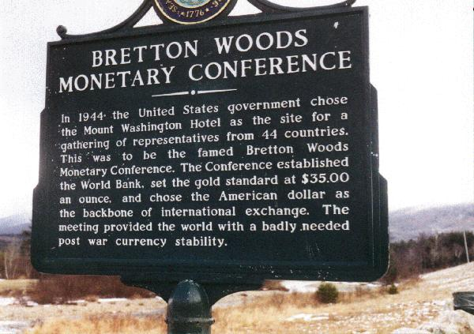

Slide 10
GATT = General Agreement on Tariffs and Trade, 1947
Plans to reduce custom taxes (or tariffs)
The US government spreads its liberal economic model across the world
The US goverment doesn’t resume its isolationist position

Slide 11
B) An ideological model involved in the Cold War
1) The Truman Doctrine and the Marshall Plan

Slide 12

A turning point
Responsabilities as a global power
Europe already owes the US $12 bn
Marshall Plan = another $13 bn over a period of 4 years; grants and loans
Ex: Britain, 2.7 bn
Ex: France, 2.4 bn
Ex: West Germany, 1.3 bn
France and Britain, 15% of loans and 85% of grants
Also called the Europe Recovery Program (ERP)

Slide 13
2) Innovation and the space race

Slide 14
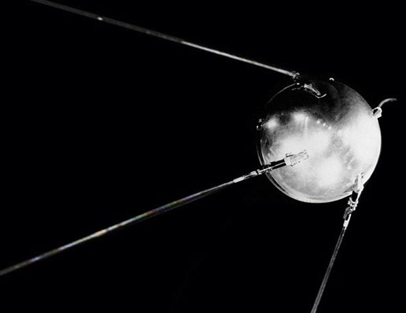
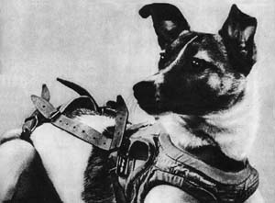
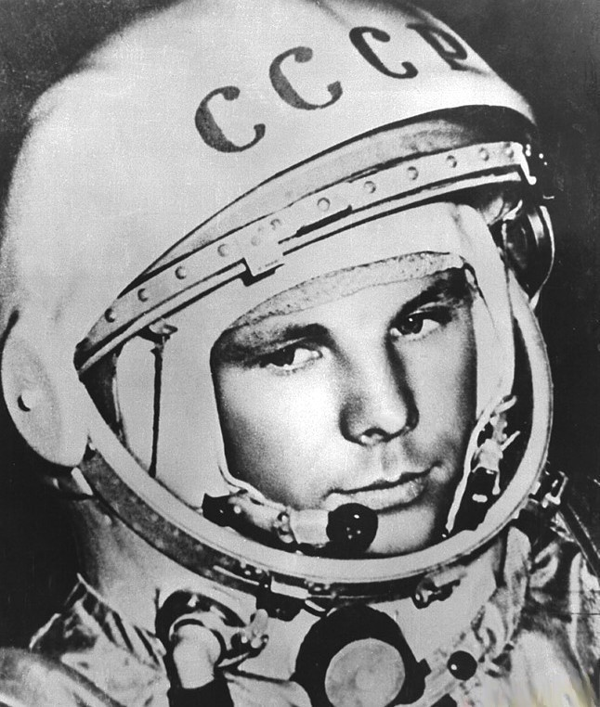
1957 = Sputnik 1 (october) and Sputnik 2 (november) with Laika on board, the first animal launched into orbit.
Yuri Gagarine
First man to journey into outer space, his spacecraft completed an orbit of the Earth on April 1961

Slide 15
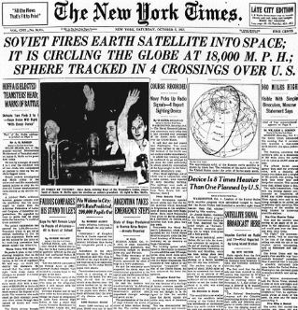
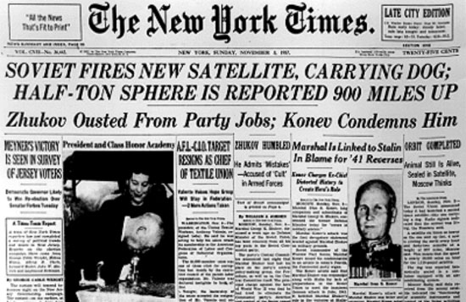
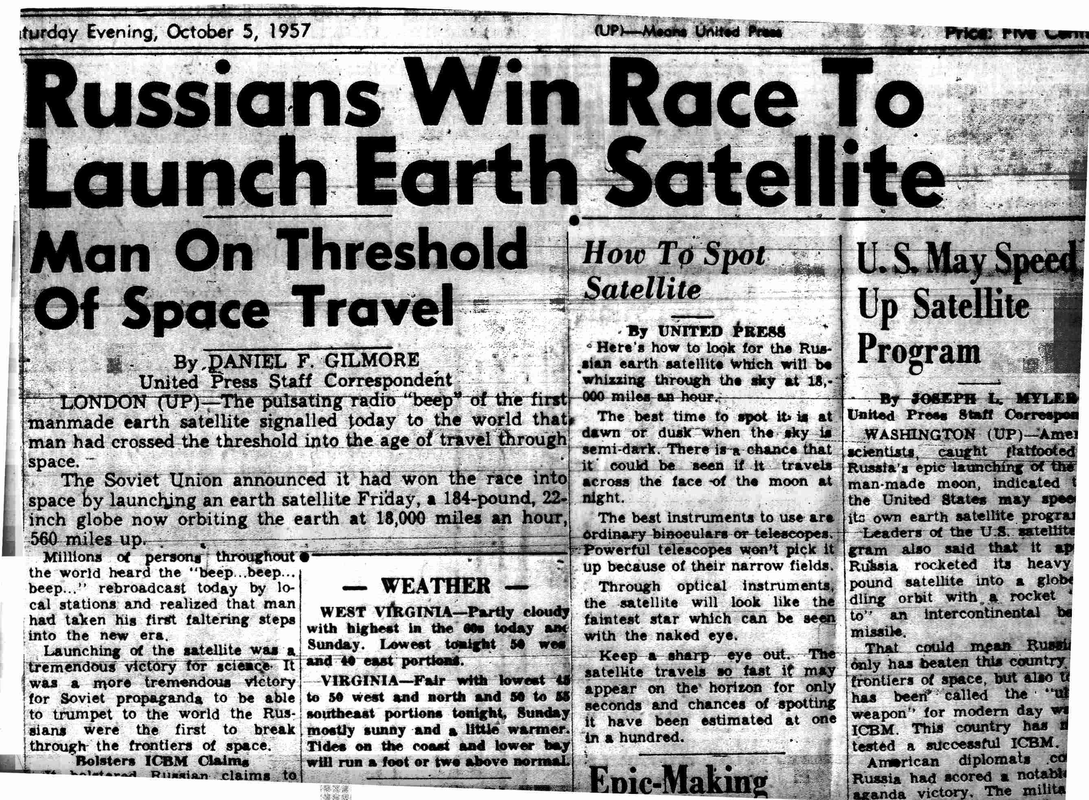

Slide 16
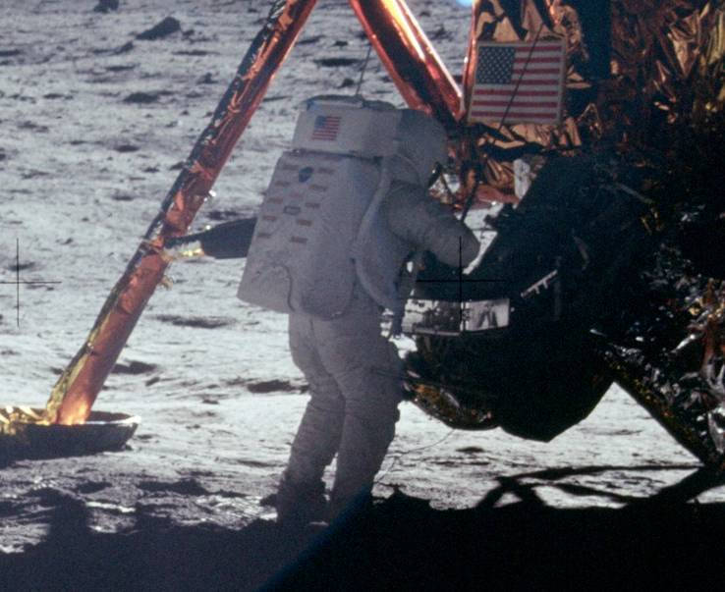
Apollo 11
1969
Neil Armstrong, first man to descend to the lunar surface, and … walk on the moon

Slide 17
3) From Bewitched to ET, The Extra-Terrestrial, a new conception of power
Hollywood and the propaganda war

Slide 18
The US uses its economic and cultural power to influence countries and people all around the world
Ex: Blum-Byrnes Agreement (1946); new credit in exchange for opening France’s markets to American products, especially film productions
Americanization of US allies

Slide 19
Soft power; concept created by Joseph Nye
The ability to attract rather than coerce
Established through culture, political values and foreign policies
1990, Bound to Lead: The Changing Nature of American Power
At its peak during the 50s and 60s
Powerful TNCs export cultural and industrial products

Slide 20
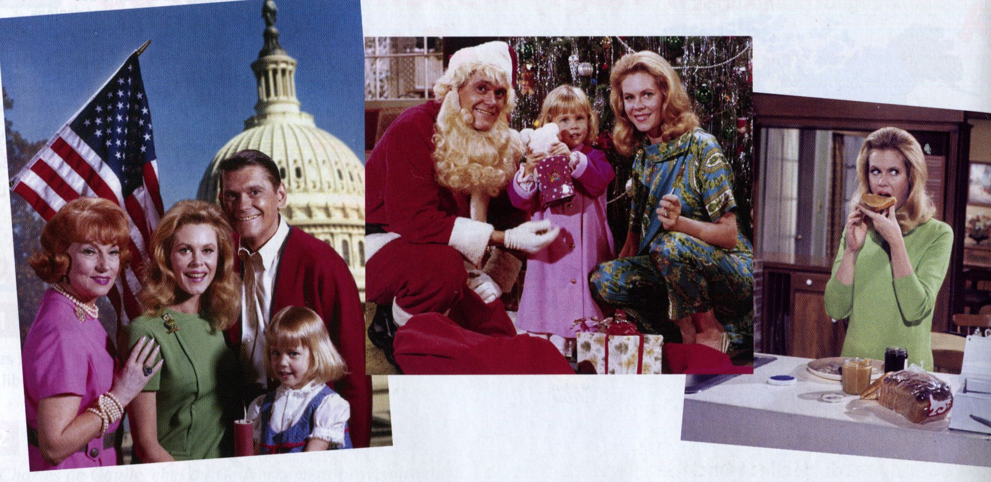
Bewitched (ABC, 1964-1972)
Broadcast in France starting 1966; and in many countries
Middle class family; happy and comfortable life
Suburban house; garden; car
Husband = breadwinner
Wife = home-maker; caring mother, devoted and supportive wife

Slide 21

ET, The Extra-Terrestrial
Steven Spielberg
1982
Ranked for 10 years first in the world box office
Reaffirms American values

Slide 22
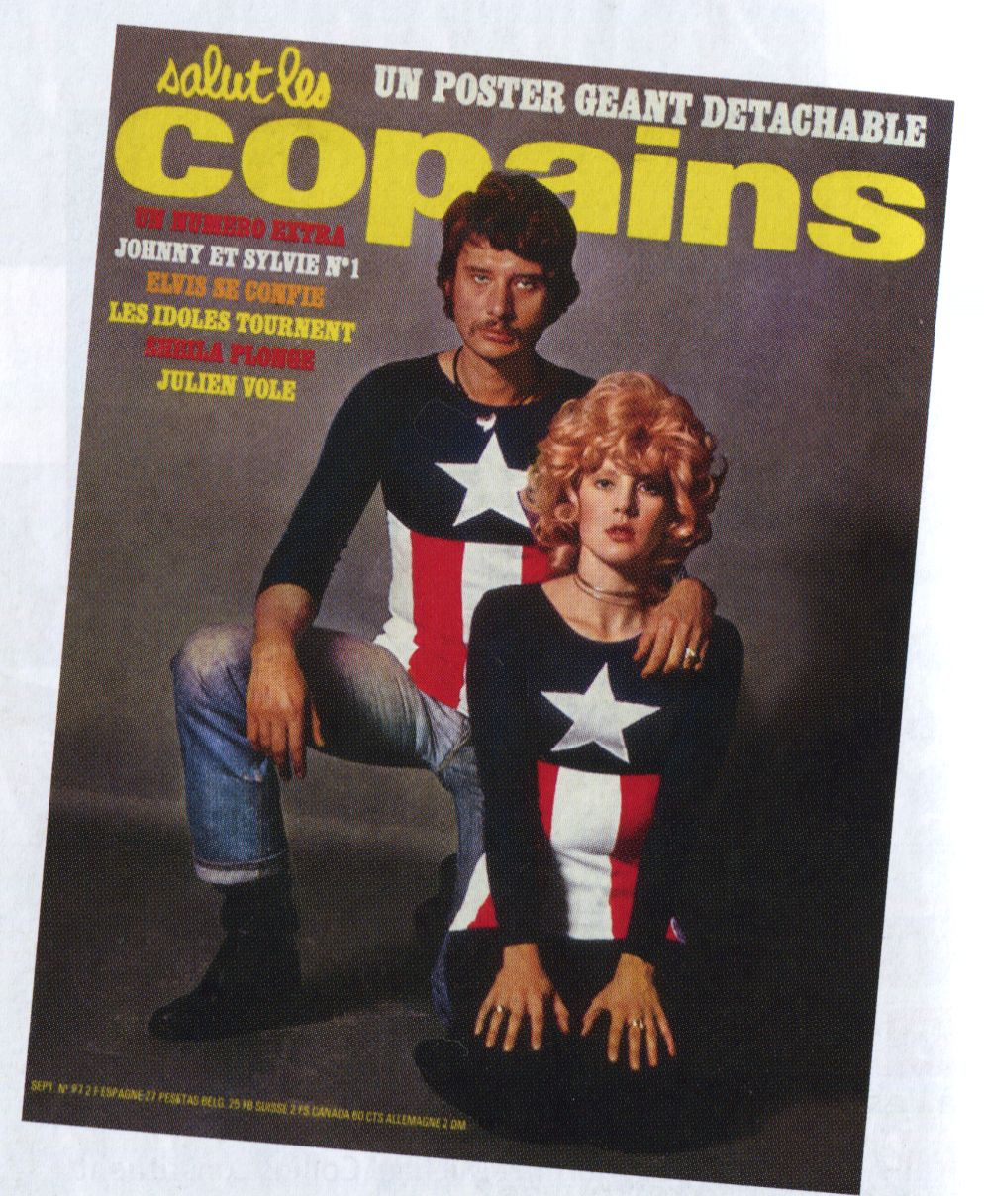
Johnny Halliday and Sylvie Vartan,
1970

Slide 23
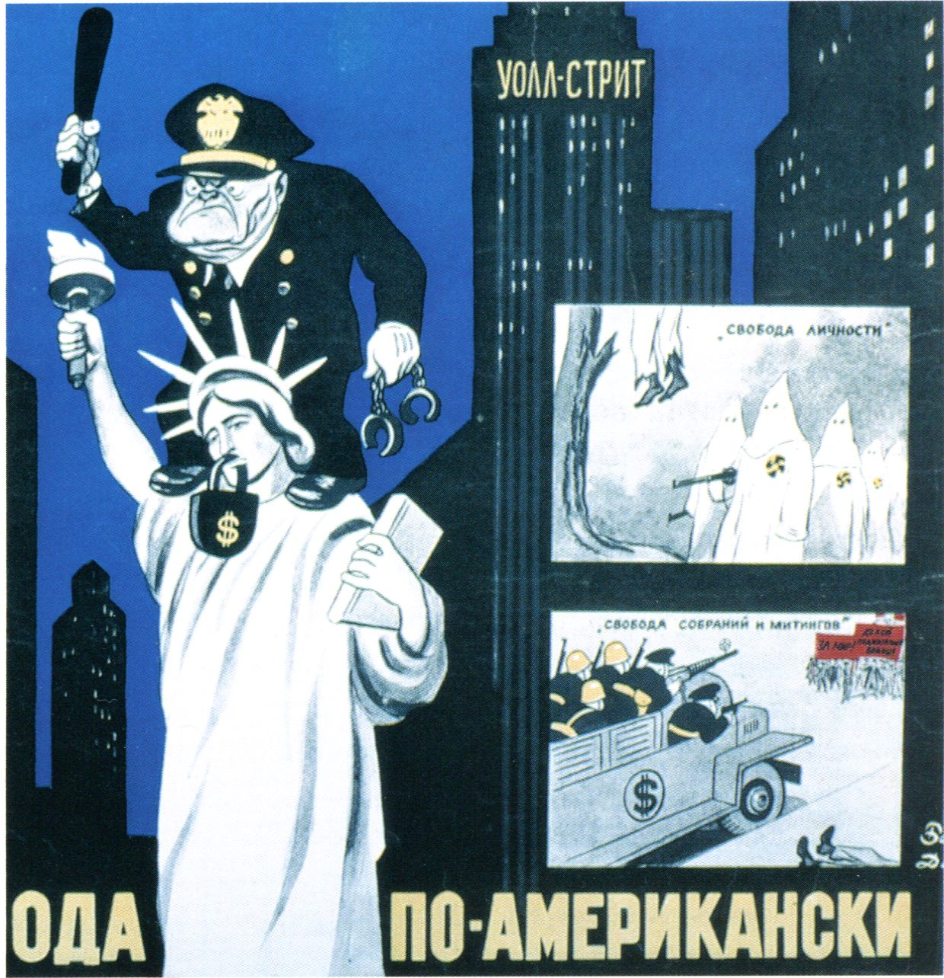
A negative image; the American way of life is criticised as an illusion
Almighty dollar
No freedom of speech
Social unrest/ conflictual labor relations
Racial issues/ segregation

Slide 24
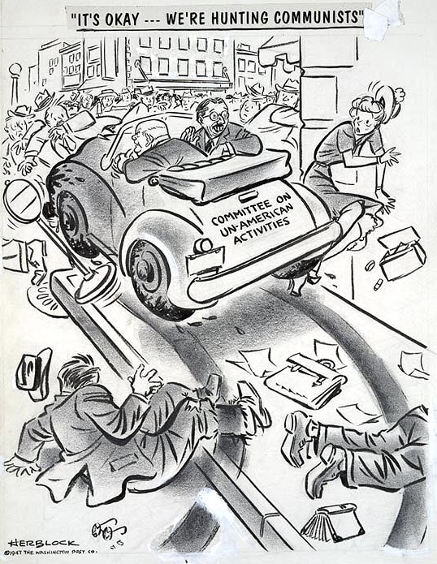
Maccarthyism
The execution of the Rosenbergs

