Slide 1
III. The socio-spatial consequences of the city’s inclusion in globalization

Slide 2
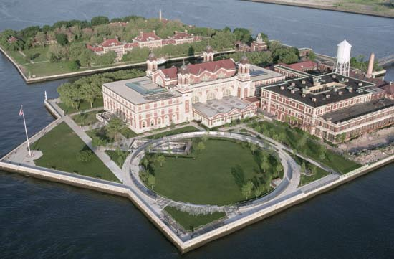
A) Global city, cosmopolitan city
Main gateway to the US
Ellis Island; 12 M migrants processed (1892-1954)
Busiest immigrants inspection station in the US
19th c. = Europe (catholics, tensions in the city)
20th c. = diverse origins (Asia, Caribbean, Latin America, …); refugiees after WWII (Holocaust survivors)

Slide 3
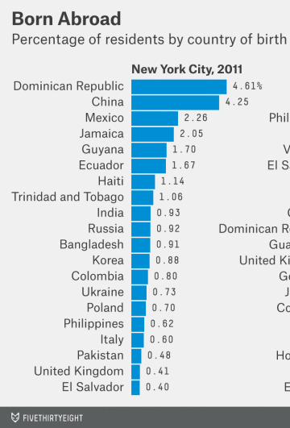
Today = approximately 6 M immigrants
Third rank in the country
2011; more than 1/3 of NYC inhabitants are foreign born
30% were born in the Caribbean
24% in Asia
19% in Europe
9% in Central America
3% in Africa

Slide 4
B) Salad bowl or melting pot? Racial and socio-spatial segregation in New York
Melting pot = assimilation / common culture
Salad bowl = juxtaposition of cultures; they do not merge

Slide 5
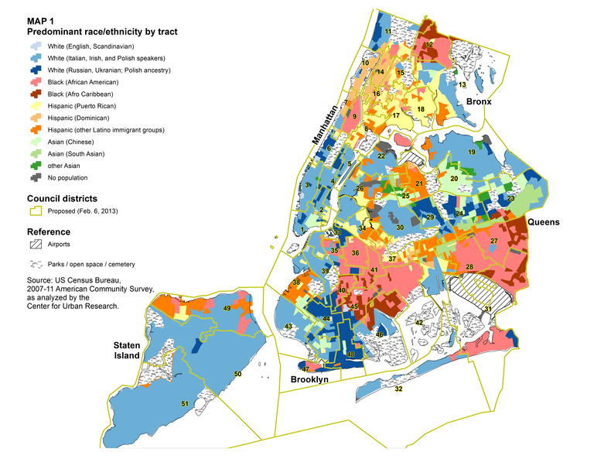
Racial segregation?

Slide 7
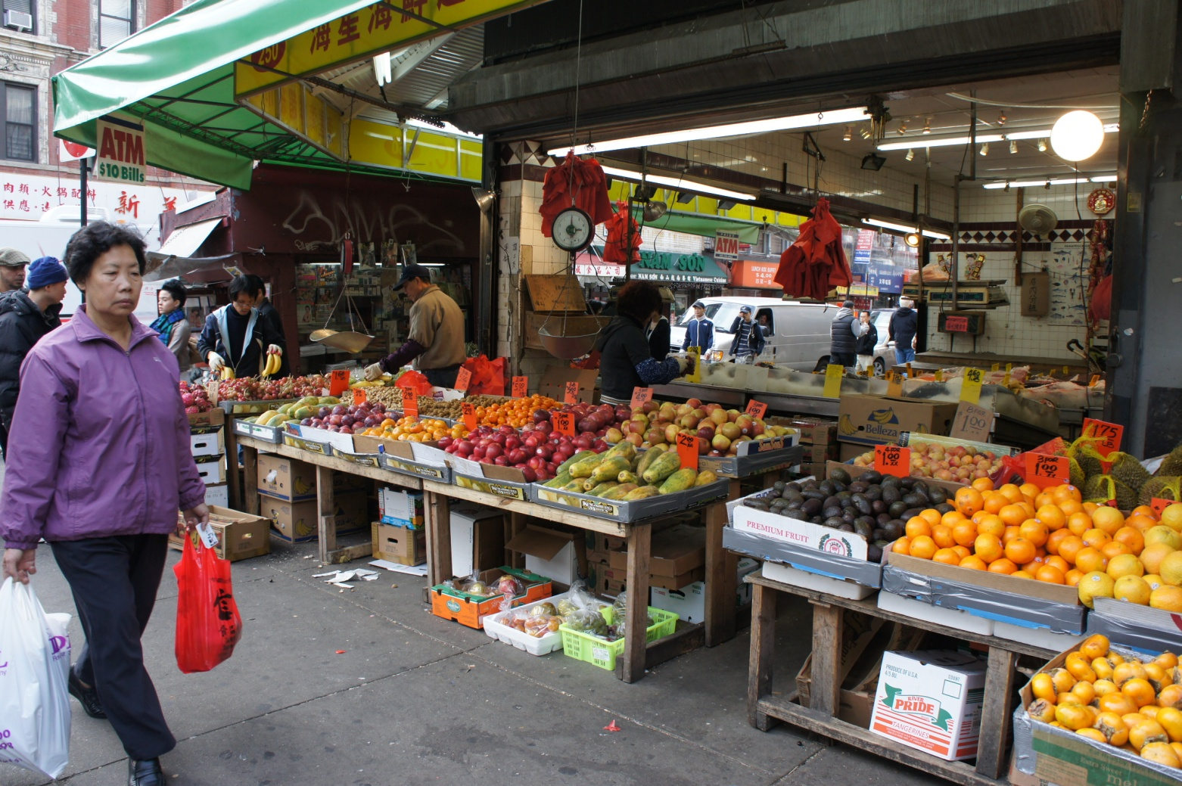
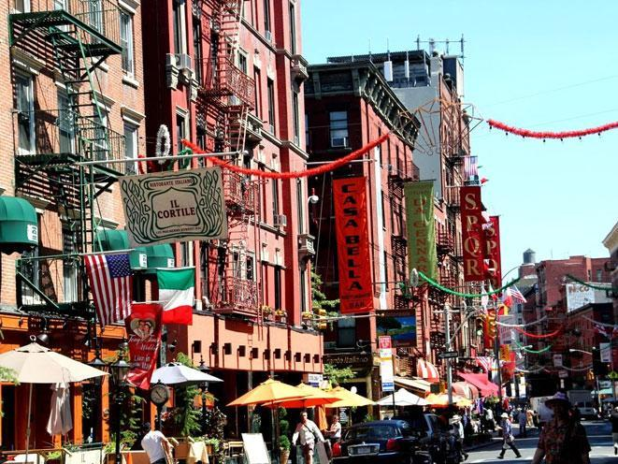
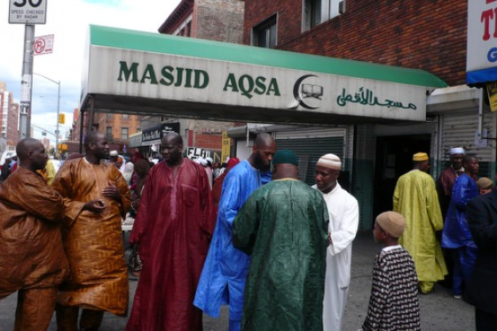
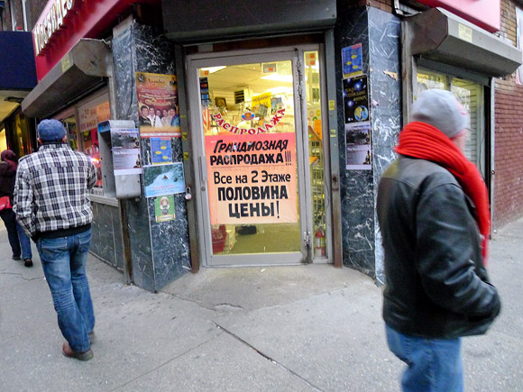
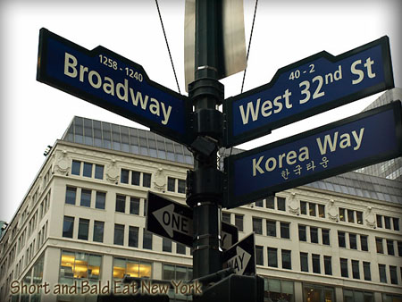
Communitarianism
Neighbourhoods:

Slide 8
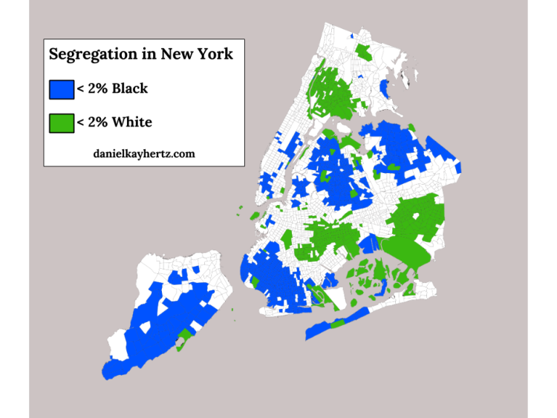
Median income of Black people in the city is 2/3 of the median income of Whites
Segregated areas:
Harlem
Central Brooklyn
Bronx
Queens

Slide 9
Social segregation?
Poverty in NYC
Social inequalities
10% of the poorest people have less than $22000 per year at their disposal
2011: 25% of lone mother households have an income below the federal poverty line
1 household out of 4 spends 50% or more of its income to pay the rent (lack of public housing)
0.8 M poor people, 35000 people are homeless

Slide 12
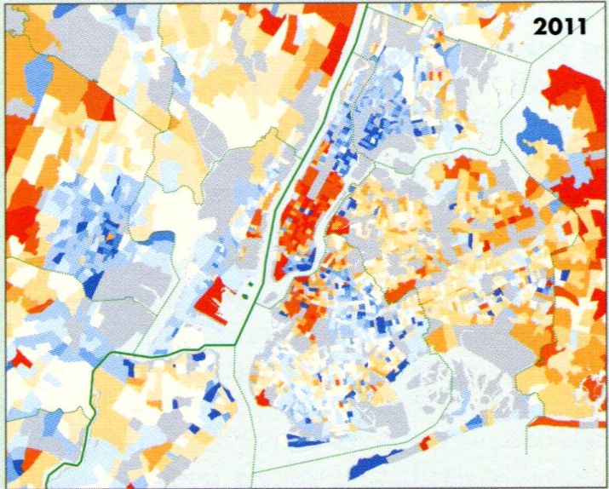
Wealth in NYC
Real estate (or property) prices = best indicator of a wealthy area
On this map (the median rent, 2011), red = over 2000 US $; dark blue = less than 500 US $
Wealthiest neighborhoods:
Downtown, Midtown, Upper East and West Side
Brooklyn (near Manhattan) as an extension of the core of the city
Jersey City (idem)
Then Newark, Orange, Westchester, Long Island … representing the rich suburbs
In between = pockets of poverty, middle class people

Slide 13
Inside One57, Where New York's Most Expensive Penthouse Just Sold For A Record-Breaking $100 Million Jan, 2015 http://uk.businessinsider.com/inside-one57s-100-million-penthouse-2015-1?r=US&IR=T
Pockets of wealth
The 10 most expensive apartment buildings are in Manhattn, with a Central Park View
That’s why they are taller each year, to sell this famous view
Example here: One57; the tallest occupied residential building
57th Street ( close to Central Park) is nicknamed Billionaires’ Row
19 units were on the market in 2015, prices ranged from 4.95 million US $ to 58.5
You also find gated communities in Long Island for example

Slide 14
C) Urban renewal and gentrification
Gentrification = process; changes in a neighborhood
Lower-income families and small businesses are replaced by wealthier residents and businesses (= from a ghetto to a rich neighborhood)
Result = real estate prices increase
A gentrifier = a wealthy person who recently moved to a low-income neighborhood
A gentrified neighbo(u)rhood

Slide 15
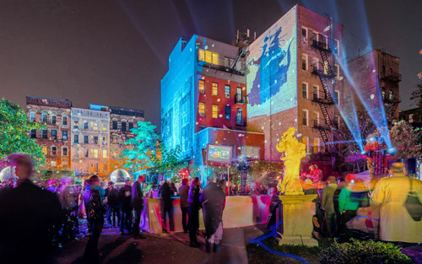
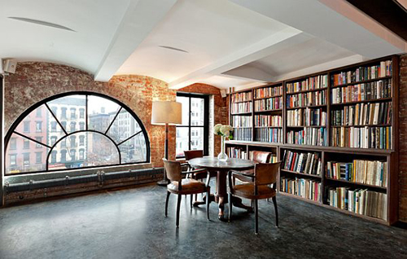
Industrial buildings, warehouses, industrial wastelands, workshops … are renovated, retrofitted and refurbished
Lofts (most common)
1st wave of inhabitants = artists, designers (the gentrification begins)
2nd wave = fashion, media, and then businesses and upper-class families (when the pricey strollers are on the street, gentrification is finished!)
Festival of Lights
DUMBO (Brooklyn)

Slide 16
Business Improvement District
Some measures created by the authorities are linked with this process, and sometimes are the sign that gentrification is underway like …
Private businesses located in the same area decide to work together and finance services
Cleaning streets, providing security, … (= public services are now private) and marketing the area
Usually first step to urban renewal
Can also attract other investments
Map of the BID:
Gentrified neighborhoods in Downtown and Midtown, and also in Harlem
A cluster of BIDs in Brooklyn (DUMBO) = near the bridges connecting Brooklyn to Downtown Manhattan (as an extension of the core of the city)

Slide 17
Empowerment Zones
Poor and run-down areas; « distressed » communities
Federal funding (the money comes from Washington DC)
Incentives to attract companies and businesses:
Grants
Tax credits for businesses
NB: Empire Zone = same kind of incentives; funded by the State of New York
Example: Upper Manhattan Empowerment Zone (Harlem)

Slide 18
So, in Harlem, you find three factors of gentrification
A BID
An Empowerment Zone (Upper Manhattan Empowerment Zone)
Very wealthy neighborhoods in the vicinity (Upper East Side, Upper West Side); Harlem could be an extension of the core of the city
As a consequence, real estate prices increase and people are forced to move out of their own neighborhood when they can’t afford the rent anymore

Slide 19
For people interested in this topic:
Whose Harlem Is It?
Source: http://nymag.com/realestate/features/48328/index4.html
It’s not about identity politics or cultural preservation, [Suggs the real estate agent] tells me. It’s about math. [...]”What is going to change, is anybody with money who can afford the house is gonna buy the house. And if the house is very expensive, because the black middle class is smaller than the white middle class, there will be more nonblacks buying the houses.”
[...] No one wants to go back to the bad old days of sky-high murder rates and bombed-out tenements. But that doesn’t mean everyone is in favor of unchecked gentrification, either. In one of the most expensive cities in the world, Harlem has long been one of the few reliably affordable neighborhoods, and neighborhood advocates say that’s invaluable. [...] The Bloomberg administration is rezoning all of 125th Street for more than 2,000 new market-rate condos, as well as office towers; along the East River, $1 million condos are coming next to the site of a future shopping mall; and to the west, Columbia is threatening to swallow a whole swath of the neighborhood. [...]
Then there’s the even trickier question of race. Suggs and others insist that trying to preserve Harlem as a mainly black neighborhood is just reverse discrimination. [...] Still others simply sense something important disappearing in Harlem. “I feel about Harlem the same way I feel about Chinatown or Florence, or even New Orleans,” says Michael Henry Adams. “A place like this without natives living there becomes pointless.”
[...] The practical reality, Suggs maintains, is that Harlem will remain black no matter what. “Look out the window,” she says. “What are we seeing? What are those big buildings? That’s public housing. Who lives in public housing? Black folks. Public housing, you’re rent-stabilized or rent-controlled. You’re not leaving unless you go feet-first. [...]”

