Slide 1
New York, a global city
Section européenne – Terminales
G2 – 2e trimestre 2016-2017

Slide 2
Introduction: what is a global city?
« world city »; used to describe Liverpool in 1886
A city that controls a very large amount a global business
Notion popularized by Saskia Sassen (sociologist): The Global City: New York, London, Tokyo (1991)

Slide 3
Global city/ world city/ alpha city/ world center
Important node
Globalization is created in strategic locales, and global cities are the most complex of them
Decisions made there have a direct effect on global affairs
“The ultimate irony in the placeless world is that some places organize the rest.” Manuel Castells, sociologist (1998)
POWER, CONTROL is the topic here

Slide 4
A problem: criteria/ metrics to determine which city is a global city
Many indices, with complex sets of metrics to rank global city, exist

Slide 5
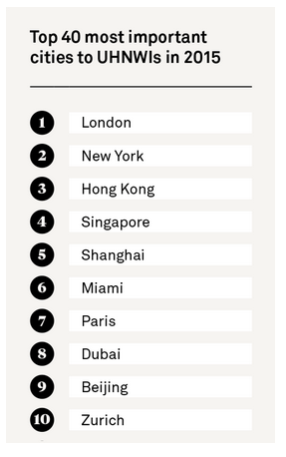
The Wealth Report
Cities considered the most important to the richest people. Wealth advisors and luxury property specialists were polled.
Criteria:
Economic activity
Political power
Knowledge and influence
Quality of life

Slide 6
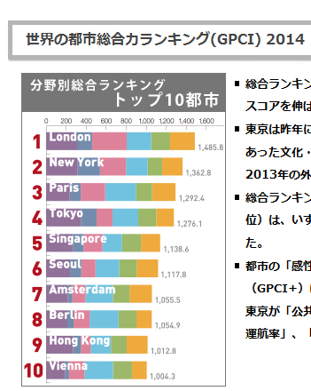
Global Power City Index
The Mori Memorial Foundation, Tokyo-based
6 categories:
Economy
Research and development
Cultural Interaction
Livability
Environment
Accessibility

Slide 7
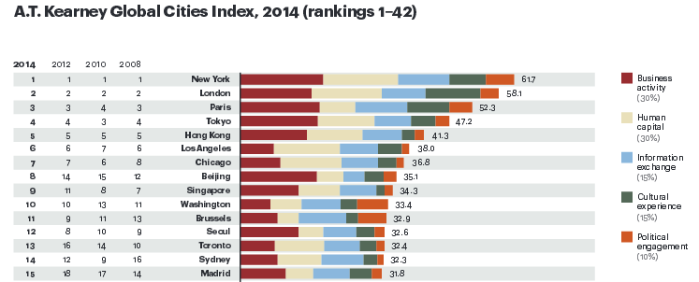
Global Cities Index
American journal (Foreign Policy) and Chicago-based entities, and consultants (Saskia Sassen and others)
26 criteria, and 5 dimensions
Business activity
Human capital
Information exchange
Cultural experience
Political engagement

Slide 8
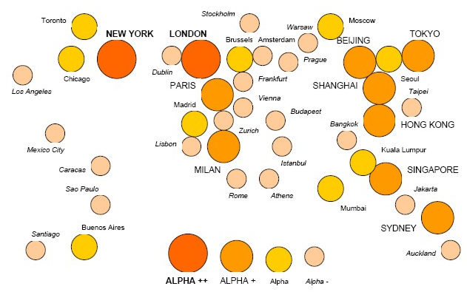
GaWC Study
Globalization and World Cities Research Network
Criterion = presence of 4 « advanced producer services »
Accountancy
Advertising
Banking, finance
Law

Slide 9
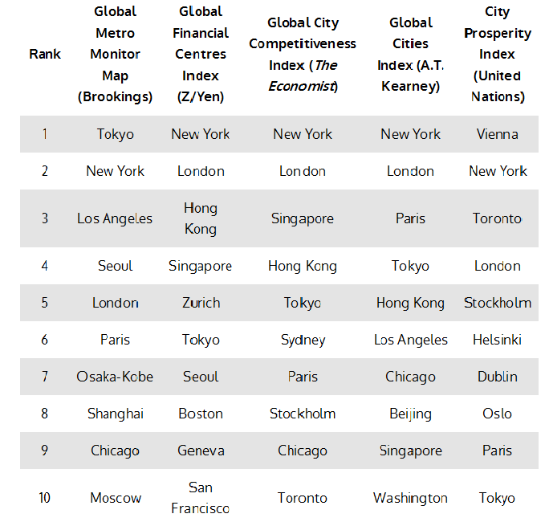
“Sorry, London: New York Is the World's Most Economically Powerful City.
Our new ranking puts the Big Apple firmly on top.”
Global City Economic Power Index
March 2015

Slide 10
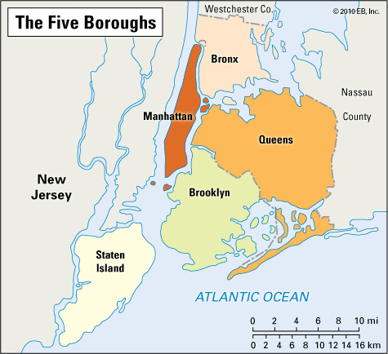
Introduction: New York? New York?
What territory are we talking about?
New York City = 8.5 million residents
Manhattan = 1.6

Slide 11
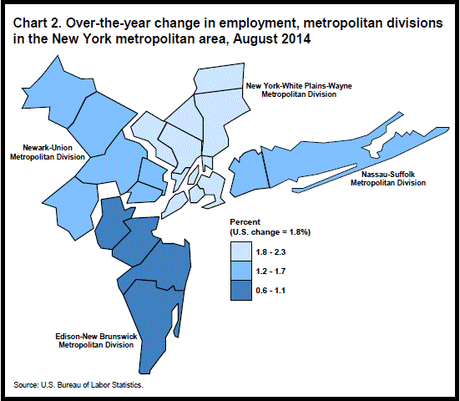
Metropolitan Statistical Area = MSA
18.8 million residents

Slide 12
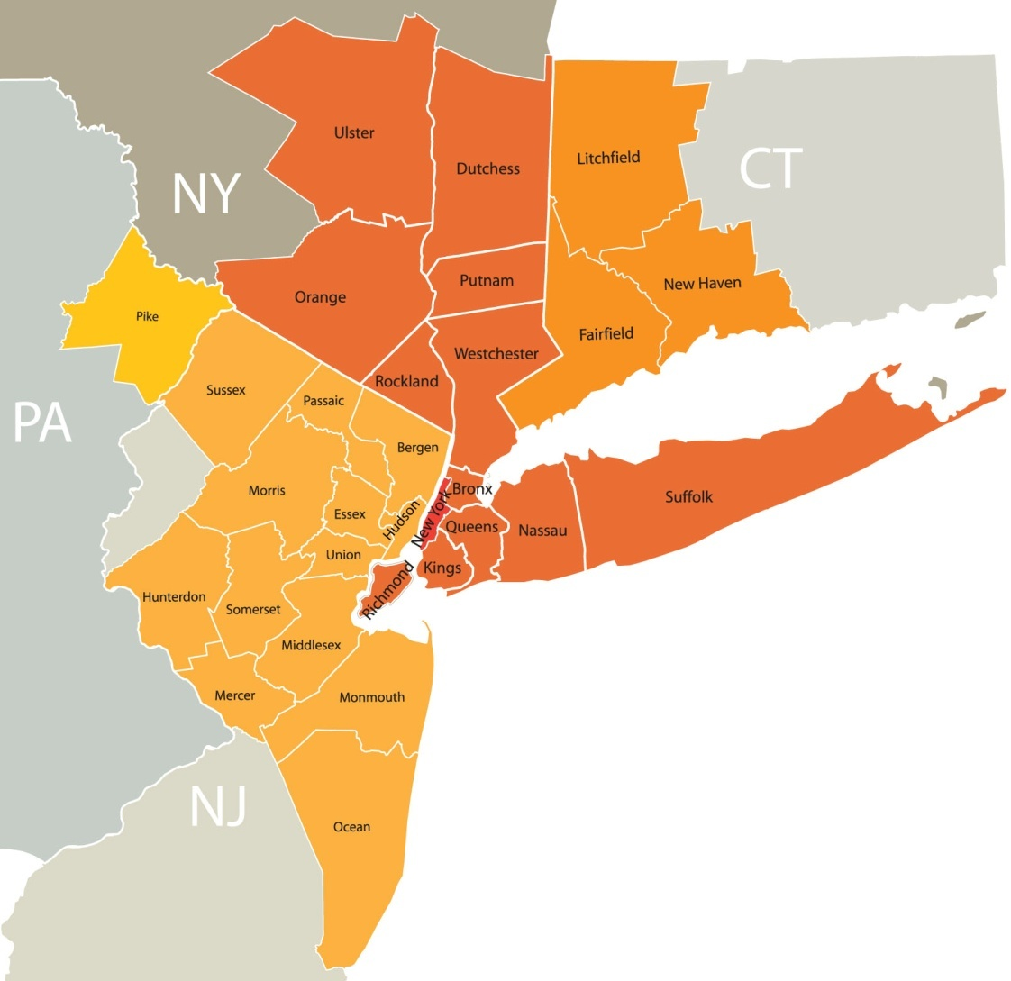
Combined Statistical Area = CSA
21.9 million

