Slide 1
Mapping the UK – part 2
2016-2017

Slide 2
2) The organization of space in the UK (economic perspective)
A) Mapping the population of the UK

Slide 3
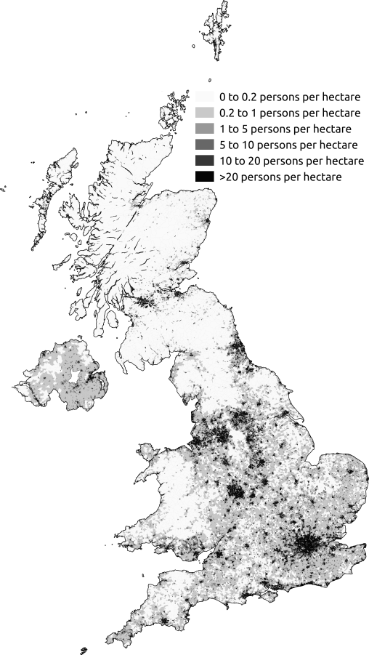
Map 1
Map of population density in the UK as at the 2011 census
April 2014
Author : Skate Tier
GNU Free Documentation License

Slide 4
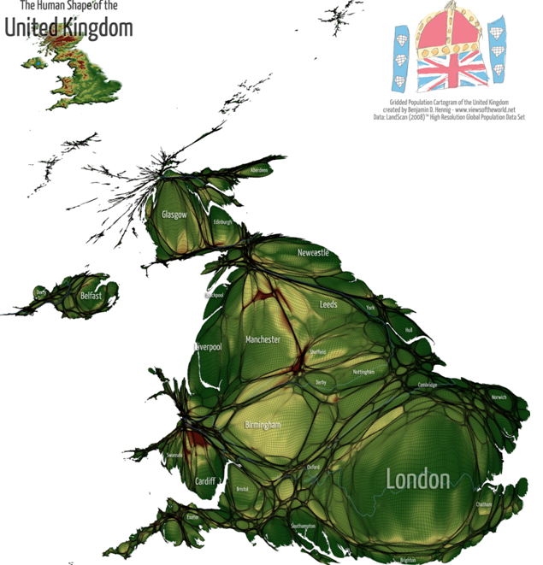
Map 2
Gridded population cartogram of the UK
Source/ author: Benjamin Hennig, geographer, Department of Geography, University of Sheffield
Gridded cartogram = distorted map used to show statistical data in a different light (more dramatic, intuitive, or understandable)

Slide 5
Key question: Why is the conventional map of population densities not satisfactory in the case of the UK?

Slide 6
A third of the population lives in 7 metropolitan counties
These 7 counties occupy only 3% of the land
These agglomerations are in the central core of Britain (from London to Liverpool)
This core is the Northern limit of the European Megalopolis

Slide 7
B) Mapping the North-South divide

Slide 8
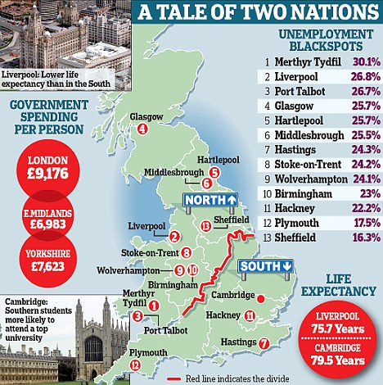
The Daily Telegraph, august 2010

Slide 9
Key question:
Is the North-South divide noticeable on maps?

Slide 10
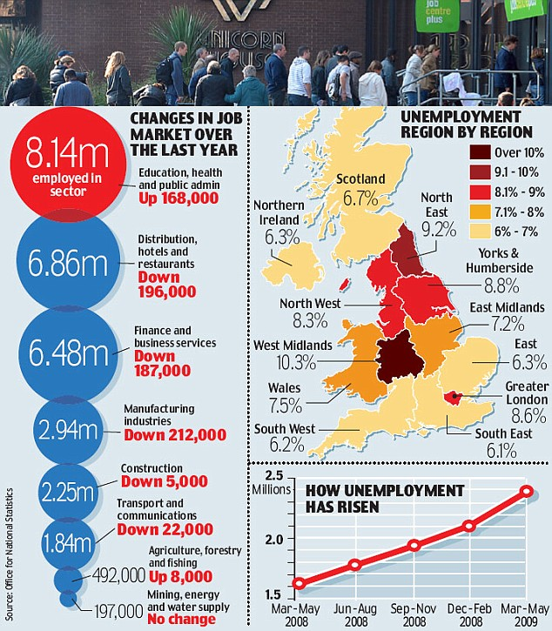
The Daily Telegraph, 2009 Source: Office for National Statistics

Slide 11
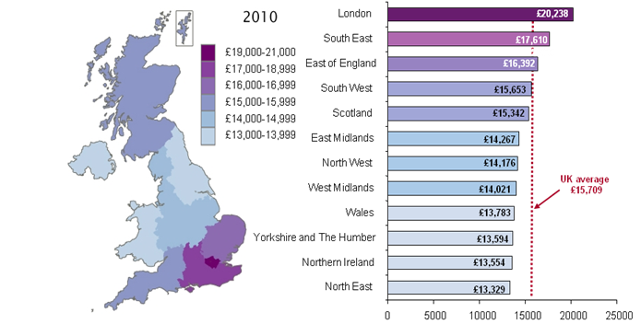
Regional Gross Disposable income per head, 2010 Office for National Statistics MAP C

Slide 12
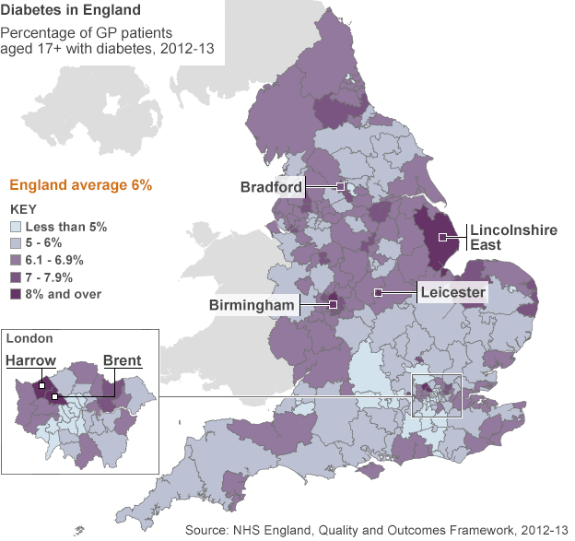
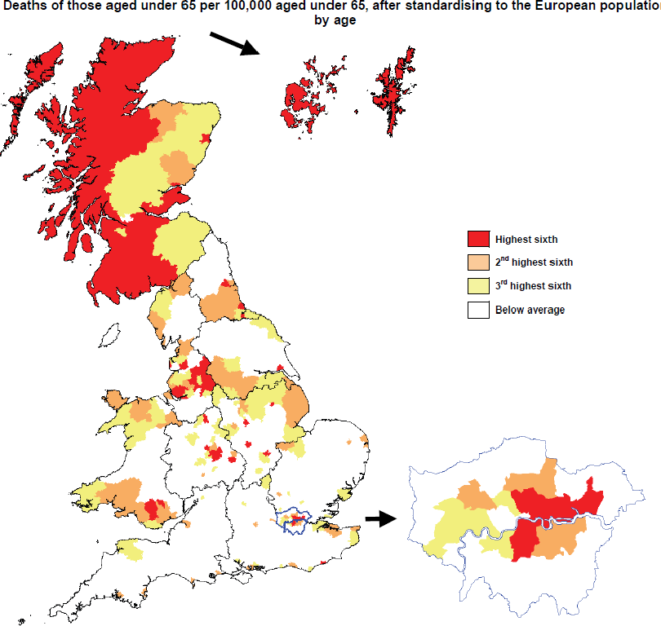
MAP B1 and B2

Slide 13
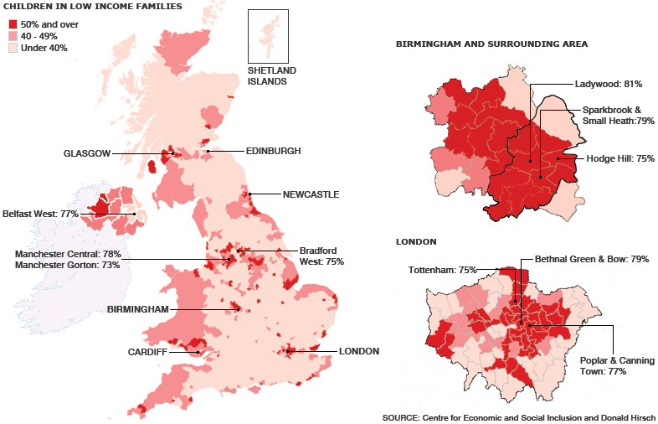
MAP A

Slide 14
C) Explaining the North-South divide with maps

Slide 15
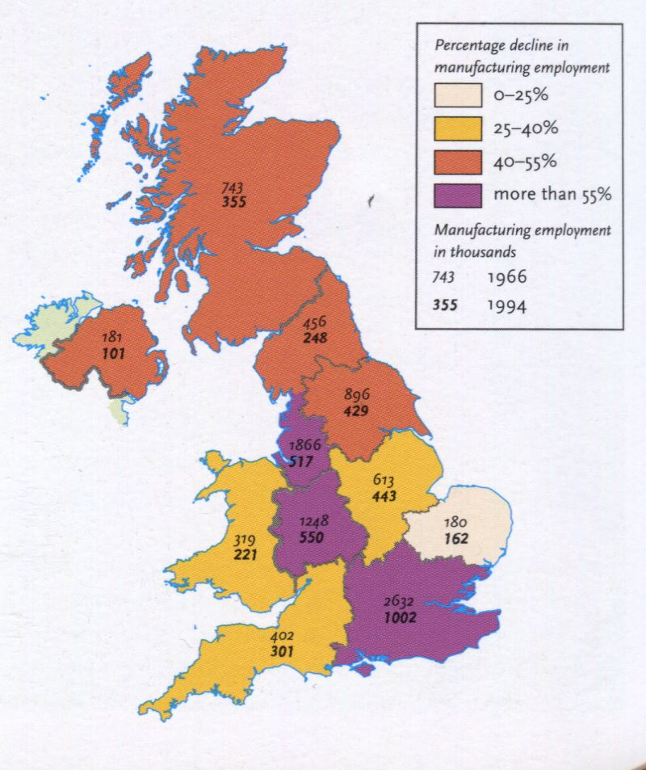
Map 1: deindustrialisation from 1966 to 1994

Slide 16
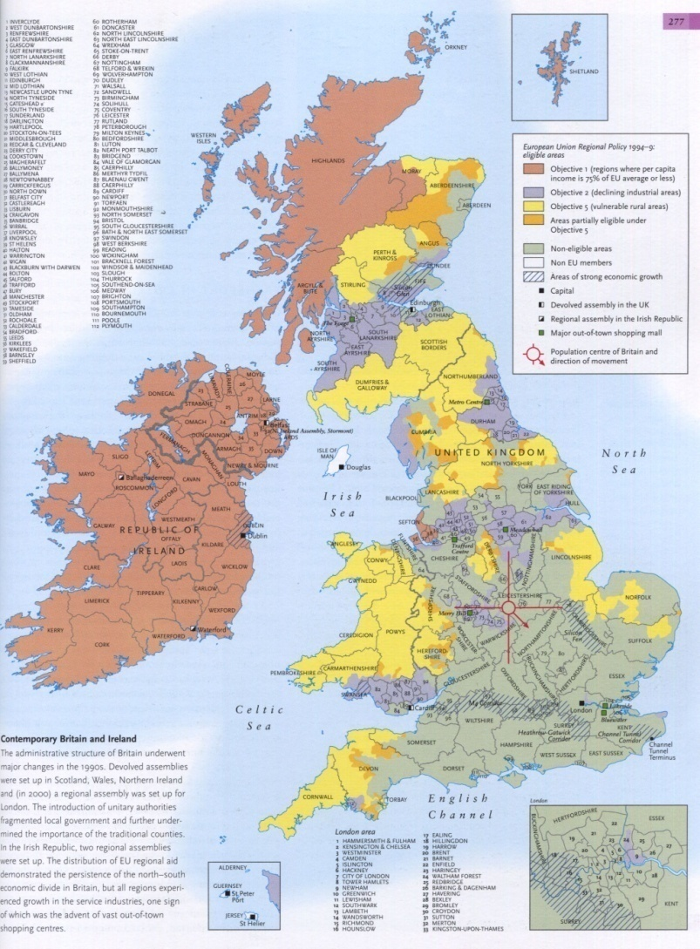
Map 2: European Union Regional Policy in the UK (1996-1999)

Slide 17
3) Mapping the migratory movements in the UK

Slide 18
Context:
About 7.5 million non-UK born residents in the UK; 13% of 63 million people
Illegal migrants = 400 000 to 850 000
A « British dream » that leads to massive migrations

Slide 19
A) The UK in the system of world mobility

Slide 20
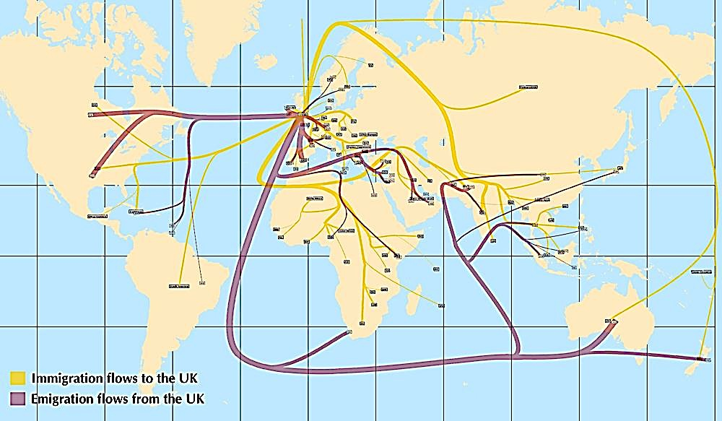
Map 1 : migrations to and from the UK, 2006

Slide 21
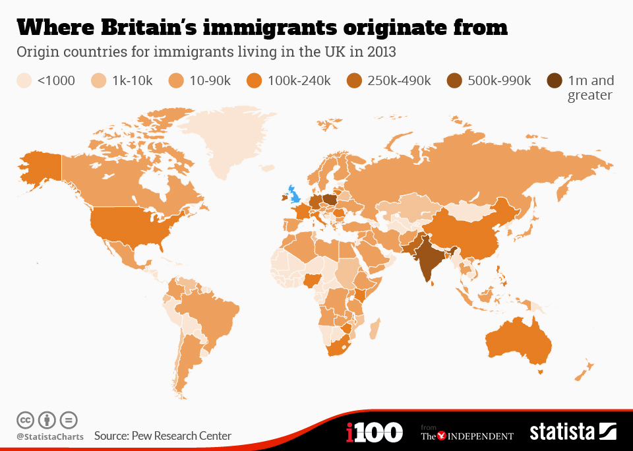

Slide 22
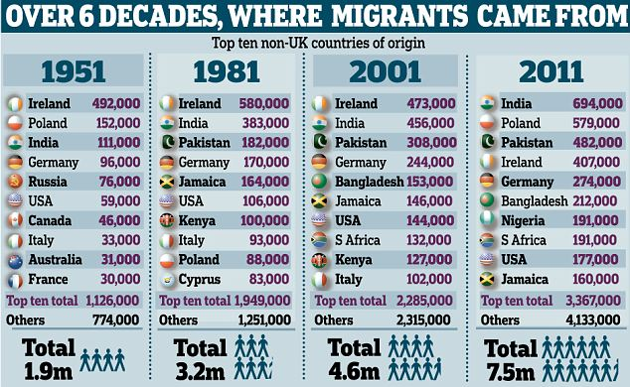
Source : Daily Mail

Slide 23
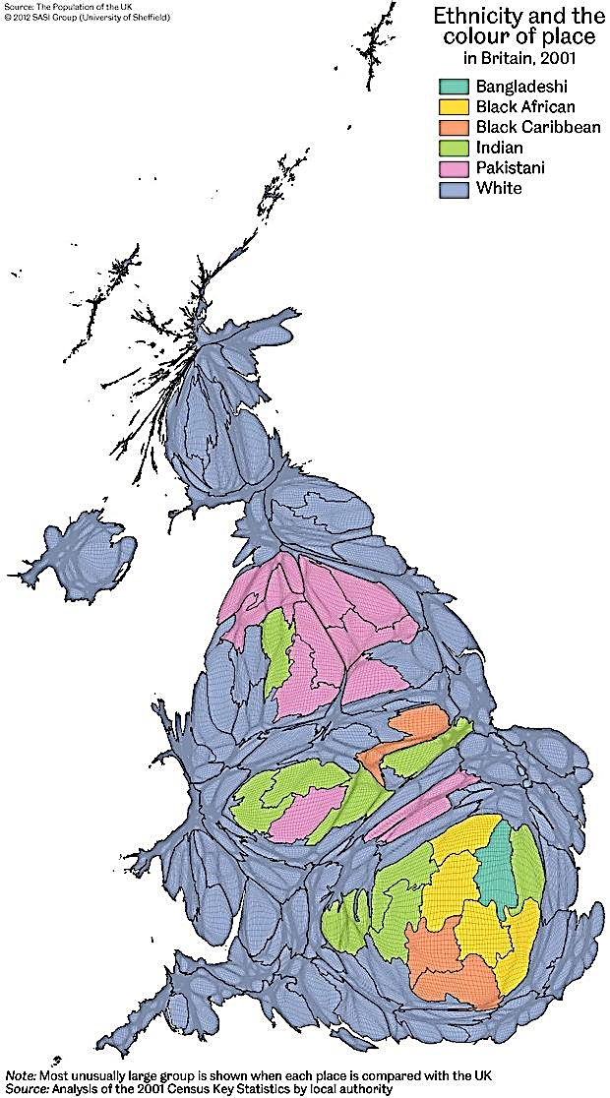
B) The integration of foreigners in the UK

Slide 24
British immigration system
Since 2006 = PBS (Points Based System)
Points for age, education, earnings, previous UK experience
Categories of people allowed: highly skilled individuals, skilled workers with a job offer, students, temporary workers
2011 = cap (about 20 000 people allowed in 2011)

Slide 25
Second source of migrations: asylum seekers

Slide 26
Third source of migrations: immigrations flows linked to European membership

Slide 27
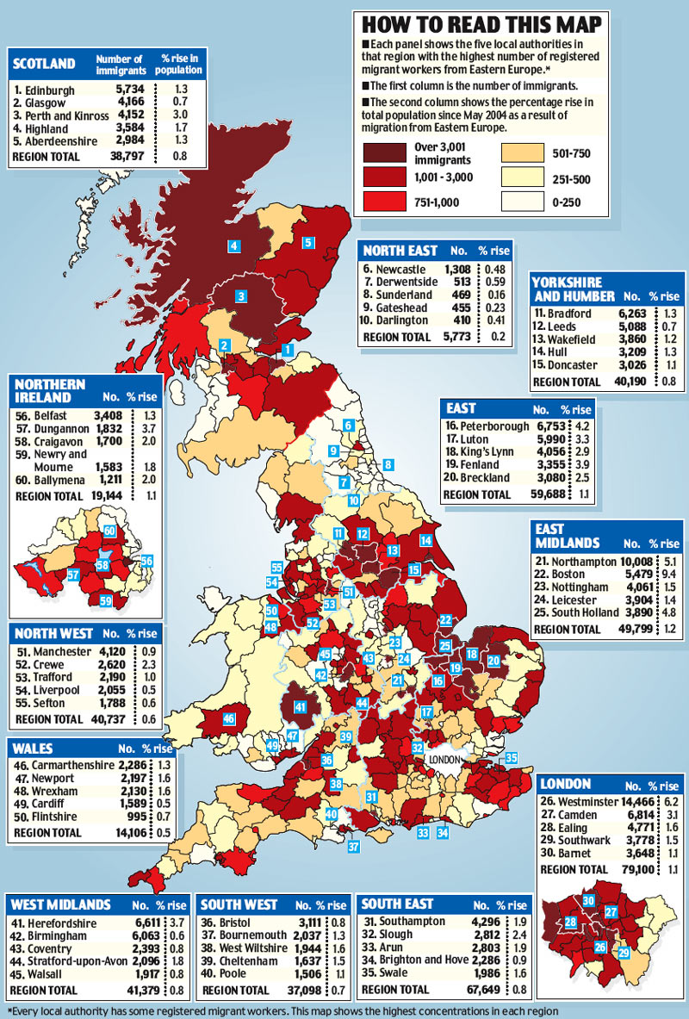

Slide 28
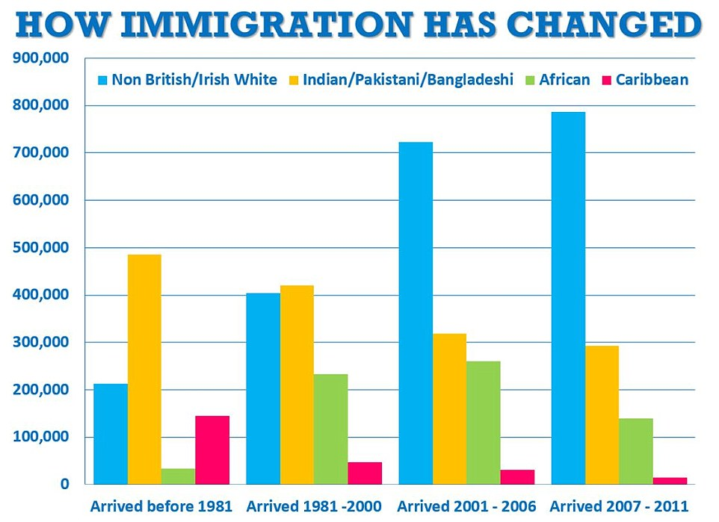
2004 = European Union enlargement; from 15 to 25 member states
Free movement of labour within the EU
Today, Polish citizens in the UK = 0.85 M people
Blamed for unemployment and low wages by part of the public opinion

Slide 30
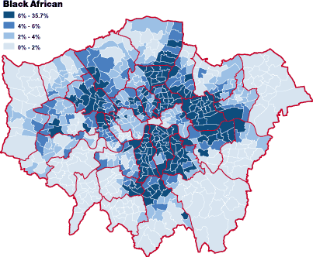
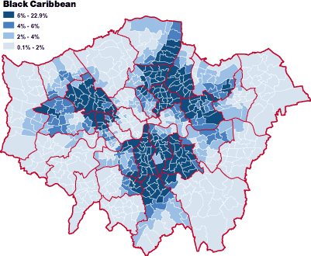
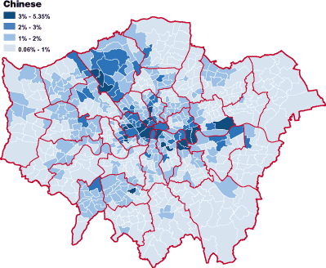

Slide 31
