Slide 1
Mapping the United Kingdom
Section européenne
2016-2017
Terminales
Géographique – Question 1

Slide 2
1) Mapping political issues of the UK (geopolitical and cultural perspectives)
Key issue: The UK, a disunited union?
One state, four nations

Slide 3
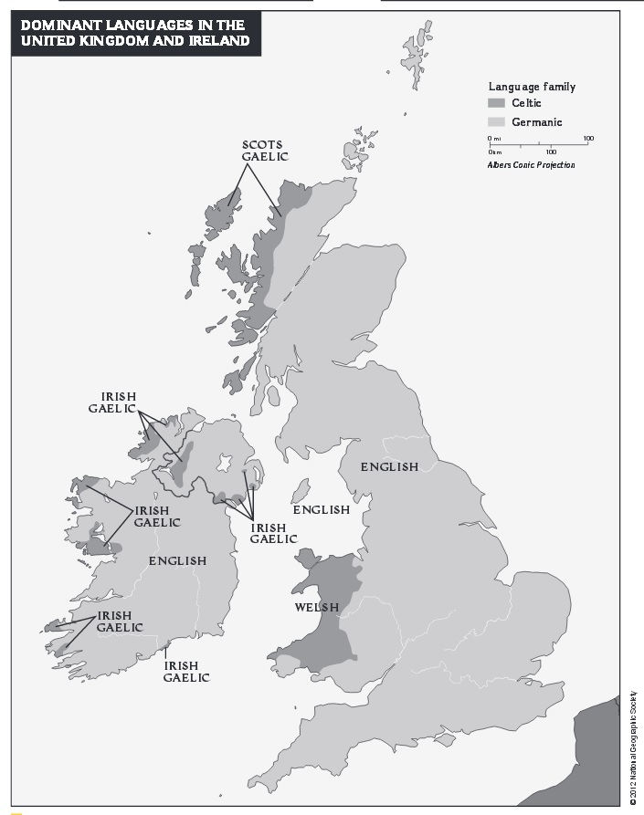
Map 1
Apply you critical mind to analyse map 1.

Slide 4
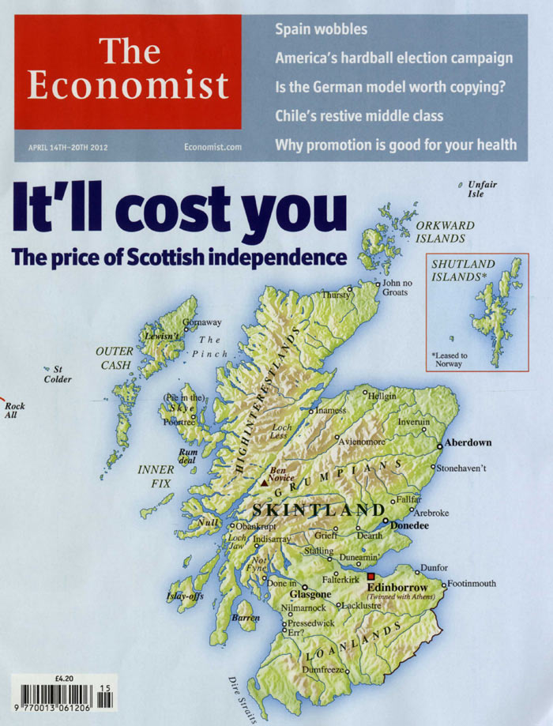

Slide 5
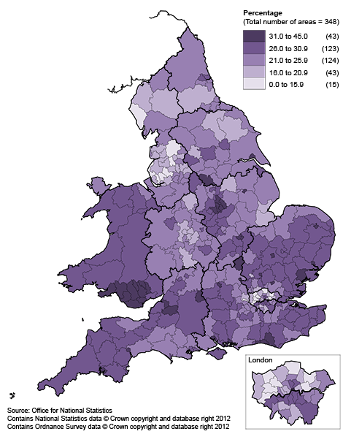
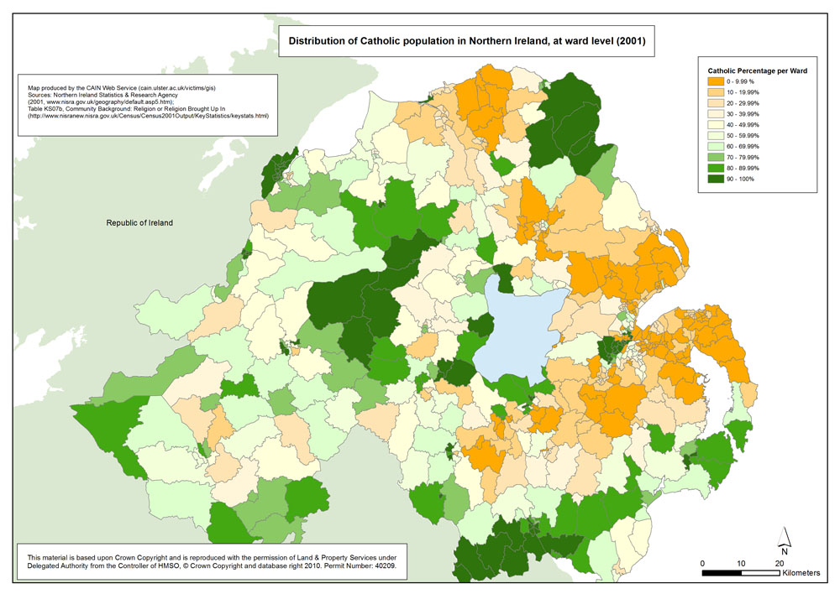
Population reporting no religion, 2011, England and Wales local and unitary authorities

Slide 6
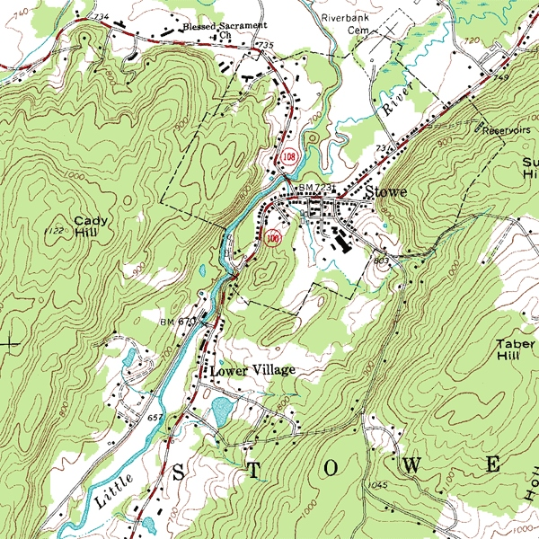
Topographic map
Contour lines = an imaginary line that joins places of equal height

Slide 7
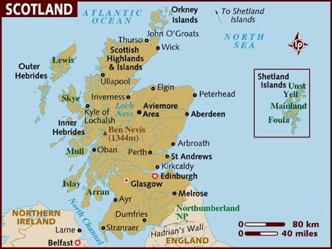

Slide 8
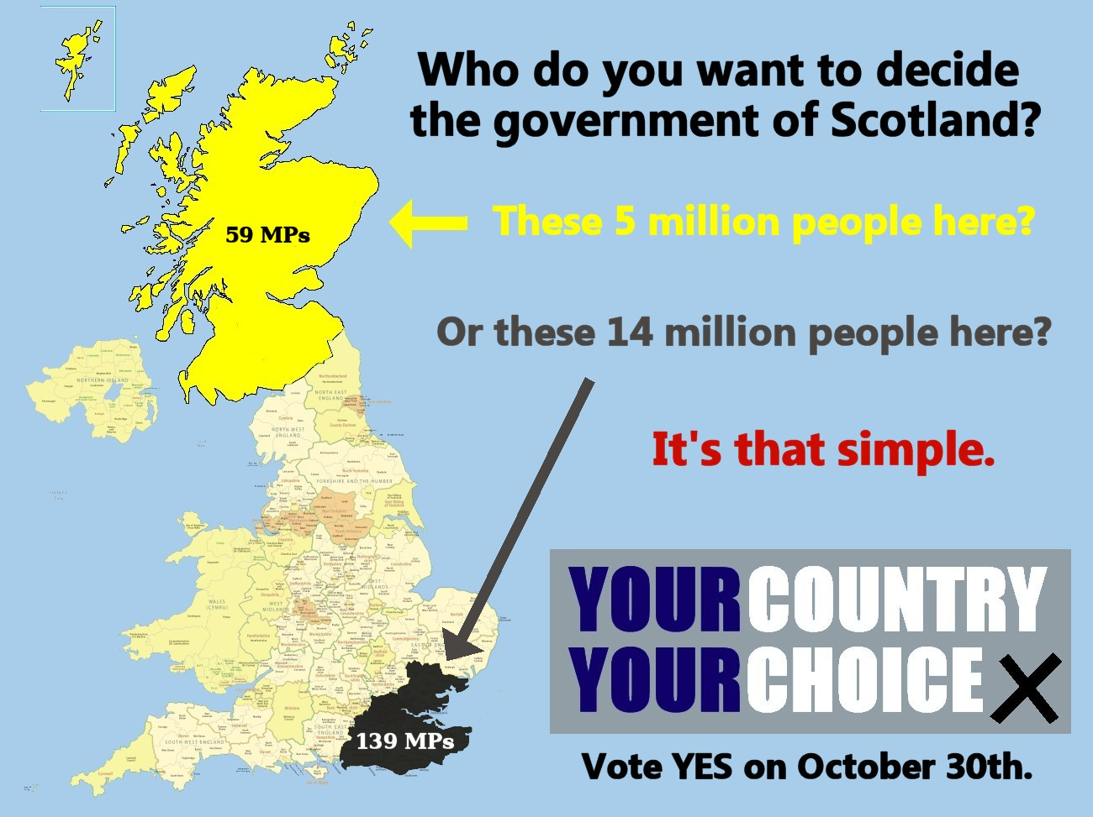

Slide 9
In response to the independentist movement:
Referendum in Scotland 1997 on devolution ( = décentralisation)
Scotland Act of 1998; Scottish Parliament and Scottish Executive established in 1999.
After 2007, it is called “Scottish Government” with a Scottish “First Minister”.
Today: Nicola Sturgeon
After the 2014 referendum , the Scotland Act of 2016 was voted, making the Scottish Parliament and Government permanent and granting them new powers.

Slide 10
Scotland powers since 2016
The Act devolves all powers except over matter it specifies as reserved matters.
Control of its electoral system
Control over the Scottish Railways, planning and nature conservation matters at sea (offshore industry, oil and gas), speed limits ...
Control over certain and removable taxes, the right to receive half of the VAT (= TVA) raised in Scotland
Ability to set Income Tax rates
Control over certain aspects of several welfare and housing related benefits

Slide 11
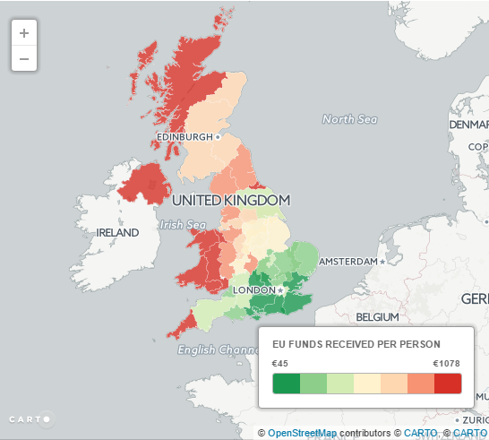
Scotland also has power over European funding
The Scottish Government is the Managing Authority for the European Regional Development Fund (ERDF) and European Social Fund (ESF) programmes.
The funds are focused on EU priorities in areas such as employment, innovation, education, poverty reduction and climate/energy. They also align with Scottish Government priorities.
Source: Scottish government official site (http://www.gov.scot/Topics/Business-Industry/support/17404)

Slide 12
Between 2014 and 2020, Scotland will receive over €900 million of funding through European Structural Fund programmes.
Funding from the 2007-2013 European Structural Fund programme supported almost 100,000 people into work, created over 40,000 jobs, supported over 80,000 enterprises and more than 17,000 new business start-ups.
Source: SNP (Scottish National Party) official site (http://www.snp.org/pb_how_does_scotland_benefit_from_eu_funding)

Slide 13
B) Mapping the relations between the UK and the rest of the world
Key question : How has the UK maintained a global status and influence ?

Slide 14
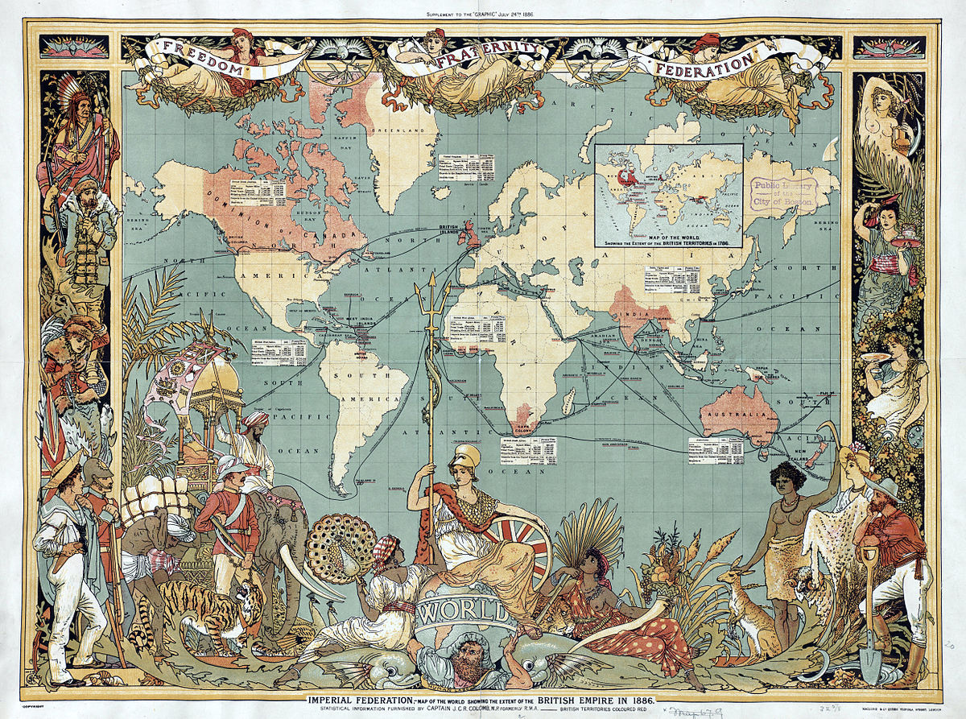
Is the UK still a global political power?

Slide 15
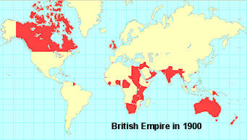

Slide 16
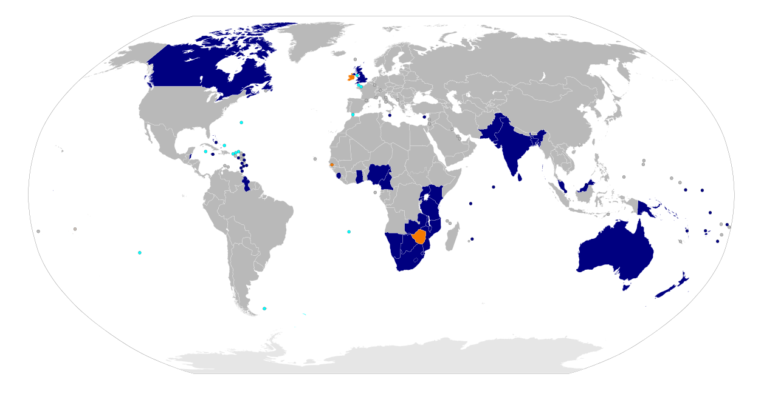
Map highlighting the member states of the Commonwealth (dark blue)
NB orange = former member states; light blue = overseas territories and crown dependencies

Slide 17
C) Mapping the relations between the UK and the European Union
Key question: Why is the UK a reluctant participant regarding European integration?

Slide 18
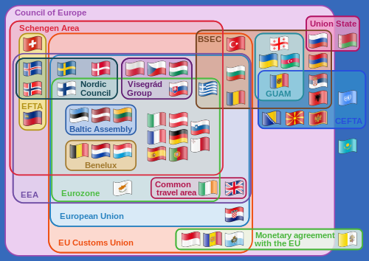
1) The UK and European bodies, so far

Slide 19
In a nutshell …
The British government accepts the country’s integration in a free trade area (good for the economy)
But political integration is turned down. The British government refuses to delegate powers to the EU (budget, borders, criminal justice system, …)

Slide 20
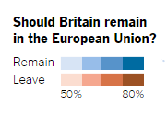
2) The results of the Brexit referendum
Source: Preliminary results data from the BBC, British Office of National Statistics (http://www.nytimes.com/interactive/2016/06/24/world/europe/how-britain-voted-brexit-referendum.html?_r=0/)

Slide 21
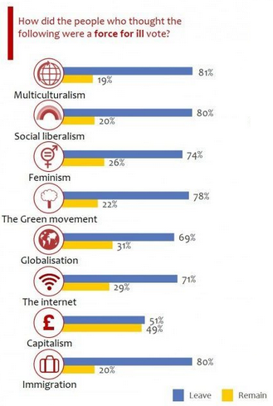
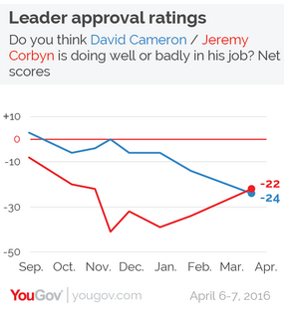
Source: http://lordashcroftpolls.com/2016/06/how-the-united-kingdom-voted-and-why/

Slide 22
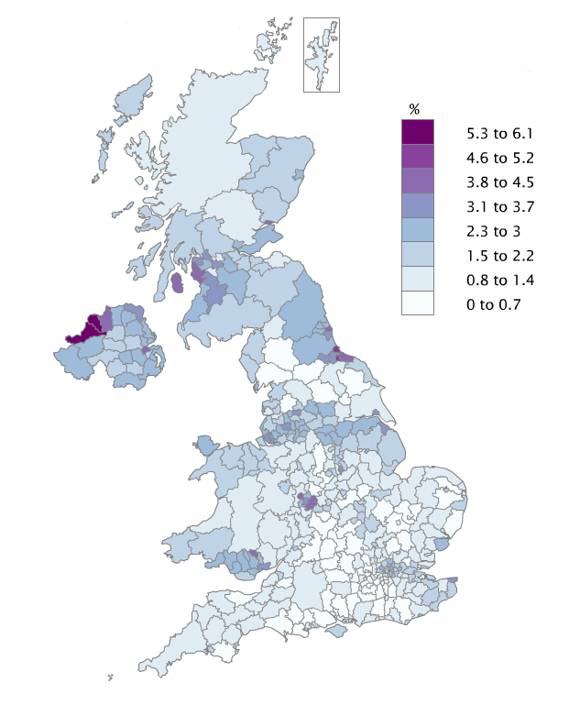
Claimant Count proportion of people aged 16 to 64 in local authorities in the UK
August 2016
NB = Jobless People claiming governmental help

Slide 23
Source: http://www.telegraph.co.uk/news/2016/06/22/eu-referendum-delia-smith-ulrika-jonsson-and-rick-edwards-on-lef/

Slide 24
https://www.theguardian.com/commentisfree/2016/sep/05/death-arkadiusz-jozwik-post-referendum-racism-xenophobes-brexit-vote
The Guardian, september 2016

Slide 26
