Slide 1

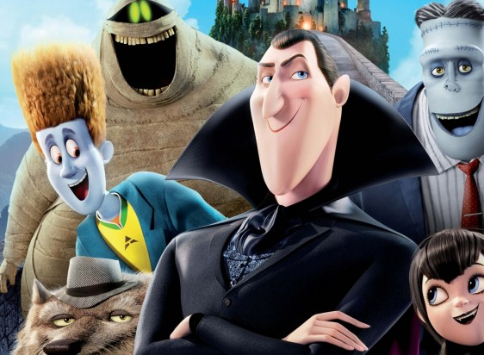
English class
Friday, March 27th

Slide 2

Résumé de l’épisode précédent (mercredi 25)
Correction des activités du mardi 24.
Travail sur les personnages d’Hôtel Transylvanie.

Slide 3
Avant de commencer :
Relire les leçons et exercices précédents.
Refaire des activités de révision du vocabulaire.
Avoir son cahier, de quoi noter, de quoi vérifier le vocabulaire (dictionnaire en ligne ou papier).
Liens utiles :
Vos séances sur mon blog.
Un bon dictionnaire en ligne
Le vocabulaire de la famille sur Quizlet
Je vous rappelle que vous pouvez vous inscrire gratuitement sur votre espace classe Quizlet avec ce lien.

Slide 4
Today
Activities and exercises correction (Wednesday 25).
Continue to work with Hotel Transylvania characters!

Slide 5
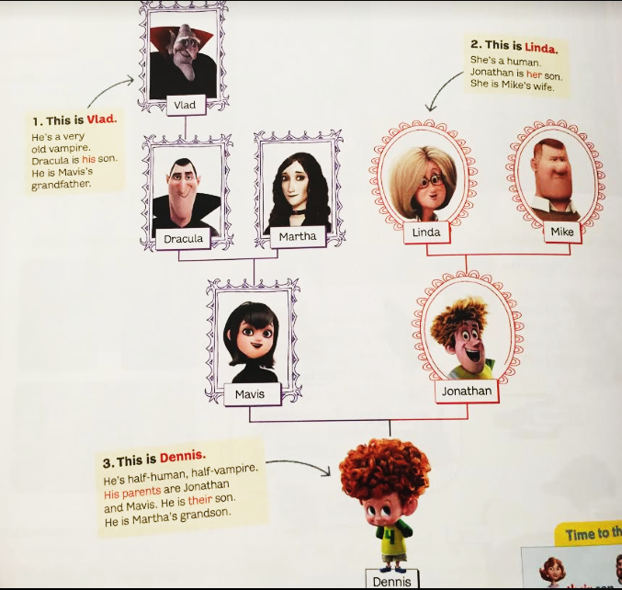
Correction

Slide 6
Quelques exemples
HAVE GOT = HAVE
C’est une manière plus naturelle d’exprimer les liens de parenté ou la possession.
Forme affirmative au présent :
I have got
You have got
He, she, it has got
We have got
You have got
They have got
Forme négative :
I haven’t got your keys.
Forme interrogative:
Have you got a sister?
Dracula has got a father. His name is Vlad. Dracula is Vlad’s son.
Mavis has got a mother-in-law. Her name is Linda. Mavis is Linda’s daughter-in-law.
Linda has got a son. His name is Jonathan. Linda is Jonathan’s mother.
Jonathan has got a wife. Her name is Mavis. Jonathan is Mavis’s husband.

Slide 7
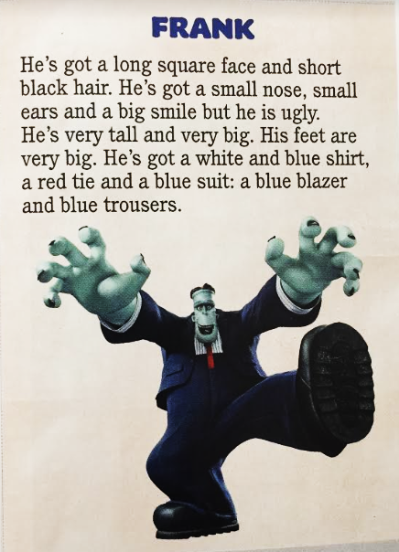

A family portrait
1) Listen to Frank’s description as you read the text.
2) Write down the words related to physical description in the text. Do you remember their meaning?

Slide 8
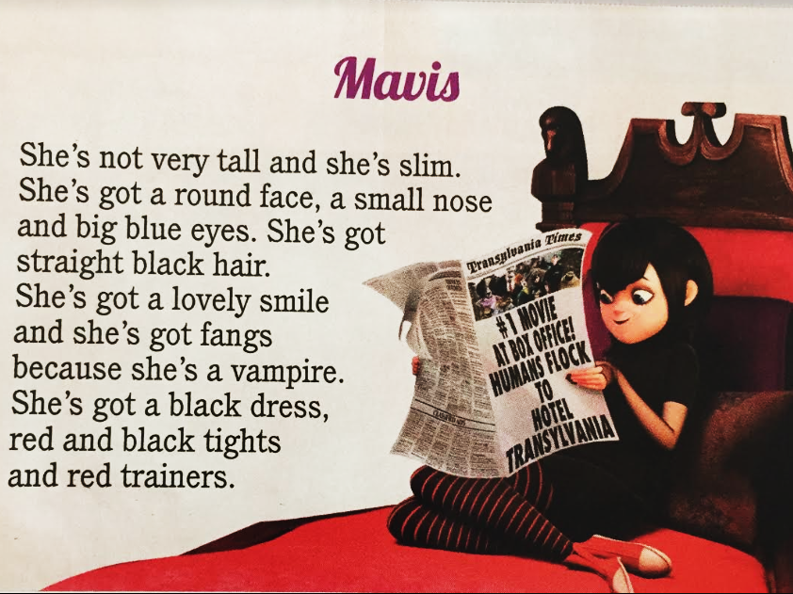
A family portrait
1) Listen to Mavis’s description as you read the text.
2) Write down the words related to physical description in the text. Do you remember their meaning?

Slide 9
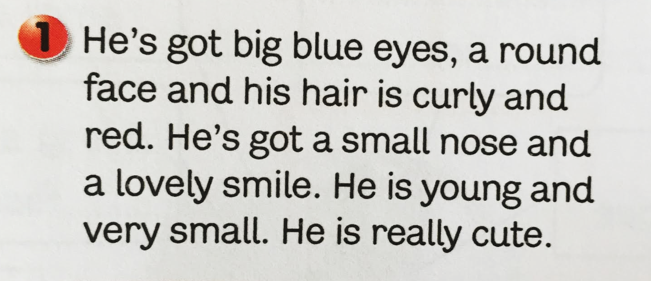
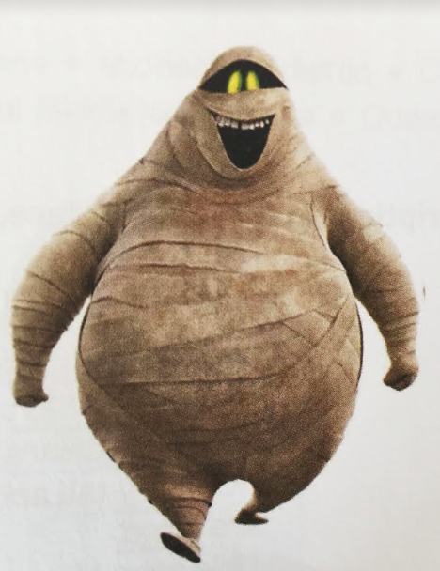
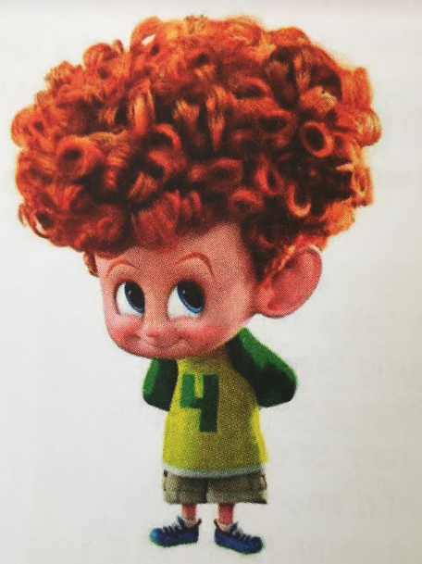
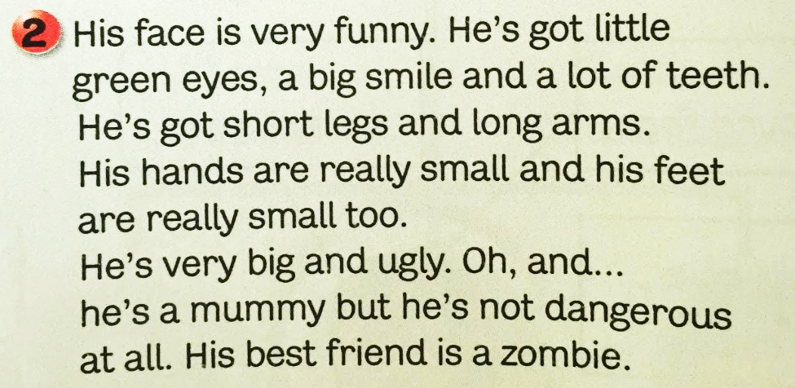
A family portrait
Which text describes Murray?
Which text describes Dennis?
MURRAY
DENNIS

Slide 10
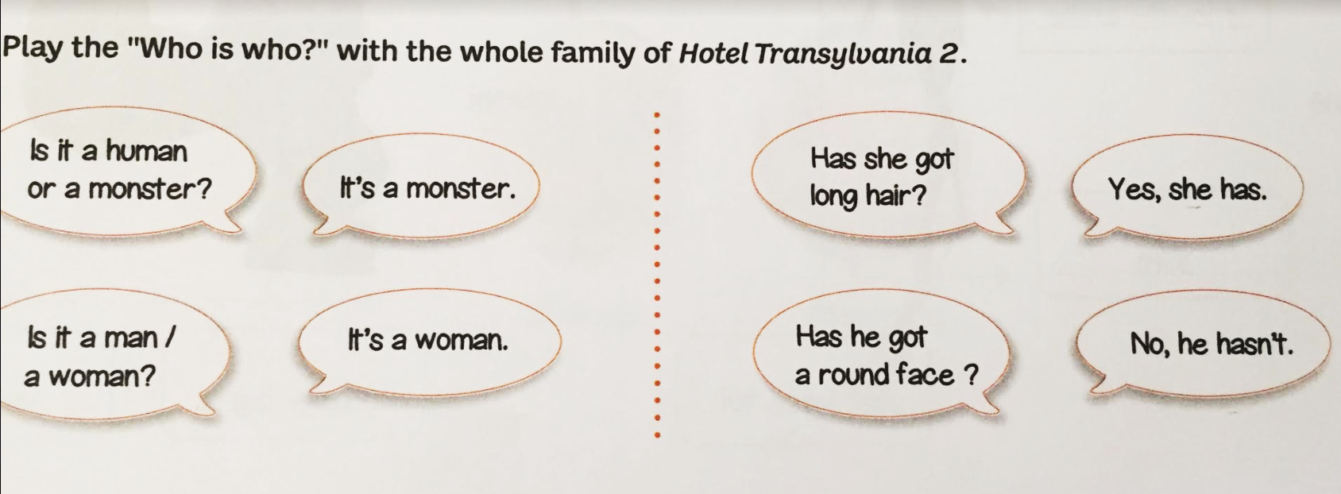
A family portrait – Who’s who?
We will play together, but you can practise with your classmates on the phone or with your family. Go to the next pages to see the characters!

Slide 11
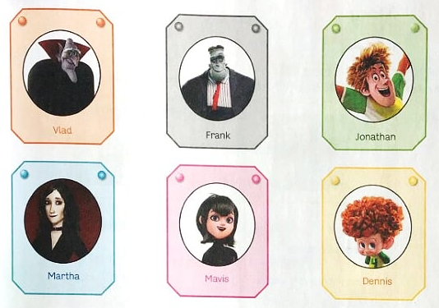

Slide 12
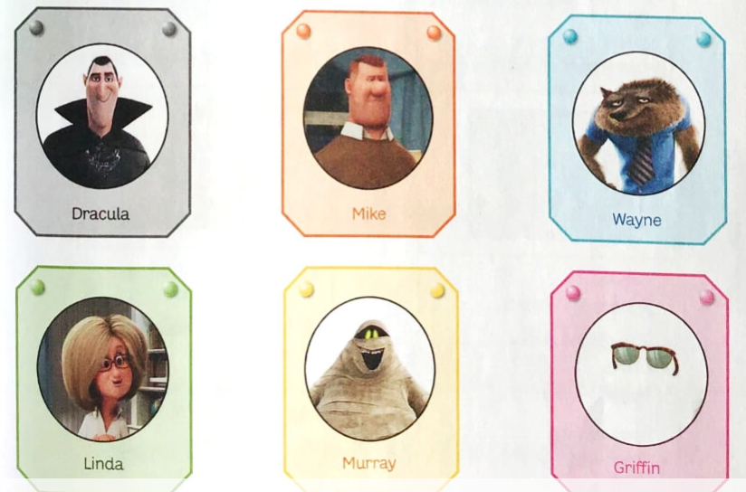

Slide 13

That’s all for today! See you next time.

