Slide 1

English class
Friday, March 27th

Slide 2

Résumé de l’épisode précédent (mardi 24)
Correction des activités et exercices du lundi 23.
Compréhension audiovisuelle.

Slide 3
Avant de commencer :
Relire les leçons et exercices précédents.
Refaire des activités de révision du vocabulaire.
Avoir son cahier, de quoi noter, de quoi rechercher / vérifier le vocabulaire (dictionnaire en ligne ou papier).
Liens utiles :
Vos séances sur le blog
Un bon dictionnaire en ligne
Le vocabulaire du crime sur Quizlet

Slide 4
Today
Activities and exercises correction.
Grammar: think and practice.

Slide 5

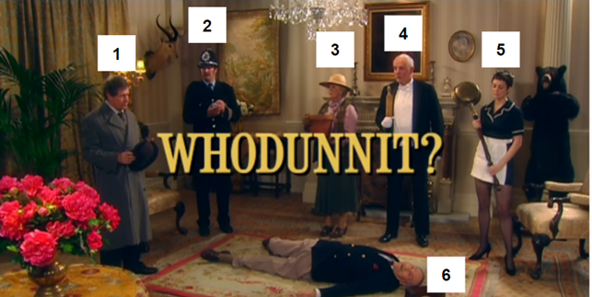
Activities and exercises correction.

Slide 6
Correction
Watch the video and take notes about the situation.
There was a murder. The corpse of the victim is on the floor. There are an inspector (or a detective) and a policeman. The inspector questions the suspects and the suspects tell their alibis. The lady with the hat is the culprit. Since the curtains are closed and the lights are on, we can imagine that the scene takes place during the evening or at night.

Slide 7
Correction
Who are the characters?
1 : a police inspector
2 : a policeman (a police officer ; a cop)
3 : Lady Smithe (the wife of the victim)
4 : a butler
5 : a maid
6 : Lord Smithe (the victim)

Slide 8
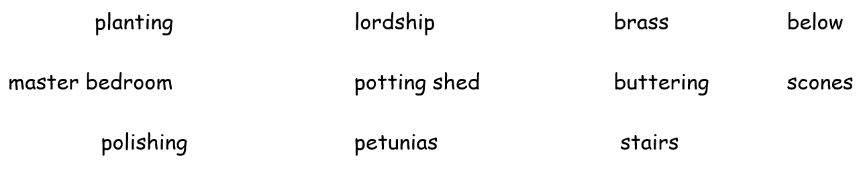






Correction
Listen and:
Circle in RED what [ 3 ] says.
Circle in BLUE what [ 4 ] says.
Circle in GREEN what [ 5 ] says.

Slide 9
Correction
Write down the suspects’ alibis.
Lady Smithe was planting petunias in the potting shed.
The butler was buttering scones for his lordship below stairs.
The maid was polishing brass in the master bedroom .
Who is the culprit according to the inspector?
According to the inspector, Lady Smithe is guilty.
How did he find out the culprit?
Lady Smithe said that she was planting petunias but you cannot plant petunias until May. It was way too early for this! Lady Smithe lied, she must have killed Lord Smithe.

Slide 10

Grammar

Slide 11
Observe:
Lady Smithe was planting petunias in the potting shed.
The butler was buttering scones for his lordship below stairs.
The maid was polishing brass in the master bedroom .
What types of action are being described?

Slide 12
Write the lesson
LE PRETERIT EN BE + V-ING
On utilise le prétérit en BE+ V-ING pour parler de ce que l’on faisait à un moment du passé.
Yesterday at 5:30, I was watching television in my room.
Une action en cours de déroulement dans le passé peut être interrompue par une autre action ponctuelle. L’action longue est alors conjuguée au prétérit en BE + V-ING et l’action brève est conjuguée au prétérit simple.
They were sleeping when they heard a strange noise.
Prétérit en BE + V-ING :
On conjugue l’auxiliaire BE au prétérit simple et on ajoute la base verbale avec le suffixe –ing.
WATCH:
I was watching.

Slide 13
Write the lesson
Forme affirmative :
I / he / she / it was cooking at the time of the murder.
You / we/ they were playing with the children at the time of the murder.
Forme négative :
I / he / she / it wasn’t getting the post at the time of the murder.
You / we / they weren’t preparing the meal at the time of the murder.
Forme interrogative :
Was I / he / she / it planting flowers at the time of the murder?
Were you / we / they talking to the neighbour at the time of the murder?

Slide 14
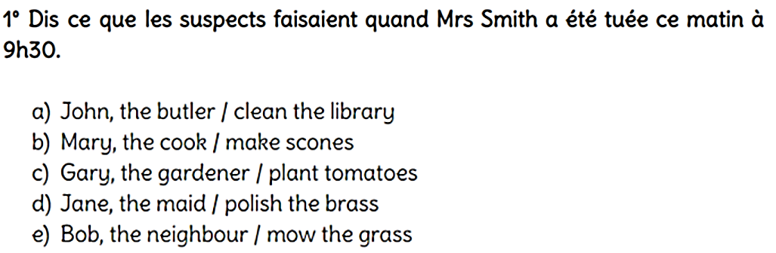
Do the exercises in your copybook

Slide 15
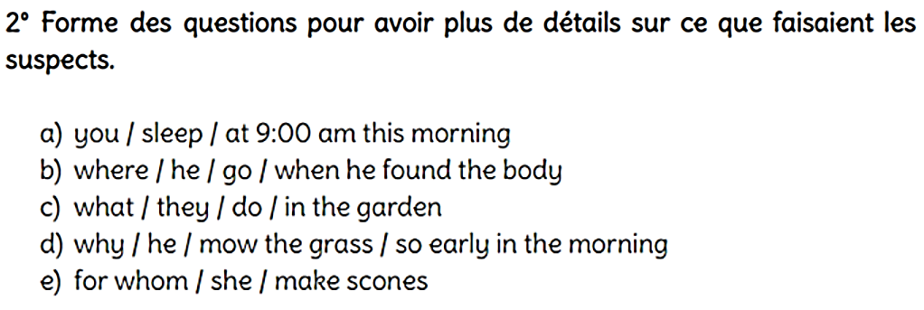
Do the exercises in your copybook

Slide 16
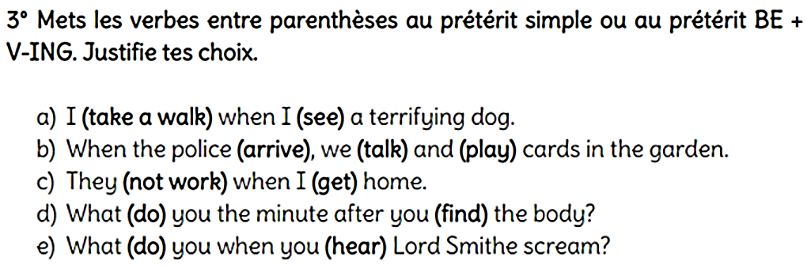
Do the exercises in your copybook

Slide 17
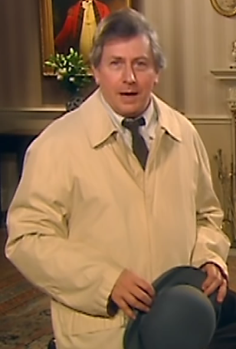
For Monday 30
Read the lessons and corrections.
Redo the activities and exercises that you did not understand.

Slide 18


