Slide 1

English class
Tuesday, March 24th

Slide 2

Résumé de l’épisode précédent (lundi 23)
Correction des activités et exercices du vendredi 20.
Une nouvelle énigme policière à résoudre.
Réflexion grammaticale.

Slide 3
Avant de commencer :
Relire les leçons et exercices précédents.
Refaire des activités de révision du vocabulaire.
Avoir son cahier, de quoi noter, de quoi vérifier le vocabulaire (dictionnaire en ligne ou papier).
Liens utiles :
Vos séances sur le blog
Un bon dictionnaire en ligne
Le vocabulaire du crime sur Quizlet

Slide 4
Today
Activities and exercises correction.
Understanding a video.

Slide 5
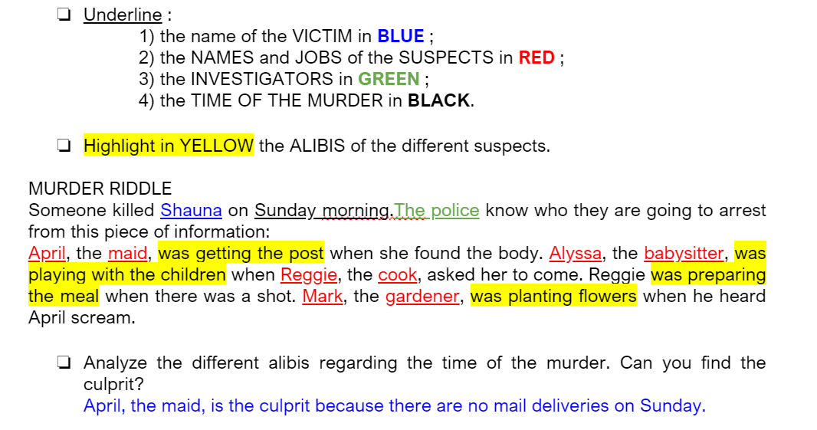
Correction: who killed Shauna?

Slide 6
Correction: thinking about grammar
Look at the verbs in red. In your opinion, what type of action do they describe?
Someone killed Shauna on Sunday morning. The police know who they are going to arrest from this piece of information:
April, the maid, was getting the post when she found the body. Alyssa, the babysitter, was playing with the children when Reggie, the cook, asked her to come. Reggie was preparing the meal when there was a shot. Mark, the gardener, was planting flowers when he heard April scream.
These verbs are describing something that was in progress around a particular time in the past.

Slide 7
Understanding a video – Step 1
Watch the video (next page).

Slide 8
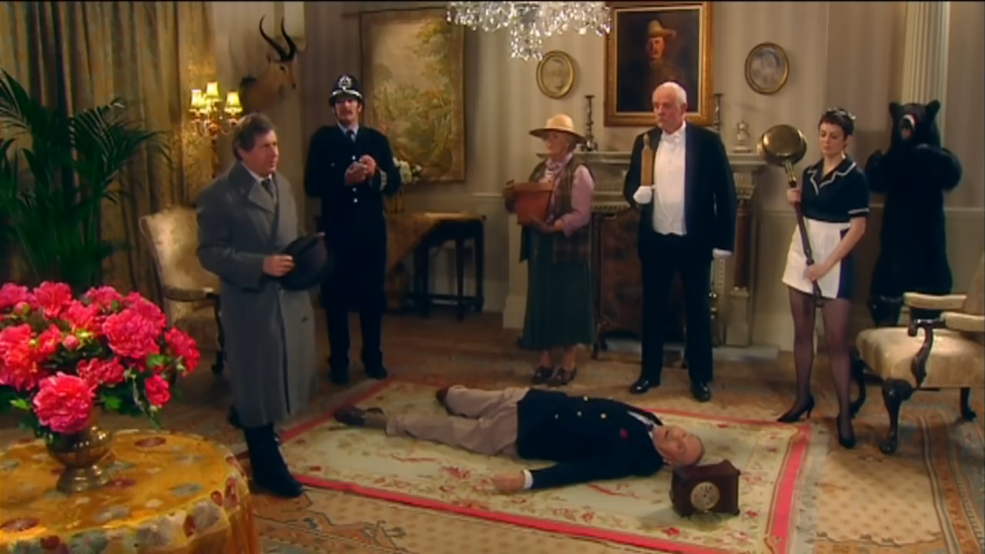

Slide 9
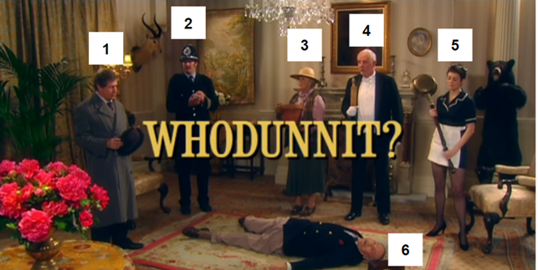
Understanding a video – Step 2
Watch the video again and :
Take notes about the situation.
Say who the characters are:
1 ……………………………………….
2 ……………………………………….
3 ……………………………………….
4 ……………………………………….
5 ……………………………………….
6 ……………………………………….

Slide 10



Understanding a video – Step 3
Watch the video again and:
Circle in RED what [ 3 ] says.
Circle in BLUE what [ 4 ] says.
Circle in GREEN what [ 5 ] says.
planting lordship brass below
master bedroom potting shed buttering scones
polishing petunias stairs

Slide 11
Understanding a video – Step 4
If you need it, you can watch the video again.
Answer these questions:
Write down the suspects’ alibis.
Who is the culprit according to the inspector?
How did he find out the culprit?

Slide 12
Are you a good detective?
Did you notice any changes between the beginning and the end of the video? If not, you can watch the video again.
Write down the changes you noticed.

Slide 13
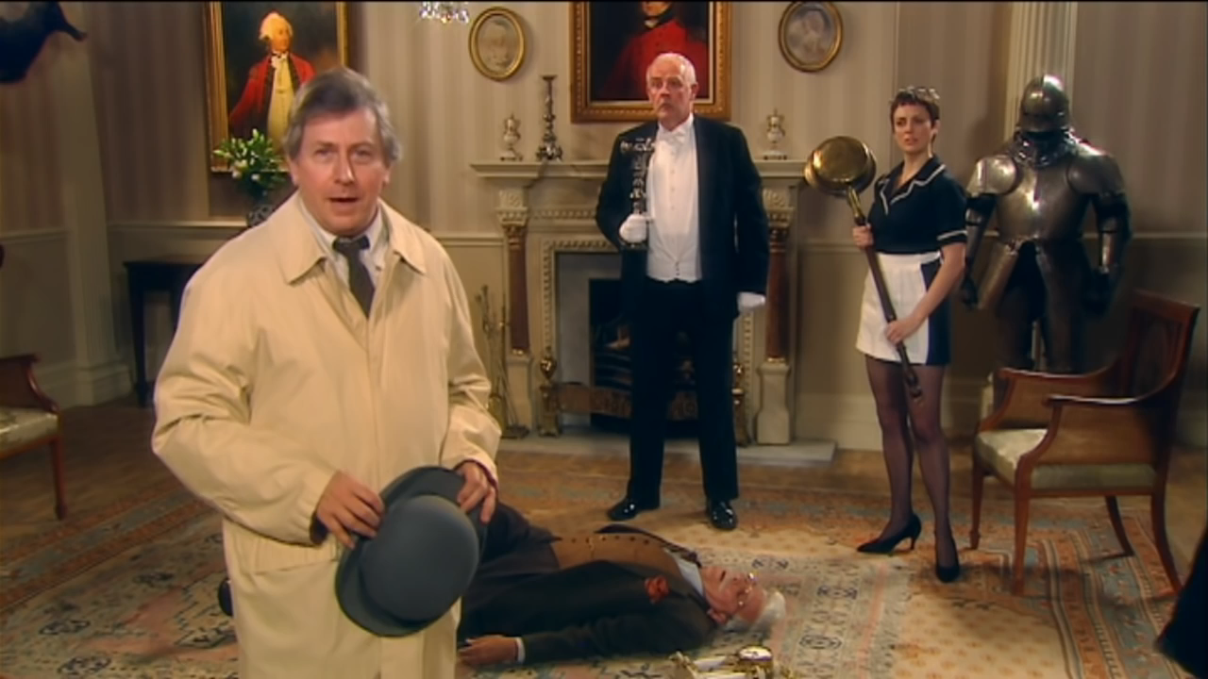
Now, find out what you missed!

Slide 14
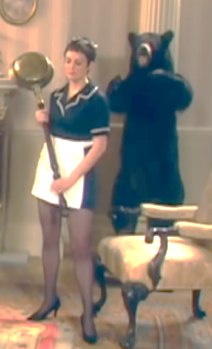
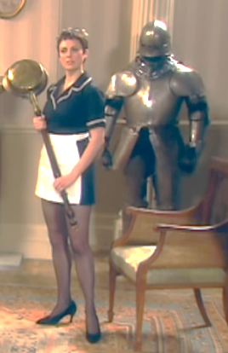


For Friday 27
Gotcha.
Read the lessons and corrections.
Redo the activities and exercises that you did not understand.

Slide 15


