Slide 1

5°3
English
Semaine du 4 au 8 mai

Slide 2
Liens utiles
Les séances précédentes sur le blog.
Un bon dictionnaire en ligne.
Votre espace Quizlet.

Slide 3
Découpage du travail de la semaine. | Temps de travail conseillé.
Etape 1 Page 4 (révisions sur Kahoot et Quizlet) | 20 minutes.
Etape 2 Pages 5 à 13 (correction des activités précédentes) | 30 minutes.
Etape 3 Pages 14 à 17 (another murder riddle) | 40 minutes.
Etape 4 Pages 18 à 21 (video comprehension) | 30 minutes.
1
2
3
4
Retour : découpage séances.

Slide 4

Révise les notions des séances précédentes.
1
Joue à Kahoot (code d’accès : 0814117).
Joue à Quizlet :
Irregular verbs
Crime vocabulary – Actions
Crime vocabulary – Persons
Crime vocabulary – Objects and places
Retour : découpage séances.

Slide 5
Vérifie la correction des activités précédentes.
2
Exemple de description de l’image tirée de Brooklyn Nine Nine.
Qu’a-t-il pu se passer avant cette scène ?
Exercice de révision du prétérit simple.
Le rapport pour le shérif.
Nier les affirmations de la police.
Être témoin d’une scène.
Le son « ED ».
L’énigme policière.
Retour : découpage séances.

Slide 6
Vérifie la correction des activités précédentes.
2
Exemple de description de l’image :
This is a screen capture from a TV series called Brooklyn Nine Nine.
There is a man standing in front of another man and perhaps more people.
The man who is standing is probably an American police officer. Indeed, he is wearing a police badge and there is the US flag in the background. He may be in a police station.
The TV screen on the left shows a black-haired man standing in front of a suspects wall. There are also two other pictures on the TV screen: one with the same black-haired man walking through a public place and one with a briefcase. The black-haired man may be a suspect or even a criminal.
Retour : découpage séances.

Slide 7
Vérifie la correction des activités précédentes.
2
Imaginer ce qui a pu se passer avant la scène que l'on voit sur l'image.
Yesterday, a black-haired man was in New York. He stole a briefcase full of money and tried to run away. Police officers were there so they caught him and arrested him. They brought him to the police station and took his picture in front of a suspects wall. They interrogated the suspect but he said that he was innocent.
Retour : découpage séances.

Slide 8
Vérifie la correction des activités précédentes.
2
Exercice de révision du prétérit simple :
Les verbes irréguliers à souligner étaient : FIND – HAVE – BE
Yesterday, we arrived at the crime scene.
We investigated but we did not find any clues.
The sheriff called me and asked about the case.
The suspect had a lot of money in his briefcase.
The suspect was in New York.
The police officers arrested the suspect.
Retour : découpage séances.

Slide 9
Vérifie la correction des activités précédentes.
2
Le rapport pour le shérif :
Yesterday, I received a phone call from Miss Bee. She was afraid.​
She told me that she needed to talk to a police officer.​
“He had a gun!” she said. ​
“He was tall with short brown hair.”​
She called the police at 10 p.m. and a patrol arrived at 10.10 p.m. ​
They took her testimony and went back to the police station.​
Retour : découpage séances.

Slide 10
Vérifie la correction des activités précédentes.
2
Nier les affirmations de la police :
He was not my friend.
I did not (didn’t) kill Colonel Mustard.
I didn’t change my identity.
I didn’t go to the bank and I didn’t steal the money.
I didn’t witness the scene.
I didn’t call the victim right before he disappeared.
I didn’t escape the crime scene.
I didn’t hide the weapon.
I didn’t trap the victim.
I didn’t want to rob the jewelry store.
Retour : découpage séances.

Slide 11
Vérifie la correction des activités précédentes.
2
Tu as été témoin d’une scène :
I was on the sidewalk next to the bank. A robber broke the windowpane and ran away. A man and a woman shouted and alerted a police officer, who was also there. He whistled but the robber escaped anyway. An old man, a youngster and children also witnessed the scene but they remained quite calm.
Retour : découpage séances.

Slide 12
Vérifie la correction des activités précédentes.
2
Le son “ED”
Les verbes se terminant par les sons p – k – f – s – ch – tch : le « ed » va se prononcer « t » | Les verbes se terminant par les sons d – t : le « ed » va se prononcer « id » | Les verbes se terminant par les sons v – y – n – l : le « ed » va se prononcer « d »
stopped​ | decided​ | lived​
worked​ | suspected​ ​ ​ ​ ​ | played​
laughed​ |  | happened​
missed​ |  | called​ ​ ​
pushed​
watched​
Retour : découpage séances.

Slide 13
Vérifie la correction des activités précédentes.
2
L’énigme policière
One night, a man killed his wife with a knife in their car. No one saw him. He threw the knife in the river. He was careful not to leave fingerprints. Then, he went back home. An hour later, the police called him and told him his wife was dead and that he needed to come to the crime scene immediately. When he arrived, they arrested him. How did they know?
Highlight or underline the people involved in this mystery in yellow.
Highlight or underline the weapon(s) in orange.
Highlight or underline the places in pink.
Highlight or underline the clues in blue.
Underline verbs in the simple past in red.
The police knew that the husband was the culprit because he came immediately to the crime scene, even though the police never mentioned where the crime scene was. It was the only way, since there were no clues and no witnesses.
Retour : découpage séances.

Slide 14
Passe aux activités de la semaine.
3
3) It’s a mystery…
Read the text.
Analyze the text.
Solve the mystery.
Another murder riddle!
Thinking about grammar.
Video comprehension.
Semaine précédente
Retour : découpage séances.

Slide 15
d) Another murder riddle!
Read the text and answer the questions on the following page.
Someone killed Shauna on Sunday morning. The police know who they are going to arrest from this piece of information:
April, the maid, was getting the post when she found the body. Alyssa, the babysitter, was playing with the children when Reggie, the cook, asked her to come. Reggie was preparing the meal when there was a shot. Mark, the gardener, was planting flowers when he heard April scream.
3
« The police » est toujours pluriel, on dit donc « the police know », sans le « s » à la fin du verbe.
Retour : découpage séances.

Slide 16
3
1) Underline :
the name of the victim in blue ;
the names and jobs of the suspects in red ;
the investigators in green ;
the time of the murder in black.
2) Highlight in yellow the alibis of the different suspects.
3) Analyze the different alibis regarding the time of the murder. Can you find the culprit?
Retour : découpage séances.

Slide 17
e) Thinking about grammar.
Look at the verbs in red. In your opinion, what type of action do they describe?
Someone killed Shauna on Sunday morning. The police know who they are going to arrest from this piece of information:
April, the maid, was getting the post when she found the body. Alyssa, the babysitter, was playing with the children when Reggie, the cook, asked her to come. Reggie was preparing the meal when there was a shot. Mark, the gardener, was planting flowers when he heard April scream.
3
Retour : découpage séances.
Retour : découpage séances.

Slide 18
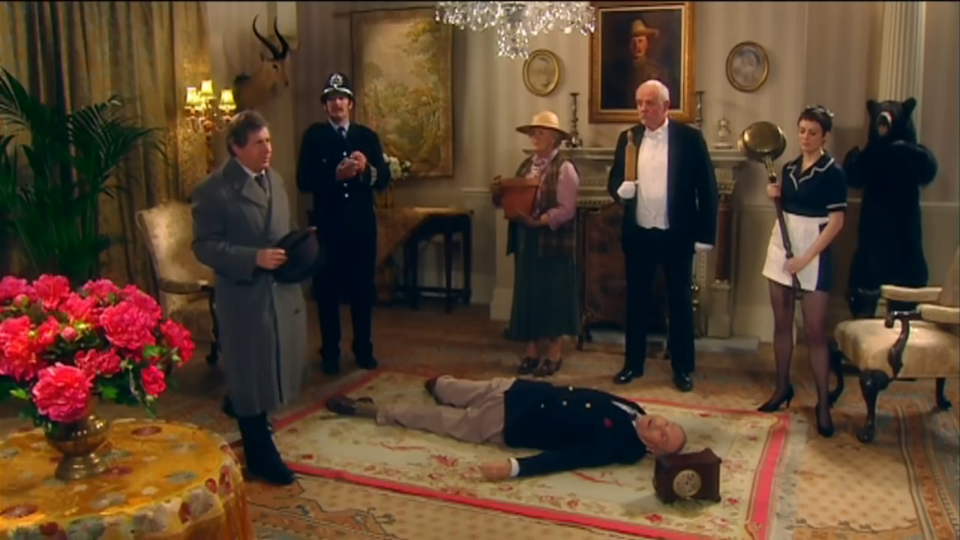
f) Video comprehension.
Watch the video and answer the questions on the following page.
4
Retour : découpage séances.

Slide 19
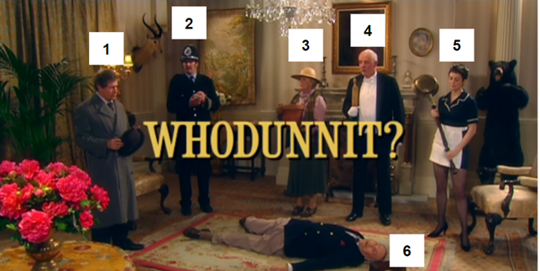
4
Who are the characters?
Retour : découpage séances.

Slide 20
4
Match each alibi to the correct person:
I was polishing brass in the master bedroom.
I was buttering scones below stairs.
I was planting petunias in the potting shed.
Retour : découpage séances.

Slide 21
4
Who is the culprit according to the inspector?
The inspector thinks that the culprit is …
How did the inspector find out?
The inspector found out because …
Did you notice any changes between the beginning and the end of the video? Write them down (there are 21 changes to discover!):
Example: the bear/the armor
Retour : découpage séances.

Slide 22
Bye!

