Slide 1
English class
Wednesday, April 1st

Slide 2
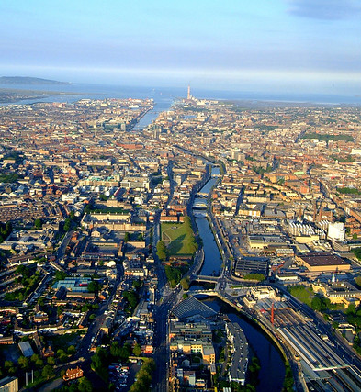
Résumé de l'épisode précédent
Picture analysis.
Listening comprehension.
Grammar: passive voice.

Slide 3

Recommandations
Recopiez leçons, exercices et corrections dans le cahier.
Recherchez le vocabulaire inconnu dans un dictionnaire papier ou en ligne et notez-le dans votre cahier.
Prenez tout le temps nécessaire en autonomie.

Slide 4
Liens utiles
Vos séances sur le blog.
Votre lien d’invitation pour votre classe sur Quizlet.
Votre classe Quizlet.
Un bon dictionnaire en ligne.

Slide 5
Today
Correction: Thursday 26 and Friday 27
Revision: grammar and vocabulary

Slide 6
1) Correction
A) Activités du jeudi 26 mars.
a) Compréhension écrite.
This document is an excerpt from a brochure about Croke Park visitor attractions.
Croke Park is in Dublin. Indeed, the brochure is about Dublin city attractions.
If you go to Croke Park, you can visit the stadium, the GAA museum and play interactive games for example.
Croke Park is free for children under three years old. Adults and children under twelve years old respectively have to pay 12,50 euros and 8,50 euros.
The opening hours are not written in the brochure. However, there is a website address: www.skylinecrokepark.ie. The website might be helpful to find out at what time Croke Park attractions open.

Slide 7
1) Correction
A) Activités du jeudi 26 mars.
b) 1° Trouver des questions en tant que touriste.
Example: Dublinia Museum
How much does a ticket for the Dublinia Museum cost?
When does the Dublinia Museum open?
Where is the Dublinia Museum?
What can you buy at the gift shop?
Is there a cafeteria in the museum?

Slide 8
1) Correction
A) Activités du jeudi 26 mars.
b) 2° Trouver des réponses aux questions en tant que guide.
Example: Dublinia Museum
The ticket costs 11 euros for an adult, 6,50 euros for a child and 10 euros for students, provided that they can prove it with a valid ID.
The museum opens every day from 10:00 am to 6:30 pm, March to September.
It is located at Christ Church, in Dublin.
You can probably buy souvenirs and postcards in the gift shop.
Yes, there is a café where you can buy drinks and pastries for example.

Slide 9
1) Correction
B) Activités du vendredi 27 mars.
a) Description de l’image.
I can see a very old book. From what I already know, it must be the famous Book of Kells. Therefore, you can find this book in the Old Library of Trinity College in Dublin. It is displayed behind a window so that no one can touch it. It is highly probable that only the museum curator and conservationists are allowed to take care of the Book of Kells. The pages are quite beautiful. I can see illuminated letters and drawings, but I can’t decipher the words. There are a lot of lovely colours and gold ornaments.

Slide 10
1) Correction
B) Activités du vendredi 27 mars.
b) Compréhension orale.
WHO? WHERE? WHAT?
Aiden is speaking. He is Fiona’s husband and a conservationist at Trinity College. He takes care of the Book of Kells.

Slide 11
Questions asked to Aiden
Where are we? / Where is the Book of Kells kept? / Where do we keep the Book of Kells?
How old is the Book of Kells?
Who made the Book of Kells?
When was the Book of Kells moved? Why?
How many pages are there in the Book of Kells?
What are the pages like? / What do the pages look like? / Can you describe the pages of the book?
REMINDER
WHO
WHERE
WHEN
WHAT
WHY
HOW
HOW OLD
HOW MANY
HOW MUCH

Slide 12
1) Correction
B) Activités du vendredi 27 mars.
c) Le passif.
Exemples de phrases au passif utilisées par Aiden :
It was handmade and handwritten by monks.
It was completed around 800 AD.
800 AD signifie 800 après JC.
AD = After Death

Slide 13
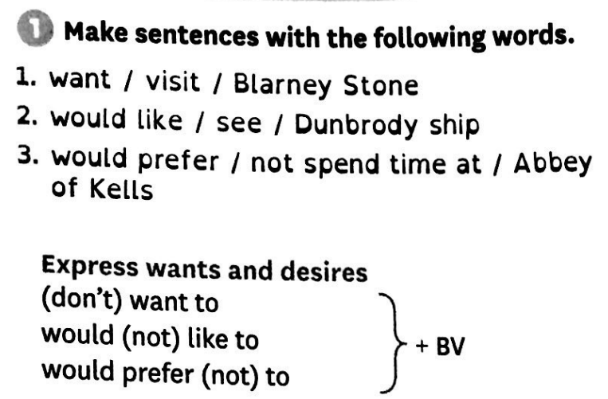
2) Exercices de révision

Slide 14
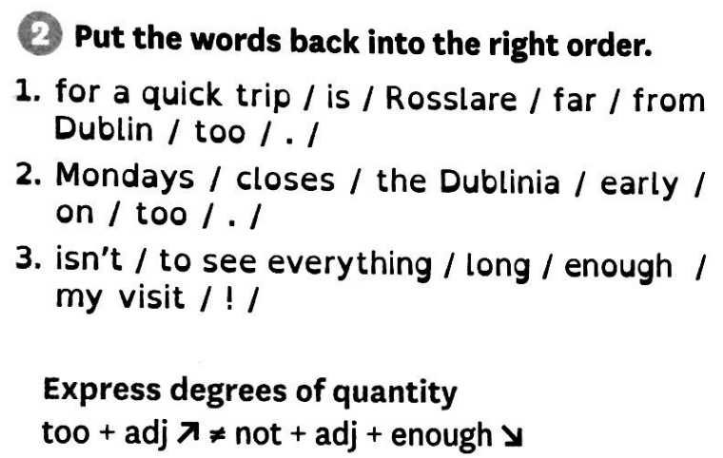

Slide 15
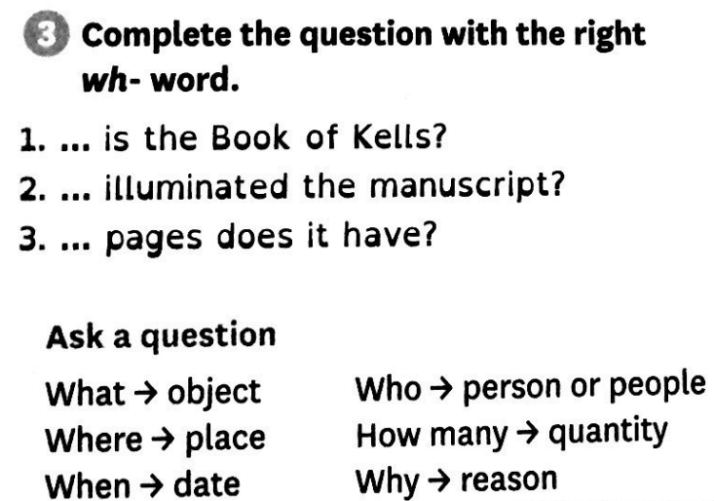

Slide 16
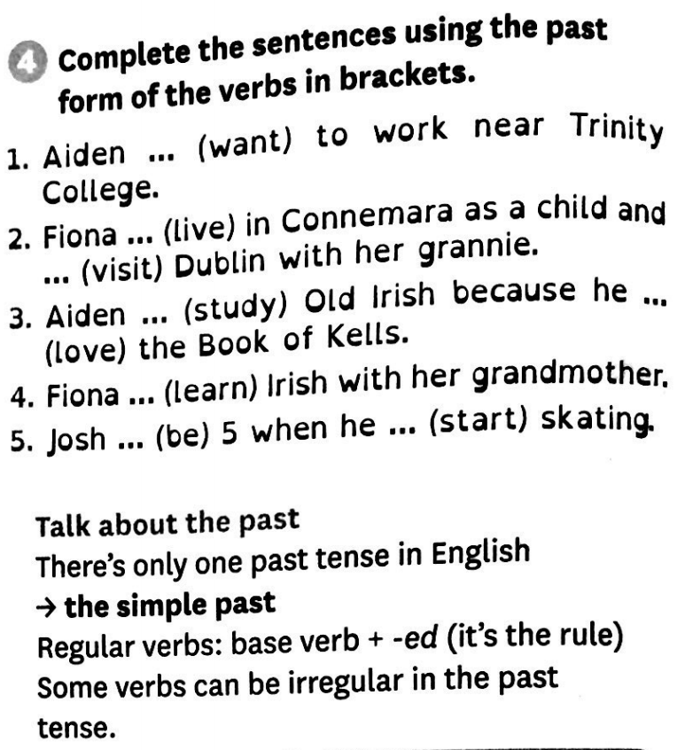

Slide 17
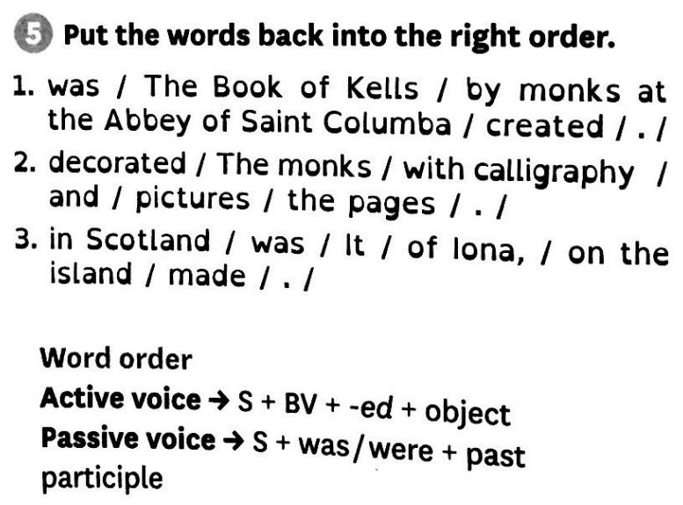

Slide 18
See you next time!

