Slide 1
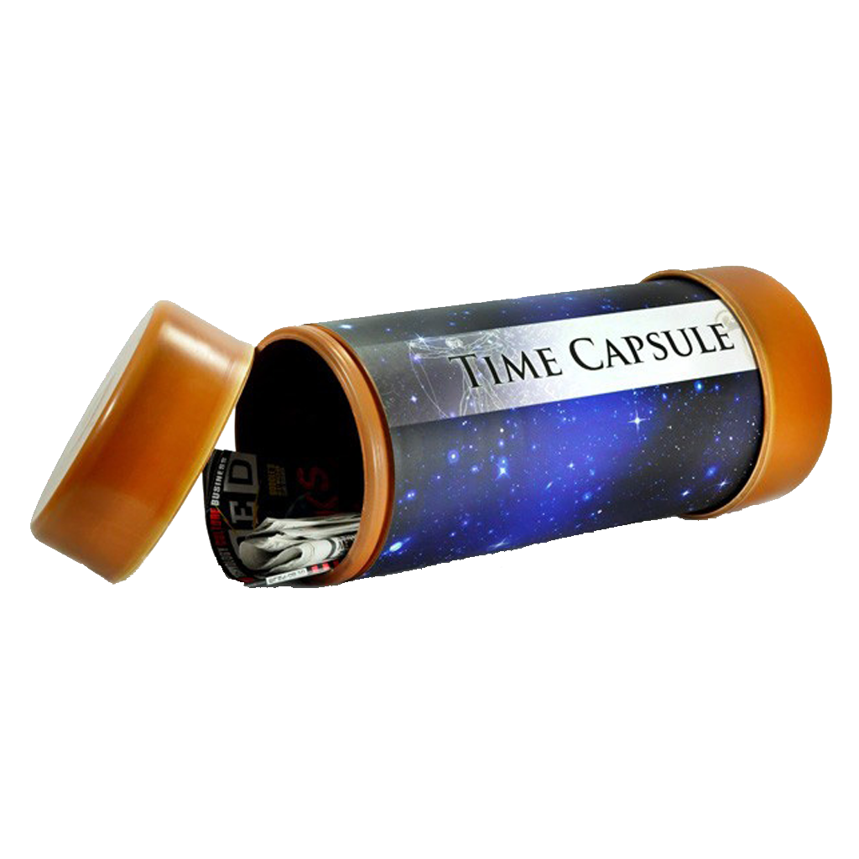
4°2
English
Semaine du 4 mai au 8 mai 2020.

Slide 2
Liens utiles
Un bon dictionnaire en ligne
Les séances précédentes sur le blog
L’invitation pour votre classe sur Quizlet
Votre classe sur Quizlet

Slide 3
Tu verras apparaître ces boutons aux coins des diapositives. Voici à quoi ils servent.
S1
Liens cliquables pour aller aux premières pages de chaque séance.
S2
S3
Lien cliquable pour aller à la page de répartition des séances.

Slide 4
Temps de travail conseillé
Découpage suggéré des séances de travail. | Temps de travail conseillé par séance.
Séance 1 Pages 5 à 20 | 50 minutes
Séance 2 Pages 21 à 28 | 40 minutes
Séance 3 Pages 29 à 33 | 30 minutes
S1
S2
S3
Selon tes possibilités, tu peux imprimer les pages (en combinant plusieurs diapositives sur une feuille) et les coller dans ton cahier, ou recopier les titres et le contenu des leçons et exercices dans ton cahier.

Slide 5
Révise les notions des séances précédentes.
S1

Slide 6
Practice
S1
Play Kahoot:
Click on this link.
Type 02918216 to play the game.
Play Quizlet:
Click on this link.

Slide 7
Vérifie ta compréhension des activités de la semaine dernière avec la correction.
S1

Slide 8
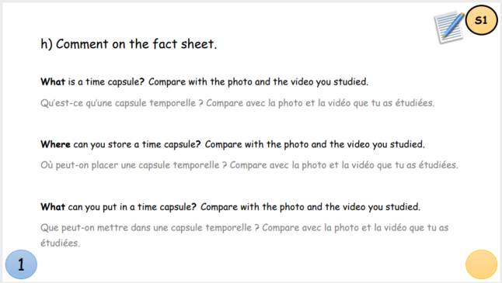
Correction
S1
What is a time capsule?
It is a kind of box in which people put objects from a particular time. It is intended to be opened in the future. For instance, the time capsule in the film is a sealed box. However, it is filled with children drawings instead of objects.

Slide 9
Correction
S1
Where are they stored?
Most time capsules are buried underground. The time capsule in the film is buried underground too. In the picture, the bronze plaque on the right marks the spot where the time capsule is buried.

Slide 10
Correction
S1
What can you put in a time capsule?
Among various things, people sometimes put pictures in time capsules. This can easily be compared to the children drawings in the film. They could also have put letters, lists, objects, a 1959 calendar or other documents from their time.

Slide 11
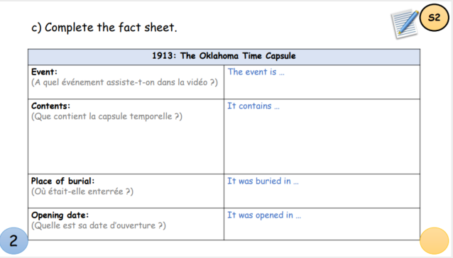
Correction
S1
The 1913 Oklahoma Time Capsule
The event is the opening of the Oklahoma Time Capsule. It contains a bow made by a Choctaw Indian, a plate painted by a Chickasaw Indian, Indian pottery, a pen used by President McKinley to sign an important piece of legislation, a phonograph, a book of pictures and poems, a 1913 telephone, a ladies’ hat, a boys’ suit, a pair of shoes and the first state flag of Oklahoma.

Slide 12
Correction
S1
The 1913 Oklahoma Time Capsule
This time capsule was buried in the basement of the first Lutheran Church of Oklahoma City.
Its opening date was in April 2013, seven years ago.

Slide 13
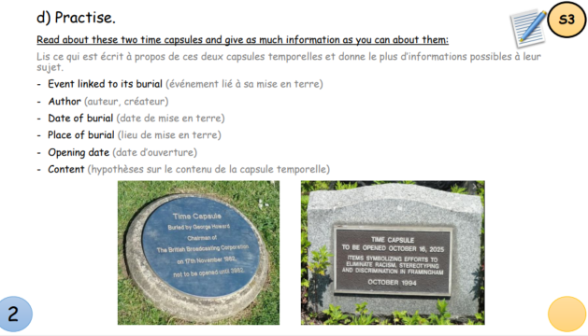
Correction
S1
The 1982 BBC Time Capsule
This time capsule was buried as the BBC celebrated its 60th birthday. George Howard, chairman of the BBC at that time, created the capsule. It was buried on the 17th of November 1982, in the grounds of Castle Howard. It will be opened in 3982, 2000 years after its burial. There is no information about the content but there might be items that represents the BBC or messages to the future in the capsule.

Slide 14
Correction
S1
The 1994 Framingham Time Capsule
There is no specific event linked to the burial of the capsule and its author is anonymous. It was buried in October 1994 and will be opened five years from now, on October 16, 2025. The capsule probably contains items symbolizing efforts made against racism and discrimination: newspaper articles, letters, works of art, pictures of important people who fought racism…

Slide 15
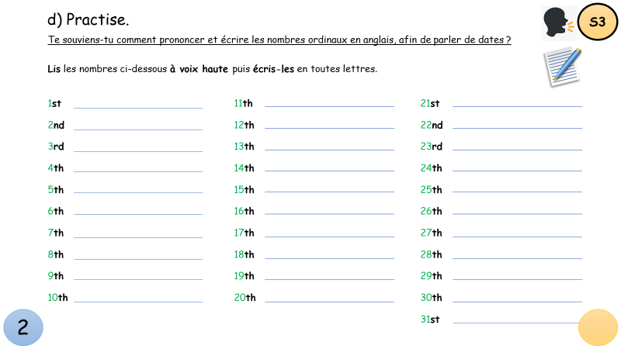
Correction
S1
Ordinal numbers
1st = first
2nd = second
3rd = third
4th = fourth
5th = fifth
6th = sixth
7th = seventh
8th = eighth
9th = ninth
10th = tenth

Slide 16
Correction
S1
Ordinal numbers
11th = eleventh
12th = twelfth
13th = thirteenth
14th = fourteenth
15th = fifteenth
16th = sixteenth
17th = seventeenth
18th = eighteenth
19th = nineteenth
20th = twentieth

Slide 17
Correction
S1
Ordinal numbers
21st = twenty-first
22nd = twenty-second
23rd = twenty-third
24th = twenty-fourth
25th = twenty-fifth
26th = twenty-sixth
27th = twenty-seventh
28th = twenty-eighth
29th = twenty-ninth
30th = thirtieth
31st = thirty-first

Slide 18
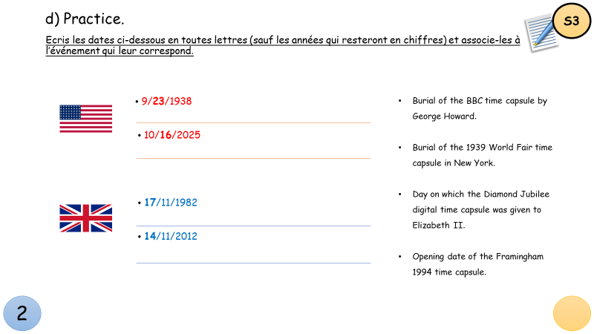
Correction
S1
Dates in American English
9/23/1938: the twenty-third of September 1938
Event: Burial of the 1939 World Fair time capsule in New York.
10/16/2025: the sixteenth of October 2025
Event: Opening date of the Framingham 1994 time capsule.

Slide 19
Correction
S1
Dates in British English
17/11/1982: the seventeenth of November 1982.
Event: Burial of the BBC time capsule by George Howard.
14/11/2012: the fourteenth of November 2012.
Event: Day on which the Diamond Jubilee digital time capsule was given to Elizabeth II.

Slide 20
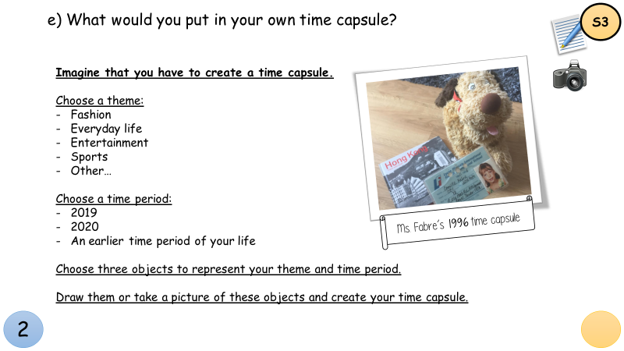
Correction
S1
Your own time capsule.
Did you think about it?
If you want, you can present your time capsule during our online class.

Slide 21
Passe maintenant aux activités de la semaine.
S2

Slide 22
This week’s activities
S2
3) Talking to your future self.
a) Read the text.
b) Answer the questions.
c) Observe (grammaire).
d) Réponds aux questions (grammaire).
…

Slide 23
S2
Read the text.
June 11, 2007
Dear Abby,
Congratulations! High school is finally over! As I write this letter I am a freshman and I can’t even imagine opening it when I graduate. It seems so far in the future from now. But look, here you are. You are finally done now!

Slide 24
S2
Can you believe it has already been four years? Have you kept the same friends? Did you end up getting good grades? Also, what about college? Have you decided where you are going yet? Always remember you are a smart girl. Take care of yourself and have fun! The world is waiting for you!
Love Always,
Abby ❤

Slide 25
S2
Answer the questions in your notebook.
What type of document is it? Justify your answer.
Identify the sender and the addressee.
Explain the link between this document and a time capsule.
Why did the author write this document?

Slide 26
5) Explain what grade the author is in when she writes the document and when she opens the document later.
Help
to get good grades = avoir de bonnes notes
to be in 12th grade = être en terminale
S2
USA |  | FRANCE
Diploma | Graduation | Baccalauréat | Diplôme
High school | 12th grade – senior | Terminale | Lycée
 | 11th grade – junior | Première
 | 10th grade – sophomore | Seconde
 | 9th grade – freshman | Troisième | Collège
Junior high school / middle school | 8th grade | Quatrième
 | 7th grade | Cinquième
 | 6th grade | Sixième

Slide 27
S2
6) Pour chaque partie du document, trouve l’intitulé correspondant.
Explique ensuite en français à quoi correspondent les différentes parties du document.
Voici les intitulés, réfère-toi ensuite au texte en page suivante :
Body - Closing – Greetings – Date – Signature

Slide 28
June 11, 2007
Dear Abby,
Congratulations! High school is finally over! As I write this letter I am a freshman and I can’t even imagine opening it when I graduate. It seems so far in the future from now. But look, here you are. You are finally done now!
Can you believe it has already been four years? Have you kept the same friends? Did you end up getting good grades? Also, what about college? Have you decided where you are going yet? Always remember you are a smart girl. Take care of yourself and have fun! The world is waiting for you!
Love Always,
Abby ❤
S2

Slide 29
S3
Observe les phrases suivantes :
Have you kept the same friends?
Have you decided where you are going yet?
I’ve just had a conversation with my future self.
The cement is still fresh: they have buried a time capsule.

Slide 30
S3
Réponds aux questions :
A quel temps fait référence le verbe en vert ?
⬜ passé
⬜ présent
2) A quel temps font référence les mots soulignés?
⬜ passé
⬜ présent

Slide 31
S3
3) A quel temps font référence les mots en rose ?
⬜ passé
⬜ présent
4) Qualifie le mot en vert :
⬜ C’est le verbe HAVE au passé.
⬜ C’est le verbe HAVE au présent.
⬜ C’est l’auxiliaire HAVE au présent.

Slide 32
S3
5) Qualifie les mots soulignés :
⬜ Ce sont des verbes au prétérit.
⬜ Ce sont des participes passés.
6) Que peux-tu en déduire sur la forme HAVE + VERBE-ED ?
⬜ Elle fait référence au passé, comme le prétérit simple.
⬜ Elle fait référence à un passé récent, coupé du présent.
⬜ Elle fait le lien entre le passé et le présent.

Slide 33
S3
7) D’après ce que tu as pu déduire de tes observations, trouve deux nouvelles questions que l’auteur du document aurait pu poser.

Slide 34
See you next week!

