Slide 1
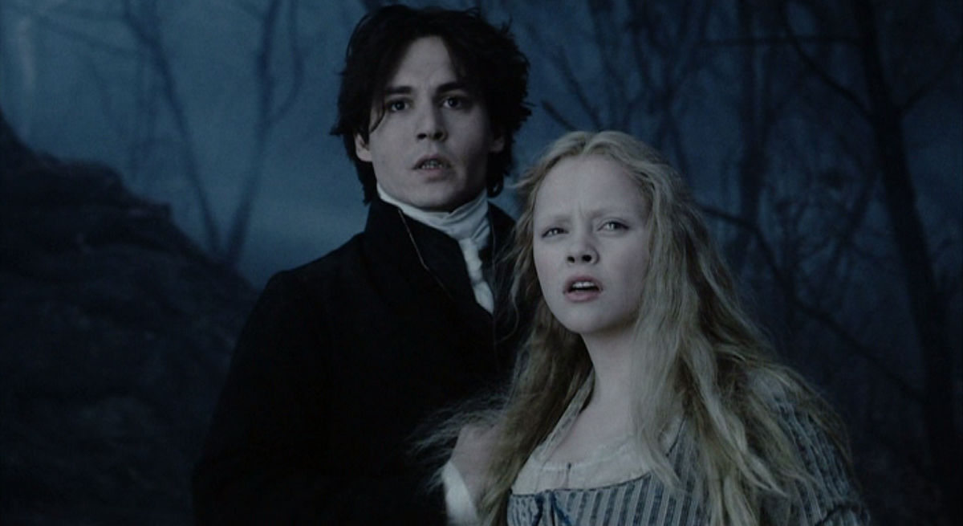
English class
Tuesday, March 24th
Cette photo par Auteur inconnu est soumise à la licence CC BY-SA

Slide 2

Résumé de l’épisode précédent (lundi 23)
Dernières consignes pour la thématique Afrique du Sud.
Nouvelle thématique : Horror stories.
Brainstorming à partir de photographies.
Définition de la « horror story » ?
Analyse de tableau.

Slide 3
Avant de commencer :
Relire les leçons et exercices précédents.
Refaire des activités de révision du vocabulaire.
Avoir son cahier, de quoi noter, de quoi vérifier/rechercher le vocabulaire (dictionnaire en ligne ou papier).
Liens utiles :
Un bon dictionnaire en ligne
Vos séances sur le blog
Compte-rendu de la classe virtuelle du lundi 23 mars

Slide 4
Today
Activities and exercises correction.
Understanding a video.
Going further: vocabulary and grammar.

Slide 5
Correction
Possible sentences about the first documents:
These are two frightening pictures from American horror movies and TV shows. The girls from Scream Queens are screaming, maybe because they have seen something terrible. The children from Village of the Damned are scary because of their glowing eyes. A horror story is a story with monsters or killers. It is a story that terrifies you, like the story of the White Lady or Frankenstein.

Slide 6
Correction
Possible description of the painting:
This document is a painting by William John Wilgus entitled Ichabod Crane. There are two characters on the painting: Ichabod Crane and the Headless Horseman. There is a dark atmosphere in this painting because it is night-time, the scene is taking place in dark woods and there is a church in the background. Ichabod Crane must be really scared right now. Maybe he thinks that he is going to die. He is trying to escape but he is scared to death.

Slide 7
To do:
Read again the two previous pages and look up the words in green in a dictionary.
Write down their definitions in your copybook.

Slide 8

Watch the video

Slide 9
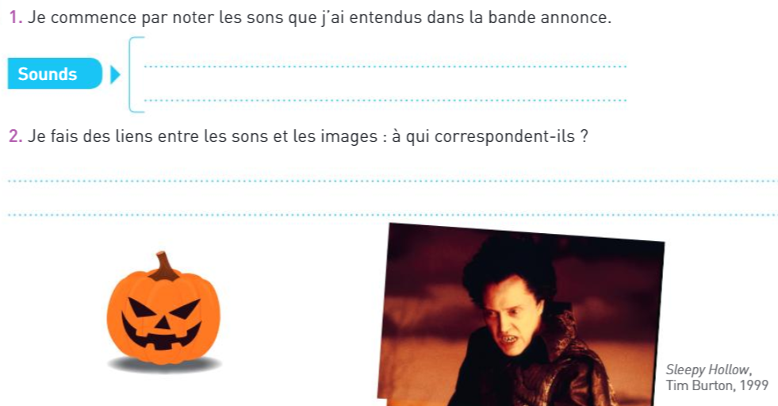
Understanding a video – Step 1

Slide 10
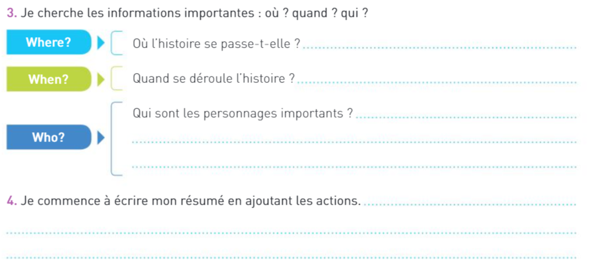
Understanding a video – Step 2

Slide 11
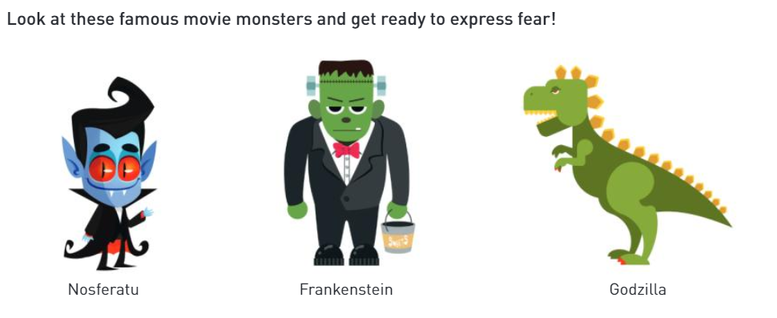
Go further – Step 1

Slide 12
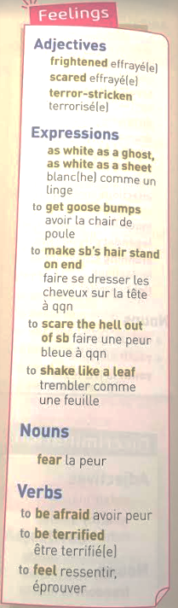
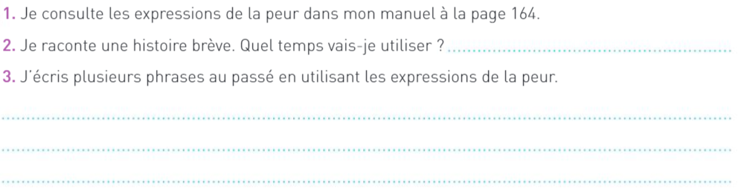
Go further – Step 2

Slide 13
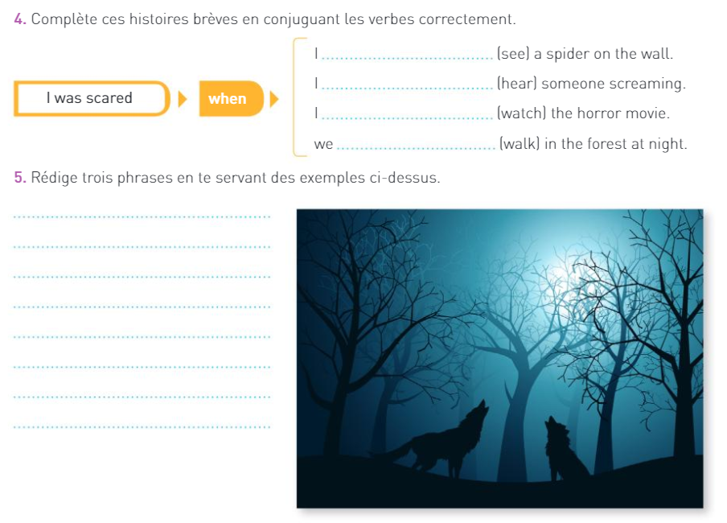
Go further Step 3

Slide 14
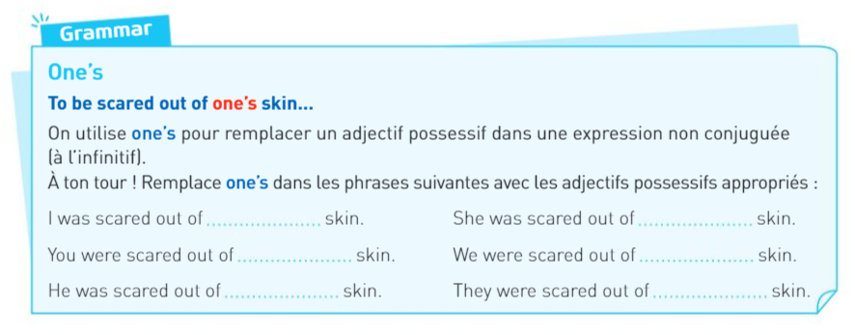
Go further – Step 4
HELP: my / your / his / her / its / our / your / their

Slide 15


For our further lessons and classes:
Redo the activities and exercises that you did not understand.
Don’t forget to send me your paragraph about Invictus’s opening scene.
When you are done with today’s activity, send me a copy or a picture of your work at: camille.fabre1@ecollege78.fr

Slide 16
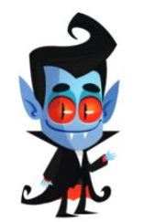
Bye :-)

