Slide 1
Do you remember the description of this picture ?

Slide 2
READ the text and answer the questions

Slide 4
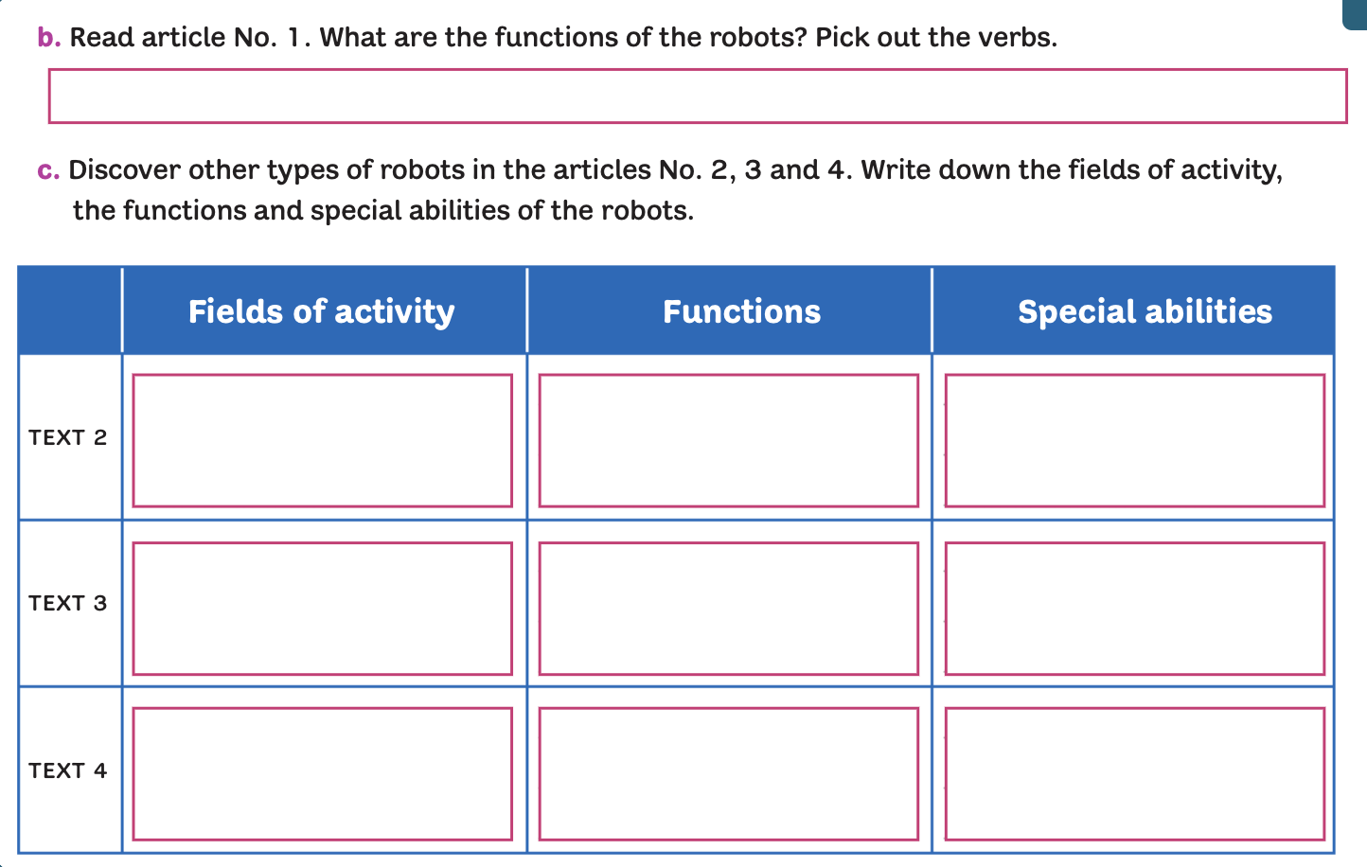

Slide 5
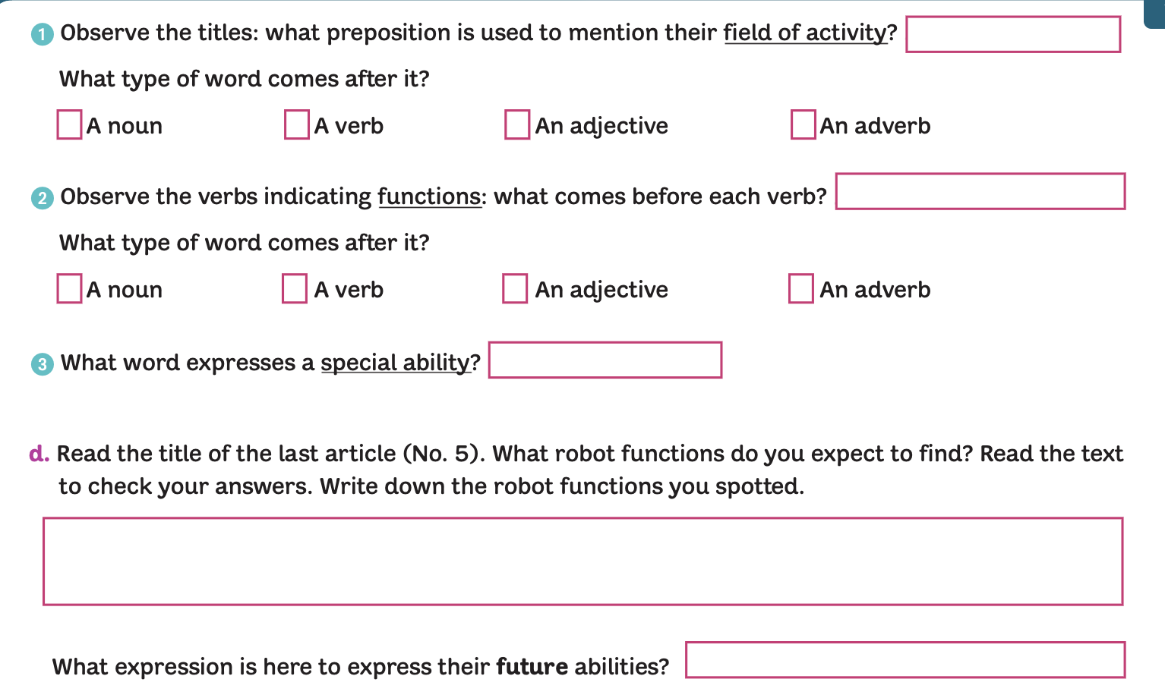

Slide 6
Correction:

Slide 7
Correction:

Slide 8
Point de grammaire: ’Pour’ en anglais
Pour exprimer ‘pour’ en anglais, on utilise ‘for’ ou ‘to’:
→For:
Il est suivi d'un pronom ou d'un nom.
Ex: I want to buy a robot for my little sister.
→To:
Il est suivi d'un verbe
Ex: I want to buy a robot to clean my bedroom.

Slide 9
Questions : Choisis entre 'to' et 'for'
1. Can you do this _____________________________ me ?
2. Have you bought anything new _____________________________ your bedroom ?
3. He left _____________________________ his holidays on Monday.
4. Open the window _____________________________ let in some fresh air.
5. We need more time _____________________________ finish this test !
6. This exercise is too difficult _____________________________ me ...
7. _____________________________ begin with, let's have a drink.
8. I've got a little present _____________________________ you.
9. He 's too young _____________________________ come with us.
10. The peaches are not ripe enough _____________________________ eat.

Slide 10
Correction:

Slide 11
5 minutes Write down why we use robots
We can use robots to…

Slide 12
Correction:
We can use robots to teleport, destroy things, travel in time, multiply things, think, replace humans and teachers in class !

Slide 13
Homework
*Underline all the new words in course 1 and find their definition on https://www.linguee.fr/
*Learn the lesson and the new vocabulary
*Good luck ☺

