Slide 1
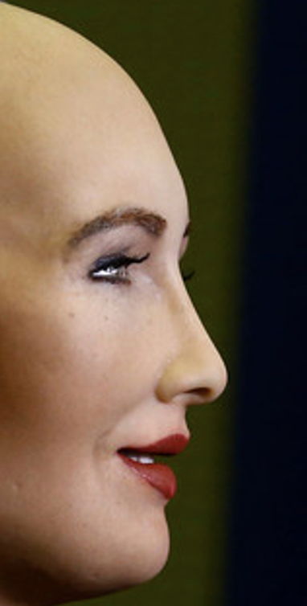
Describe the picture. Do you see Anything special?

Slide 2
And now?
Who is this person?

Slide 3
Copybook: Sequence 4: Are we robot-ready ?

Slide 4
Correction: description of the picture
This picture is quite surprising, it’s a bit creepy / freaky. This human-like robot, called Sophia, looks like a science fiction character. Its face looks like a woman’s. But when we take a closer look, the face looks like a wax doll’s. The back of its head is a robot’s head. We can see the mechanism and circuits. It looks very complicated: there are electrical wires, springs and perhaps micro- phones and recording tapes.
This robot is fitted with artificial intelligence. But we wonder how far its skills / abilities can go. Can it move? Is it able to walk? Can it answer questions? Can it solve a maths problem?

Slide 5
2 minutes: in your copybook
Find as many words as possible in link with robot and programme

Slide 6
Correction
Automatic - a programme - a computer - a scientist - science-fiction - robots - a developer - software - a programmer - artificial intelligence - AI - a code - humanoid - a home assistant

Slide 7
Now listen to the words and repeat them

Slide 8
2 minutes: out loud (à haute voix) *describe the robot from picture a *describe the robot from picture b *compare the robots

Slide 9
2 minutes: out loud Imagine what the 2 women are doing.
They are…

Slide 10
Correction:
Picture A: they have no arms, no legs, no hands, no face. They look very aggressive. They are like an army. The man is giving them orders / leading them and they are obeying him. They are imitating him.
Picture B: the robot looks like a human. It has got limbs: arms and legs, a head. It has a human attitude. It looks very gentle and kind. It is helping the woman.
Their common point: they both help / assist humans, they both live with human beings, they both interact with them.
The women are working on a computer. They are creating a programme. They are developers. Maybe they are working on Scratch. Scratch is a software to learn coding. You can code and make an object move: it can go up, it can go down, it can turn right, it can turn left.

Slide 11
5 minutes: write in your copybook What do you think of robots ? Would you like to have one ?
I would like to have a robot because...
I want my robot to...

Slide 12
Correction: do you want a robot?
I think robots are fantastic / scary / useful / useless / helpful / expensive. They are gadgets. They are / aren’t necessary. I would love to have a robot because I would love to have a servant.
I don’t want a robot because I prefer to have friends.

Slide 13
Homework
*Underline all the new words in course 1 and find their definition on https://www.linguee.fr/
*Learn the lesson and the new vocabulary
*Good luck ☺

