Slide 1
Dystopia : Course 2

Slide 2
Out loud 2 minutes: what is a Dystopia ?

Slide 3
Watch the 2 trailers. Do they correspond to what we said about dystopia?
Take notes of what you understand of the story
Take notes of the elements that correspond to the universe of a dystopia (characters, atmosphere, system,...)

Slide 4
Divergent trailer = on the blog
The hunger games trailer = on the blog

Slide 5
correction
The Hunger Games | Divergent
We can see the young people having to play the Hunger Games, where they fight against one another until there is only one left. People seem to be struggling, some of them look very poor (their clothes are worn out, all grey or blue). We can see people watching the Games on big screens, and the rich seem to even enjoy it. They make a whole show out of these young people’s misery, which shows the importance that TV has taken in our lives. Reality TV, for example, often shows shocking behaviours, relishes scornful attitudes and even sometimes bullying, because it is good for their audience ratings. | In this trailer, we also see young people, but they are not playing games, they are choosing a 'faction'. Indeed, in this world, people are divided into 5 different factions, depending on their qualities; we can recognize them with the colour of their clothes (orange/yellow, black, blue...). The main character is getting prepared for a 'test' that will help her decide to which faction she belongs. But she understands that she is a divergent, someone who does not belong to any faction. This world is very different from our world. We understand that people are being observed and that those who are different are dangerous for the system.

Slide 6
EQUILIBRIUM
The film is set in 2072 in Libria, a city-state established by the survivors of WWIII

Slide 7
Listen to the soundtrack of the extract
PART 1 (jusqu'à 1 minute 05)
What are the problems/the symptoms?
What is forbidden in that society ?
PART 2 (à partir d'1 minute 05)
What is the solution to the problem?
What are the consequences of this solution?

Slide 8
2 minutes write down What is forbidden? What is allowed? (ce qui est interdit/ Ce qui est autorisé)
In the city of Libria, it is allowed to…
It is forbidden to…

Slide 9
Correction: Libria
In the city-state of Libria:
*It is forbidden to feel emotions / It is forbidden to read books / It is forbidden to watch movies
* You are not allowed to listen to music / People are not allowed to have feelings, such as hate, love, anger, rage, happiness...

Slide 10
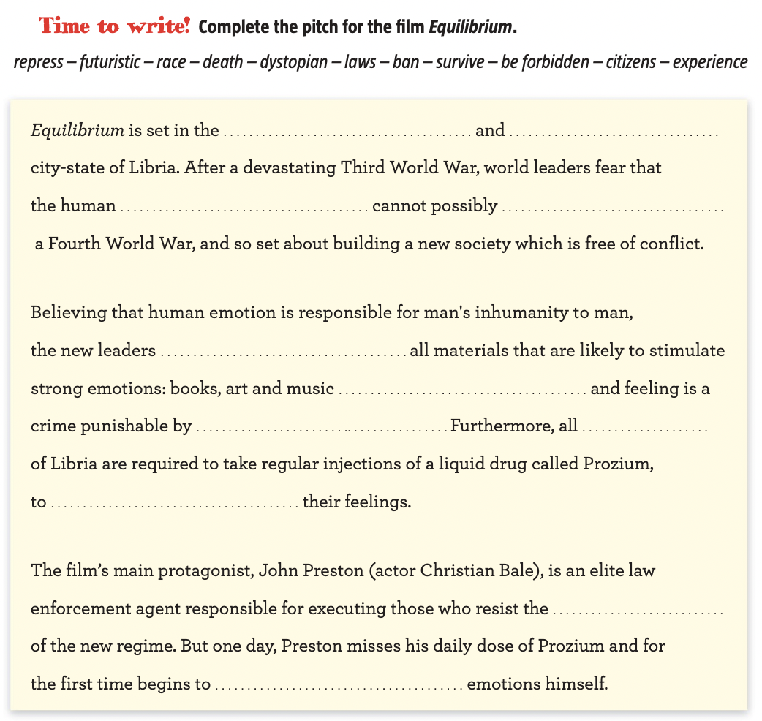

Slide 11
Correction: pitch for the film equilibrium
Equilibrium is set in the futuristic and dystopian city- state of Libria. After a devastating Third World War, world leaders fear that the human race cannot possibly survive a Fourth World War, and so set about building a new society which is free of conflict.
Believing that human emotion is responsible for man’s inhumanity to man, the new leaders ban all materials that are likely to stimulate strong emotions: books, art and music are forbidden and feeling is a crime punishable by death. Furthermore, all citizens of Libria are required to take regular injections of a liquid drug called Prozium, to repress their feelings.
The film’s main protagonist, John Preston (actor Chris- tian Bale), is an elite law enforcement agent responsible for executing those who resist the laws of the new regime. But one day, Preston misses his daily dose of Prozium and for the first time begins to experience emotions himself.

Slide 12
HOMework
*Underline all the new words in course 2 and find their definition on https://www.linguee.fr/
*Learn the lesson and the new vocabulary
*Good luck ☺

