Slide 1
Fonctionnement de la classe en ligne
1 PowerPoint = un cours d’une heure → 3 powerpoints/semaine
Devoirs, documents = OZE
Devoirs à rendre = environ 1/semaine (oral ou écrit)
Séquence du manuel d’anglais (possibilité de travailler sans l'ordinateur/tablette/smartphone)
Questions = OZE

Slide 2
2 minutes : Describe the pictures (out loud → à haute voix)
What do you see on the poster
Who are the people
What is special
What is the atmosphere

Slide 3
Movie 1

Slide 4
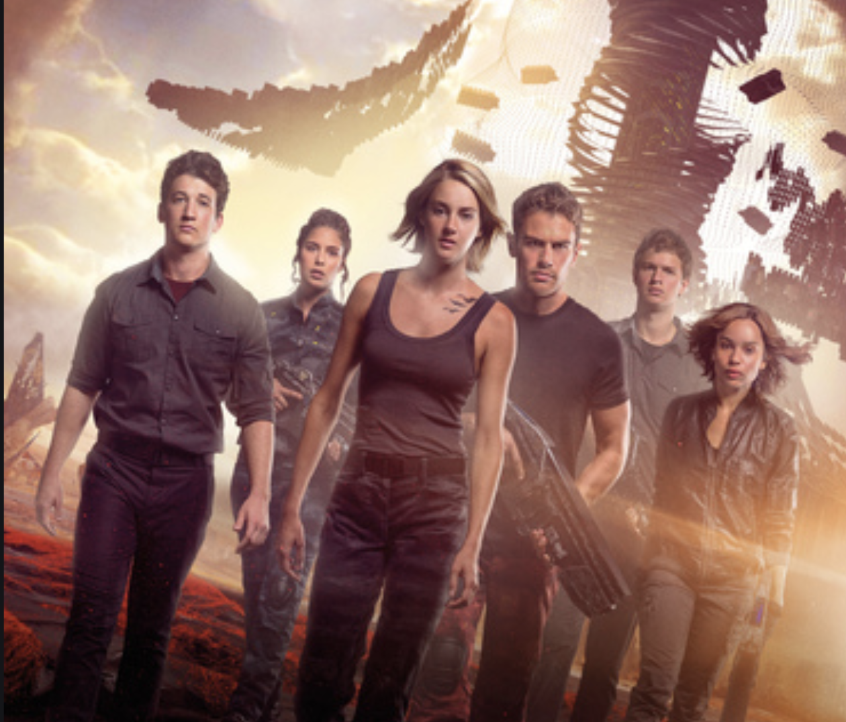
Movie 2

Slide 5
2 minutes : Explain the common points between the 2 pictures
People
Atmoshpere
Colours
...

Slide 6
Copybook : Sequence 5: DYSTOPIA

Slide 7
Correction : Common points between the posters
These films are science fiction movies. They both involve young adults and teenagers.
The colours are quite dark and in both posters, we can see that there is something bigger than the characters, above their heads, as if they were inferior to this thing.
These movies seem to represent dark, dangerous and terrible worlds. It looks like a science-fiction universe...
We know that Hunger Games is about games where young people have to kill each other until only one of them is left. These games are filmed and shown / broadcast in the whole country, so everyone can watch (as the screens and the tagline on the poster show).
Divergent is about a world where young people are put into different castes / groups. The characters on this poster look determined, and they are carrying weapons, so maybe they are rebelling against this world.

Slide 8
Listen to the audioS, answer the questions
What do you understand?

Slide 9
Listen to the Audio a 2nd time and Complete the table
 | Utopia | Dystopia
Words that are common to both definitions
Words or expressions in link with utopia or dystopia
Definition of dystopia

Slide 10
Listen to the second part of the audio and complte the table: "definition of dystopia"
 | Utopia | Dystopia
Definition of dystopia

Slide 11
correction
 | Utopia | Dystopia
Words that are common to both definitions | Opposite / antithesis / anti-idea / opposing idea / reversing idea of the concept
Words or expressions in link with utopia or dystopia | Ideal Perfect society We want to go to Best of society | Bad Oppressive We want to escape Worst of society Derive from our society
Definition of dystopia |  | Post-apocalyptic (= after the apocalypse, after something big and bad has happened → people are struggling to survive) Derives from our society: we could end up there, it is a potential, a possibility, a risk if we make mistakes

Slide 12
2 minutes: write → What is dystopia?

Slide 13
Correction: a definition of Dystopia
A dystopia is a horrible world that derives from our world but is worse. It is bad and oppressive. People want to escape.

Slide 14
Homework
*Underline all the new words in course 1 and find their definition on https://www.linguee.fr/
*Learn the lesson and the new vocabulary
*Good luck ☺

