Slide 1
Dystopia: course 3

Slide 2
Equilibrium: What is the movie about ?
What is allowed ?
What is forbidden ?
Why ?

Slide 3
Point de Grammaire: Lis la leçon et Ecris la dans ton cahier

Slide 4
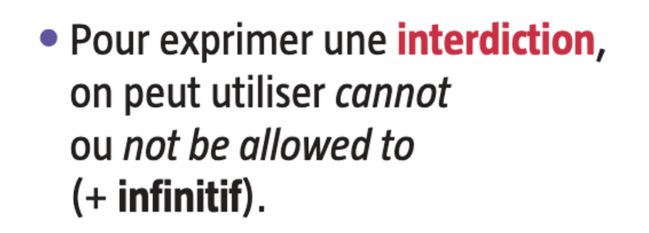
Ex: phrases 2 et 4.
Ex: phrases 1 et 3.

Slide 6
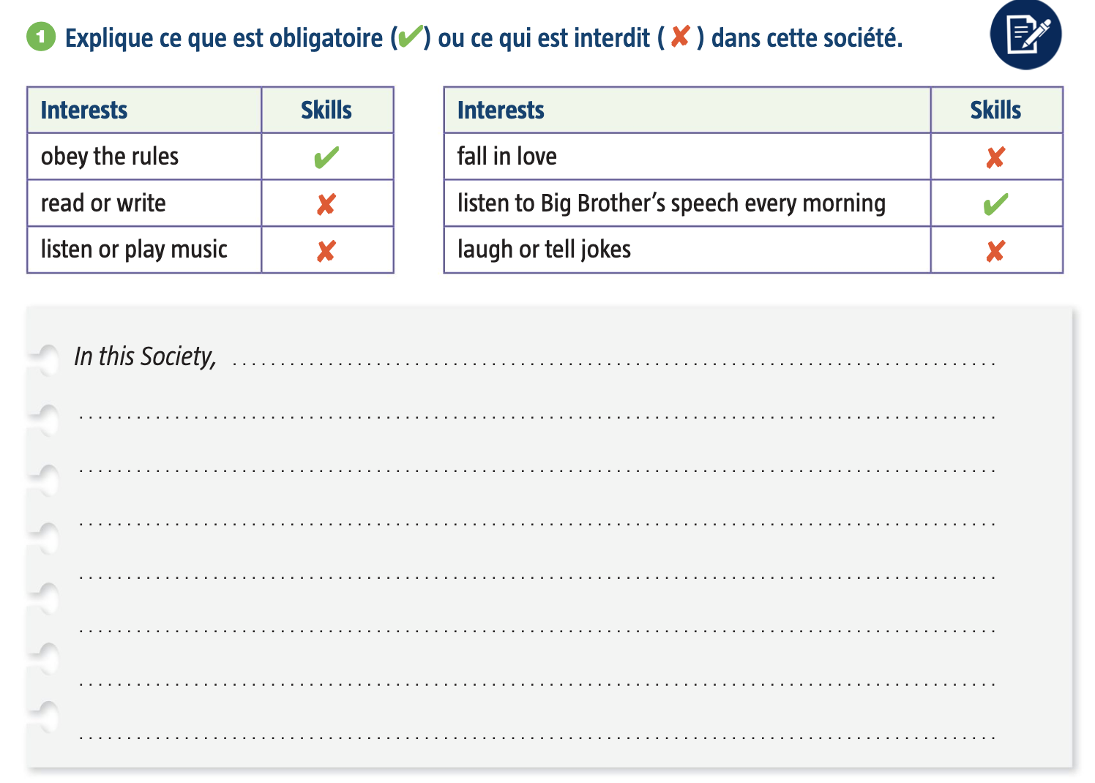

Slide 7
Correction: obligatoire/interdit
In this society, people must obey the rules. They cannot read or write and they are not allowed to listen or play music. In this society, you are not allowed to fall in love. Citizens have to listen to Big Brother’s speech every morning. People cannot laugh or tell jokes.

Slide 8
Choose one of the book covers and imagine the story. Write it and Then publish it on oze
A publier dans l'espace collaboratif de la classe avant lundi midi.
Si vous n'arrivez pas à le publier, vous pouvez me l'envoyer par mail (tapé à l'ordinateur ou un écrit pris en photo).
Minimum 75 mots

Slide 9
1. Situation
Explain where it starts, when, who are the main characters.
2. Problem
Every story has problems/conflicts. Invent them, and use the link words: but, however, until, unfortunately...
3. twist & hope
Explain the finale twist (change in a situation). What happens at the end, who wins, does the crisis end ? Is there hope ?

Slide 12
Homework
*Write the story of one of the book covers. Publish it on OZE
Ecris l'histoire d'un des deux livres présentés dans le powerpoint (tu dois l'inventer puis la publier sur OZE ou me l'envoyer par mail si tu n'arrives pas à l'envoyer).
A envoyer avant lundi midi. Ensuite, l'espace sera fermé.

