Slide 1
Goodbye! Au revoir!
Darlene Cervantes
English assistant Oct. 2015-april2016

Slide 2
Bonjour! My name is Darlene, and I was the English teaching assistant (2015-2016) at Lycée Albert Camus. This was an amazing opportunity, and I wanted to thank you for making it a great experience for me! I learned so much from you, and I will miss you!

Slide 3
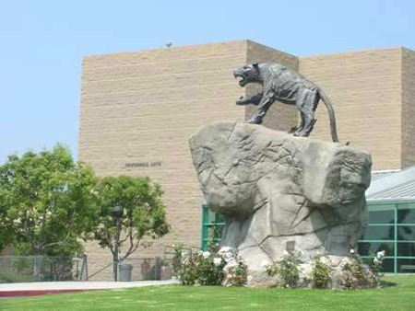
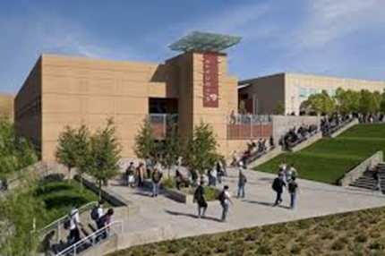
BONJOUR!
Je m’appelle Darlene.
This was my senior year of high school with my French group and teacher.
GO WILDCATS!
High school was a fun experience for me. Make the best out of your high school experience! Stay motivated, make friends, organize school clubs, etc. If there’s something you want to do, GO for it!!

Slide 4
Since I was 15, my dream was to go to France. After so much hard work and dedication, I finally accomplished it!...and I got to share that with my sister!
We went on top of the Eiffel Tower ☺

Slide 5
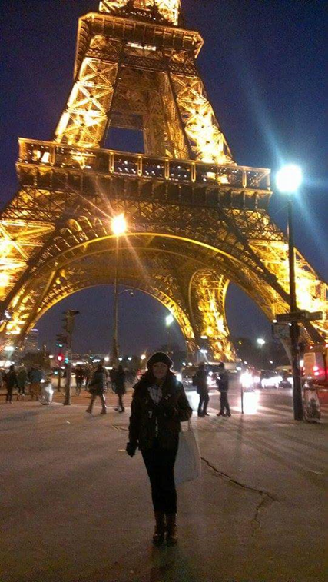
Some people believe Paris to be the “city of love,” but for me it’s the “city of dreams.”
No matter how many times I saw the Eiffel Tower I always cried or had goose bumps!

Slide 6
So…DREAM BIG! Anything is possible. Don’t let anyone put you down. Stay focused and work hard.
“Don’t ever let someone tell you that you can’t do something. Not even me. You got a dream, you gotta protect it. When people can’t do something themselves, they’re gonna tell you that you can’t do it. You want something, go get it. Period.”
The Pursuit of Happyness (film 2006)
(gotta and gonna are slang words. Don’t use these in formal situations such as for writing an essay.)
*Gotta→got to
*Gonna→ going to

Slide 7
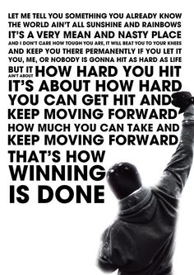
Sometimes we may experience challenges in life, but it’s important to NEVER give up!
“When life gets you down, do you wanna (want to) know what you’ve gotta (got to) do? Just keep swimming.” Finding Nemo

Slide 8
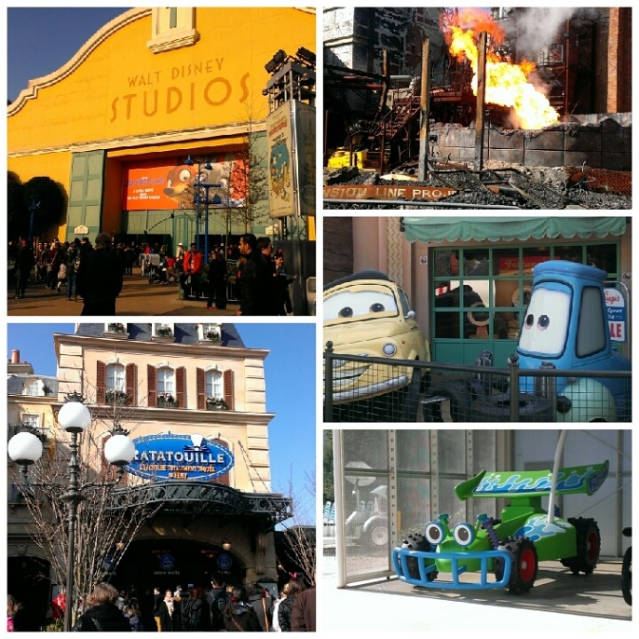
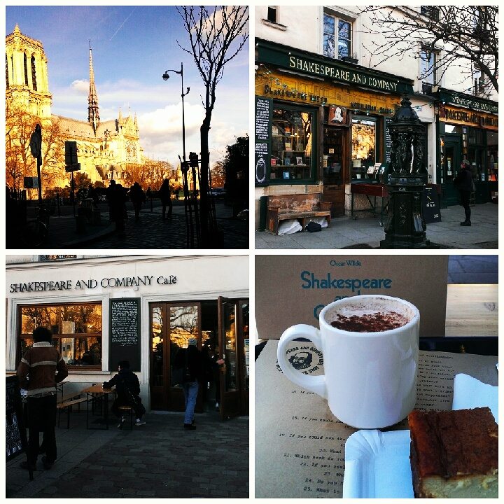
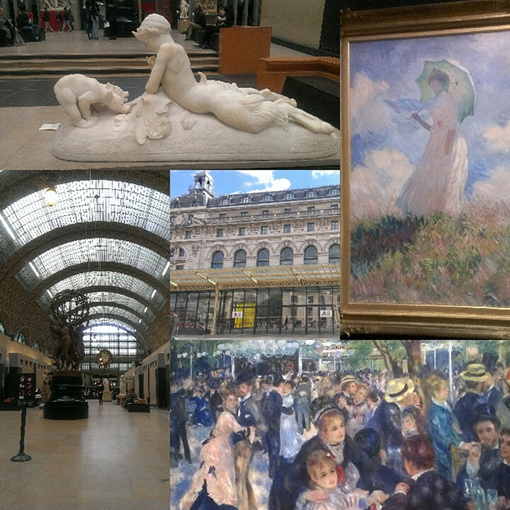
I enjoyed so many things during my stay
But the BEST moments I spent were…

Slide 9
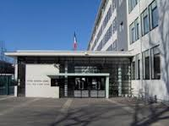
…the moments I spent with YOU!!!
I loved working with you and being able to share my passion (languages) with you. I enjoyed every moment in the classroom with you, whether it was discussing a certain topic or watching you act out certain things (my favorite!).

Slide 10
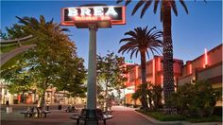
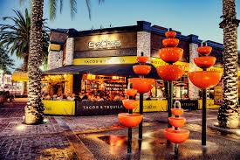
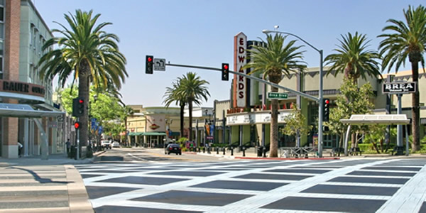
Downtown Brea
On a different note…
If you go to California, you should visit Brea, CA. It’s not a well-known city but it has a great vibe (and it’s my hometown!)!
And remember to cross the street ONLY when it’s your turn to go!

Slide 11
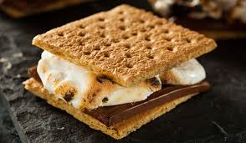
I wish you the best!
Although I’m sad to leave, I’m extremely glad I had the opportunity to work with you. I hope you know that you are all creative in your own way and that you have so much potential! Thank you again for making this a wonderful experience for me! I can’t wait to become a teacher, and I hope that my future students will be a lot like you ☺
Thank you for all of the remarkable teaching moments, participation, the smiles, and laughs…and for just being you! Au revoir!
I wish I had S’MORE time with you!!
(popular campfire treat in the U.S.)

