Slide 1


Slide 2
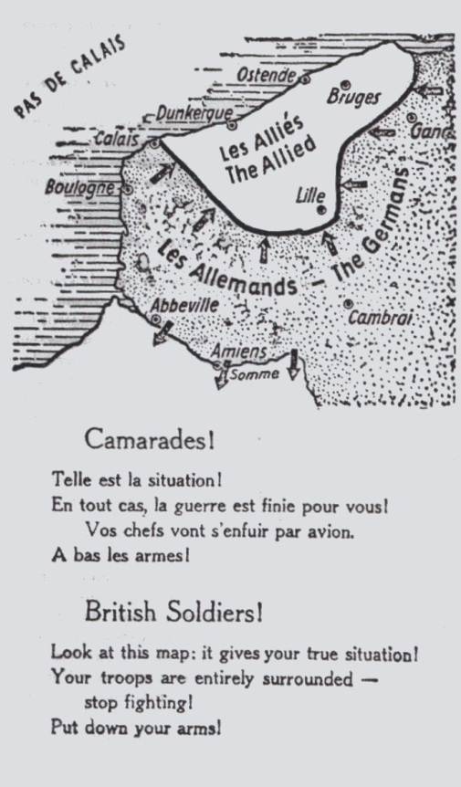
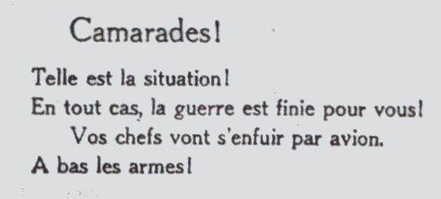
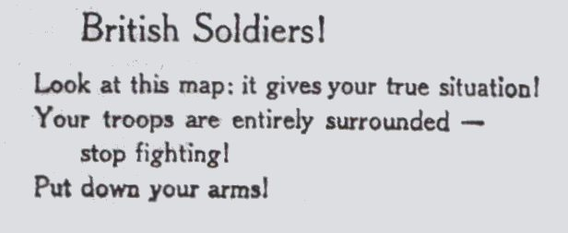
German propaganda tract May 1940

Slide 3
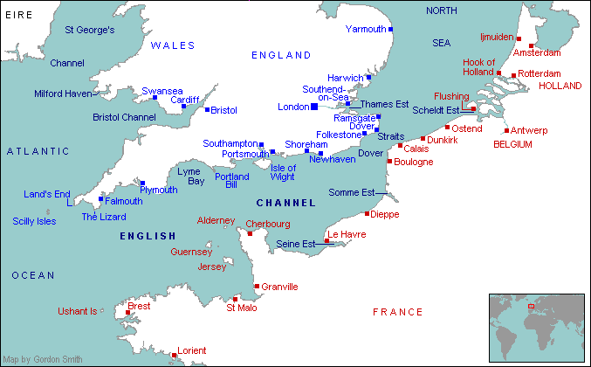

Dover, strategic position for British military operations

Slide 4
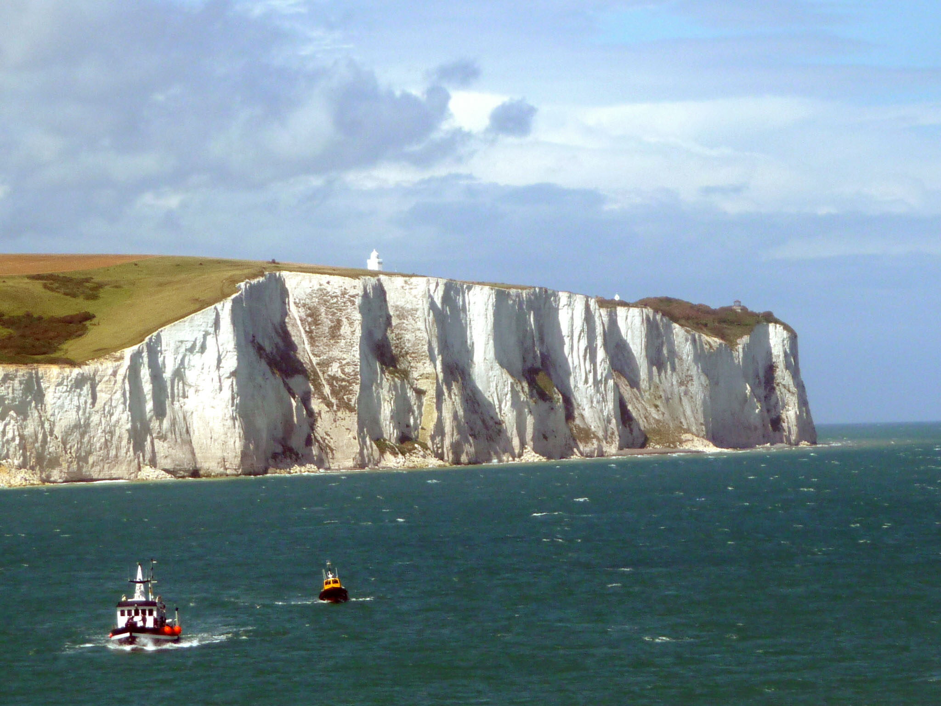
The white cliffs of Dover

Slide 5
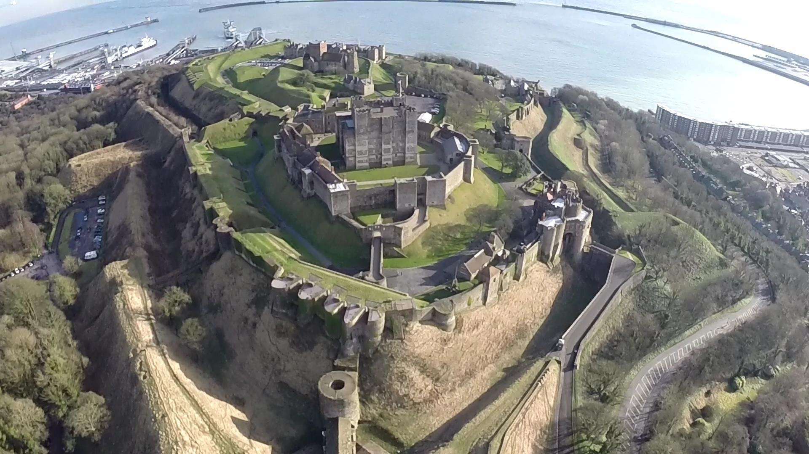
Arial view of Dover Castle

Slide 6
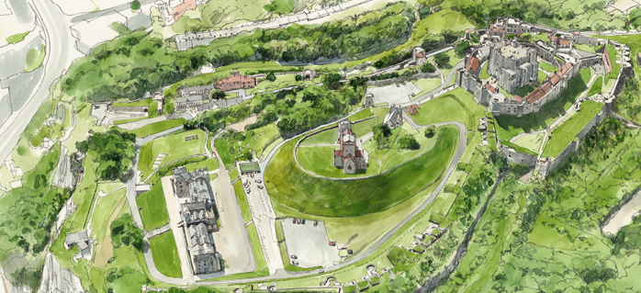
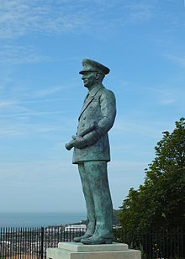
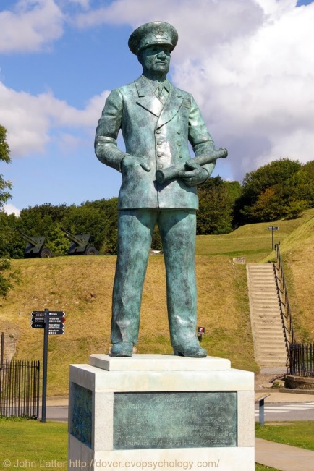
Promontory looking over the Channel
Statue of Vice-admiral Bertram Ramsay, …

Slide 7
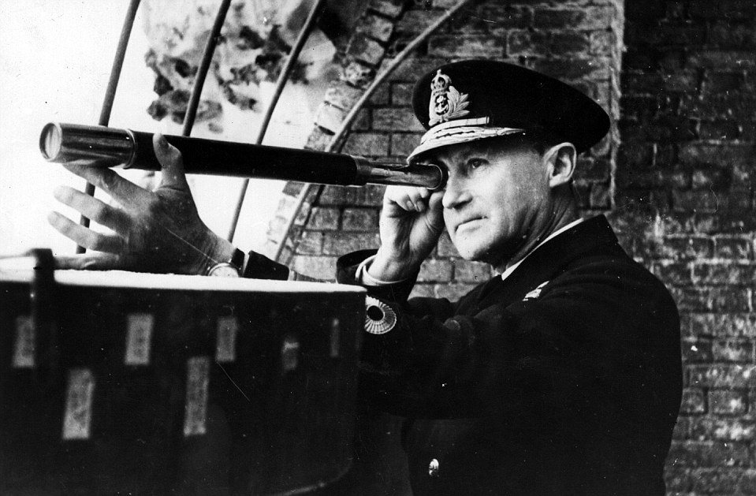
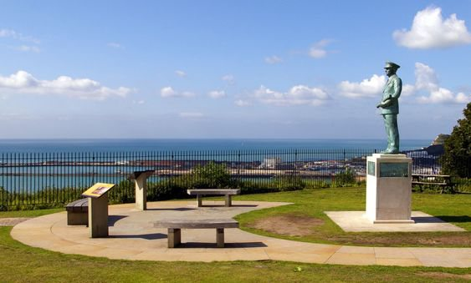
…responsible for the coordination of the Dunkirk evacuation
Codename « Operation Dynamo »

Slide 8
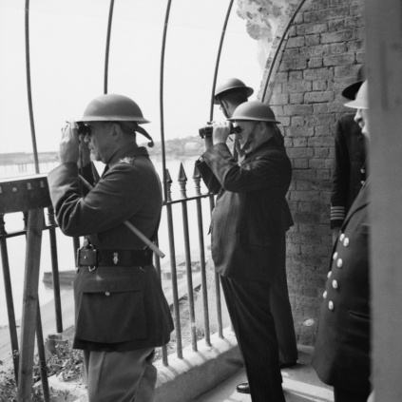
Winston Churchill surveying action in the Channel from Dover Castle

Slide 9
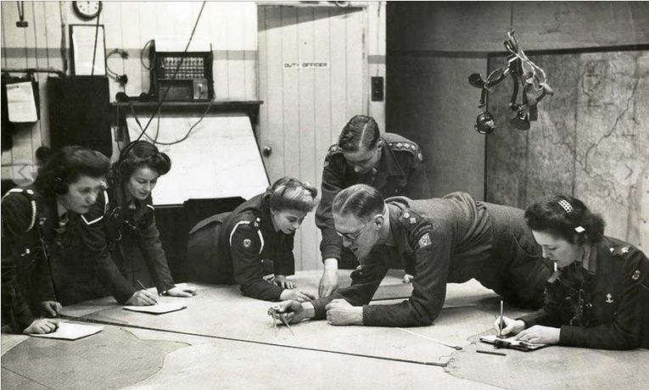
Operations room below Dover Castle

Slide 10
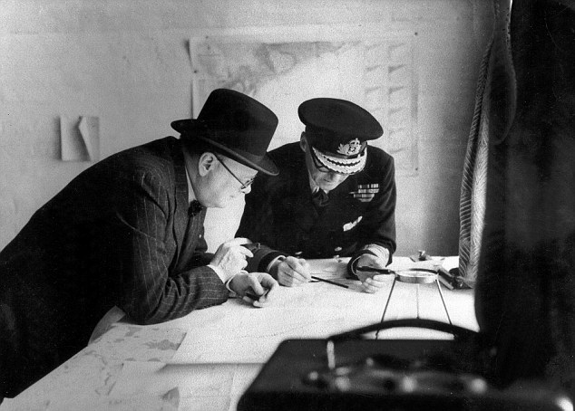

Slide 11
May 14th 1940
The BBC announced the Admiralty’s decision to requisition all boats between 30' and 100' in length for the purpose of the evacuation.

Slide 12

The first of the « Little ships »
left for Dunkirk from Ramsgate on 26th May 1940

Slide 13
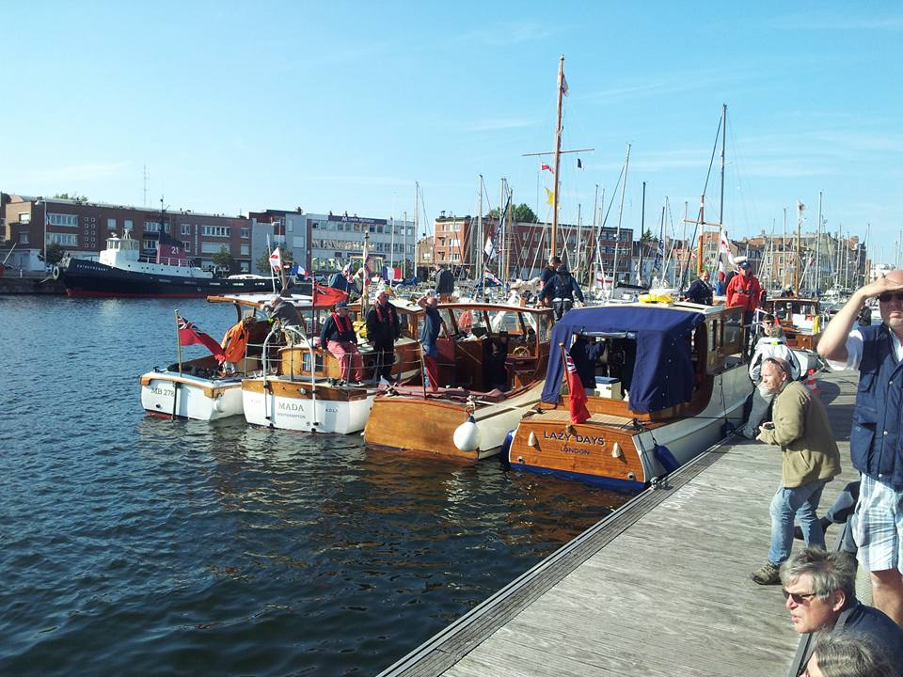
May 2015 : 75th anniversary of « Operation Dynamo »
Over 50 « Little ships » made the return jouney to Dunkirk.

Slide 14
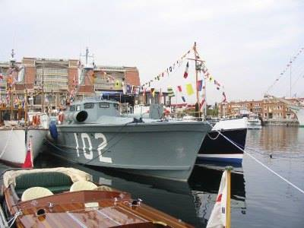
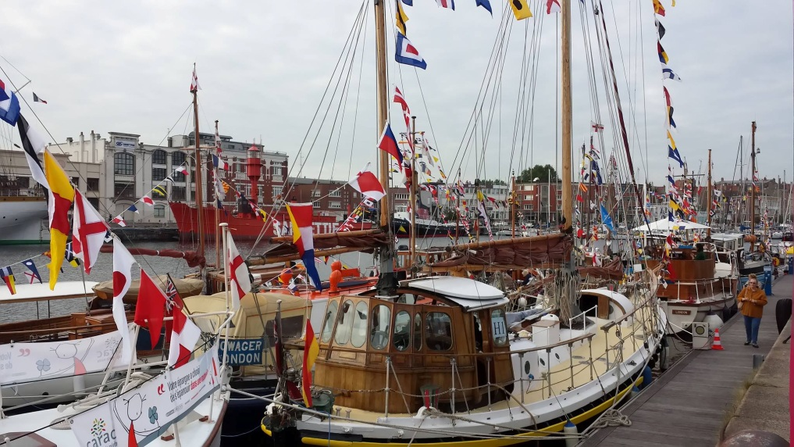
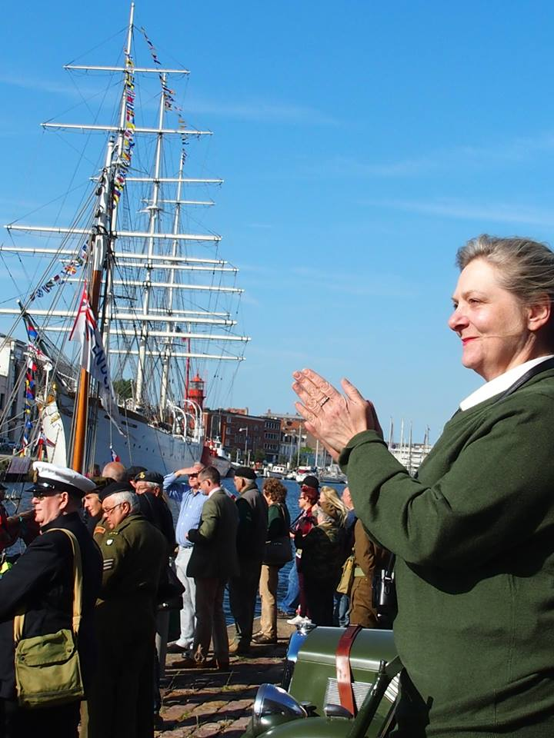
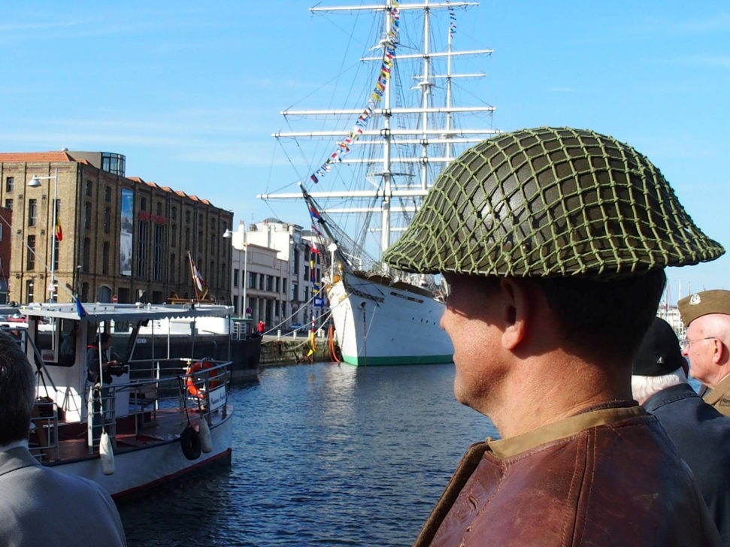

Slide 15
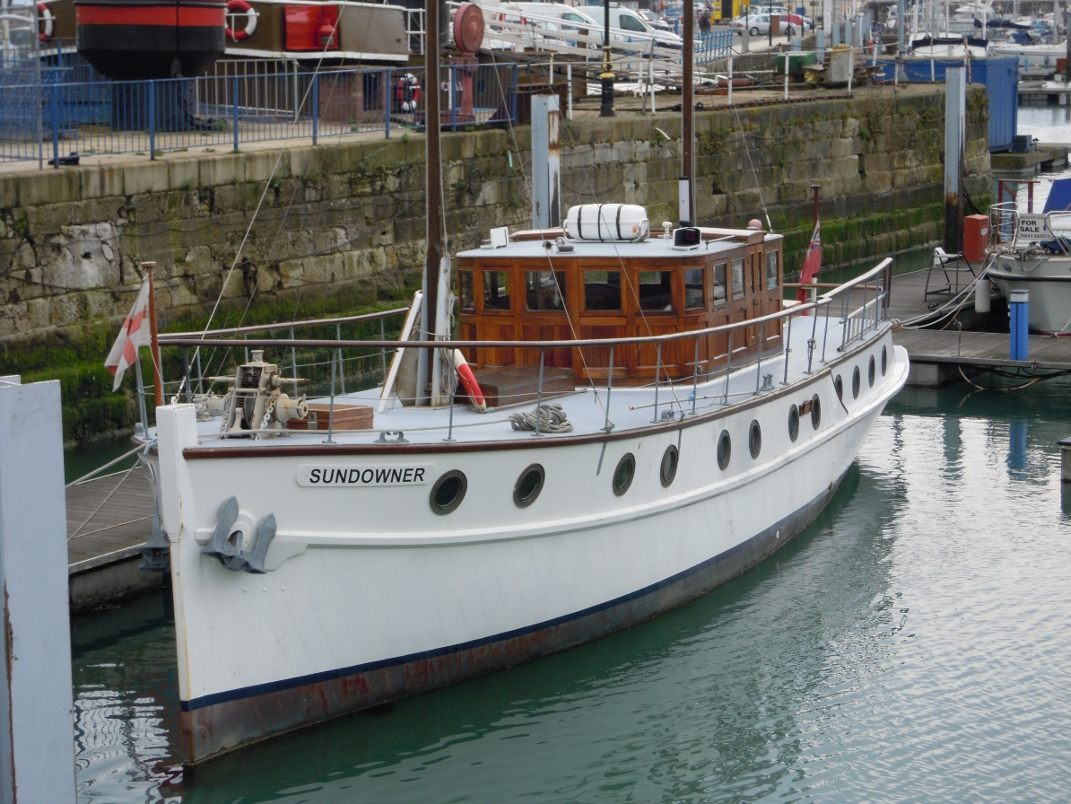
« Sundowner » belonging to Charles Lightoller
Survivor of the Titanic disaster and volunteer for Operation Dynamo

Slide 16
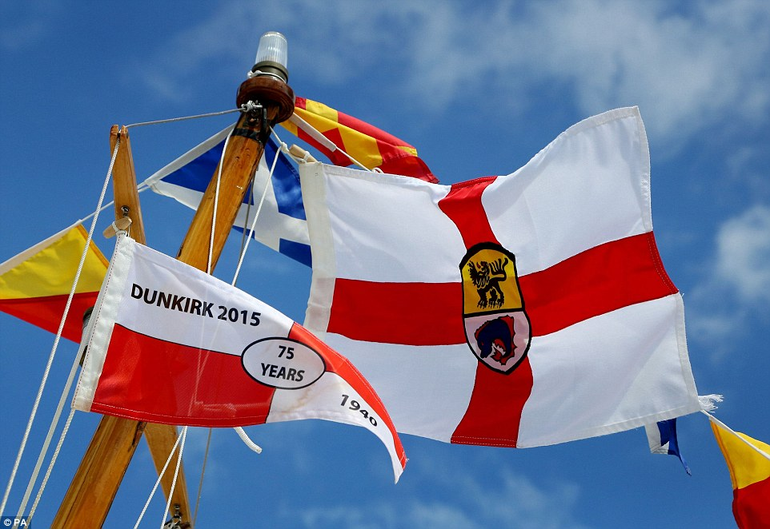
The Cross of St George, adopted by the « Little Ships »
And now the emblem of the association of Dunkirk Little ships.

Slide 18
German propaganda tract May 1940

Slide 19
Dover, strategic position for British military operations

Slide 20
The white cliffs of Dover

Slide 21
Arial view of Dover Castle

Slide 22
Promontory looking over the Channel
Statue of Vice-admiral Bertram Ramsay, …

Slide 23
…responsible for the coordination of the Dunkirk evacuation
Codename « Operation Dynamo »

Slide 24
Winston Churchill surveying action in the Channel from Dover Castle

Slide 25
Operations room below Dover Castle

Slide 27
May 14th 1940
The BBC announced the Admiralty’s decision to requisition all boats between 30' and 100' in length for the purpose of the evacuation.

Slide 28
The first of the « Little ships »
left for Dunkirk from Ramsgate on 26th May 1940

Slide 29
May 2015 : 75th anniversary of « Operation Dynamo »
Over 50 « Little ships » made the return jouney to Dunkirk.

Slide 31
« Sundowner » belonging to Charles Lightoller
Survivor of the Titanic disaster and volunteer for Operation Dynamo

Slide 32
The Cross of St George, adopted by the « Little Ships »
And now the emblem of the associiation of Dunkirk Little ships.

