Slide 1
THE BIG REVISION QUIZ
BLOGGERS 6ème

Slide 2
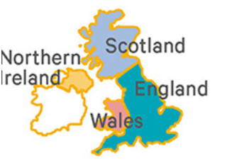
1. What is the capital city of scotland?
Cardiff
Belfast
Edinburgh
London

Slide 3
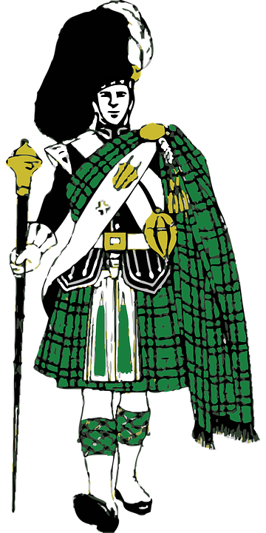
ANSWER C
The capital city of Scotland is: Edinburgh.

Slide 4
2. Name 6 english-speaking countries*. (*DES PAYS anglophones)
The United Kingdom, Ireland, Iceland , Australia, the USA and Canada
The United Kingdom, Ireland, New Zealand, Australia, the USA and Canada
The United Kingdom, Iceland, Australia, South Africa, the USA and Canada

Slide 5
ANSWER B
The UK, Ireland, New Zealand, Australia, the USA and Canada are English-speaking countries.
But people also speak English in South Africa and in India.

Slide 6
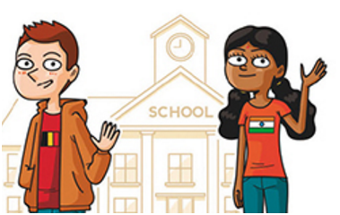
3. Fill in the blanks
Hello, _________ your name?
__________ are you from?
What’s your _____________?

Slide 7
ANSWERS:
Hello, what’s your name?
Where are you from?
What’s your nationality?

Slide 8
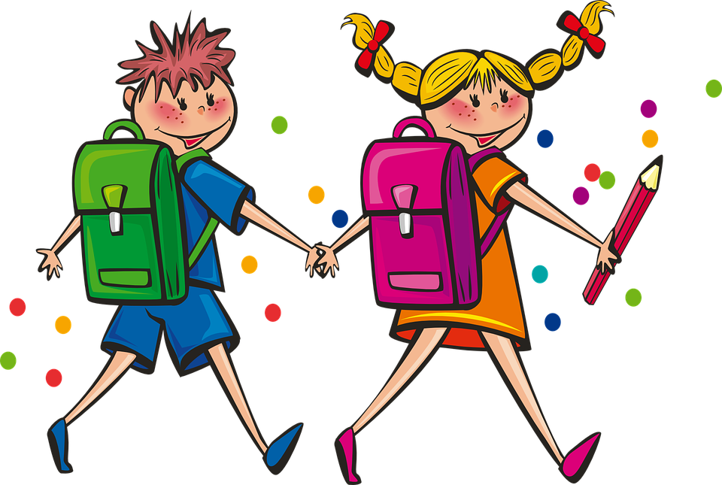
4. What can you find in a school?
A gym, a cafeteria, a library, classrooms, computer rooms and lockers.
Bedrooms, a bookshop, a library, classrooms and science rooms.
A playground, classrooms, a library, a kitchen and a hall.

Slide 9
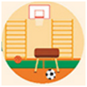
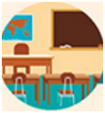
ANSWER A
At school, there is a gym, a cafeteria, a library.
There are classrooms, computer rooms and lockers.
there is + nom singulier / there are + nom pluriel = il y a

Slide 10
5. Find the correct sentence.
He likes cycling.
He like cycle.
He love cycling.
He loves cycling.

Slide 11
ANSWER D
He loves cycling.
Au présent simple, à la 3ème personne du singulier,
le verbe prend un s.

Slide 12
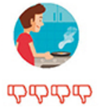
6. Find the correct sentence.
He hates cooking.
He doesn’t like cooking.
He doesn’t cooking.
He doesn’t likes cooking.

Slide 13
ANSWER A
He hates cooking.
Rappel : la forme négative du présent simple :
ex : He doesn’t like cooking.
A la 3ème personne su singulier, on utilise l’auxiliaire doesn’t + la base verbale (sans le s).

Slide 14
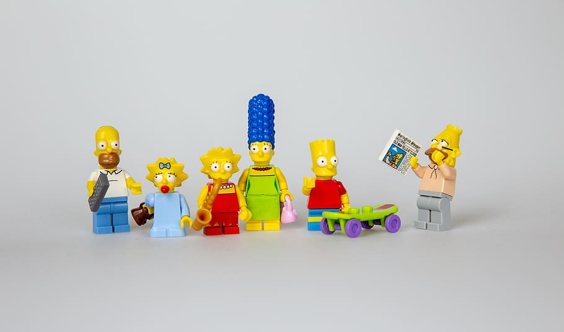
7. Complete the sentences about bart’S FAMILY.
Pxfuel royalty free
Bart _____________ two sisters.
His ______________ is Abraham.
Patty and Selma are Bart’s _________.
Homer is Marge’s ____________.

Slide 15
7. ANSWERS
Bart has got two sisters.
His grandfather is Abraham.
Patty and Selma are Bart’s aunts.
Homer is Marge’s husband.

Slide 16
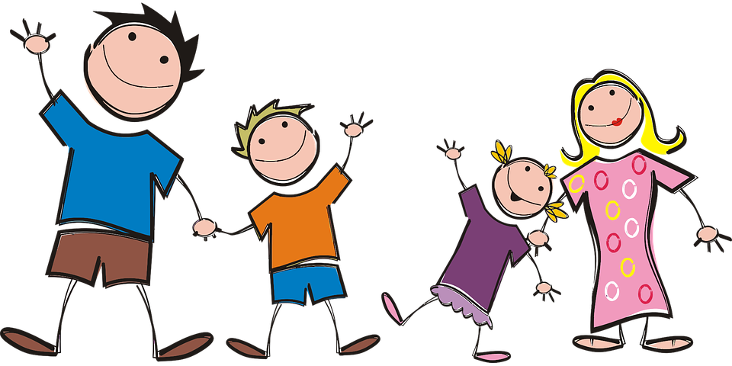
8. Who is it? LOOK AT THE PICTURE Choose the right description.
The father is fat and tall, the mother is short, the daughter has got brown hair and glasses and the son has got black hair.
The father is tall but he isn’t fat. The mother is medium-height and she is slim. The son has got blond hair and the daughter has got blond hair too.
The father is very slim, the mother has got long hair, the daughter is short and the son has got a cap.

Slide 17
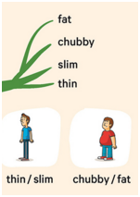
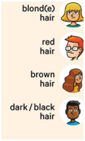
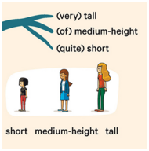
ANSWER B
b. The father is tall but he isn’t fat. The mother is medium-height and she is slim. The son has got blond hair and the daughter has got blond hair too.

Slide 18
9. Morning routine complete the sentences.
First, I ________________ at 7 am.
Then, I have ________________ . I have toast and hot chocolate.
Finally, I ________________ my teeth every morning.

Slide 19
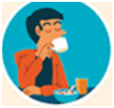
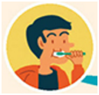
9. Morning routine ANSWERS
First, I get up at 7 am.
Then, I have breakfast . I have toast and hot chocolate.
Finally, I brush my teeth every morning.

Slide 20
10. SCHOOL SUBJECTS WHICH ONES ARE NOT SCHOOL SUBJECTS?
Writing, Gaelic Football, Irish Dancing, Acting
English, P.E, Drama, Art, History, Business Studies
Geography, Science, Religious Education, Maths, Music

Slide 21
10. ANSWER A
Writing, Gaelic football, Irish dancing and acting are hobbies (= activities) or school clubs.
They are not school subjects*.
A school subject = une matière scolaire

Slide 22
Great job !

