Slide 1
History
Pilgrims
In 1620, a group of ______________ left
________________ on a boat called the
___________ to go to ____________.
The first winter was very hard.
England
Mayflower
America

Slide 2
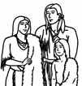
But the _________________ helped the
Pilgrims.
They showed the Pilgrims how to cultivate
_____________ and catch _______________.
To celebrate their first ________________
in 1621, the Pilgrims invited the Native Americans and
organised a big party.
Native Americans
corn
fish
harvest

Slide 3
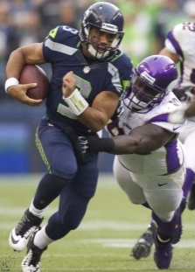
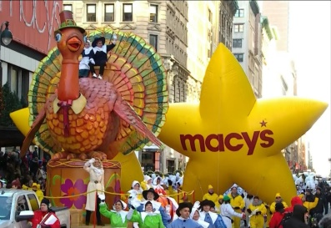
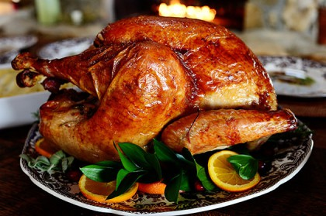
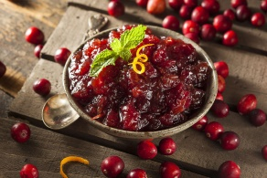
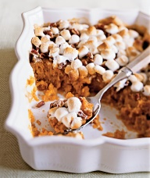
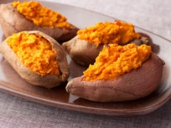
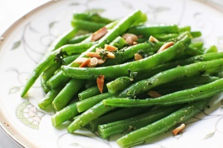
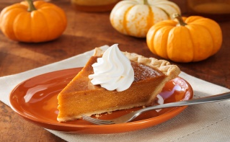
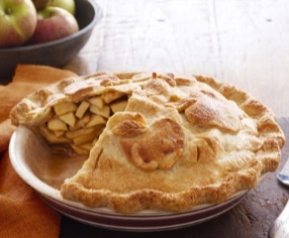
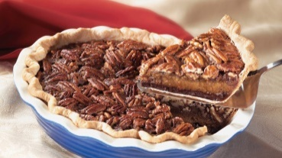
American football
Thanksgiving parade
roast turkey
cranberry
sauce
sweet
potatoes
green beans
pumpkin pie
apple pie
pecan pie

Slide 5
Thank you for ...
my
pets
my friends
my
dog
my
family
John
football
my sisters
food

