Slide 1
MOST COMMON BRITISH STEREOTYPES
Stereotyping is believing that people of a certain group, race or religion all have the same characteristics but they don’t.

Slide 3
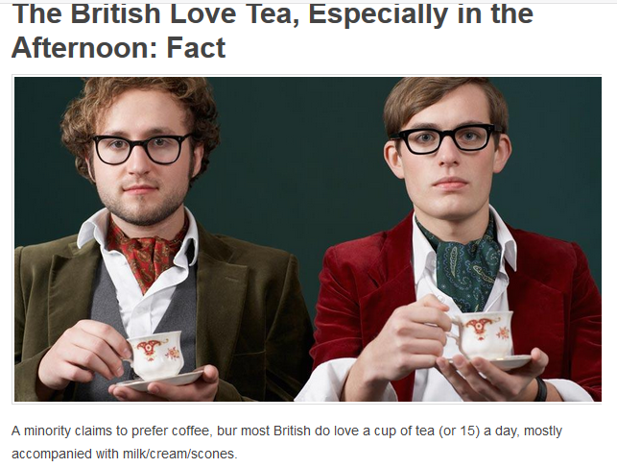

Slide 4
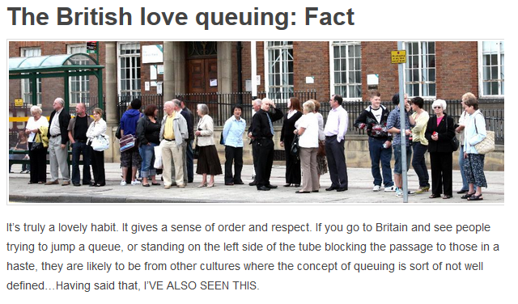

Slide 5
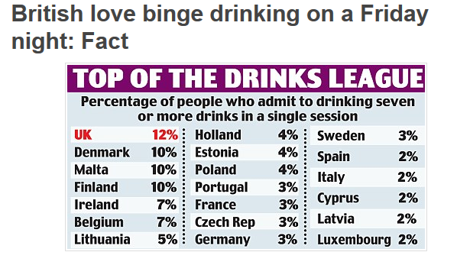
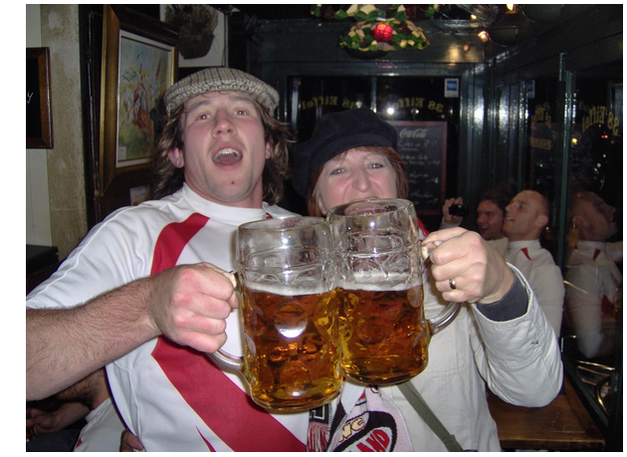

Slide 6
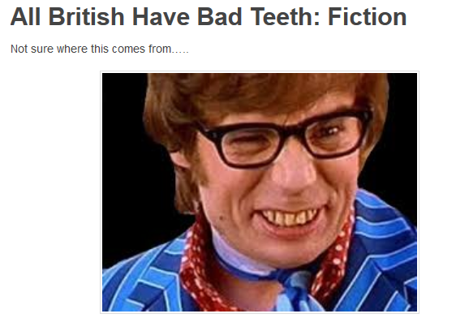

Slide 7
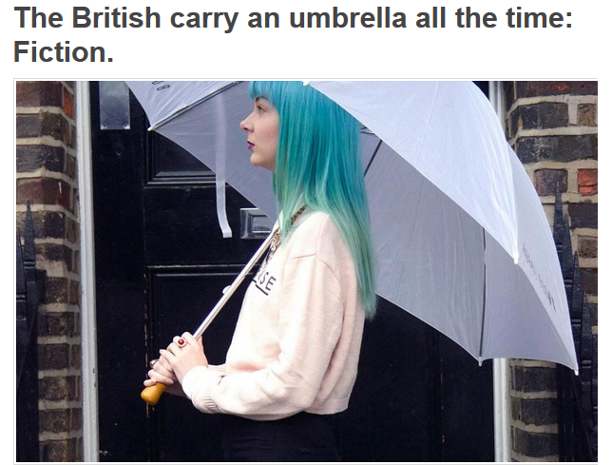

Slide 8
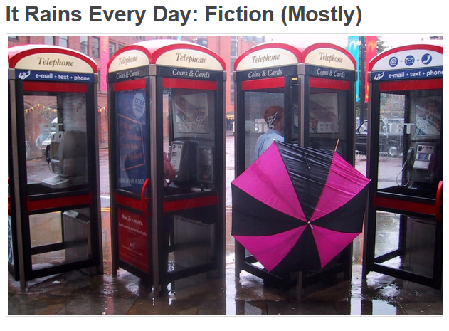

Slide 9
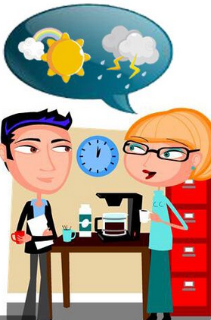
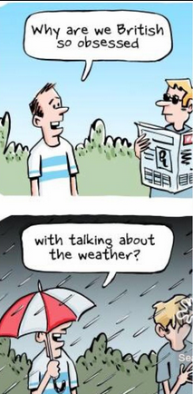

Slide 12
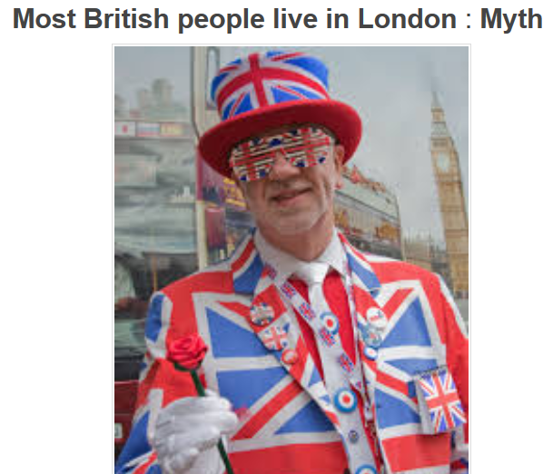

Slide 13
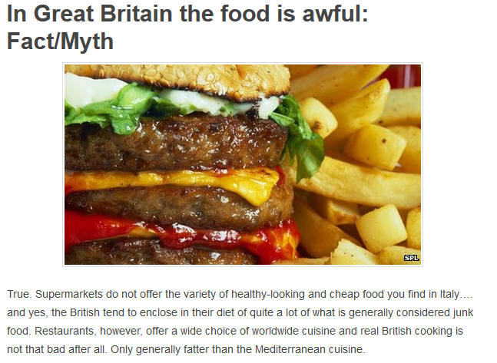

Slide 14
TEST YOUR MEMORY
FACT or MYTH?

Slide 15
FACT or MYTH?

Slide 16
LET’S RECAP
about the most common stereotypes

Slide 17
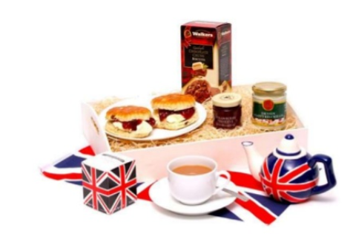

Slide 18
They love tea.

Slide 19
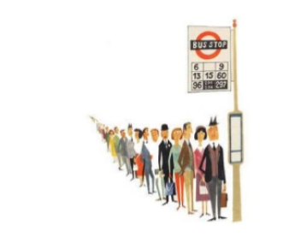

Slide 20
They like queuing a lot

Slide 21
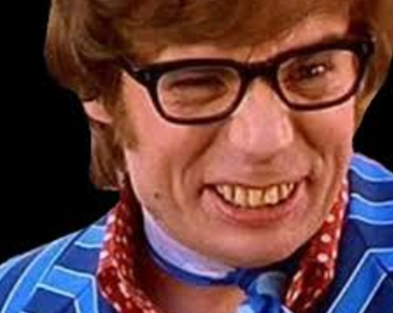

Slide 22
They all have bad teeth

Slide 23
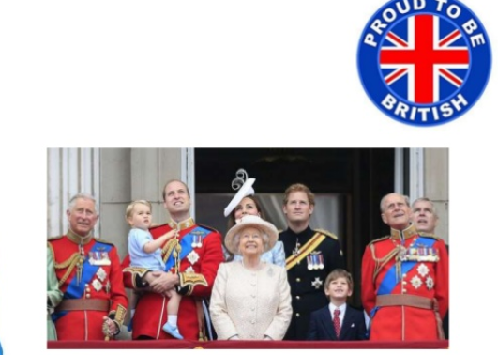

Slide 25
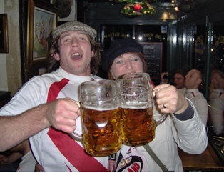

Slide 26
They love drinking beer. They drink a lot.

Slide 28
They are very punctual

Slide 30
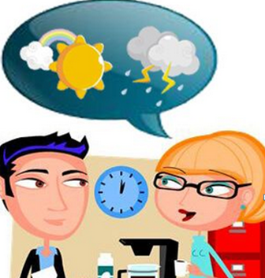
They like talking about the weather

Slide 31
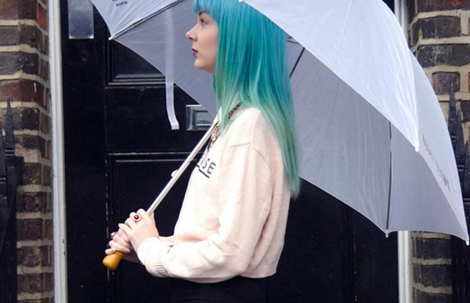

Slide 33
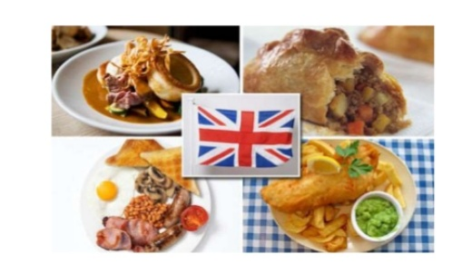

Slide 35
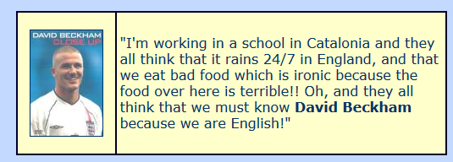
Find the 3 stereotypes mentioned:

Slide 36
Facts about English people

Slide 38
