Slide 1
Our trip to South Africa (from the 18th of June to the 2nd of July, 2010)
First city: Nelspruit
Second city: Polokwane
Third city: Johannesburg

Slide 2
Our project:
This summer, our common dream became true: we attended the football World Cup in South Africa. We had been waiting for that for so many years!
We decided to relate our trip day per day, according to the different cities we visited. That’s why Gloria wrote the first part (Nelspruit), Marco the second (Polokwane), and Maria the last one (Johannesburg). All the “articles” were written in the evening, just after the different events happened. Enjoy !

Slide 3
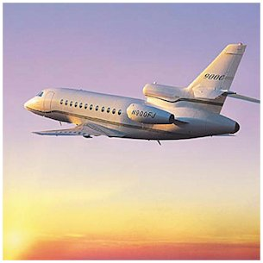
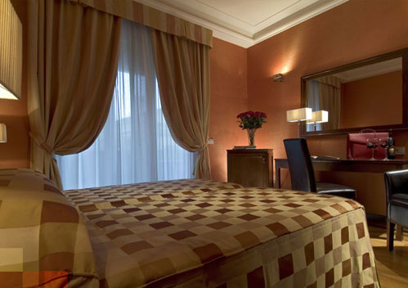
On the 18th of June : departure
We took the plane from Roma’s Chimpino airport at 9:30 am. Our plane (company : Airvalid) was late, even though we had bought quite expensive tickets (5 325 € in all) ! What a start !
The travel lasted 29 hours but we had 2 stopovers : in Egypt and in Congo. We slept on the plane. Finally, we arrived in Kruger Mpumalanga International airport in Neslpruit at 14:30 pm , local time the next day.
Fortunately, we had booked a hotel not far from the airport. The hotel (Nomndeni Celoquhle) was a very good one : for 90 € per night, we had dinner and a very beautiful view. We unpacked in our bedroom and, 2 hours later, we were prepared for the match between Italy and New Zealand the day after!

Slide 4
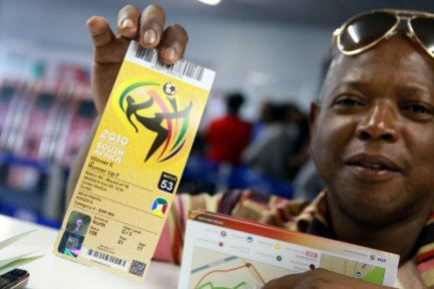
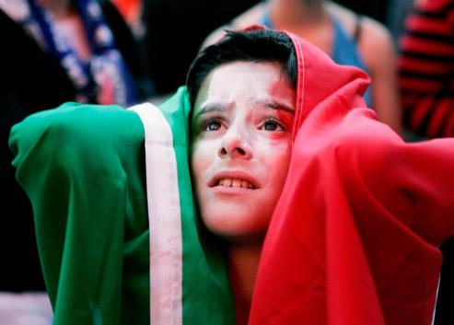
On the 19th of June : Italy vs New Zealand
Buying our tickets
A compatriot!
We were terribly excited. We were going to see a World Cup match ! We bought our tickets $80 and for that price we were quite well placed. The atmosphere was electric and joyful. Italy played especially well and won 3 to 1.
We came back exhausted to our hotel at about 11:00 pm.
It was a wonderful day, full of hope and laughter. Thank you Italy !

Slide 5
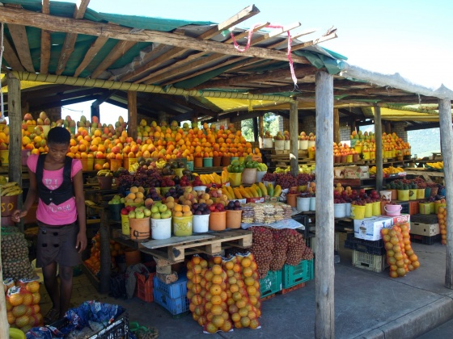
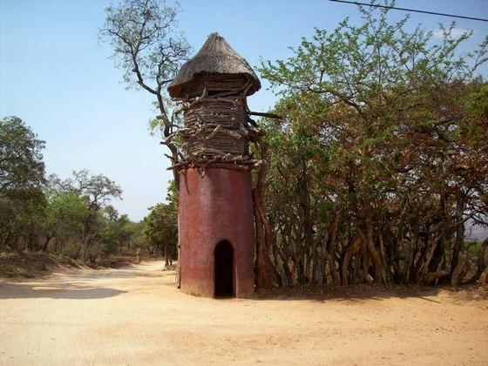
On the 20th of June
Today, we walked around the city, in the hidden streets, the markets, the public gardens… we bought traditional handcraft and local food and fruit. It was so hot (around 45°C)!
A typical South African market
On the 21 of June
That day, we visited a picturesque village : the cultural village of Shangana with a day tour.
Midway between the Blyde River Canyon and the southern Kruger National Park, the residents of the traditional village of Shangana invite guests to share the way of life of the Shangaan people. Shangana was created and built by local Shangaan people, and preserves a rich heritage, as an example of South Africa's great cultural diversity. This village is due to the installation of the Zulus, a famous tribe in South Africa who fought the English Colonizers in the nineteenth century.
Entrance to Shangana village

Slide 6
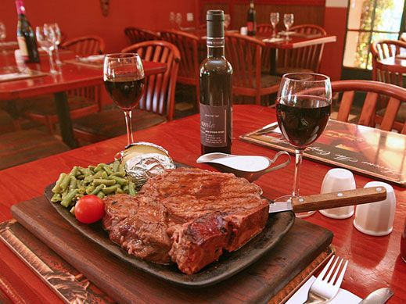
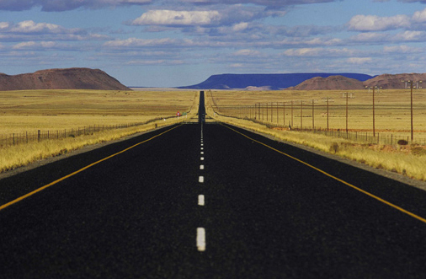
On the 22nd of June
We had booked a car from Rome and tomorrow, we’ll take it from the station. It does not cost a lot : around 15€ per day. We ate in a typical restaurant, but the South African food is inspired from Dutch cuisine (because of colonization).
Then, we packed our suitcases and checked out of the hotel.
We left Nelspruit, to go to Polokwane for the rest of this incredible trip.
South African food
On our way to Polokwane

Slide 7
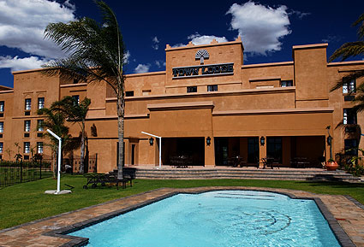
23rd of June:Polokwane, here we are!
The car trip was long (around 3 hours). We really enjoyed those breathtaking landscapes.
We arrived around noon. We had to rush into the Town Lodge Polokwane hotel because we hadn’t booked in advance and crowds of tourists were seeking for a place to sleep. Once we booked our few nights there, we enjoyed walking in Polokwane and booked to visit Bakone Malapa Open Air Museum on the 24th of June.
Our hotel
( we enjoyed so much the swimming pool!)

Slide 8
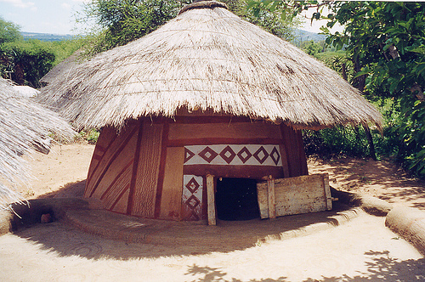
24th of June: Bakone Malapa Open Air Museum
What we found very interesting was that the museum invites visitors to take a step back in time and explore a traditional Bakone village as it existed 250 years ago as well as how the inhabitants lived.
Archaeological excavations like painted rocks have been carried out in the area around Bakone Malapa Museum. Researches proved that this area was first occupied by
the San tribe, before being occupied by the
Bakone people.
The museum is located about 9km of Polokwane along the road to Lebowakgomo

Slide 9
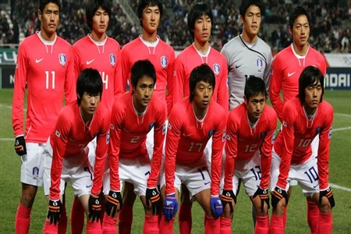
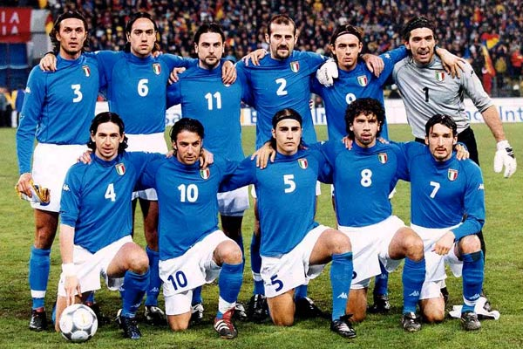
25th of June: Italy vs North Korea
Our second match was awesome! Tickets were about the same price as the previous match. The Northern Korean team played very well; but we must admit that we defended ourselves pretty well! We could hardly say who was going to win before the referee whistled the end of the match. And guess what? We WON 2 to 1
The Northern Korean team
Our national team

Slide 10
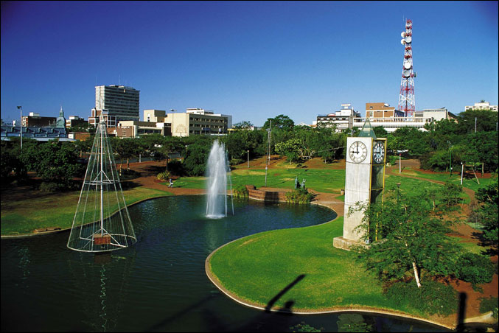
26th of June: leaving Polokwane
Leaving Polokwane was quite difficult, we had such a great time here! But we had to move on to the next match in Johannesburg, one of the hightlights of our trip: Italy vs Greece, the clash of the Titans!
We packed, and left the Limpopo province, whithout knowing when we would be able to come back.
Polokwane

Slide 11
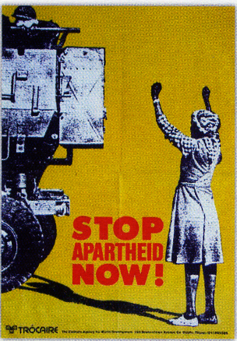
27th of June :The apartheid museum
What is apartheid?
In 1948, the white elected National Party government implemented the policy of apartheid which turned 20 million people into second class citizens. People were divided into several racial classes. White people had rights and privileges, whereas black people's civil rights didn't exist.
They didn't have the right to vote or the right to own lands. They had to live in "homelands", places established by the apartheid Government. This segregation led to the anti-apartheid movement.
After decades of fighting, apartheid was abolished. In 1994, a new constitution was ratified and the country organized the first democratic elections. Nelson Mandela, the leader of the anti-apartheid movement, was elected.
In the morning, a taxi drove us to the Apartheid Museum in Johannesburg, which opened in 2001 and illustrates the rise and fall of apartheid.
The museum is very rich in terms of information and pictures, and the guide was fascinating. Apartheid is an important part of South African's history.
We ate in a restaurant next to the museum, and then we had a walk in the city.

Slide 12
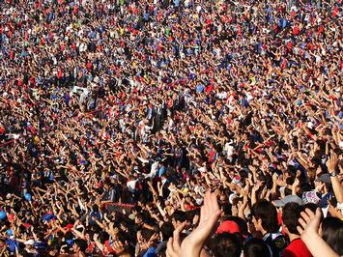
28th of June: Italy vs Greece
The day after, we attended the match which opposed Italy to Greece, in Ellis Park Stadium, situated in the heart of Johannesburg. We had already seen these two teams confronting each other a few years before, but this match was particular since it was the very first time we were seeing them playing against each other in the World Cup. It was our very last match, and we knew we might not attend another World Cup for a long time. We savoured every single moment of this event : from the departure from the hotel to the final whistle. There was a great party atmosphere in the terraces. Italy lost 4-3... But we didn't mind : we had supported our team till the last moment and that was what counted.
The crowd was pretty much involved in this match as you can see!
The stadium before it got full

Slide 13
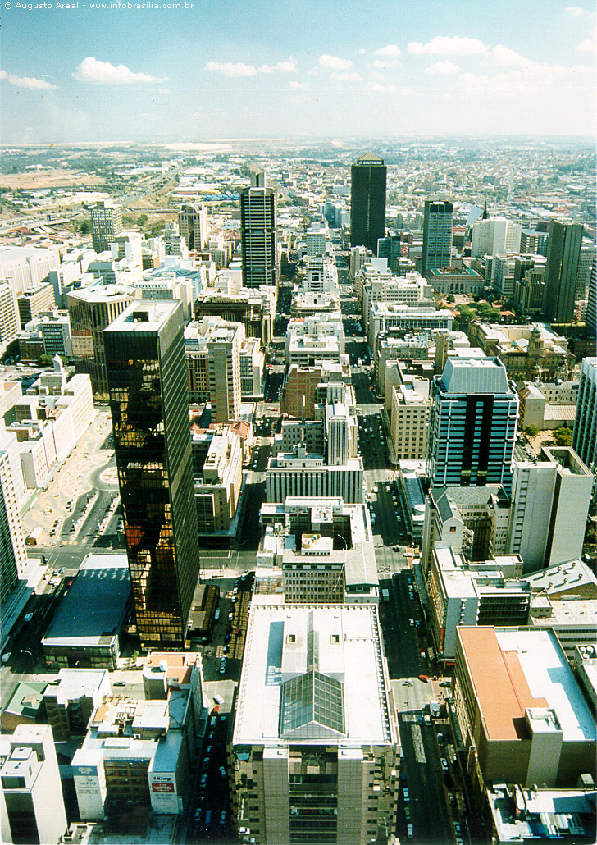
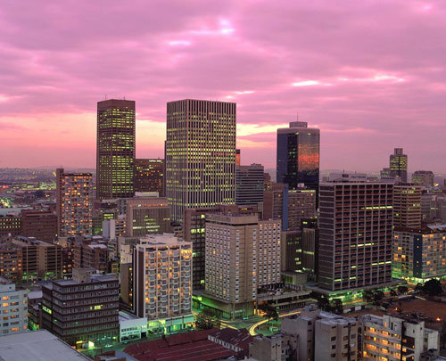
29th July: a lazy day!
We had breakfast in the hotel. We had nothing programmed for this day, so we decided to go to Johannesburg Tourist Office to see what we could do in the afternoon.
The city by night
This picture is taken from one of the highiest towers
of Johannesburg, the view was outstanding!

Slide 14
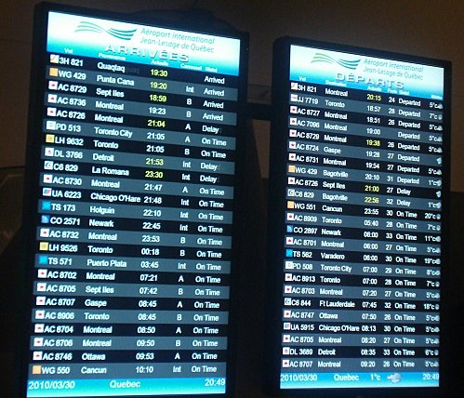
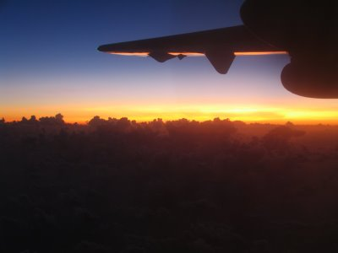
30th July: coming back home from the Rainbow Nation
We woke up at 6 am in the morning because our flight was planned at 10:53 a.m. so we had to be at the airport early enough to go to the check-in desk. We arrived in the airport just in time. In the waiting room we happened to meet Italian supporters who were going back home after a couple of weeks spent in South Africa... We hit it off straight away and, incredible coincidence: their seats were next to ours in the plane!
Fortunatly our plane was on time !
Our last South African sunset from the plane

Slide 15
This is the end of an exceptional experience we won’t forget : we spent 13 fabulous days, discovering a country, its culture, its history, its people, and we really experienced the World Cup euphoria. We were able to combine our two passions: history and football. Now we can state positively : watching a World Cup football match on TV has nothing to do with attending it in a stadium...

