Slide 1


CVs & interviews …your past, present & future
Ellen Desurmont
+
Michael Green
October 10th 2025

Slide 2
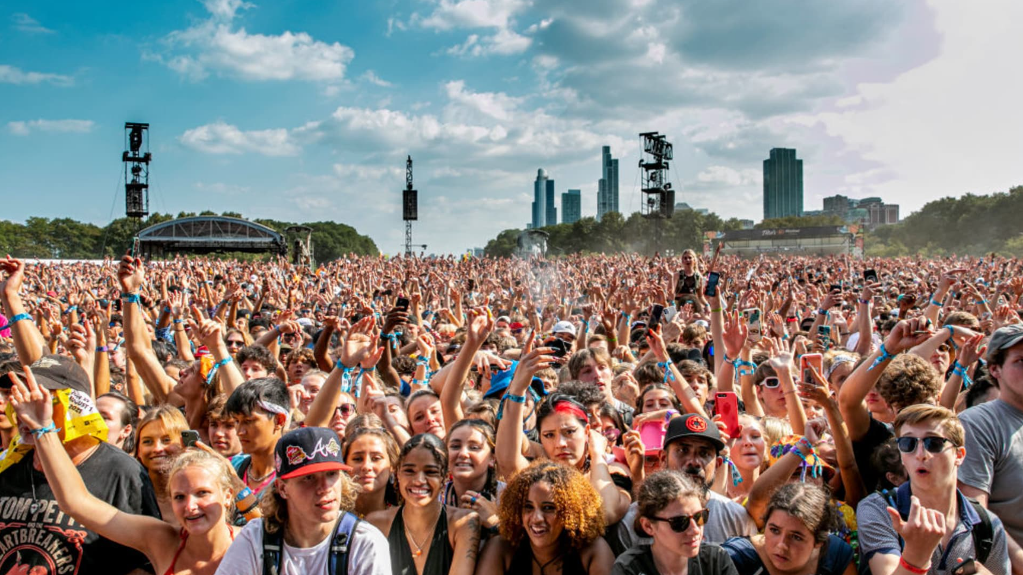
Notes:
You are one of many

Slide 3

Part 1: who am I?
Notes:
Ask yourself this question.

Slide 4
Curriculum Vitae “course of life”
Notes:
It’s not a piece of paper. It is your story

Slide 5
Telling your story. Backwards
Education. Extra-curricular. Community. Work. Skills.
Notes:
This is probably the right order at your stage in life

Slide 6

Standing out from the crowd: 20 seconds to make an impact
Notes:
This is how long someone reading your CV is likely to take when doing a first filter. They are reading A LOT of CVs

Slide 7

3-5 line summary: Make an impression In under 10 seconds
Notes:
You need to summarise yourself right at the top of the CV. This where the biggest impact happens and makes them want to read more.

Slide 8
Relax. Today, you have 1 minute
Notes:
We will ask everyone to think about how to present themselves on stage in 1 minute. At the end, depending on the time we have left we will ask for volunteers to have go.

Slide 9

Customisation
Notes:
You do not have just 1 CV. It should be customized. At very least in the opening few lines

Slide 10
Clean Concise Bold
Notes:
Design is REALLY important. Make it easy to read. Bring attention to the points you want them to read

Slide 11

Beating the algorithm: use keywords, action verbs, numbers
Notes:
This is part of the customization. Make sure you find words that match what you are applying for. Use action verbs not passive language. Use numbers where you can to quantify acheivements

Slide 12

Part 2: getting an interview
Notes:
University or job, same rules apply

Slide 13

Research
Notes:
It starts here

Slide 14
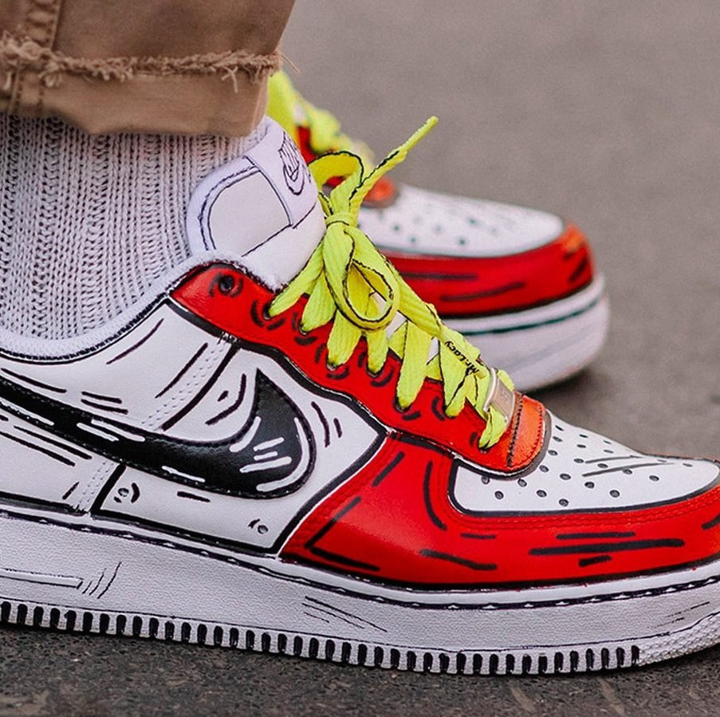
Check your CV fits. Customise it again.
Notes:
Make sure your CV still fits. Fine tune it.

Slide 15

Letter of motivation.
Notes:
Make sure the tone fits the position you’re applying for. This will really vary and should reflect the culture of the organization you’re targeting

Slide 16

Quality & Quantity
Notes:
Quality = quality of your application but also the quality of what you are applying for. Don’t send poor applications and don’t apply for things you don’t actually want.
you need to be ready send A LOT of applications. Especially for internships and jobs. Don’t lose faith.

Slide 17
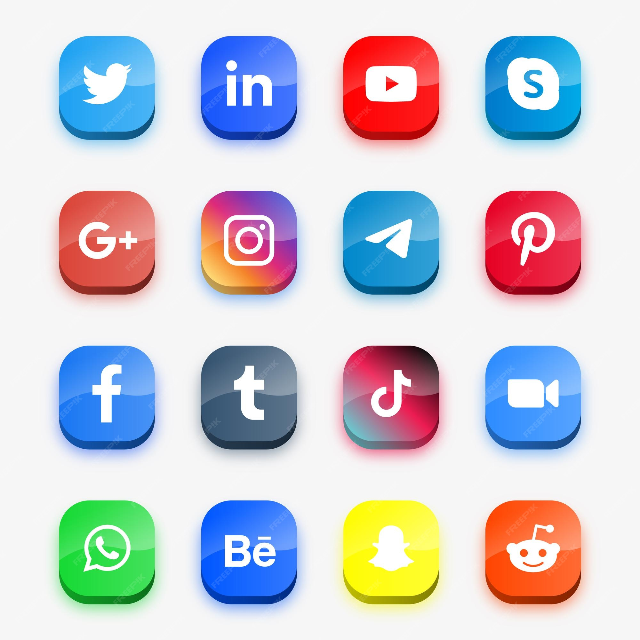
Networking: the importance of making & using contacts
Notes:
This is the NUMBER 1 way to get a good job or internship. The reality is that lots of posts are filled via networks, especially as you progress in your career
Networking is also very important for research and preparation

Slide 18

Part 3: the interview

Slide 19
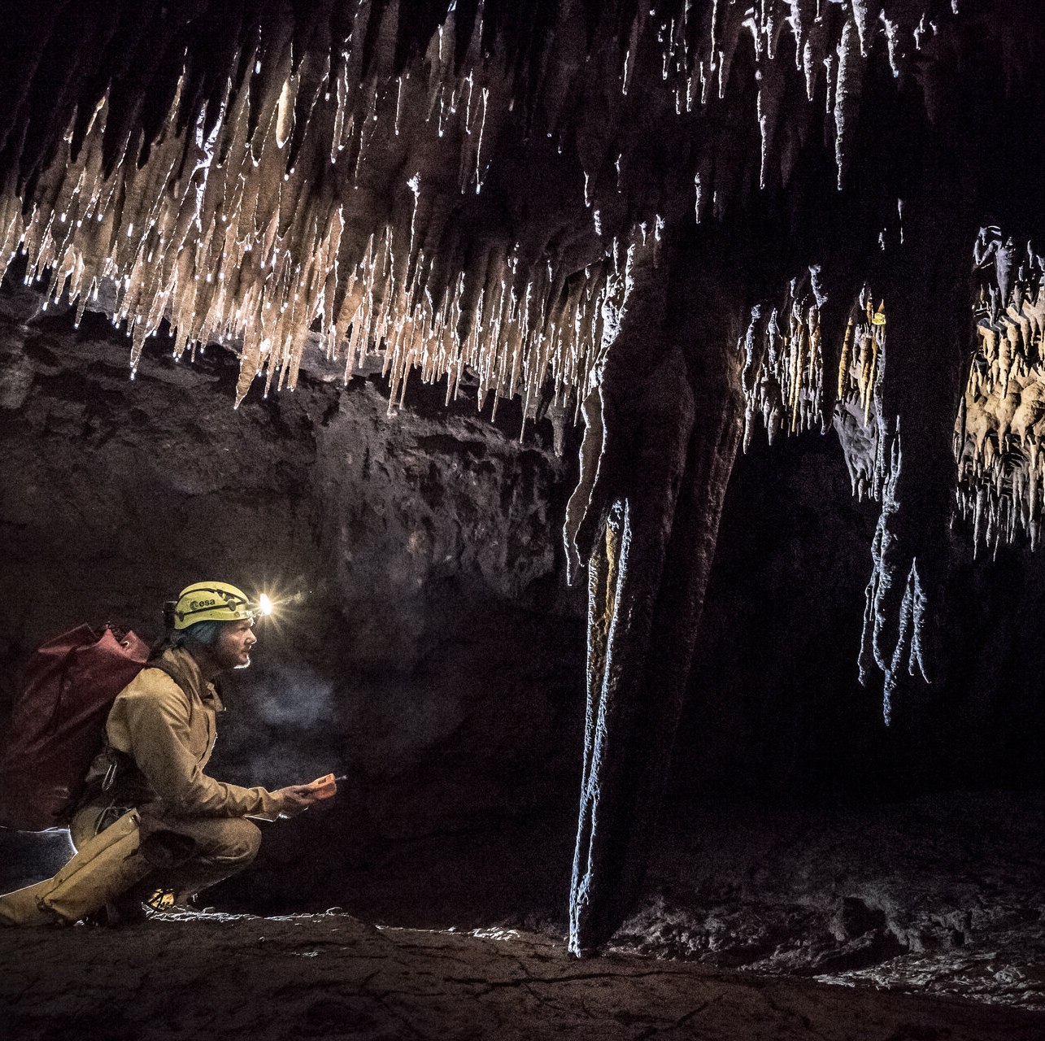
Deeper research
Notes:
Fail to prepare, prepare to fail

Slide 20
Review your CV: know every sentence, every claim
Notes:
You have to learn everything in your CV, back to front. You could be asked any question – be prepared to talk about it

Slide 21

Preparation
Prepare talking points
Prepare questions
Be ready with stories
Notes:
This gives you control in an interview. The same as for your French Oral exams

Slide 22
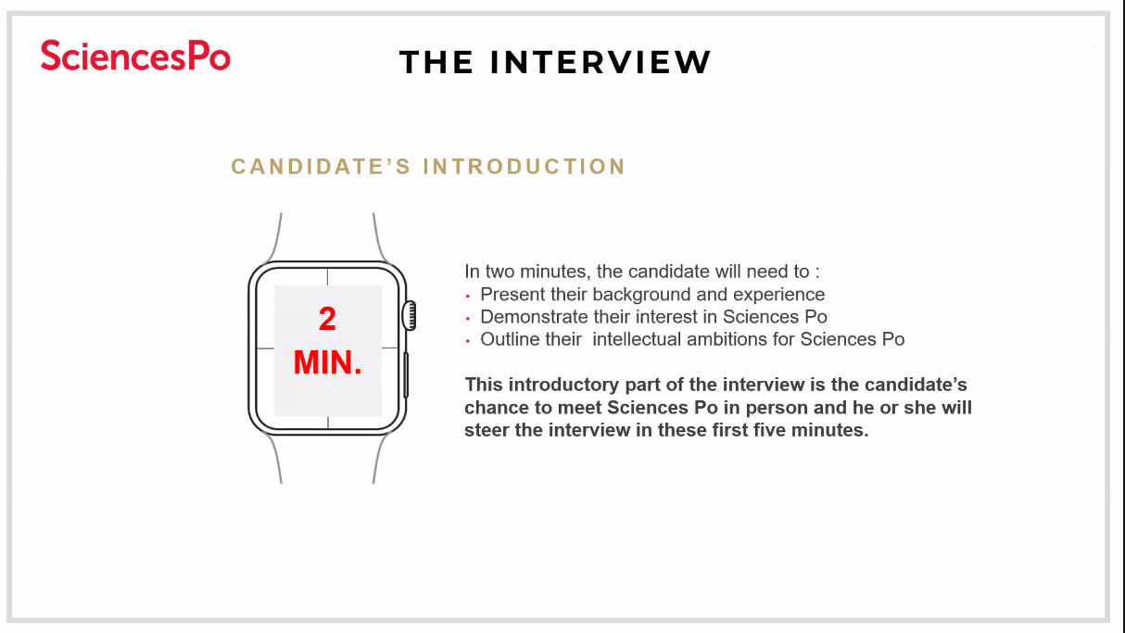
Notes:
Real example from 2025 Sciences PO dual degree programme

Slide 23
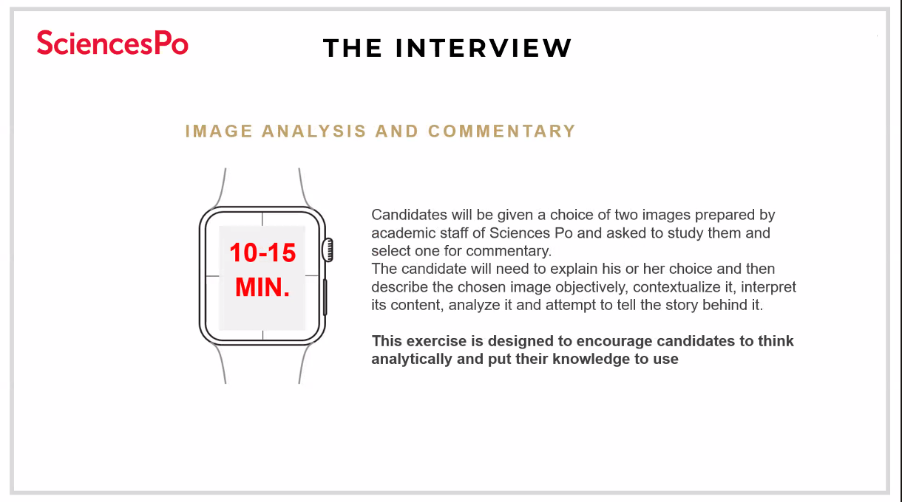

Slide 24
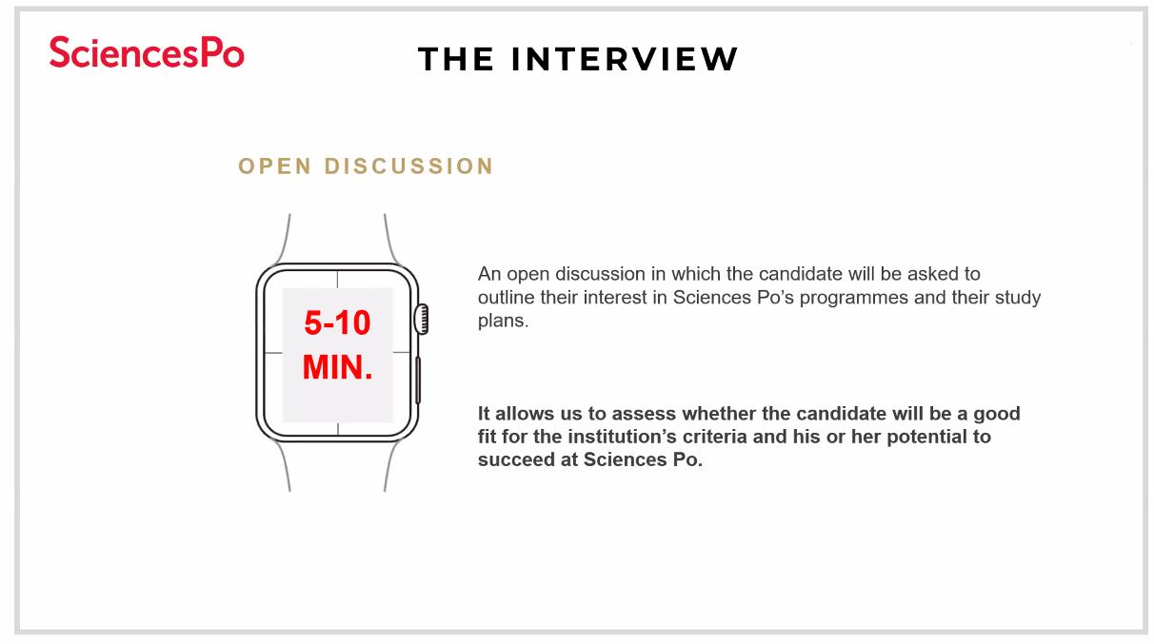

Slide 25
Rehearse. Rehearse. Rehearse.

Slide 26
Be you. Don’t be shy. Show you want it.
Notes:
Strike the right balance between modesty and arrogance is important. You know your personality, tailor it accordingly

Slide 27

Need help?
Feel free to send us your CVs & questions to:
Ellen Desurmont ellenju@hotmail.com
Michael Green michaelgreen90@me.com

