Slide 1
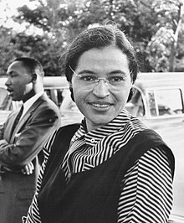
Rosa Parks
Rosa Parks was born on February 4, 1913 in Tuskegee (Alabama, United States).
She died on October 24, 2005 in Detroit. (Michigan,United States)
Her real name was Rosa Louise McCauley.
She refused to leave her place to a white man on a bus. She was sent by the NAACP. After this, she was arrested. Her actions helped create the Montgomery Bus Boycott.

