Slide 1
Guess The Job
It’s in relationship to animals
It’s in relationship to Medicine
It can be practiced indoor, outdoor, in a clinic…

Slide 2
Job of the Day
Veterinary

Slide 3
Tasks
She.He diagnoses, treats and prevents diseases
She.He delivers the necessary drugs
She.He vaccines
She.He practices surgeries
She.He must reassure the owners
She.He deliver sanity checks for the industry to avoid pandemic like avian flu or mad cow
She.He administers the clinic

Slide 4
Skills
Some skills are very important and must be natural or learnt and developed along the studies to success in veterinarian practices
Communication with the veterinary team and Owners
Empathy
With people to reassure the owner of the pet
With animals to feel their stress and relax them during examination
Organisation and Time Management
Veterinary have a lot of admin tasks and responsibility
Technical Skills
Not only medical knowledge is important but also being familiar with technology, software, instruments…

Slide 5
Qualities Required
She.He must have or develop a couple of good behaviors like
Being passionate
Being quite and comfortable with animals
Stress resistant
Being available for emergencies
Not being afraid about blood, stings and dangerous species
Having a good memory
Being adaptable to any situation

Slide 6
Studies and Qualifications
Baccalaureate S Scientific (UK equiv. “level”)
Preparatory class BCPES¹ = Bac+2
Bachelor of Veterinary (“Doctor” in France) = Bac+7
Optional Veterinary Specialization (ex. Surgery) = Bac+9
BCPES: Biology Chemistry Physical & Earth Science (Fr. “BCPST – sciences de la Terre”)

Slide 7
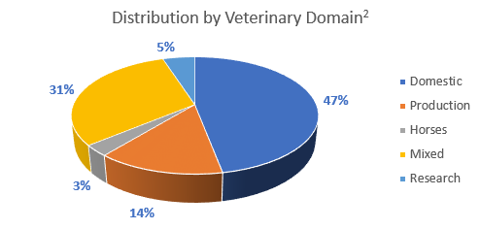
Salary
Salary for a Veterinary depends on the domain and remuneration mode. Mean salary is around €7,383¹ before Tax in between €1,500 for a beginner until €12,752.
Sample domains
Pets, usually in a city
Production animals like in farms or industries
Horses
Mixed activity with at least 2 domains
Research
The revenue may also vary depending on the remuneration mode
Public sector which is more stable but often less paid
Private company highly depending on the contract
Freelance providing autonomy but paid on consultations base and hours worked
Employee or associate in a clinic that may vary depending on reputation
1 http://www.journaldunet.com/business/salaire/veterinaire/salaire-01124
2 http://www.onisep.fr/Choisir-mes-etudes/Apres-le-bac/Principaux-domaines-d-etudes/Les-ecoles-nationales-veterinaires-ENV

Slide 8
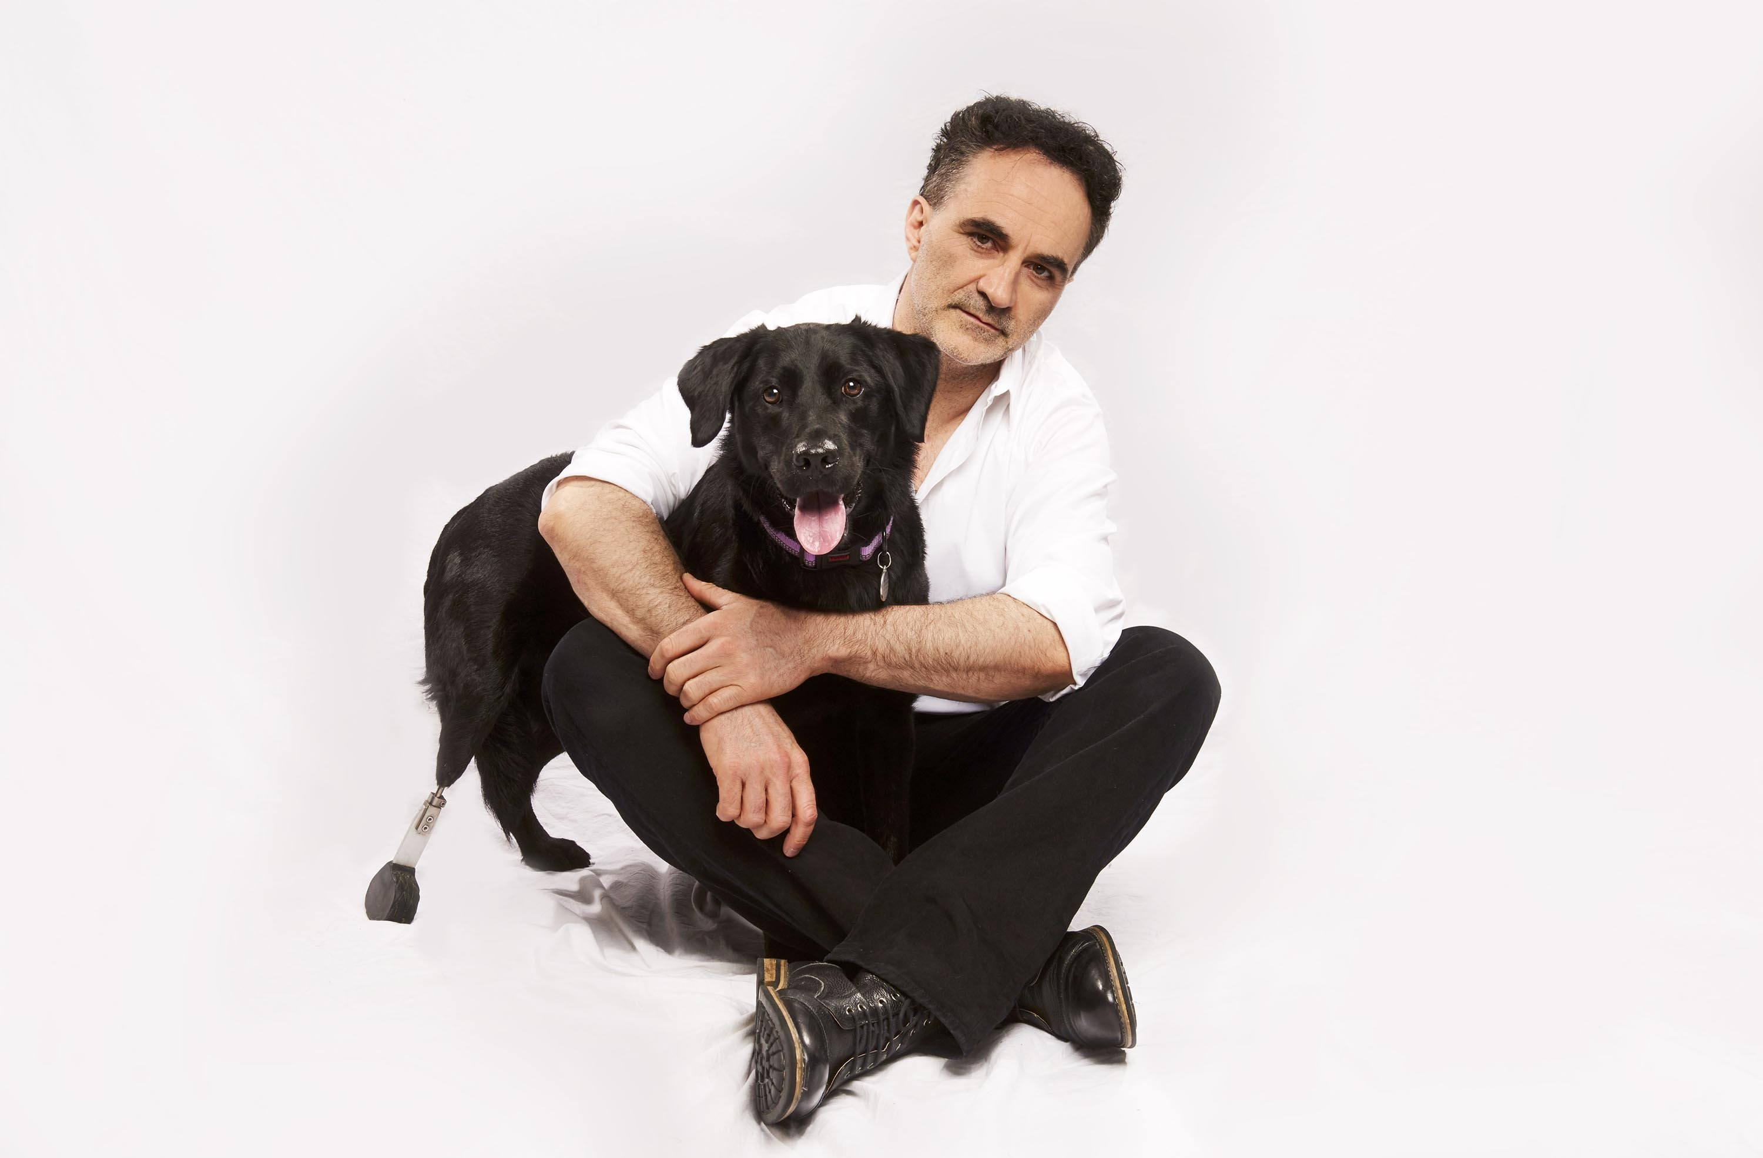
Famous People
Famous people in history
Claude Bourgelat is the founder of the Veterinary College 1761 and the first schools in Lyon in 1761 and Maisons-Alfort in 1765
Henry Bouley was a pioneer in pathology and surgery. He was elected President of the French Academy of Science in 1885
Famous people Today
Professor Noel Fitzpatrick is well-known for his huge contribution on prothesis for pets, his clinic – one of the most important in the world – and his famous TV programme
https://www.fitzpatrickreferrals.co.uk

Slide 9
Famous Schools
4 public schools in France
Famous Veterinary Schools in the World
Lyon
The first Veterinary school in the World created in 1761 to cure cattle¹ diseases
University of California—Davis
Ranked 1st Veterinary school in 2015 by the U.S.News³
Alfort
Veterinary school since 1765
Including a clinic for birds, horses, wild animals and mainly know for domestic animals
Glasgow
Ranked 1st Veterinary school in 2019 by the University Guide⁴
Toulouse
The first high school in the area of Toulouse created in 1825
London
Since 1791 this is the oldest of the 7 Veterinary school in United Kingdom
Nantes
The most recent one created in 1979
Also including a clinic and specialized in research with international partnerships²
Cattle: animals of the farm like cows or pigs (Fr. “bétail”)
Partnership: this is when two enterprises – or schools in this case – decide to work together (Fr. “partenariat”)
U.S.News: https://www.usnews.com/best-graduate-schools/top-health-schools/veterinarian-rankings
University Guide: https://www.thecompleteuniversityguide.co.uk/league-tables/rankings?s=Veterinary%20Medicine

Slide 10
Quizz
Quote me one task of Veterinary?
What qualities they need?
Which studies are needed?
What is the mean salary approximately?

