Slide 1
Guess the job
-He does experiments
-he verifies assumptions
-he communicates the results
of the experiments

Slide 2
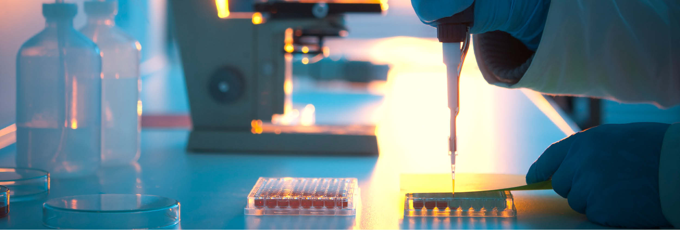
The job is Researcher

Slide 3
Qualities required:
-have originality
-be curious
-be patient

Slide 4
Skills
-master a lot of tools
-communicate the results
-computing skills
-speak different languages

Slide 5
Categories and tasks
Basic research
He plans and researchs projects:
-1st:verifies assumptions
-2nd:do the experiment -3rd:communicates the results
Applied research
He carries out conception and development work
Teacher-researcher
Lecturer or university teacher and do one project every year
-2nd:elaborates
interpretations

Slide 6
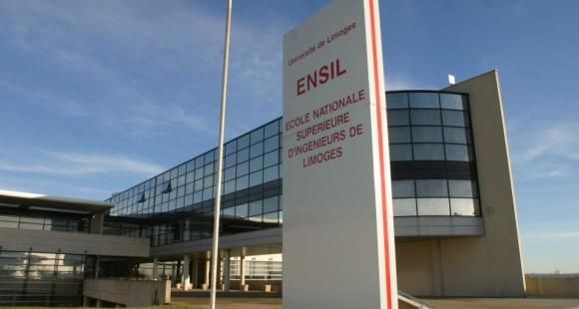
The studies
University course: research master + 3 preparation years + a doctorate(BAC+8)
Engineering school
To become a teacher-researcher: doctorate + lecturer competitive examination

Slide 7
Salary
At the beginning: 2000€-2500€ (for researcher and teacher-researcher)
University teacher: 3000€
In a private company it is very variable

Slide 8
Evolution of the career
The evolution depends on the discoveries
But: he can leave resaerch for an administrative position (management)

Slide 9
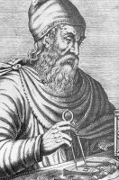
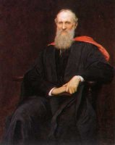
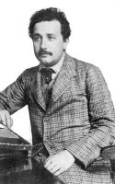
Famous people
There are many famous researchers

Slide 10
Quiz
What are the 3 categories in the research ?
Name several famous researchers
How much does a researcher earn at the begining of his carreer ?

