Slide 1
Guess The Job
- He is very close to Suppliers
- He acts as a link between businesses and Suppliers
- He negotiates prices for purchases of mass to increase company profits
Vocabulary :
Suppliers= Sellers who will make a price according to the order
Purchases of mass = Purchasing a very large numbers of things

Slide 2
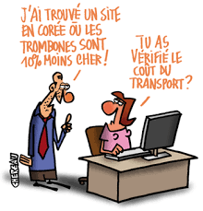
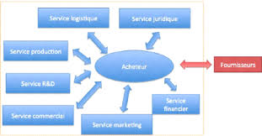
Purchaser
And the job of the day is …

Slide 3
Tasks
Listen to suppliers and propose solutions to the company
Find the best price possible to increase companys profits
Make the connection between the supplier and the company
Verify the quality of the supplier’s products

Slide 4
Skills
Negotiation : Must be able to negotiate to get the best possible price the best price possible within agreed timeframes
Be attentive : Must listen to suppliers and their company to find common ground
Not give up : Don’t let yourself be knocked down even in awkward moments or impasses
Know how to communicate : Be subtle, do not trample and be eloquent

Slide 5
Qualities
Sociable
Eloquent
Tough negociator
Charismatic

Slide 6
Studies and Qualifications
After bachelor’s degree, it takes 3 years to obtain a professional license
The recommended Master’s degrees take place 5 years after bachelor’s degree.
6 years after bachelor’s degree, you can do Specialized master's degrees
Explain what’s a bachelor’s degree and a master’s degree ( give the French equivalent)

Slide 7
Famous business school
France | U.S.A
HEC | Harvard Business School
ESSEC | University of Pennsylvania: Wharton
ESCP Europe | Stanford Gratuate School of business

Slide 8
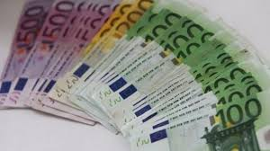
Salary
For a novice : 3333 € gross
For an expert: > 30 000 € gross

Slide 9
Quizz
What are the tasks of a purchaser?
How many years does it take to get a professional license?
Name Three famous business schools?
What is the salary of an expert?
What are the required skills?

