Slide 1
Guess the job
You will have good comunication and team-working skills
You will have to understand maths and physics
You will have to like the hight altitude

Slide 2
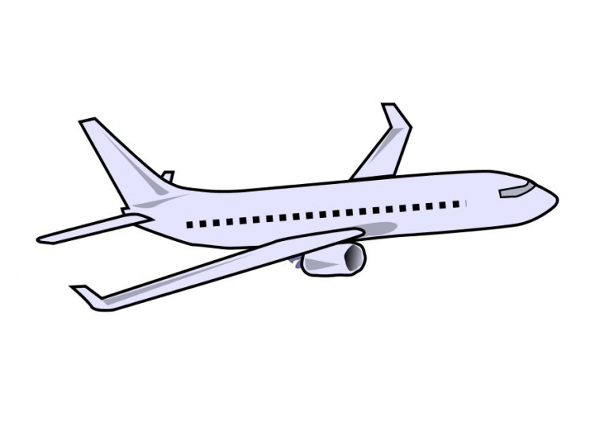
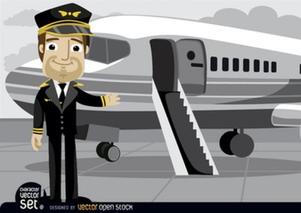
The job of the day is…
PILOT

Slide 3
Studies and qualifications required
Required Bac+5 or more
Science baccalaureate recommanded
Pass an exigeant competitive exam(EPS/S)
US Aviation Academy is a famous university situated in United States of America, Texas, 4850 Spartan Dr, Denton, TX 76207.

Slide 4
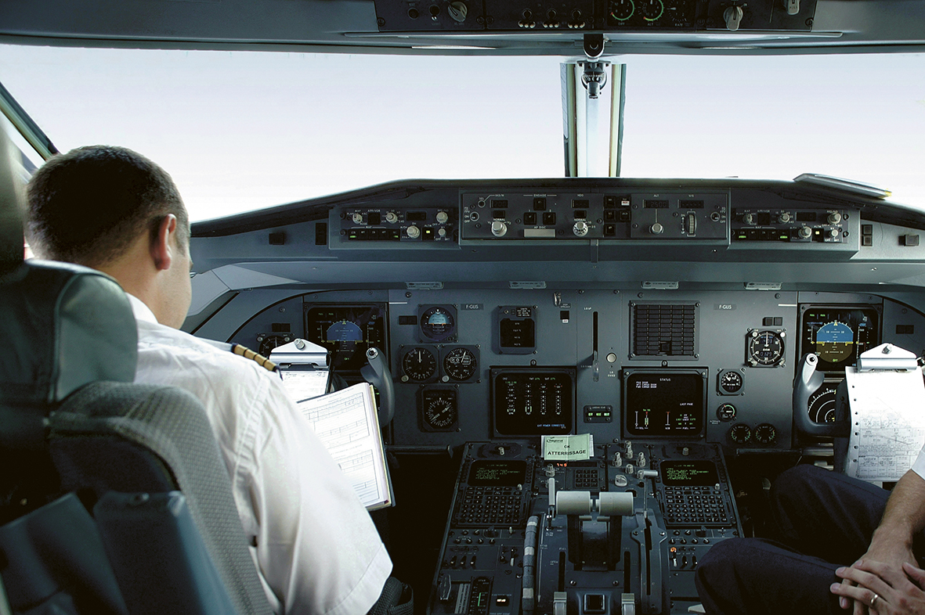
Tasks
Control the aeroplane
Get in touch with control tower
Manage the staff
Make anouncements

Slide 5
Skills and qualities
Attentive
Careful
Patient
Responsible
Reliable
The ability to think quickly and make decisions in difficult situations
The capacity to remain calm under pressure

Slide 6
Salary
Beetween 3000 and 6000

Slide 7
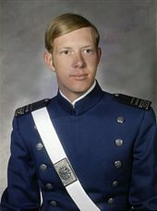
Chesley Sullenberger(1951)
He has saved 155 people abroard a plane.

Slide 8
quiz
What salary does a pilot earn ?
What qualities are required for a pilot ?(5)
What is the name of the aviation university ?
Beetween 3000 and 6000
Attentive,Careful,Patient,Responsible,Reliable.
US Aviation Academy

