Slide 1
Guess the job
Know how to manage jet lag
In this job you travel around the world
You should wear sunglasses
You must have good eyesight and be able to speak English

Slide 2
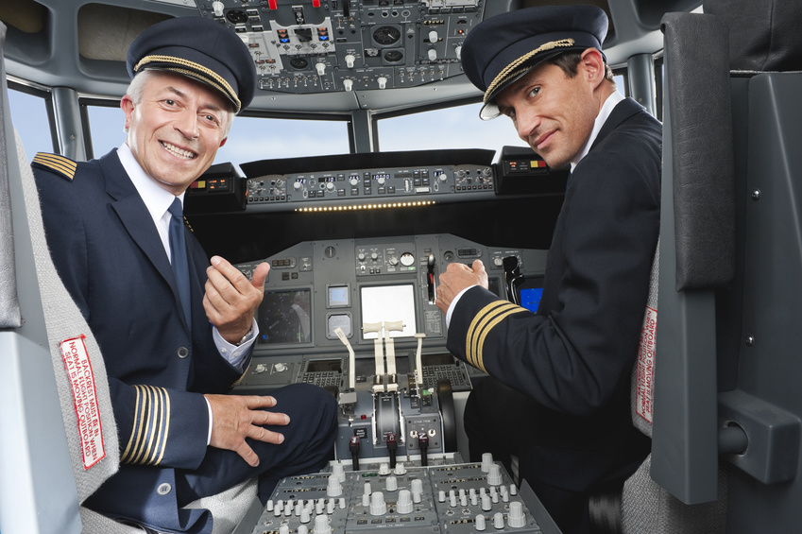
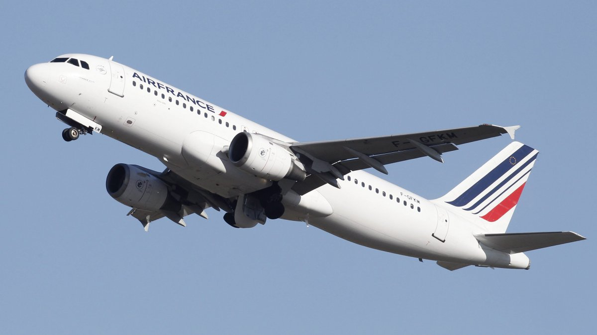
THE JOB IS AIRLINE PILOT

Slide 3
TASKS
Do fuel calculation
Study the weather situation
To drive passengers in safe conditions

Slide 4
STUDIES
To do this job it takes a BAC+ 5
You need a scientific secondary school diploma but also two years in preparatory class of engineering and to present yourself to the test of ENAC
The beginning of the carreer you are co-pilot

Slide 5
SALARY
3.500€ per month at the beginning of the carreer and it can reach 10.000€ per month at the end

Slide 6
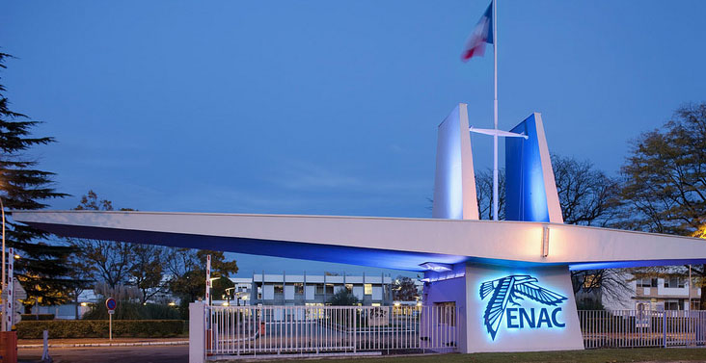
FAMOUS SCHOOL
The ENAC = Ecole Nationale d’Aviation Civile

Slide 7
SKILLS
Easyness of communication
Dynamism
Organized
Clever

Slide 8
QUALITIES
To speak English fluently
Good physical shape
Able to assume big responsibility

Slide 9
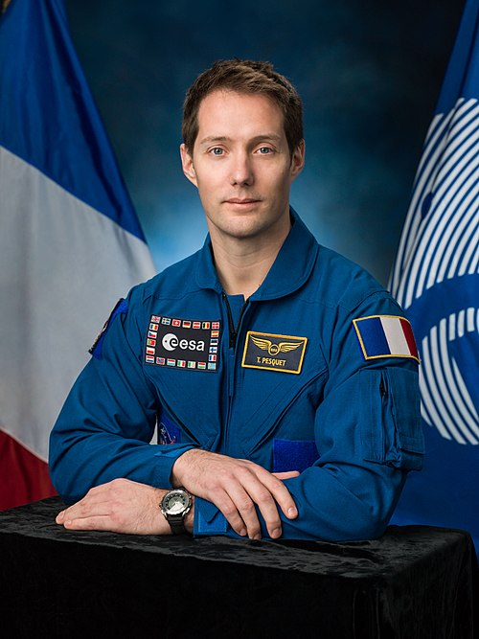
FAMOUS PEOPLE
Thomas Pesquet was an airline pilot

Slide 10
QUIZ
What qualities does an airline pilot need to have ?
How much does he earn ?
What does ENAC mean ?

