Slide 1
Guess the job !
- linked to music
- high level of playing an instrument required
- work with a lot of people

Slide 2
The answer was…
Musician in an orchestra

Slide 3
Studies
- DEM in a Conservatory (=bac)
- DNSPM in a graduate musical school (=bac+3)
- DNESM in a National Conservatory (Paris,Lyon) (=bac+5)
Must begin as early as possible !!

Slide 4
Tasks
- practice at home
- play your instrument with the orchestra
- perform at public hearings or contests

Slide 5
Skills
- ability to play an instrument
- ability to read a music sheet
- ability to perform on scene
- have a good level at music theory
- ability to work with a lot of people

Slide 6
Qualities
- dedication
- constant quest for perfection
- incontestable love for music
- sense of interaction with coworkers and public

Slide 7
Salary
tutti player : 2961 euros
solist : 3086 euros
if you are well known : 10 000 - 50 000 euros per public hearing
the most popular you are, a bigger earning you have

Slide 8
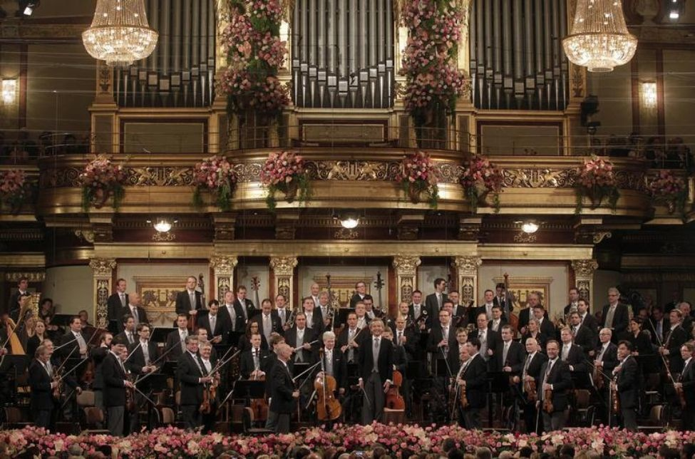
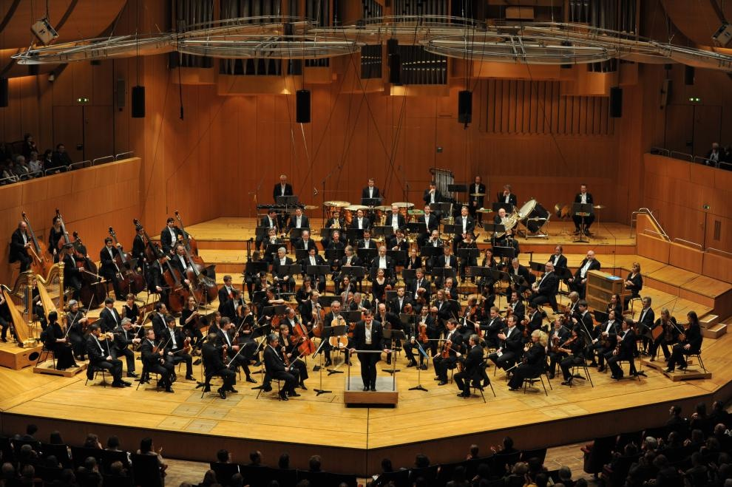
Famous orchestras
The Philharmonic Orchestra of Vienna
The Philharmonic Orchestra of Munich

Slide 9
Quiz !1!1
1. Name one skill required to become a musician in a orchestra
2. How much can you earn for one public hearing when you’re an internationally known artist ?
3. Name one famous orchestra

