Slide 1
Trafalgar Square

Slide 2
The vibrancy
Trafalgar Square is a vibrant open space at the heart of london. Yes, it is just another open space. So why is it so famous? Let’s find out!
Trafalgar Square is a public space and tourist attraction in central London, built around the area formerly known as Charing Cross. It is situated in the borough of the City of Westminster.
left empty since it was built in 1840. Then in 1880, it was revived again by the celebration of Contemporary Art. Celebrations of every big feasts are done there. The color of cultures meet at the centre of Westminister.

Slide 3
The Dark history behind the colorful destination
The name commemorates the Battle of Trafalgar, a British naval victory of the Napoleonic Wars over France and Spain. Thus killing large amount of men from all the tri-sides of this war. Every year, people pay homage to these men. The bloods are still felt in presence at Trafalgar. George Ledwell Taylor suggested the name "Trafalgar Square".
There are 4 plinths in the four corners of the square. Each plinth represents a historic figure appart from the fourth plinth which is left blank.

Slide 4
Events
VE Day, New Years Eve, Christmas, Many sports events etc are celebrated there as example of local events.
There are also different multi-cultural events. People from different countries come and make their own stage and act out as applying entertainent and knowledge for others.
The square has also been used in different films of Hollywood.

Slide 5
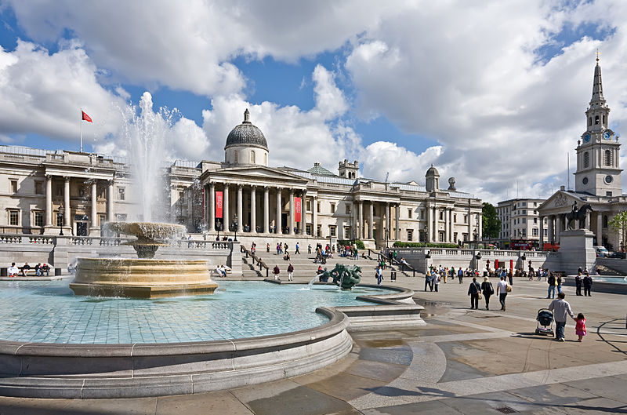

Slide 6
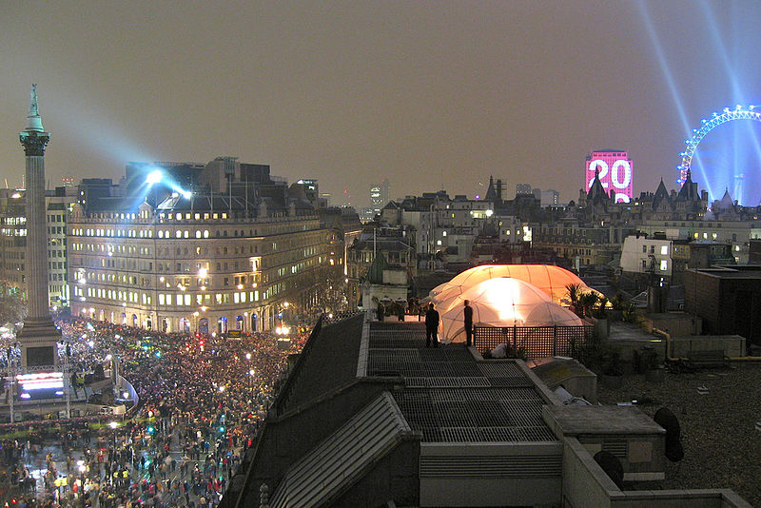

Slide 7
