Slide 1
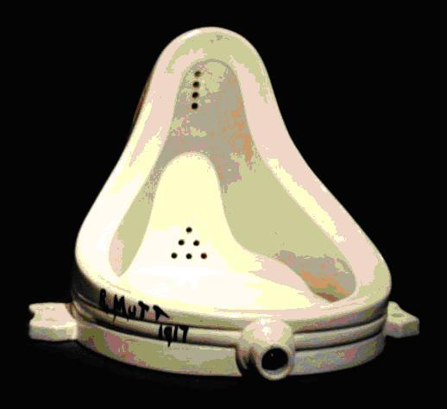
La fontaine Marcel Duchamps néo-Dada 1917

Slide 2
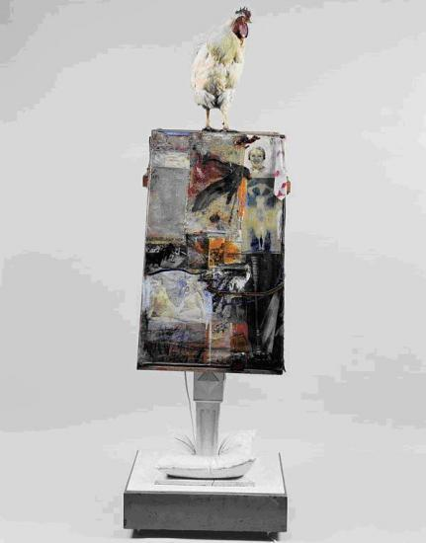
Odalisk
Robert Rauschenberg 1955-58

Slide 3
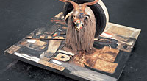
Monogram, Robert Rauchenberg 1955-59

Slide 4
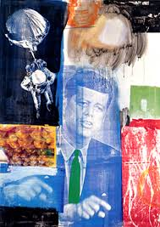
Retroactive I, Robert Rauschenberg I 1963

Slide 5
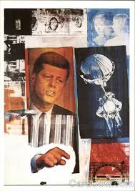
Retroactive II, Robert Rauschenberg 1963

Slide 6
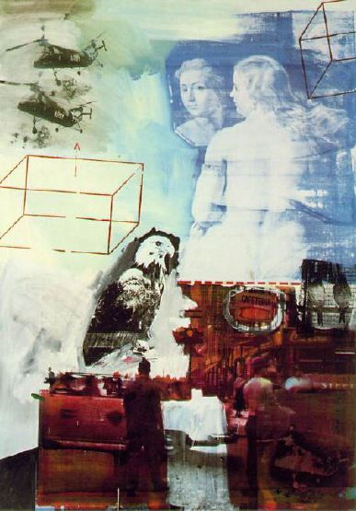
Tracer
Robert Rauschenberg, 1963

Slide 7
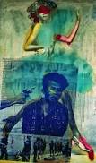
Miss America,
Wolf Vastell, 1968

Slide 8
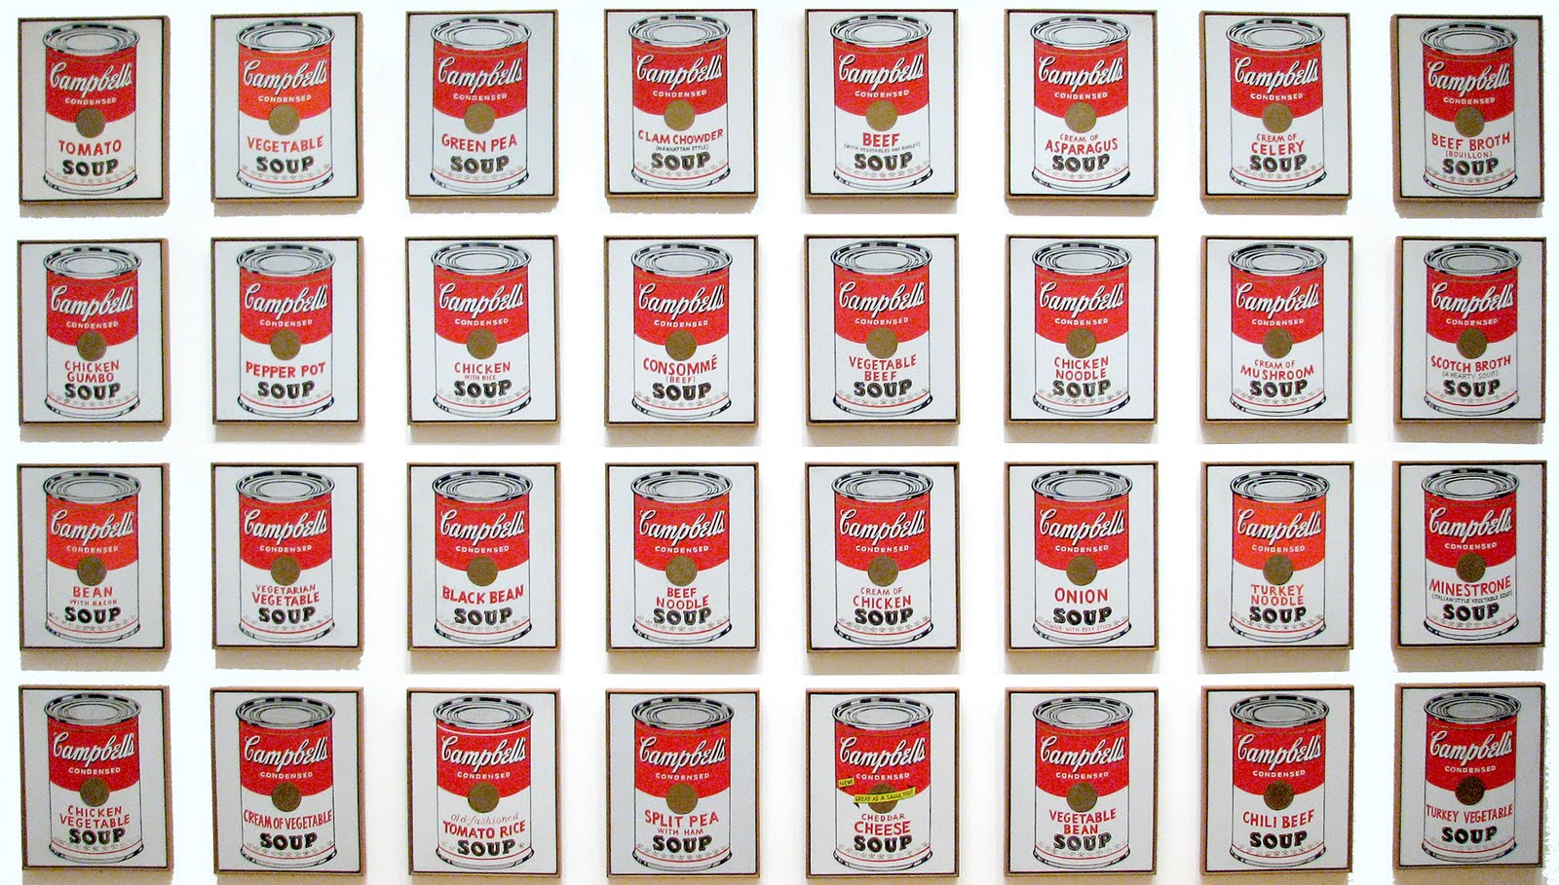
Comphell’s soup I, Andy Wharol, 1968

Slide 9
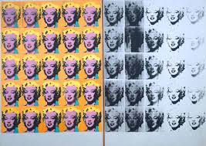
Diptyque Marilyn , Andy Warhol
1962

Slide 10
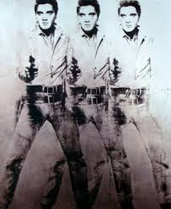
Elvis Presley,
Andy Warhol

Slide 11
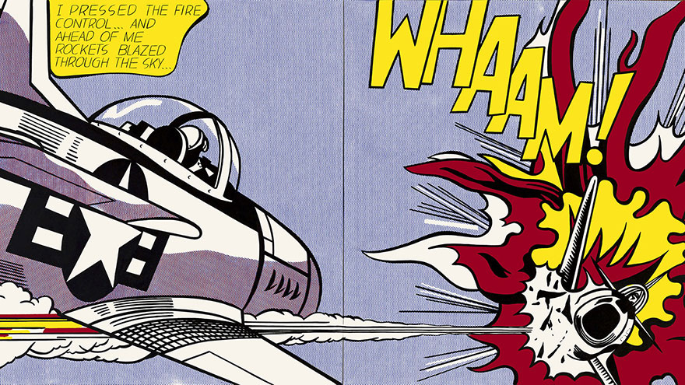
Whaam, Roy Lichtenstein
1963

Slide 12
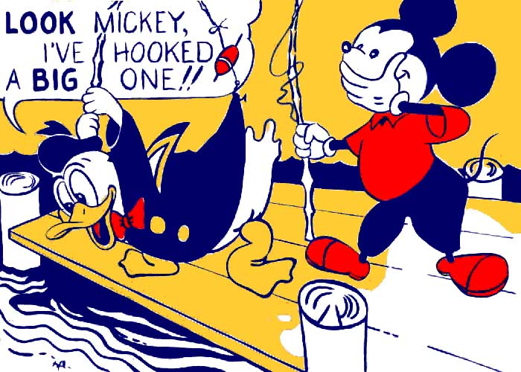
Look Mickey, Roy Lichtenstein
1961

Slide 13
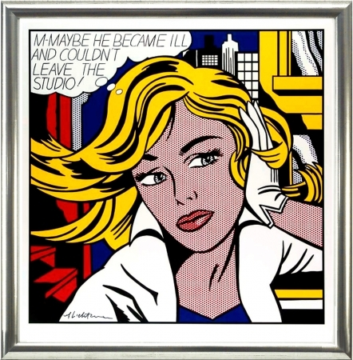
M-Maybe,
Roy Lichtenstein
1965

