Slide 1
Clothes : description
What can you see?

Slide 2
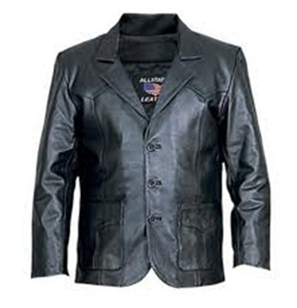
A jacket
A black jacket
A leather jacket
A black leather jacket

Slide 3
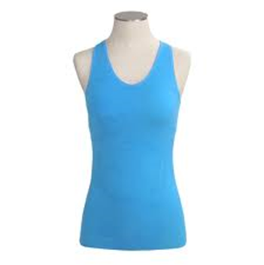
A tank top
A blue tank top
A tight tank top
A tight blue tank top

Slide 4
A dress
A beige dress
A tight dress
A tight beige dress

Slide 5
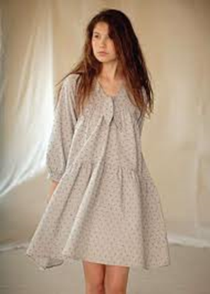
A dress
A beige dress
A loose dress
A loose beige dress

Slide 6
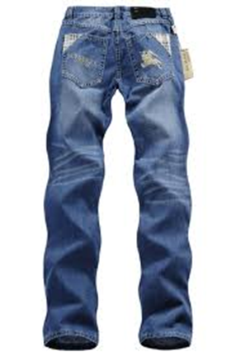
jeans
Blue jeans
Regular jeans
Regular blue jeans

Slide 7
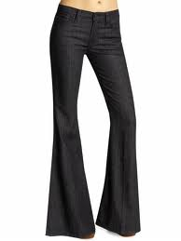
bell-bottom trousers
Black trousers
Bell-bottom black trousers

Slide 8
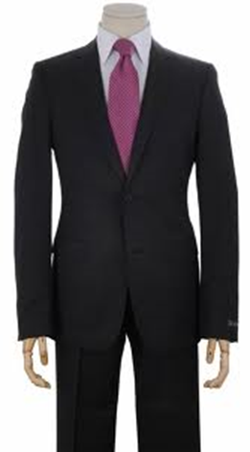
A classic suit
A black suit
A classic black suit

Slide 9
A funky suit
A colourful suit
A funky colourful suit

Slide 10
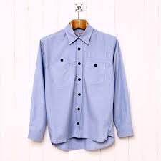
A shirt
A blue shirt
A plain shirt
A blue plain shirt

Slide 11
The memory challenge:
What is missing?

Slide 12

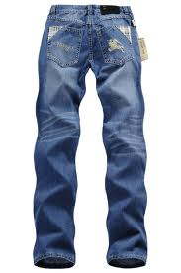


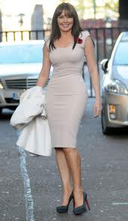

?

Slide 13
?

Slide 14
?

Slide 15
A skirt
A black skirt
A fashionable skirt
A fashionable black skirt

Slide 16
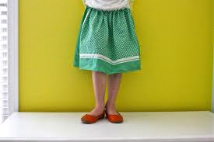
A skirt
An old-fashioned skirt
A green skirt
An old-fashioned green skirt

Slide 17
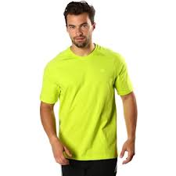
A t-shirt
A flashy t-shirt
A yellow t-shirt
A flashy yellow t-shirt

Slide 18
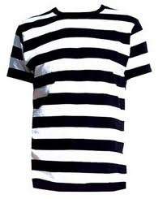
A t-shirt
A black and white t-shirt
A striped t-shirt
A black and white striped t-shirt

Slide 19
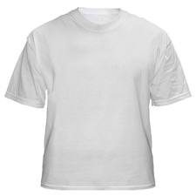
A t-shirt
A plain t-shirt
A white t-shirt
A white plain t-shirt

Slide 20
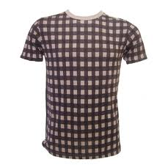
A t-shirt
A grey and brown t-shirt
A checkered t-shirt
A grey and brown checkered t-shirt

Slide 21
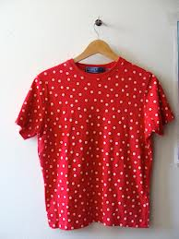
A t-shirt
A red and white t-shirt
A polka dot t-shirt
A red and white polka dot t-shirt

Slide 22
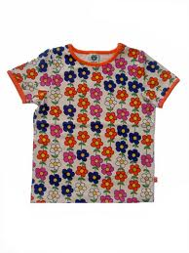
A t-shirt
A colourful t-shirt
A flowery t-shirt
A colourful flowery t-shirt

Slide 23
What is missing ?

Slide 24
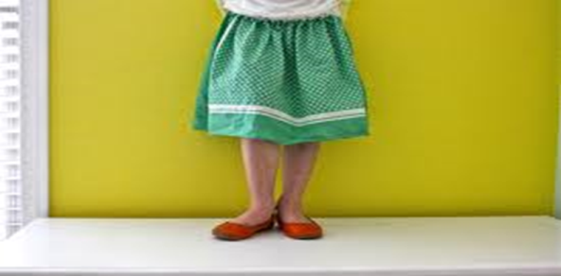
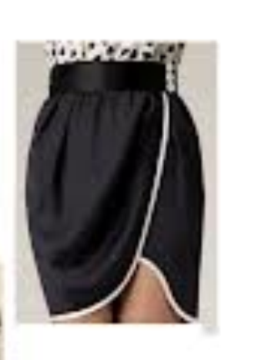
?

Slide 25
?

Slide 26
?

Slide 27
Clothes : description
2. Regular blue jeans 3. a black leather jacket 4. a tight blue tank top
7. a blue plain shirt 8. an old-fashioned green skirt. 9. a fashionable black skirt. 10. a tight beige dress 11. a loose beige dress 12. a classic black suit
13. a funky colourful suit 15. bell- bottom black trousers 16. a white plain T-shirt 17. a flashy yellow T-shirt 18. a black and white striped T-shirt
19. a grey and brown checkered T-shirt
Quand plusieurs adjectifs qualifient un nom, l’ordre est très important: Opinion, Taille, Forme, Age, Couleur, (motif), Origine, Matière (OTFACOM)
Pour les vêtements: opinion, forme, couleur, motif, matière + nom

Slide 28
HW: What are they wearing?
Répondre à la question en parlant de l’image a) c) et d) p 44 (manuel).

