Slide 1
Trivia Quiz #5

Slide 2
Question #1 On the 4th Thursday of November (this year, November 28th)

Slide 3
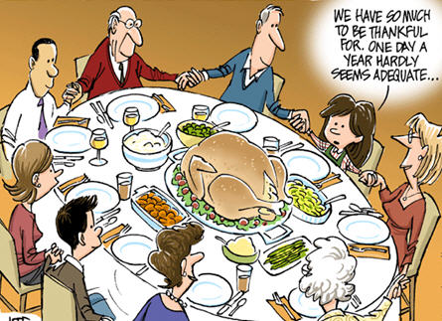
Question #2 It is a national holiday to give thanks for the blessings of the harvest and of the preceding year.

Slide 4
Question #3 1621

Slide 5
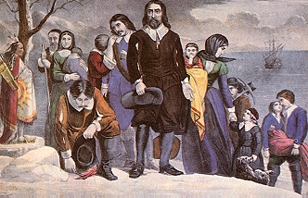
Question #4 The Pilgrim Fathers

Slide 6
Question #5 They did not agree with the religious teachings of the Church of England. They left England to find a safe place to practice their religion.

Slide 7
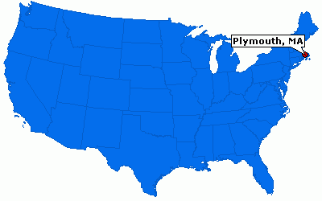
Question #6 In Plymouth, Massachussetts.

Slide 8
Question #7 The Mayflower

Slide 9
Question #8 102 passengers

Slide 10
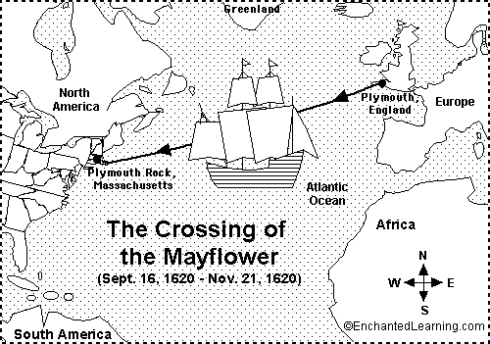
Question #9 They departed Plymouth, England on September 6th 1620 and arrived at Cape Cod on November 1620, after a 66-day journey.

Slide 11
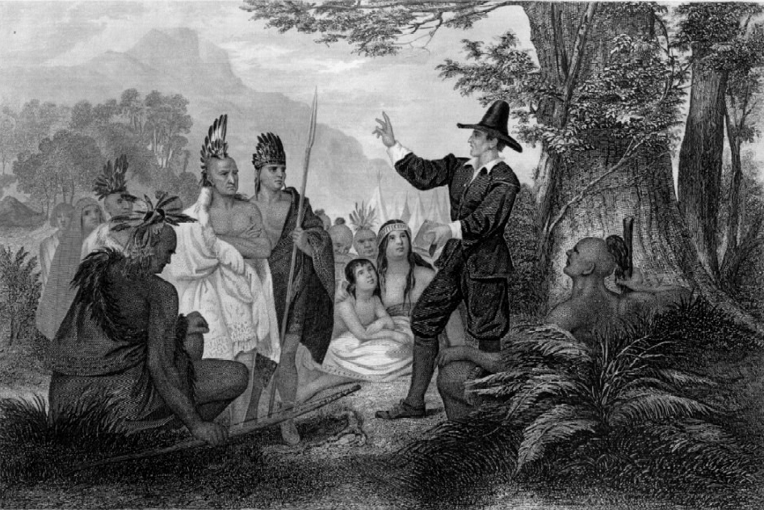
Question #10 Native Americans

Slide 12
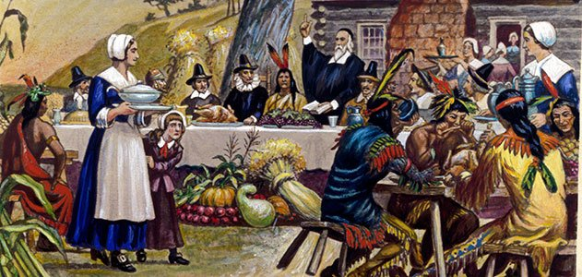
Question #11 The Wanpanoag taught the Pilgrims how to cultivate the land. Without their help, the Pilgrims would have died. That’s why they celebrated the first Thanksgiving together to say thank you for their first successful harvest.

Slide 13
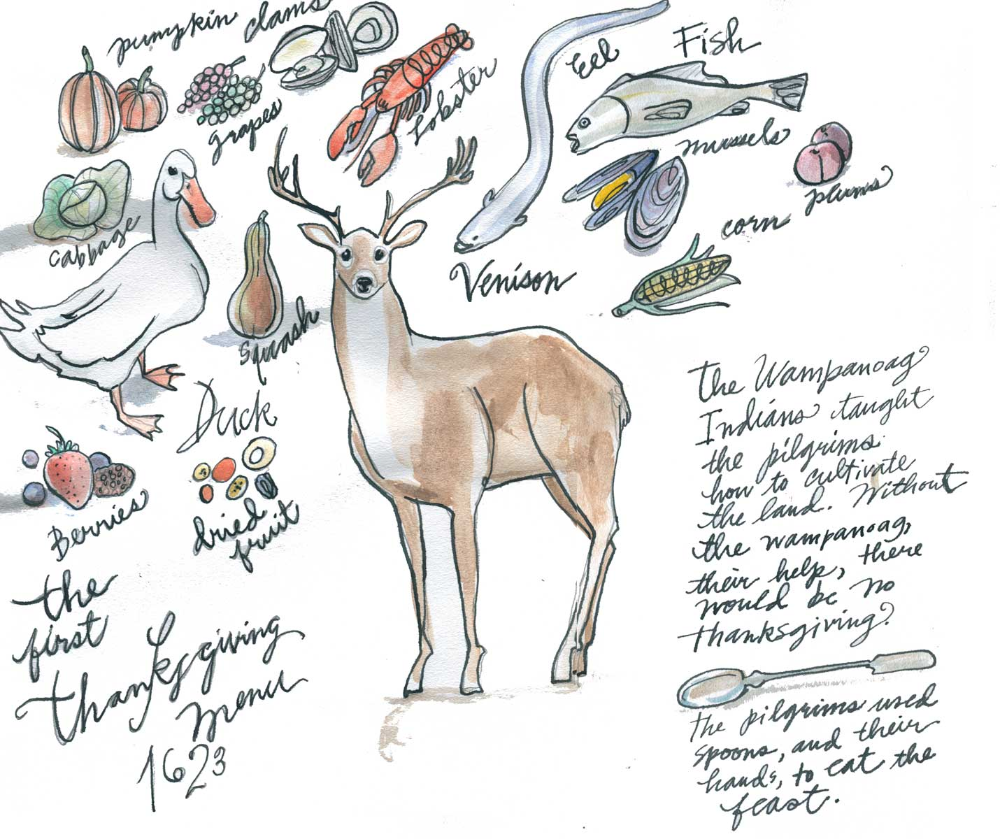
Question #12 Game, corn and porridge.

Slide 14
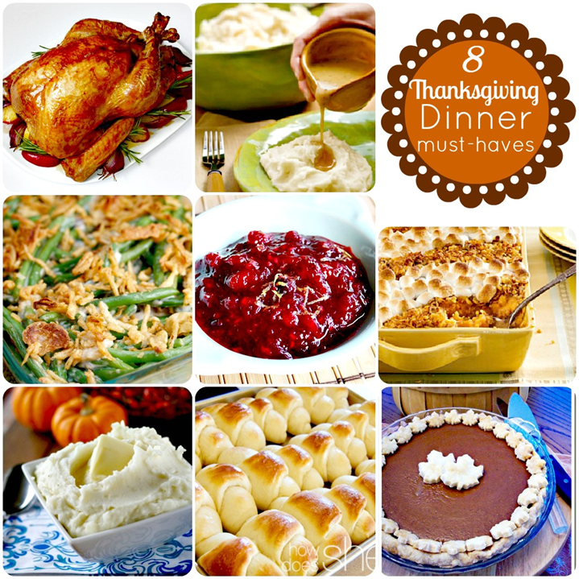
Question #13 Roasted turkey, stuffing, cranberry sauce, gravy, mashed potatoes, sweet corn,apple pie and pumpkin pie. (and sometimes sweet potatoes with marshmallows)

Slide 15
Question #14 While the Wampanoag welcomed the Pilgrims and helped them ensure a successful first harvest, they were nearly wiped out by warfare and diseases that arrived with the settlers.

Slide 16
Question #15 Abraham Lincoln

Slide 17
Question #16 « Freedom from Want » (1943) is the right not to live in poverty. Three generations of a family are gathered around a table at Thanksgiving. The opulence of the turkey is counterbalanced by the relative scarcity of other foods on the table. America was involved in World War 2, and the painting is intended to show that despite the difficulties the country was facing, traditional family values were still very important. “A l’abri du besoin”

Slide 18
Question #17 He pardoned a turkey, in other words he spared its life. http://edition.cnn.com/2017/11/20/politics/white-house-turkey-pardon-details/index.html

Slide 19
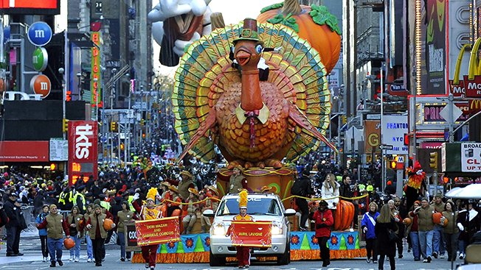
Question #18 Macy’s organizes a parade in New York.

Slide 20
Question #19 Because it is one of the busiest shopping days in the USA. There are lots of good deals.

Slide 21
Question #20 It is just after the Thanksgiving holiday (4 days off this year) and it is one of the biggest online shopping days of the year.

Slide 22
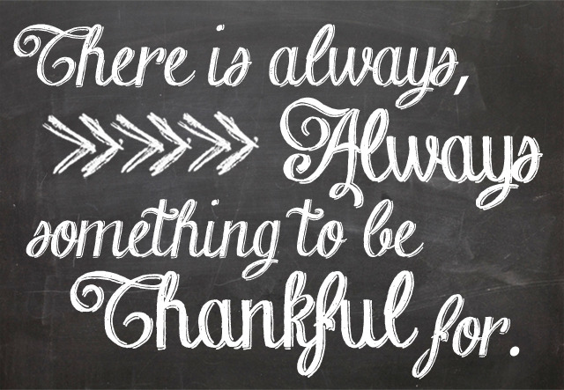

Slide 25
Yummy ! http://www.foodnetwork.com/recipes/giada-de-laurentiis/thanksgiving-turkeys-recipe.html

Slide 26
Just for fun https://www.youtube.com/watch?v=t2667ogd5kw

