Slide 1
Guess the job !
-To do this job, you have to be hard working and organized.
- This job is in relation with actualities.
- You will have to be good in literature and computer science.
What is the job ?

Slide 2
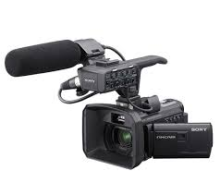
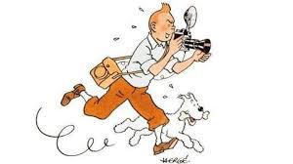
The job of the day is … Journalist !

Slide 3
Studies : professional Bac + 5
or literary Bac + 5
Qualifications : diploma in journalism
or a master in political science, in sports, …

Slide 4
Tasks
Interview famous and political people
Write articles and reports about actualities
Inquire
Present televisions news

Slide 5
Skills/Qualities
Have a excellent general culture and a critical thinking
Speak foreign languages
Be curious and invested
Be available already to get The scoop

Slide 6
Wage
For a debutant : 1480€ (French minimum wage) monthly
For a “professional”: about 2100€ gross monthly

Slide 7
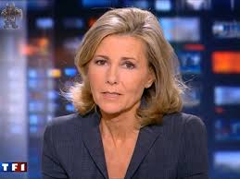
Claire Chazal

Slide 8
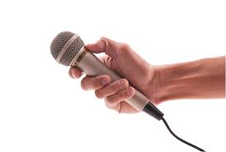
Quiz
What studies has to made a journalist ?
What is the name of the famous English newspapers ?
Quote a journalist task’s.
What’s the wage of a debutant ?

