Slide 1
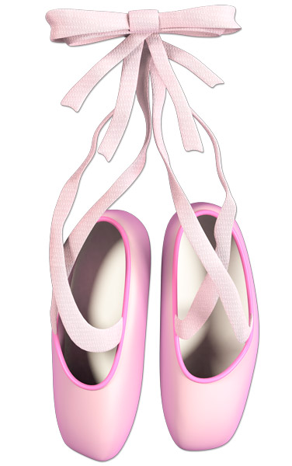
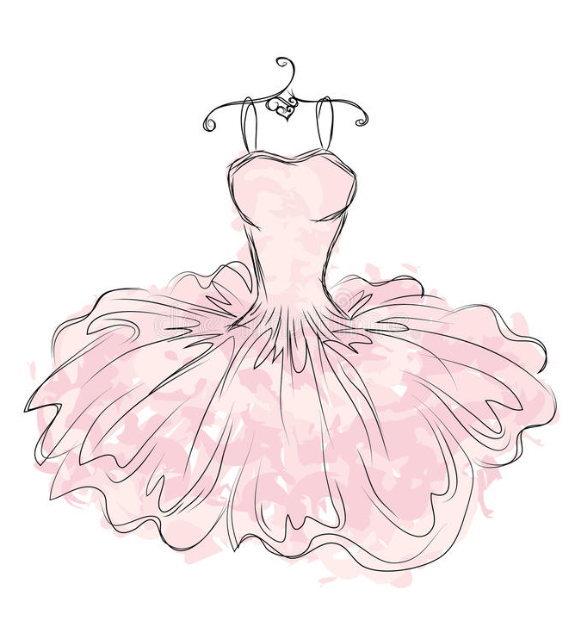
Can you guess my future job ?
?
➳

Slide 2
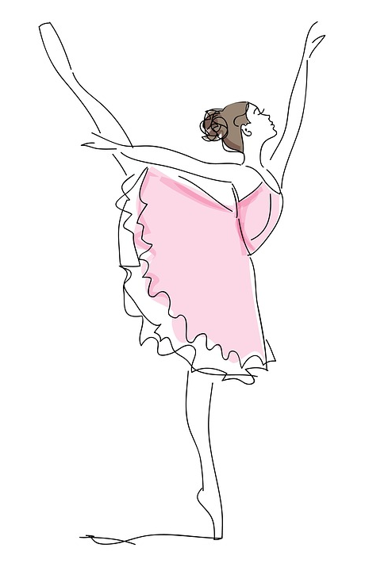
The job of the day is...
Professional ballet dancer

Slide 3
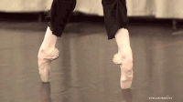
Tasks
⤳ Train every day.
⤳ Take care of their bodies.
⤳ Focus only on dance.

Slide 4
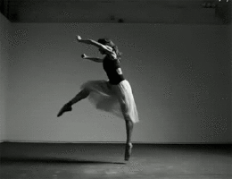
Skills
⤳ be gifted in dance
⤳ know how to seize opportunities¹
⤳ have rhythm sense²
Qualities
Vocabulary : ⤳ be competitive
¹ to seize opportunities = saisir des opportunités ⤳ be persistent
² to have rhythm sense = avoir le sens du rythme ⤳ be sociable
⤳ love work in team

Slide 5
Famous schools
Paris National
Opera
1
Paris National
Conservatory
Rosella
Hightower
2
3

Slide 6
Studies and qualifications
⤳ DNSP¹ dancer (National Superior Professional Dancer Degree)
⤳ TMD Techno Baccalaureate (Music and Dance Techniques)
⤳ All baccalaureates offered by the school (L, S, ES).
⤳ Bachelor's degree² in performing arts³. (Bac + 3)
Vocabulary
¹ DNSP = acronyme français pour Dîplôme National Supérieur Professionnel
² Bachelor's degree = Licence
³ Performing arts = art du spectacle
https://www.cidj.com/metiers/danseuse-danseur

Slide 7
Salary
For a novice : from 1500€ to 4000 € per month.
For a star dancer : from 8 000€ to 10000€ by external representation¹
Vocabulary :
¹external representation = représentation faite
en dehors de la maison où le danseur est employé.
https://www.cidj.com/metiers/danseuse-danseur

Slide 8
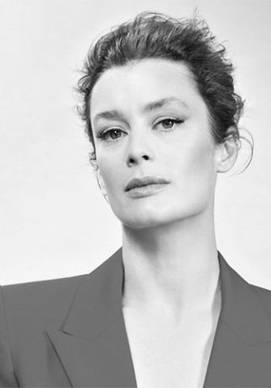
Famous people
https://www.operadeparis.fr/artistes/dorothee-gilbert
Aurélie Dupont, star dancer

Slide 9
https://www.youtube.com/watch?v=WADsYml295w

Slide 10
Famous Movies
Billy, 11 years old, discovers with surprise that a dance class now shares the same premises as his boxing club.Initially intrigued and soon fascinated by the magic of dance, Billy abandons leather gloves to discreetly attend dance lessons.
But Billy's dad and his brother Tony get upset when they discover that Billy has spent the money of boxing classes for much less manly activities...

Slide 11
https://www.youtube.com/watch?v=phCEwSmHpOE

Slide 12
Quiz
Which are the tasks of a dancer?
Which are the 3 major dance schools in France?
Which dance diploma does students have at the same time as the baccalaureate?
Give me one task that dancers must do.

Slide 13
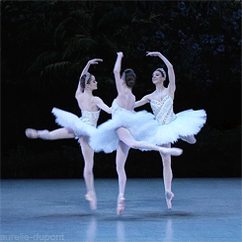
Thank you for listening me and have a nice day !

