Slide 1
NEIGHBOURHOODS, CITIES AND VILLAGES
A MULTI-FACETED CITY IN THE U.S.A

Slide 2
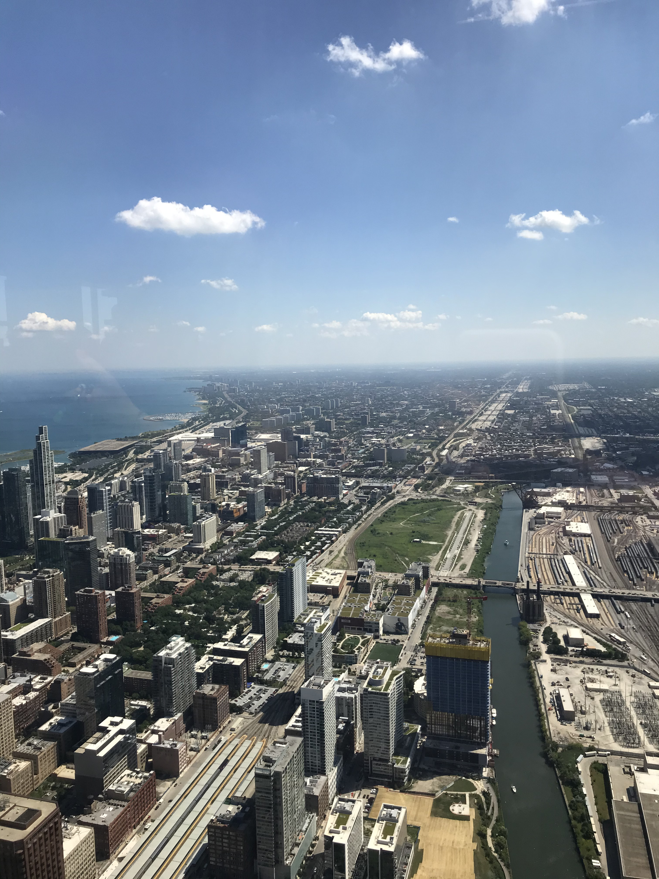

Slide 3
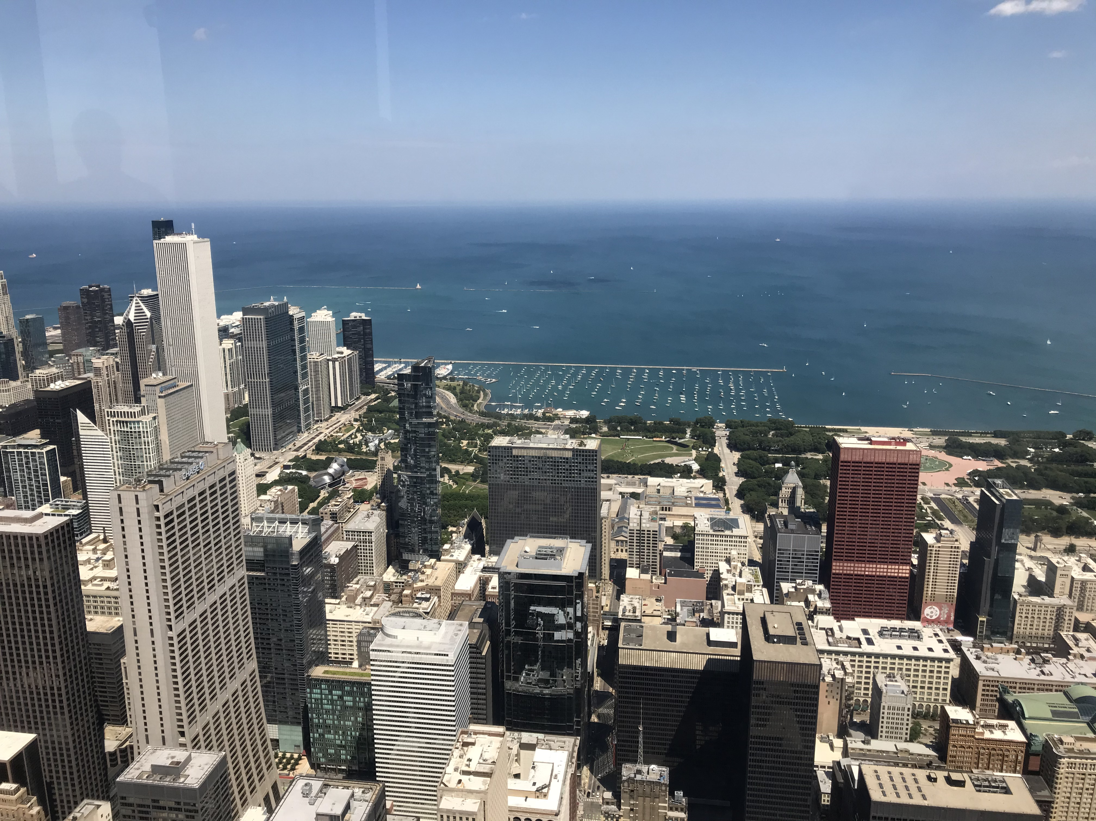

Slide 4
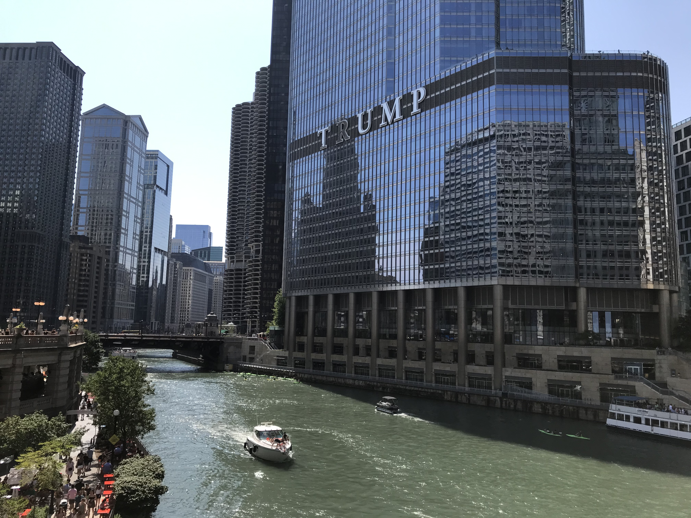

Slide 5
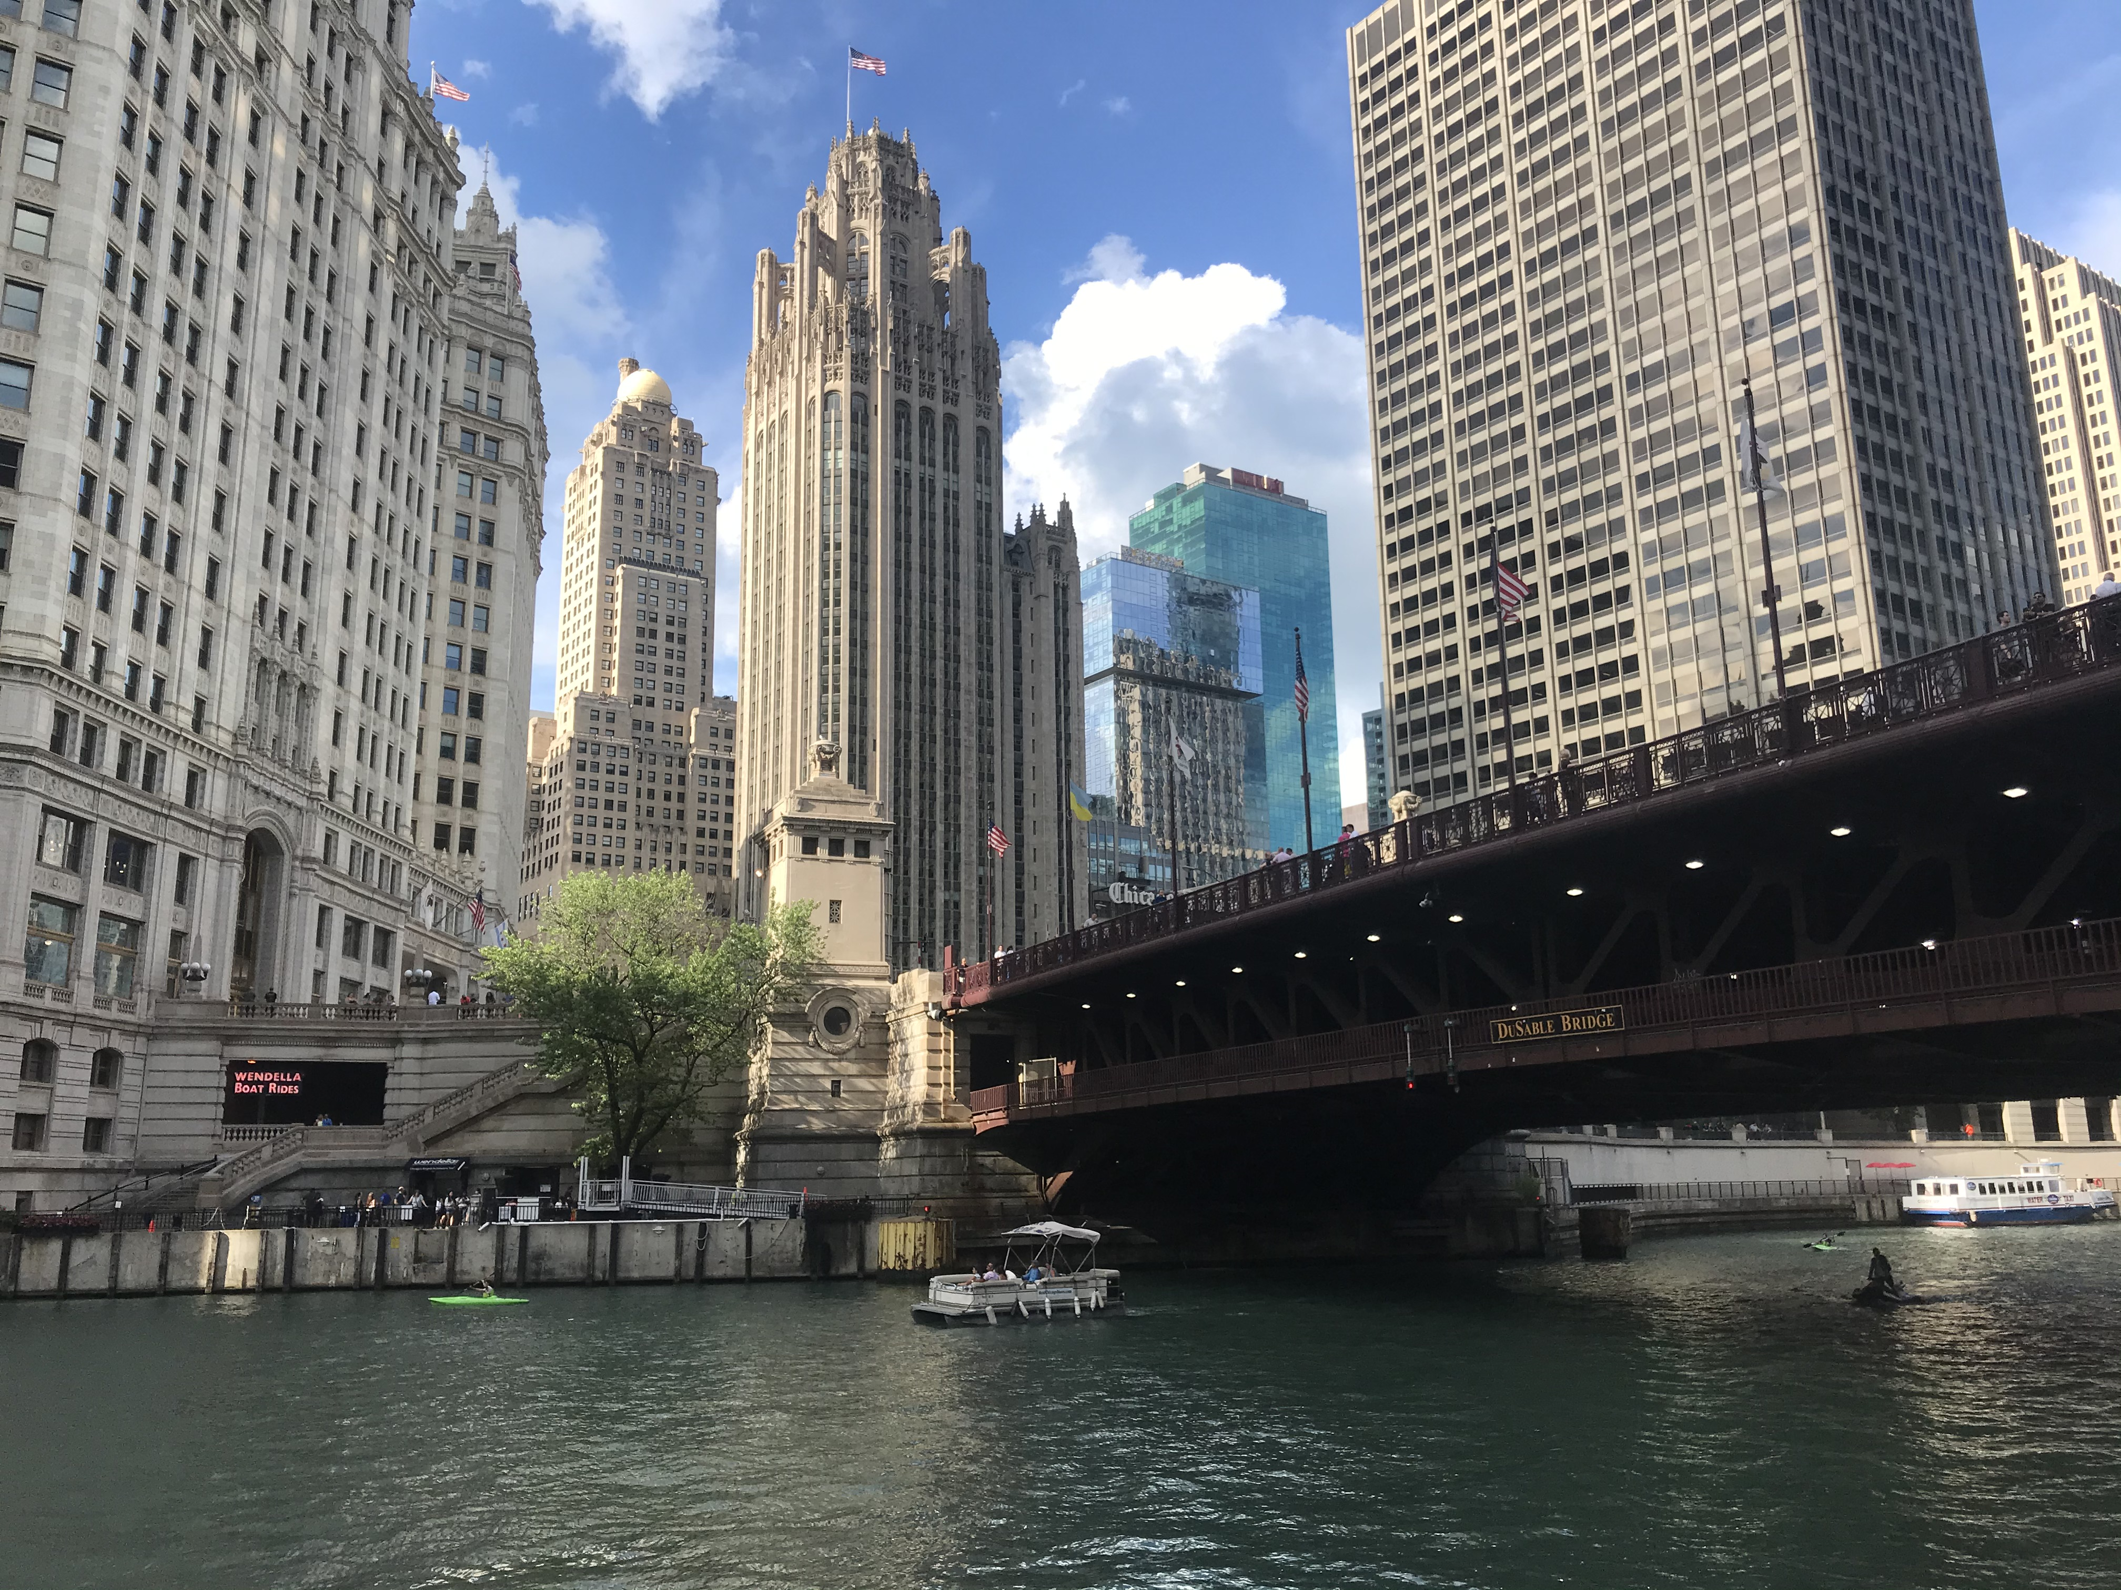

Slide 6
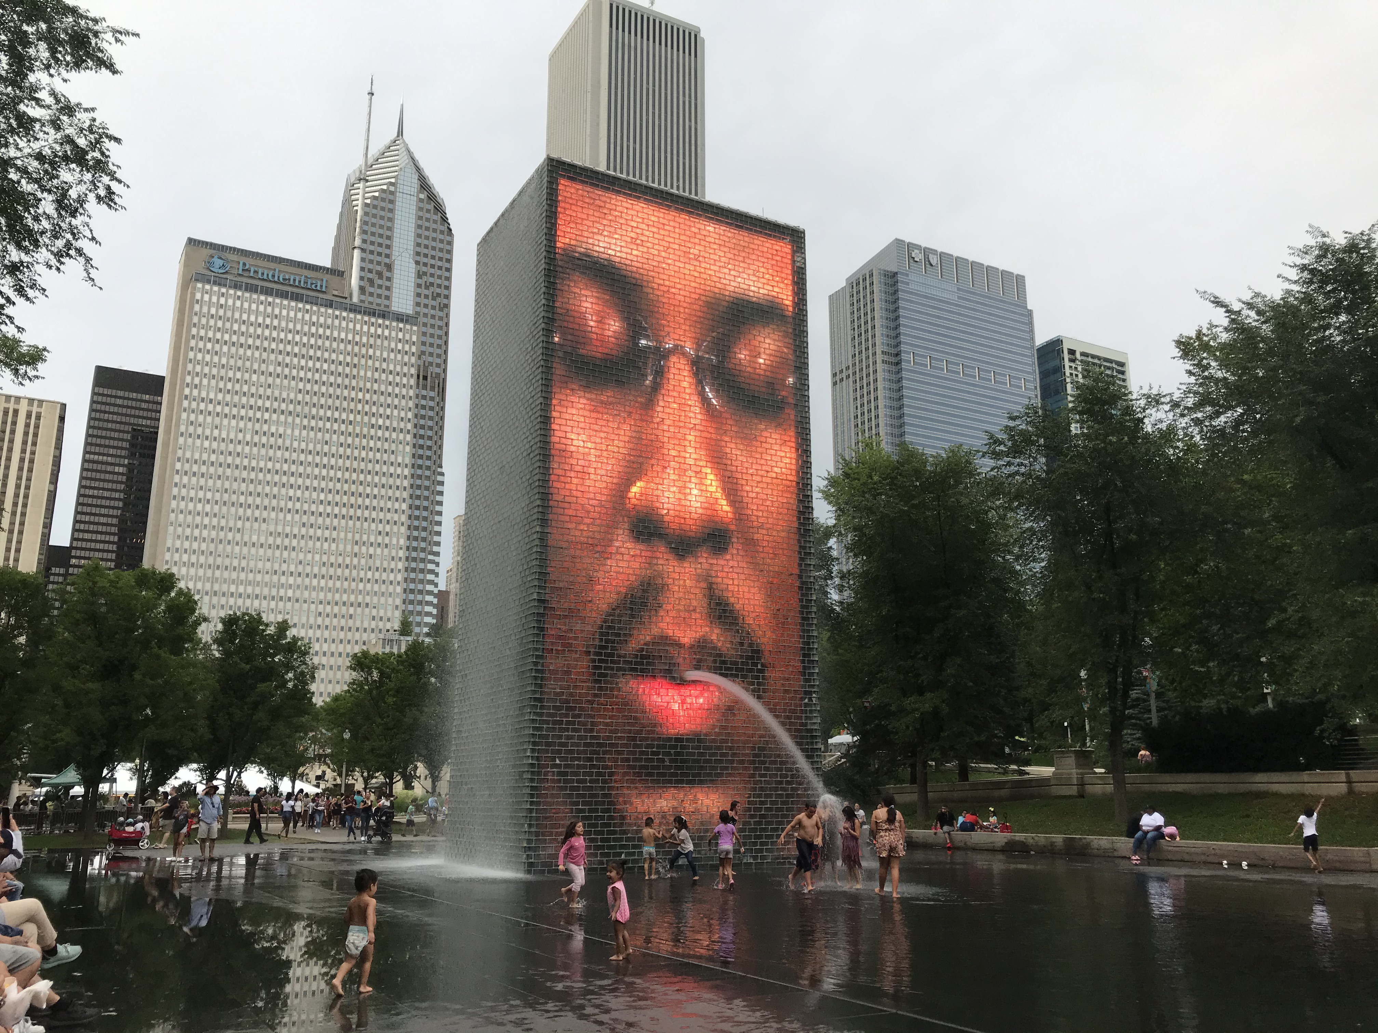
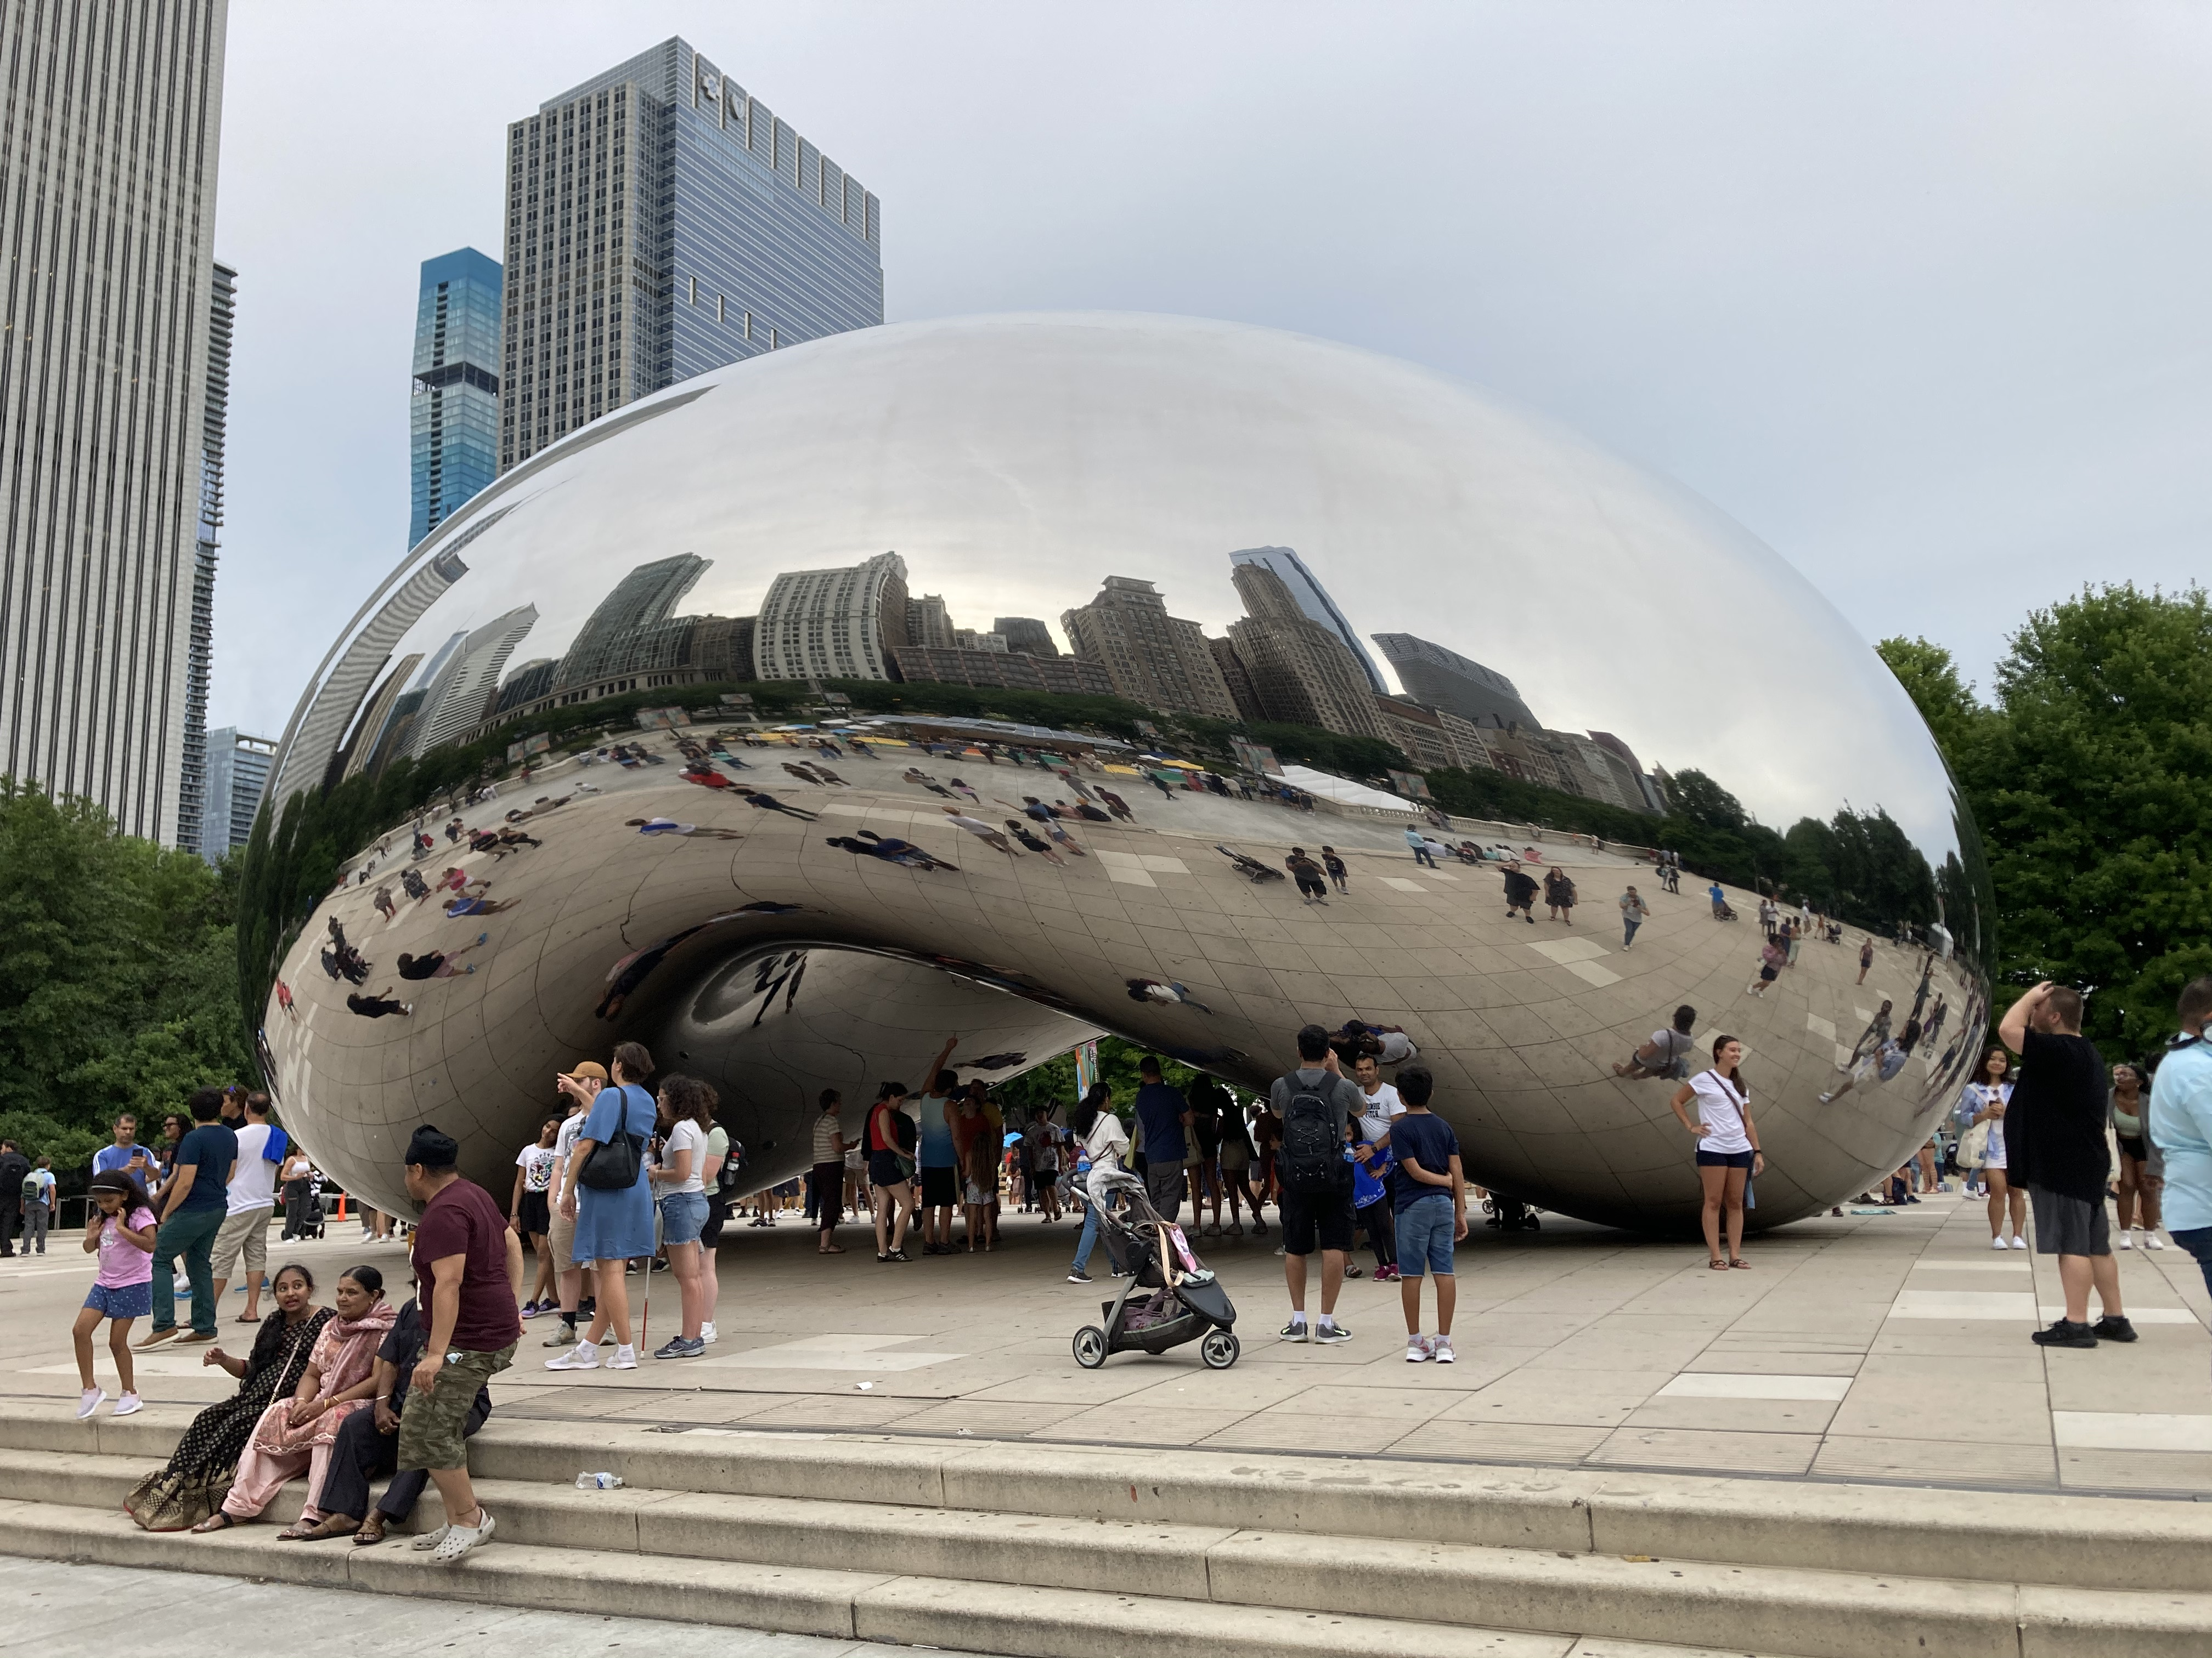

Slide 7
