Slide 1
THE HIGHLAND GAMES

Slide 2
The following slides will give you different clues about what THE HIGHLAND GAMES are. Memorize as much information as possible to be able to imagine a definition.
Close your copybooks and pay attention to every single detail !

Slide 4
Geographic location:

Slide 5
- Every year, from May to September - Only on weekends
Over (= more than) 80 Highland Games all over the region
When to attend the games ?

Slide 6
They are held in various places across the Highlands: - on the islands, in the cities - in villages, in settlements (= installations) - sometimes even in castles
Where to attend the games ?

Slide 7
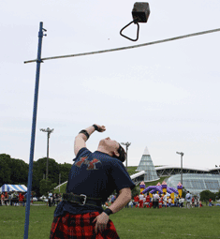
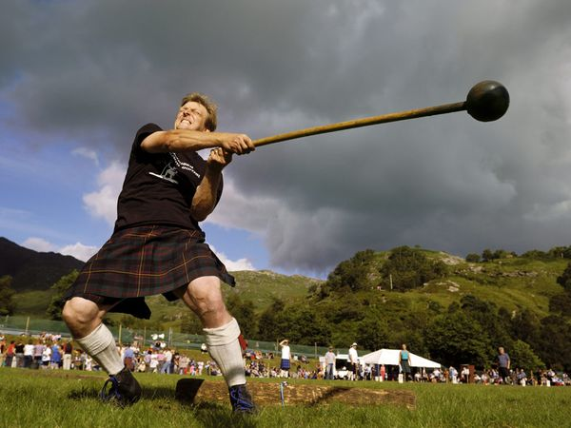
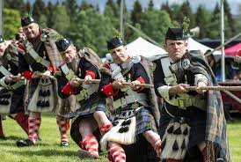
Examples of sports in the Highland Games
Weight for height
Hammer throw
Tug o’war

Slide 8
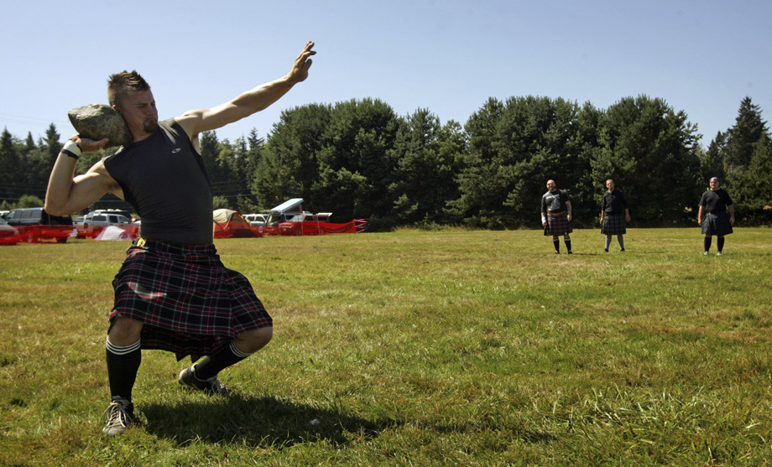
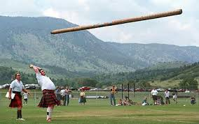
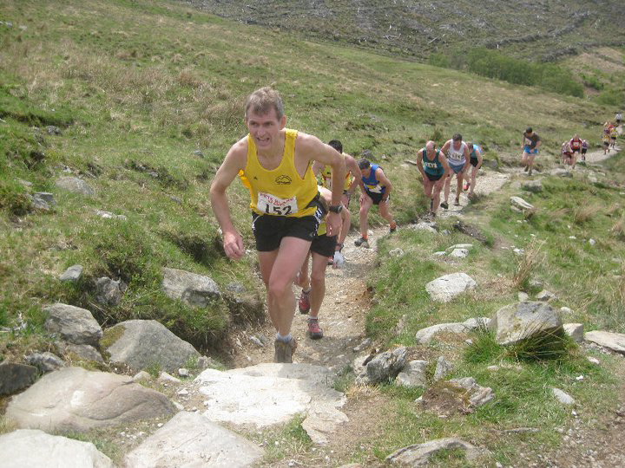
Examples of sports in the Highland Games
Stone put
Caber toss
Hill race
but also many other track and field (= athlétisme) sports…

Slide 9
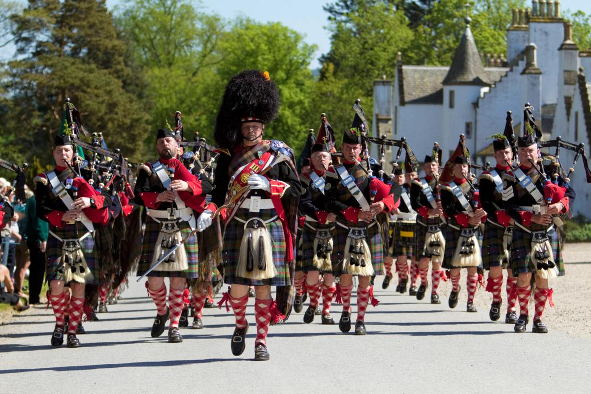
The Highland Games are also quite famous for:
their bands of pipers (playing bagpipes) marching in unison

Slide 10
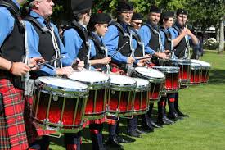
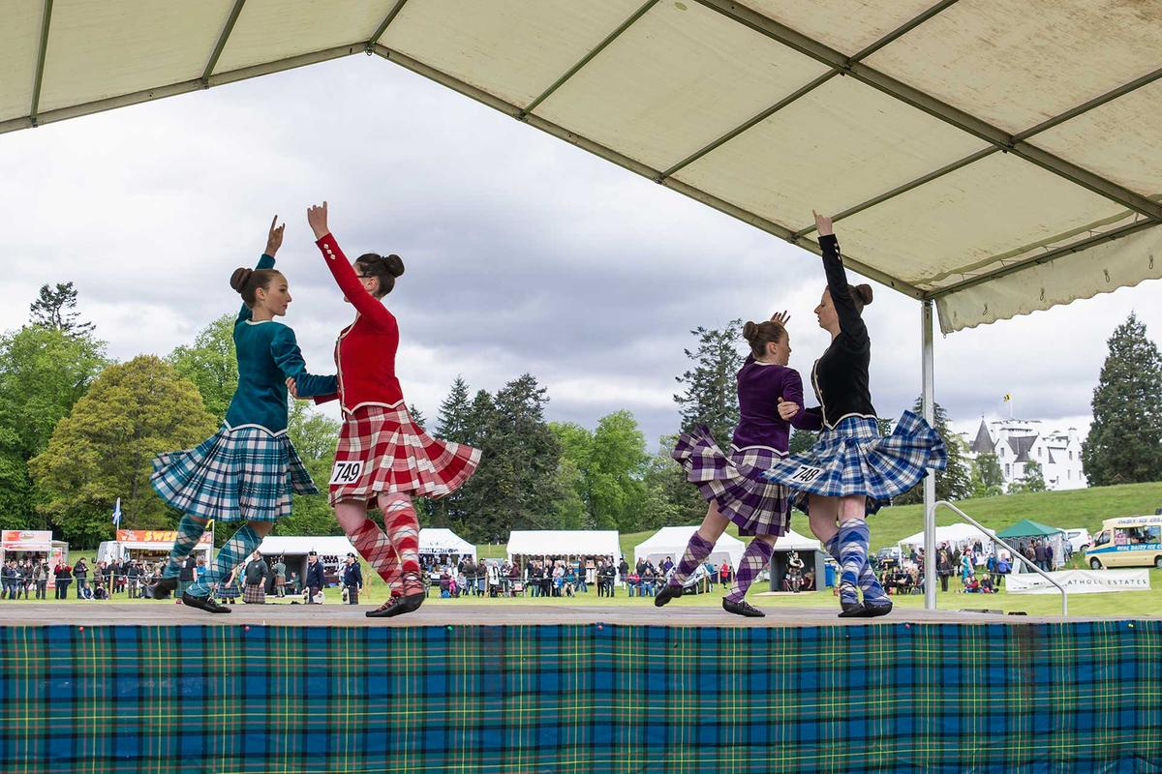
The Highland Games are also quite famous for:
their drumming competitions
their Scottish dancing performances

Slide 11
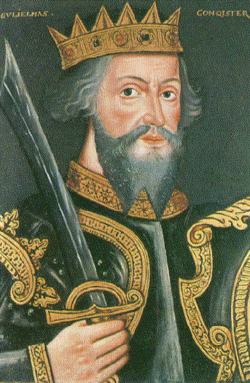
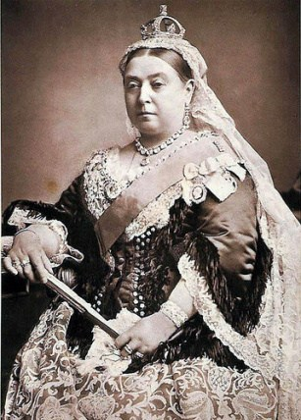
King Malcolm III of Scotland, in the 11th century, summoned contestants to a foot race to the summit of Craig Choinnich mountain. King Malcolm created this foot race in order to find the fastest runner in the land to be his royal messenger. Some have seen this event to be the origin of today's modern Highland games. However, the modern Highland games are largely a Victorian invention, that is to say they were created under Queen Victoria’s reign (1837-1901).
Historical origins of the Highland Games
King Malcolm III of Scotland
Queen Victoria

Slide 12
The largest Highland Games in the world: the Cowal Games (or Cowal Highland Gathering)
- in Dunoon, Scotland, every August - about 3,500 competitors and 23,000 spectators from everywhere around the world

Slide 13
The Highland Games are also held in:
and many other countries…

Slide 14
The Highland Games are a way of:
celebrating Scottish and Celtic culture in various places around the world
claiming the Scottish identity and showing the pride of being Scottish

