Slide 1
GET TO KNOW
GEORGE ORWELL
Take a look at the third slide and memorize as much information as possible in one and a half minute only.

Slide 3
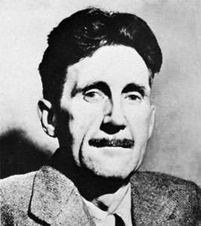
Source: bbc.co.uk
QUICK FACTS
Birth: June 25th, 1903 in Motihari, Bihar, British India | Predilection genre: dystopian novels*
Date of death: January 21st, 1950 (aged 46) in London, UK | Subjects: anti-fascism, anti-Stalinism, democratic socialism
Real name: Eric Arthur Blair | Political affiliation: socialism
Alma mater (Education): Eton College (near Windsor, England) | Spouses: Eileen O’Shaughnessy, Sonia Bronwell
Occupation: novelist and essayist, journalist and literary critic | Children: an adoptive son, Richard Blair (born in 1944)
Best-known novels: Animal Farm (1945), Nineteen Eighty-Four (1949) | Cause of death: tuberculosis
Definition of the word DYSTOPIA according to the Oxford English Dictionary:
*DYSTOPIA (noun): An imagined state or society in which there is great suffering or injustice, typically one that is totalitarian or post-apocalyptic.
Origin: Late 18th century from dys-‘bad’ + utopia.

