Slide 1
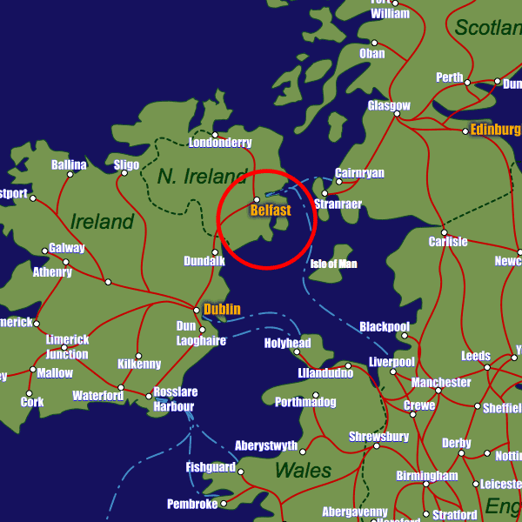
Belfast, Northern Ireland

Slide 2
Pair work : Oral Interaction
Pair up with a classmate. You both are in Belfast, having a phone conversation about the different sights you two have visited so far. Describe them to your friend and react (Did you like it ? Why?).
Let’s take an example…

Slide 3
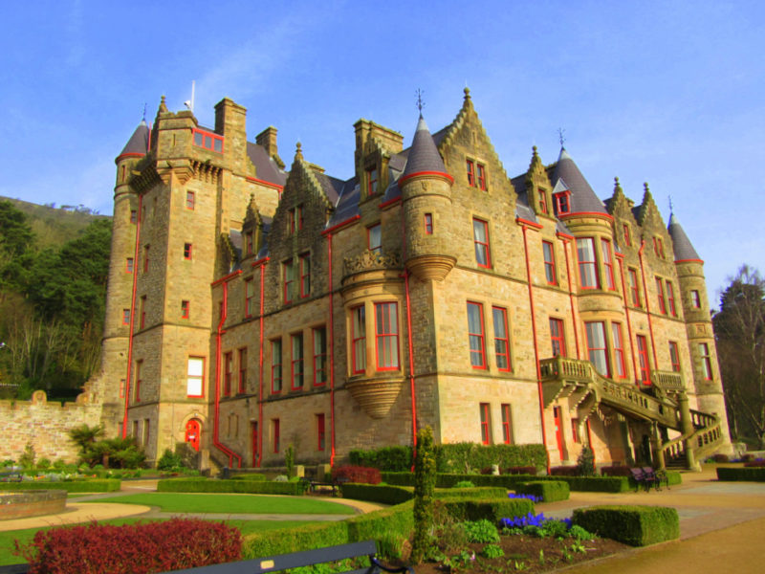
Belfast Castle
a fairy tale castle
weddings, conferences and other events
restaurant – stunning views

Slide 4
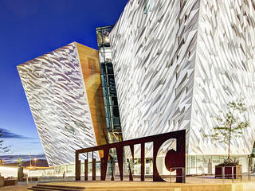
Titanic Belfast Museum
a shipwreck = when a ship sinks
a footage = a documentary

Slide 5
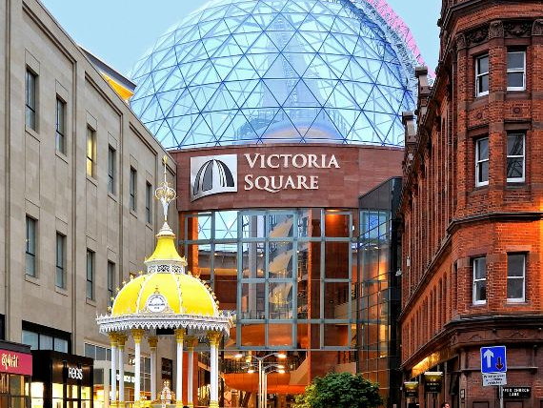
Victoria Square
a shopping mall (US) = a commercial centre
to purchase = to buy
a souvenir = a cheap object to remember your trip
a present = a gift

Slide 6
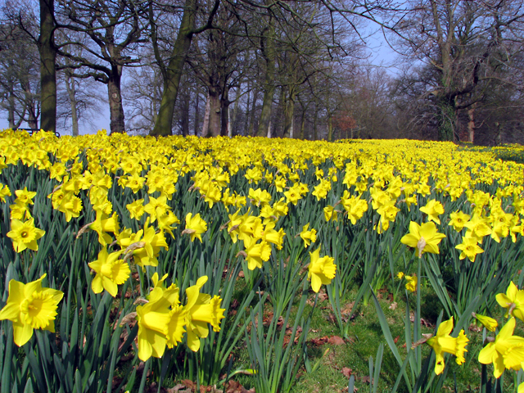
Barnett Demesne Park
daffodils = yellow flowers on the picture
wildlife displays = natural landscapes

Slide 7
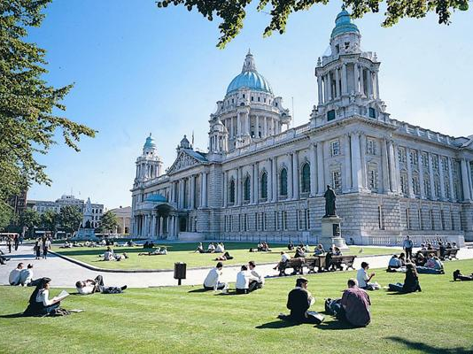
Belfast City Hall
a civic building
iconic = symbolical
a picnic
a well-mown lawn = clearly-cut grass

Slide 8
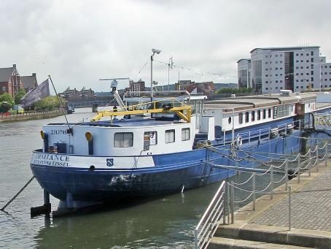
Belfast Barge Museum
the River Lagan
cruise = make a boat ride
a barge = a large boat carrying passengers or goods
afloat on = floating on

Slide 9
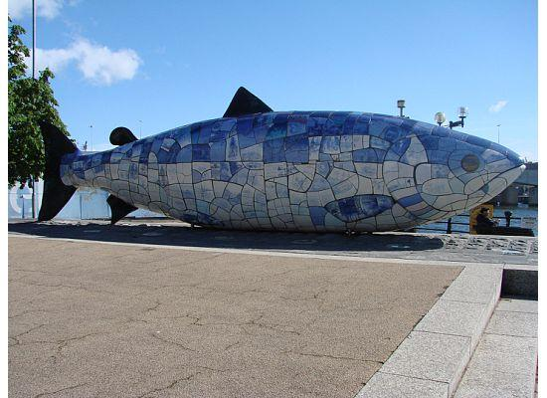
The Big Fish
a 32-foot salmon = a 10-meter salmon
ceramic tiles
an artwork

Slide 10
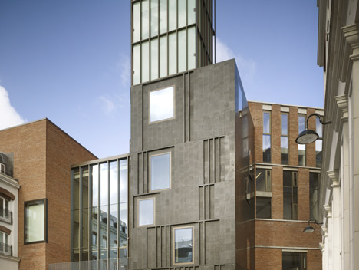
MAC (Metropolitan Arts Center)
an arts venue/site
visual art exhibitions
theatre performances

Slide 11
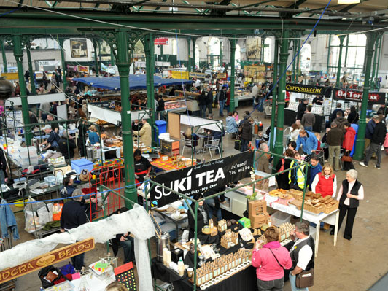
St George’s Market
fresh produce - local food
built from 1890 to 1896
opening days = Friday, Saturday and Sunday

Slide 12
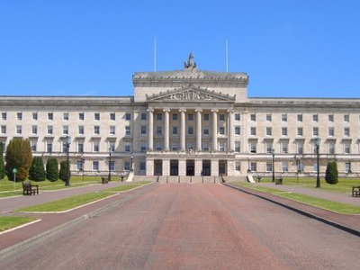
Stormont Parliament Buildings
Northern Ireland Assembly = legislative body of Northern Ireland
an estate = a property, a territory
attend debates – tour parliament buildings – watch committee meetings

Slide 13
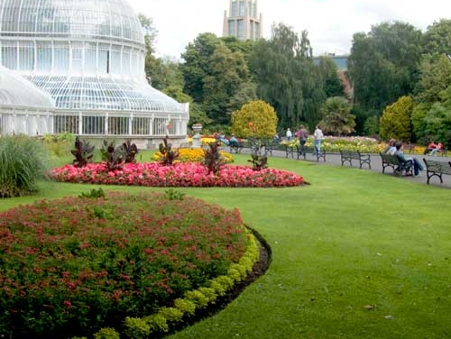
Botanic Gardens
horticulture – botany
exotic tree species
impressive plant collections from the Southern hemisphere

Slide 14
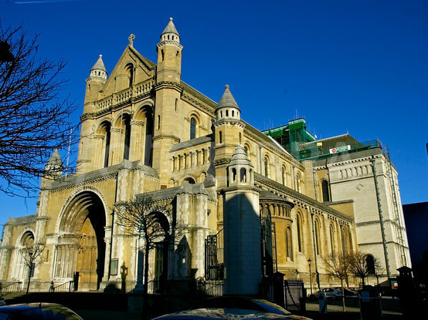
St Anne’s Cathedral
a place of Anglican worship = an Anglican cult place
works of art: mosaics – stone carvings – textiles – historical artefacts
audio tours

