Slide 1
Belfast Memory Game
Take a look at the third slide and memorize as much information as possible in one minute only.

Slide 2
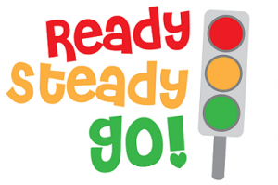
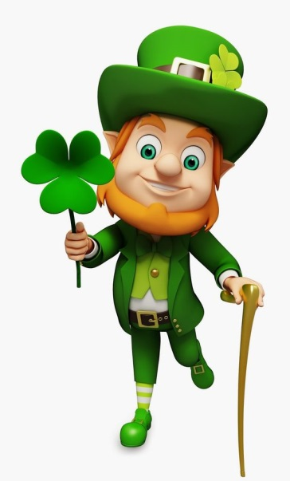

Slide 3
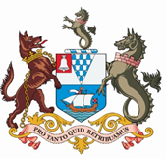
Belfast is the capital city of Northern Ireland, the 2nd largest city in Ireland and the 15th largest one in the United Kingdom , with an estimated 2014 population of 295,000. The name Belfast comes from the Gaelic ‘Beal Feirste’ (‘mouth of the river’). The current Lord Mayor of Belfast is Deirdre Hargey (political party: Sinn Fein). She is Sinn Fein’s first female Belfast Lord Mayor in the history of the city.
Like a lot of historic cities, Belfast grew up around its cottage industries situated in ‘quarters’. There are still remnants of four quarters in Belfast - Cathedral, Queen’s, Titanic and Gaeltacht quarters. Once the home of the Irish linen industry, tobacco production, rope making and the world famous Harland and Wolff shipbuilders, Belfast lays claim to a unique history.
Belfast offers plenty of restaurants where you can eat Northern Ireland’s traditional dishes such as steak & Guinness pie and Irish stew.
Information found on
visitbelfast.com

Slide 4
Time’s up !

Slide 5
Quiz time !
Take half a sheet of paper, write your name on it and be ready to answer the following questions.
LET’S GET STARTED !

Slide 6
QUESTIONS:
1 – What country is Belfast the capital city of?
2 – At what position does Belfast rank among the largest cities of the UK?
3 – How many inhabitants were estimated in Belfast in 2014?
4 – What does Beal Feirste – Belfast’s Gaelic name – mean?
5 – Who is the current Lord Mayor of Belfast?
6 - Alongside with steak & Guinness pie, what other traditional dish from Northern Ireland was mentioned in the text?
7 - Cathedral, Titanic, Gaeltacht and …….. : what is the name of the fourth historic quarter in Belfast?
8 - What world-famous shipbuilding industry developed in Belfast?
9 - How long does the train trip approximately take from Dublin to Belfast?
10 - On Belfast’s official coat of arms, what animal can be seen in between the chained wolf and the sea horse?

Slide 7
Correction time !
Swap your papers with a classmate, take a red pen and correct his answers if he/she is wrong. Count the number of good answers at the end of the correction.

Slide 8
Question n°1
What country is Belfast the capital city of?

Slide 9
Question n°2
At what position does Belfast rank among the largest cities of the United Kingdom ?

Slide 10
Question n°3
How many inhabitants were estimated in Belfast in 2014?

Slide 11
Question n°4
What does Beal Feirste – Belfast’s Gaelic name – actually mean ?

Slide 12
Question n°5
Who is the current Lord Mayor of Belfast ?

Slide 13
Question n°6
Alongside with steak & Guinness pie, what other traditional dish from Northern Ireland was mentioned in the text?

Slide 14
Question n°7
Cathedral, Titanic, Gaeltacht and …….. : what is the name of the fourth historic quarter in Belfast?

Slide 15
Question n°8
What world-famous shipbuilding industry developed in Belfast ?

Slide 16
Question n°9
How long does the train trip approximately take from Dublin to Belfast ?

Slide 17
Question n°10
On Belfast’s official coat of arms, what animal can be seen in between the chained wolf and the sea horse?

Slide 18
