Slide 1
APARTHEID
Definition and facts

Slide 2
The following slides will give you different clues about what APARTHEID is. Memorize as much information as possible to be able to imagine a definition.
Close your copybooks and pay attention to every single detail !

Slide 4
Etymology of the word “APARTHEID”
→ 1940s: from Afrikaans, literally ‘separateness’,
→ from Dutch apart (‘separate’) + -heid (equivalent of the suffix -hood).

Slide 5
Definition FOUND ON THE OXFORD ENGLISH DICTIONARY
NOUN
mass noun
(in South Africa) a policy or system of segregation or discrimination on grounds of race.

Slide 6
DATES OF THE APARTHEID ERA

Slide 7
How it all started
After the end of World War II, the Nationalist Party, made up of Afrikaners, wins control of the South African government
Hendrik Venwoerd, an influential member of the Nationalist Party, argues that races in the world will never be able to coexist, hence he recommends the system of apartheid

Slide 8
1950 – GROUP AREAS ACT
Created basis for ethnic government in African reserves or ‘homelands’
Each race was assigned a different ‘homeland’
Black political rights restricted to designated homelands, but had no rights in South African Parliament, which had complete control over the homelands

Slide 9
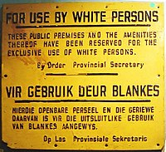

Slide 10
CONSEQUENCES OF THE ESTABLISHMENT OF APARTHEID
Priority housing, jobs, education and political power for whites
Whites and non-whites held different jobs, lived in different regions, and were subject to different levels of pay, education, and health care
Fraternization between Africans of different tribes, Asians, and Europeans was frowned upon

Slide 12
CONSEQUENCES OF THE ESTABLISHMENT OF APARTHEID
Blacks had to carry passes & obey curfew laws if they wanted to travel outside of their homelands.
Along the fringes of the cities, Africans lived in massive, terrible slums, often separated from their families because only one family member could get a permit to live in the city.
1977: Press censorship = the Apartheid government banned The World, the Weekend World and arrested the newspapers' editor Percy Qoboza. Pro Veritate, an ecumenical newspaper, was also banned.

Slide 13
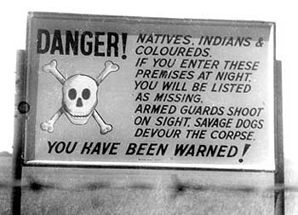

Slide 14
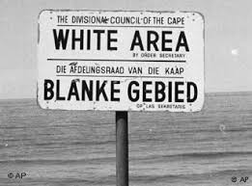

Slide 15
Slums in South Africa during the Apartheid era

Slide 16
Frederik W. DE KLERK
During his political career, he often fought to protect white privilege
Elected President in 1989
Helped create a new constitution
→ “One person, one vote”
Ordered Nelson Mandela’s release in 1990
Played important part in dismantling Apartheid

Slide 17
Nelson mandela
1918 - 2013
One of the founding members of Umkhonto we Sizwe, a violent civil rights organization (paramilitary wing of the African National Congress).
1962: Standing up against a government that was committing egregious human rights, Mandela was imprisoned for life.
11th February 1990: Mandela is liberated thanks to President F.W. De Klerk who ordered his release.

Slide 18
1991 : APARTHEID Starts being dismantled
1985: the United Kingdom and United States imposed economic sanctions on the country, after denouncing apartheid in the UN General Assembly in 1973
1991 : the African National Congress is reformed thanks to De Klerk, Mandela is elected President of the African National Congress
→ ANC was first created in 1912 to bring all Africans together as one people to defend their rights and freedoms, then was dismantled under the Apartheid regime)
F. W. De Klerk also lifted the ban on other black liberation parties, restored freedom of the press and released political prisoners

Slide 19
1993: MANDELA & DE KLERK ARE JOINTLY AWARDED THE NOBEL PEACE PRIZE
They won the Nobel Peace Prize in recognition for their efforts to end apartheid.

Slide 20
1994: Nelson MANDELA IS ELECTED PRESIDENT oF THE REPUBLIC OF SOUTH AFRICA
Served from 1994 to 1999
Official dismantling/dismantlement of apartheid
First Black President in South Africa
Introduced housing, education, and economic development initiatives designed to improve the living standards of the country’s black population.
In 1996 he oversaw the enactment of a new democratic constitution.

