Slide 1
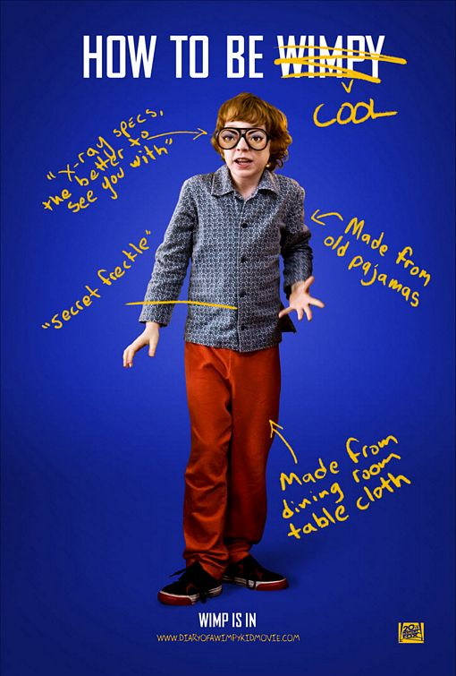
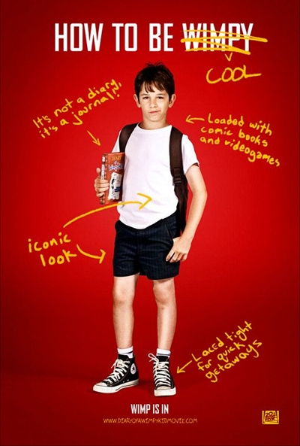
OUR COOL POSTERS

Slide 2
Cool poster n°1

Slide 3
Cool poster n°2

Slide 4
Cool poster n°3

Slide 5
Cool poster n°4

Slide 6
Cool poster n°5

Slide 7
Cool poster n°6

Slide 8
Cool poster n°7

Slide 9
Cool poster n°8

Slide 10
Cool poster n°9

Slide 11
Cool poster n°10

Slide 12
Cool poster n°11

Slide 13
Cool poster n°12

Slide 14
Cool poster n°13

Slide 15
Cool poster n°14

Slide 16
Cool poster n°15

Slide 17
Cool poster n°16

Slide 18
Cool poster n°17

Slide 19
Cool poster n°18

Slide 20
Cool poster n°19

